Slide 1
LI:To be able to write a list SC:I can write a list. I can write using the sounds including digraphs that I know.

Slide 2


Slide 3
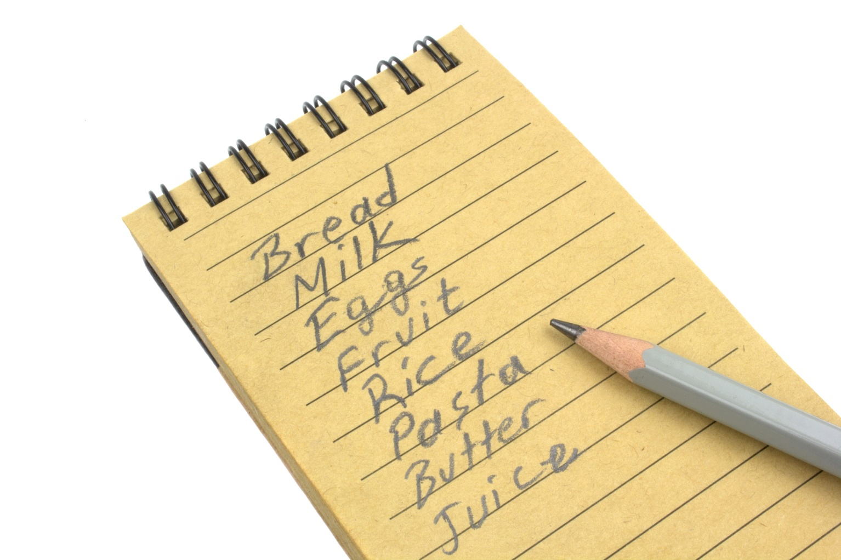

Slide 4


Slide 5
LI:To be able to write a list SC:I can write a list. I can write using the sounds including digraphs that I know.

Slide 6


Slide 8


