Slide 1
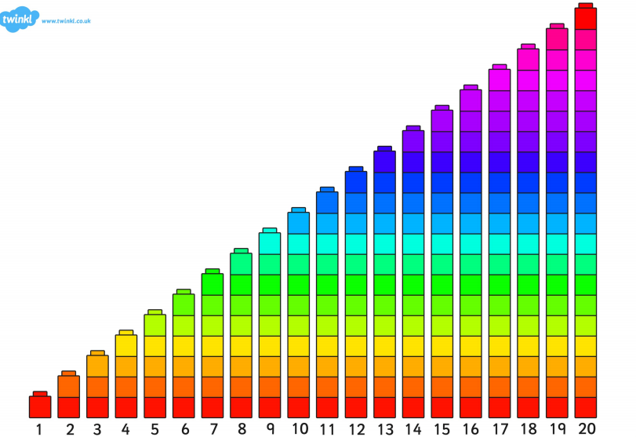

Slide 2
LI: I can use vocabulary associated with length. To be able to measure using a standard unit SC: I can use the words longer, shorter, long, short. I can measure using a standard unit.

Slide 3


Slide 4
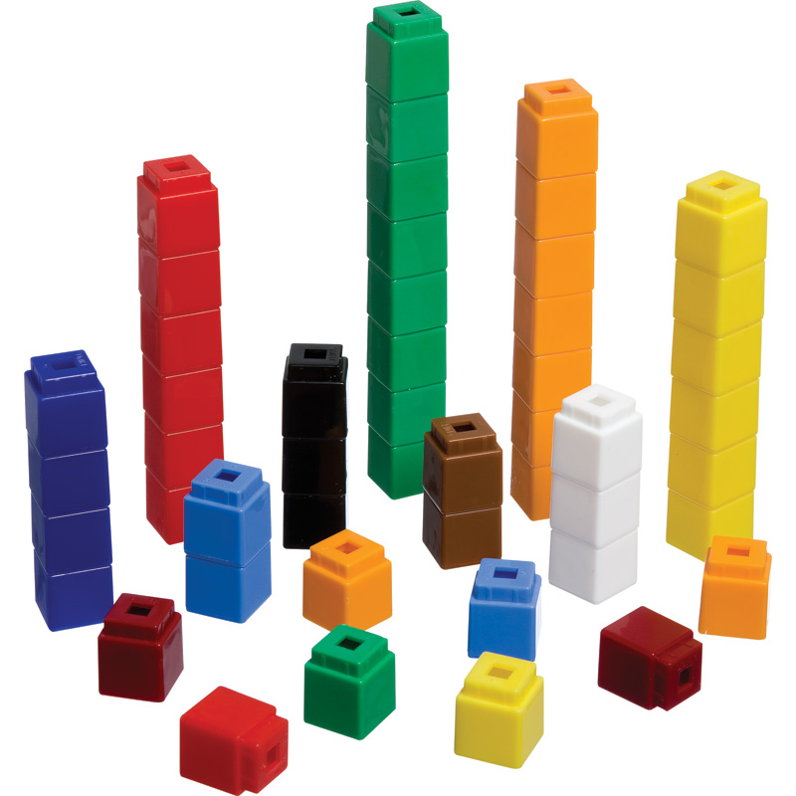

Slide 5


Slide 7
LI: I can use vocabulary associated with length. To be able to measure using a standard unit SC: I can use the words longer, shorter, long, short. I can measure using a standard unit.

Slide 9
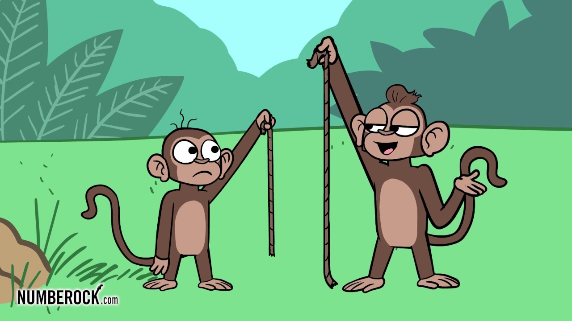
shorter longer

