Slide 1
LI: To be able to use the sounds I know to label SC: I can use the sounds I know to label a picture. I can write using the sounds including digraphs that I know.

Slide 2
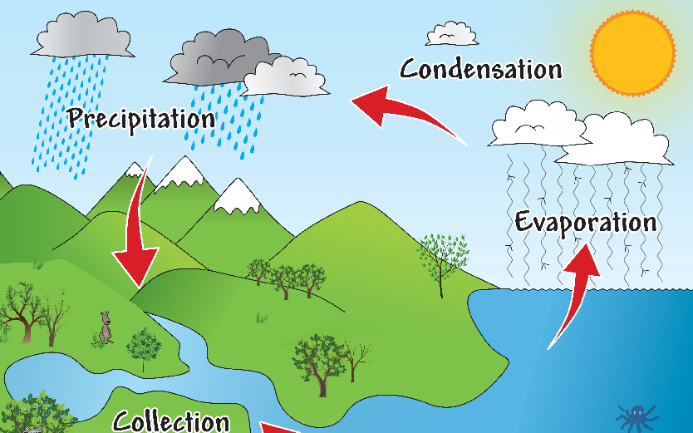
clouds
sun
rain
river
sea

Slide 3


Slide 4
LI: To be able to conduct an experiment and record what happens SC:I can conduct an experiment. I can write what happened using the sounds I know.

Slide 5


