Slide 1
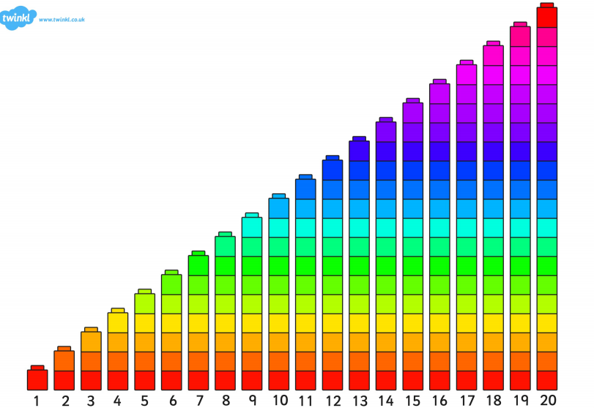

Slide 2
LI: To be able count to 10/20 and to order numbers correctly SC: I can count and order numbers from 1-10/20

Slide 3
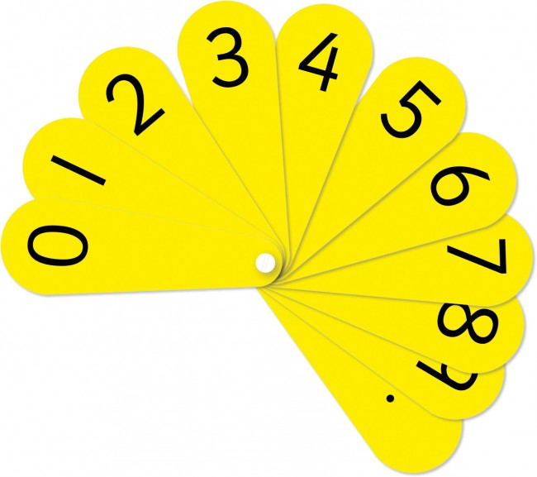

Slide 4
1 2 __ 4 5 __ 7 8 __ 10
11 __ 13 14 15 ___ 17 18
19 ___

Slide 5


Slide 7
LI: To be able count to 10/20 and to order numbers correctly To be able to recognise teen numbers and what each numeral means. SC: I can count and order numbers from 1-10/20 I can recognise a teen number and understand that there is 1 lot of 10s and ? 1s

Slide 8
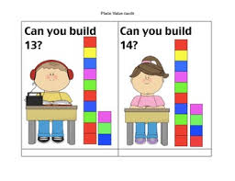

Slide 9


Count some objects to see what a teen number really is. Use the language 13 is 1 lot of 10 and 3 1s
1
3

