Slide 1
LI:To be able to write a sentence using adjectives SC:I can write a sentence with a cap letter, finger space, full stop and adjective. I can write using the sounds including digraphs that I know.

Slide 2


Slide 3
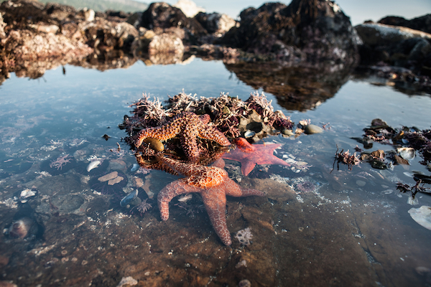

Slide 4


Slide 5


Slide 6
LI:To be able to write a sentence using adjectives SC:I can write a sentence with a cap letter, finger space, full stop and adjective. I can write using the sounds including digraphs that I know.

Slide 7
https://www.youtube.com/watch?v=JtOb6YfqWWo

