Slide 1
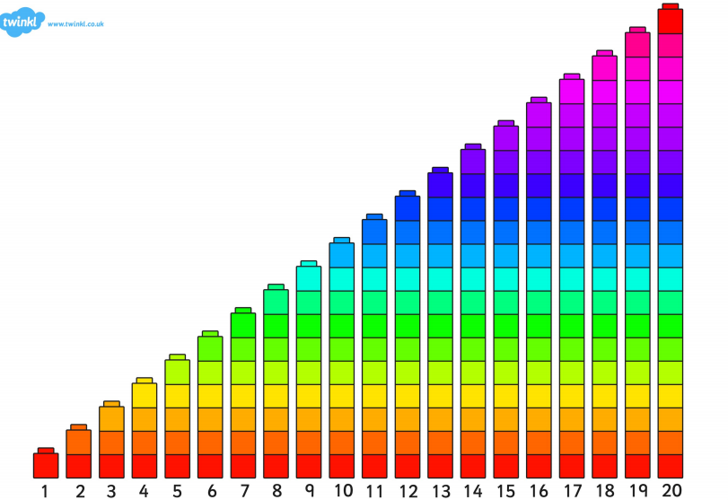

Slide 2
LI: to be able to recognise coins and to add values SC: I can recognise all coins and use 2 coins to make a value to 10p

Slide 3
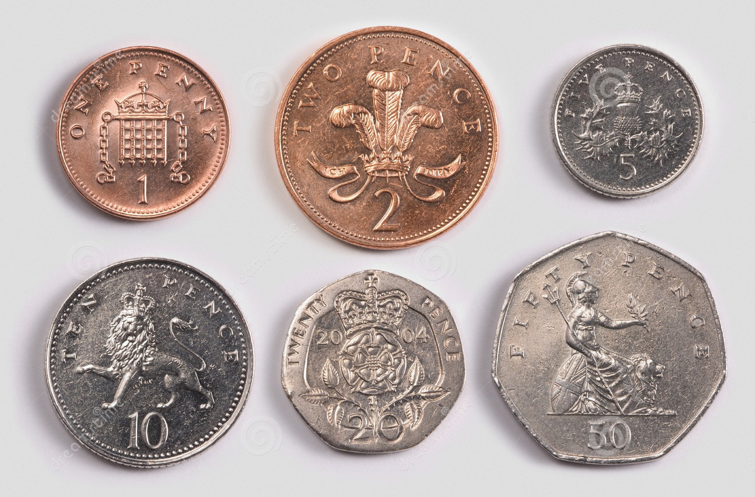

Slide 4




5p

Slide 5


Slide 7
LI: to be able to recognise coins and to add values SC: I can recognise all coins and use 2 coins to make a value to 10p

Slide 9
7p

