Slide 1
LI To be able to read sentences and write words containing ear SC: I can read and write using ear LO: To be able to identify ear in words, and find the sounds I hear SC: I can begin to recognise the ear sound in words and find the sound I hear.

Slide 2
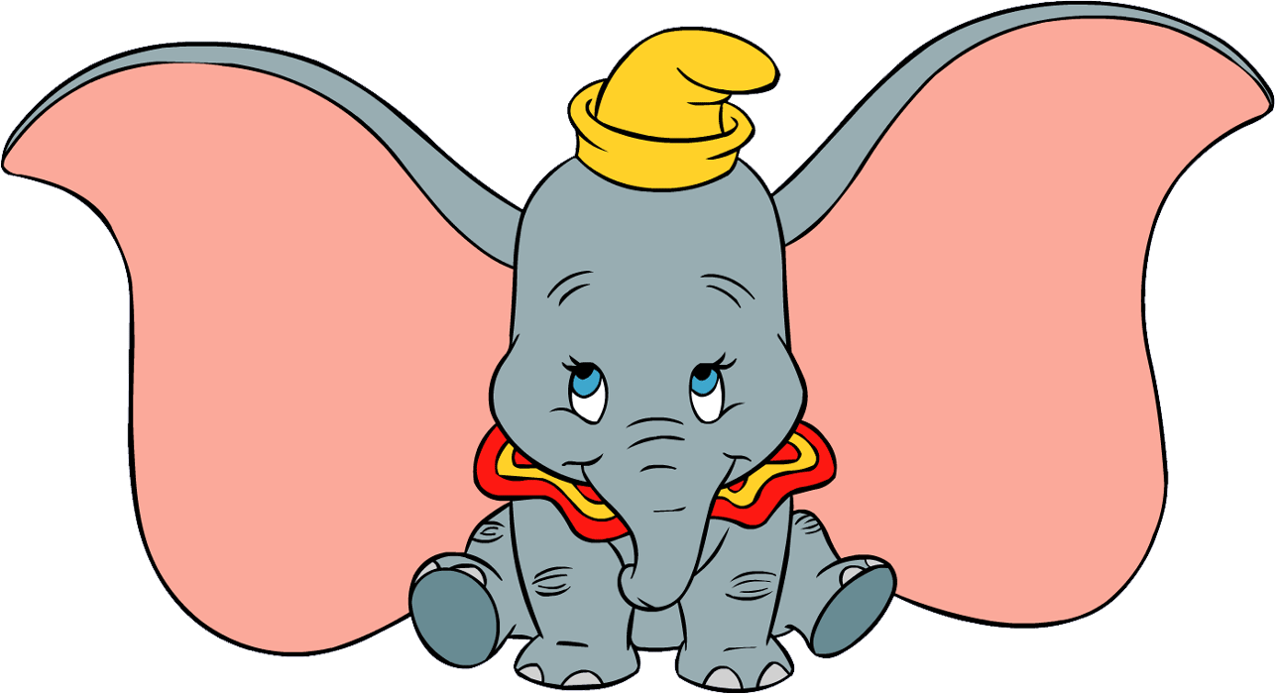
ear

Slide 3
ear hear fear tear rear clear

Slide 4
My ear is big. I have a tear when I cry. I can hear the dog. Is the road clear.

Slide 5


Slide 6
LI: To be able to read words containing the diagraphs/ trigraphs SC: I can read words containing sounds with 2 and 3 letters. LI: To be able to match sounds to pictures. SC: I can recognise digraphs and match to the correct picture.

Slide 7
ai or ee oo OO
igh oa er ur ou ow

Slide 8
car rain surf mixer feet book moon cow out light

Slide 10
LI: To be able to read cvc/ccvc words and identify which is psuedo SC: I can read cvc/ccvc words and know which is a pseudo work

Slide 11

www.phonicsplay

