Slide 1
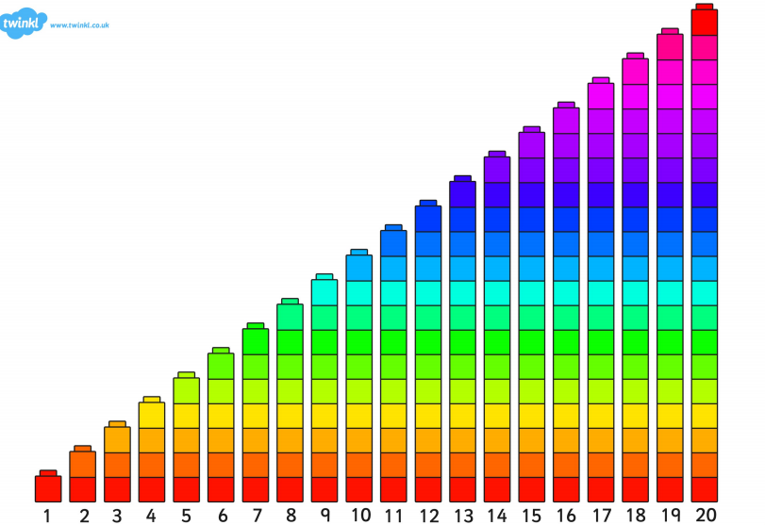

Slide 2
LI: To be able to use the shapes I know to make a repeating pattern. SC: I say the names of 2D shapes. I can use the shapes to make a 3 repeat pattern.

Slide 3
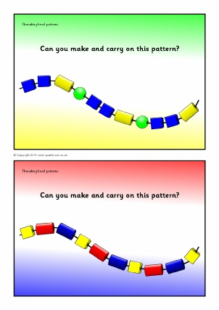

Slide 4


Slide 6
LI: To be able to use the shapes I know to make a repeating pattern. SC: I say the names of 2D shapes. I can use the shapes to make a 3 repeat pattern.

