Slide 1
LI To be able to read sentences and write words containing ou. ow SC: I can read and write using the ou, owsound

Slide 2
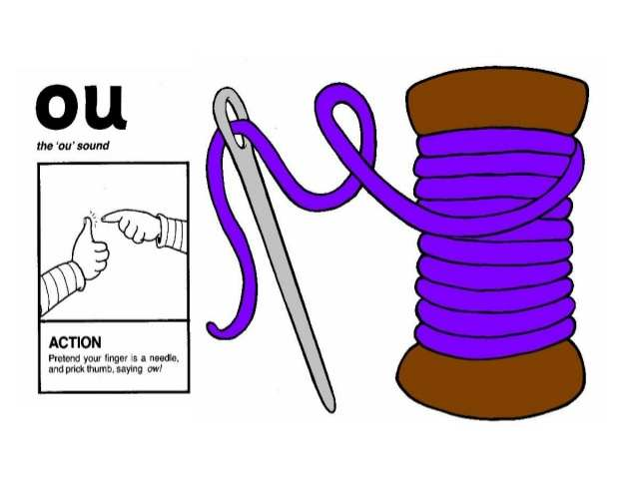
ow

Slide 3
down now howl out shout brown

Slide 4
The cow is brown. Is it far down . The owl can howl. I go out if I shout.

Slide 5
LI: To be able to read words containing the diagraph ar. SC: I can find ar words within a text. I can read a list of ar words that I have learnt. LI: To be able to match sounds to objects. SC: I can say which sound comes firstin a word. I can help to put sounds in the correct order.

Slide 6
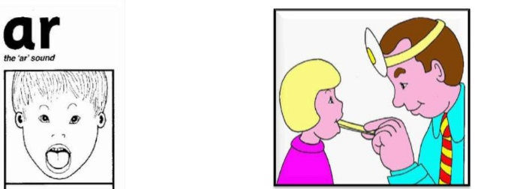

Slide 7
car far star shark dark park spark

Slide 8


Slide 9
down
now

Slide 10
I went down the step now.
I am going to the park now.

Slide 12
LI: To recognise/ read phase 2/3 tricky words, and HF words taught SC: I can read the above phase 2 /3words.

Slide 13
now down

Slide 14
I no go to the into

Slide 16
Practise sh words write them on your whiteboard

Slide 17




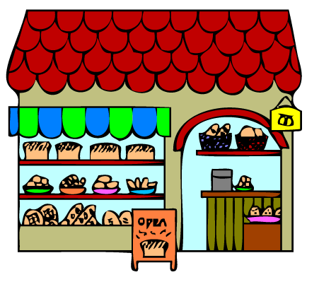

Slide 18
Is a ship wet?
Can a fish hop?
Can a shop sell a bag?

