Slide 1
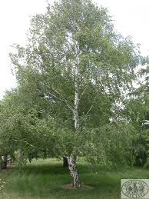
Welcome to Silver Birch
Class
Mrs Hall
Mrs Hams
Mrs Glass
Mrs Woodward

Slide 2
Timings:
School starts at 8:45 am
Children may come into class at 8:30am to read or complete their reading quiz.
….. It ends at 3:15 pm.

Slide 3
PE:
Term 1 – Wednesday – Coach
Tuesday – Year 4 – Hockey
Thursday – Year 3 – Swimming
Term 2 – As above, except Thursday Year 4 with Miss Boyle
Term4-6 Friday with Miss Boyle
Earrings to be removed or taped on these days.
It is not an optional subject so please make sure they have the correct kit.
Trainers (and a carrier bag to put them in) and tracksuits for the colder months.

Slide 4
Homework:
Reading daily
At least 3 times a week – recorded in reading records (date and initials). These will be taken in and checked regularly.
Tables weekly
Test on a Tuesday.
All children start with 2, 5 and 10.
Topmarks website
Spellings weekly
Given out on a Friday.
Spelling sheets to be in by Wednesday.
Their words to be written 3 times and 4 sentences
Test on a Thursday.
If spellings are not handed in, children complete the sheet at lunchtime play.

Slide 5
Spellings in Silver Birch
Words are taken from the NC statutory word list for Year 3 & 4.
There are 15 words altogether – the last 2 are bonus words linked to the topics and are for all children regardless of group.
Group 1 – first 5 words
Group 2 – first 10 words
Group 3 – all 15
If full marks in 2 weeks children can move to the next group.
Children will move down a group if they are getting low scores

Slide 6
Star Reader Chart
Every time a quiz is completed your child should show a teacher that they’ve passed (60% +)
The value of points that the book is worth is tallied.
Each child has an individual target to reach.
When that target is reached, they receive a small prize.

Slide 7
Expectations:
P Presentation of work is high.
PChildren are reading at home.
PE Kit here for PE lessons.
Children give their best at all times.
Children follow the rules

Slide 8
Rewards and Sanctions
Children that are displaying good behaviour and learning;
Sunshine chart – Start on the rainbow, move up = sticker at the end of the day.
Top sunshine = a tick, gold sticker and Excellence award.
10 ticks = prize from the shiny box.
Excellence awards = letter home.
4 letters home = 5 star badge from Mr File.

Slide 9

Rewards and Sanctions cntd...
Great learning = team points.
Tables that are tidied quickly – table points = trophy for the week for the table with the most points.

Slide 10
Rewards and Sanctions cntd...
If children are not following our school Golden rules or our class charter;
Children will get a warning and move down to the cloud (if they are on the rainbow). 5 mins of playtime missed.
If the behaviour hasn’t improved, the child will move down to the rain cloud. This means 20mins of lunchtime play will be missed, a letter of apology written, and a visit to a senior member of staff.
If this is a regular occurrence, we will tell the child to phone parents to inform them of their behaviour.
Children can move back up if they redeem themselves during the session.
Violence or swearing will result in the raincloud straight away and a visit to Mr File.

Slide 11
Groups
Mixed ability seating (apart from Guided reading)
Each term seats are changed.
Focus groups according to the lesson objective and previous learning
Maths – Children often choose the level they want to work at (Bronze, Silver, Gold, Platinum – challenge)

Slide 12
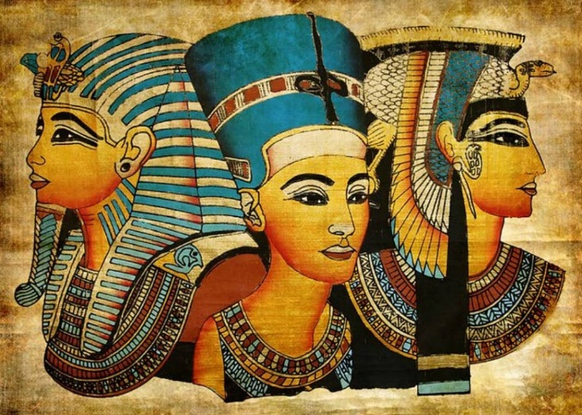

This term’s learning is about:
Egyptian Cinderella
Science – Space
Topic: Ancient Egyptians

