Slide 1
LI to be able to write about their experiences. SC: I can write a simple sentence – I can write down the sounds I know – I can use finger spaces.

Slide 2
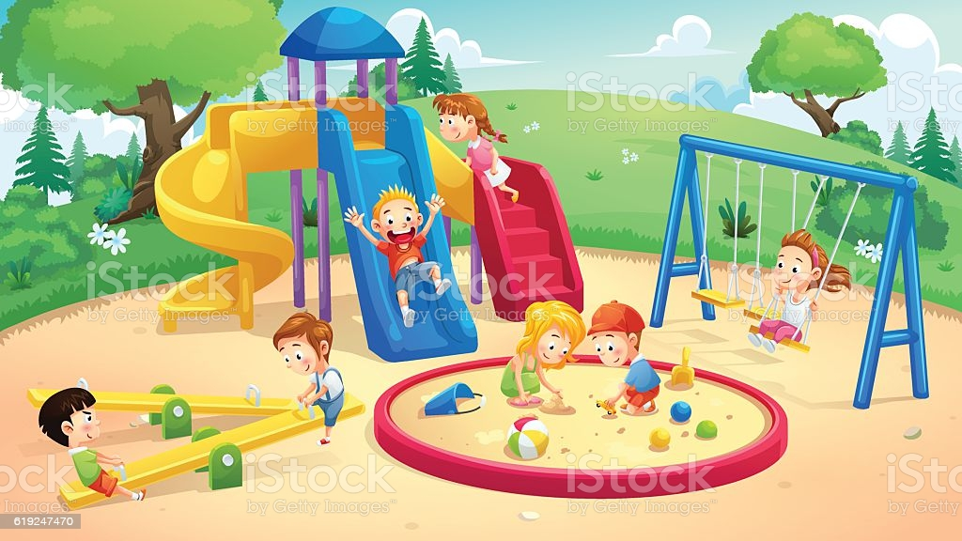

Slide 3


