Slide 1
LI: To know all of the sounds and words previously taught. SC: I can identify all phonemes taught and can read phase 2 tricky and HF words

Slide 2
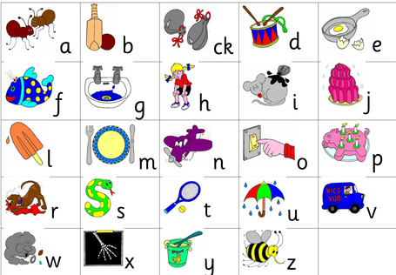

Slide 3
I go no to the into

Slide 4


