Slide 1


French
Food, Glorious Food
Year One
French | Year 3 | Food, Glorious Food | Preferences | Lesson 3

Slide 2




Title slide (themed) here
Preferences

Slide 3
Aim
To use the definite article when generalising.
To give a preference for or against things.
Success Criteria
To use definite articles le/la/les to mean ‘the’.
To choose the correct article when talking about food.
To say if I like or dislike a food.
To make my preferences stronger.

Slide 4



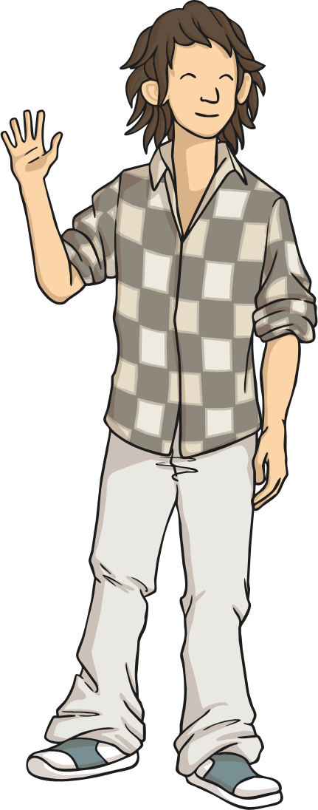
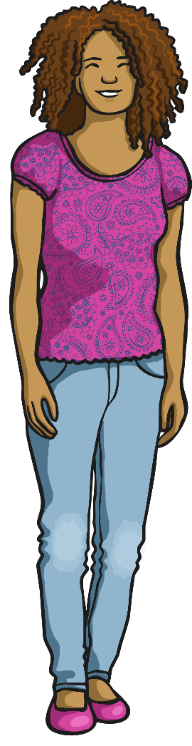


Introduction
Click play buttons throughout to hear phrases and words.
Qu’est-ce que tu aimes manger ?
J’aime la tarte aux cerises.
J’aime le saucisson.
Français
Sciences
J’aime les pommes.

Slide 5
Qu’est-ce que tu aimes manger ?
(What do you like to eat?)
Qu’est-ce que tu aimes manger ?
J’aime la tarte aux cerises.
J’aime le saucisson.
What do you think the highlighted words mean?
Which word(s) came just before the food noun last time?
J’aime les pommes.

Slide 6
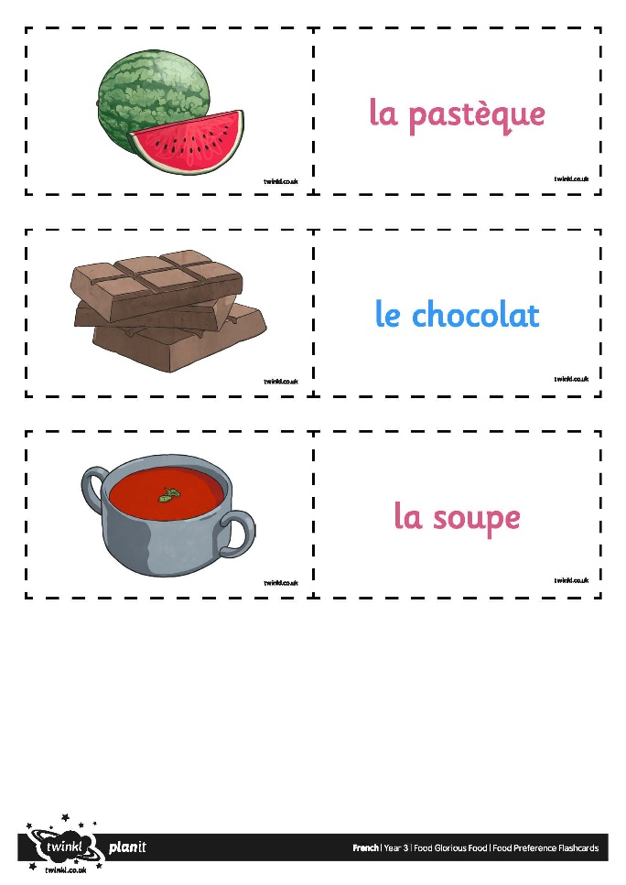
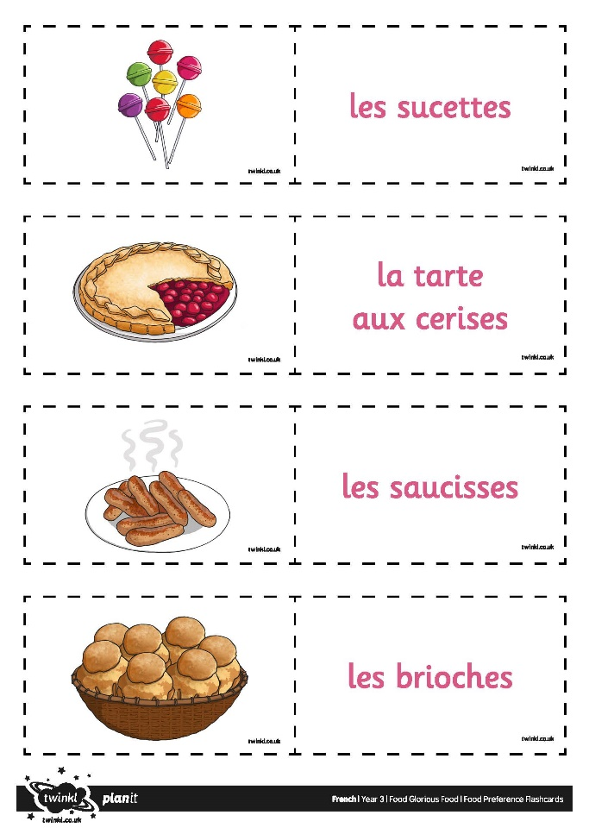
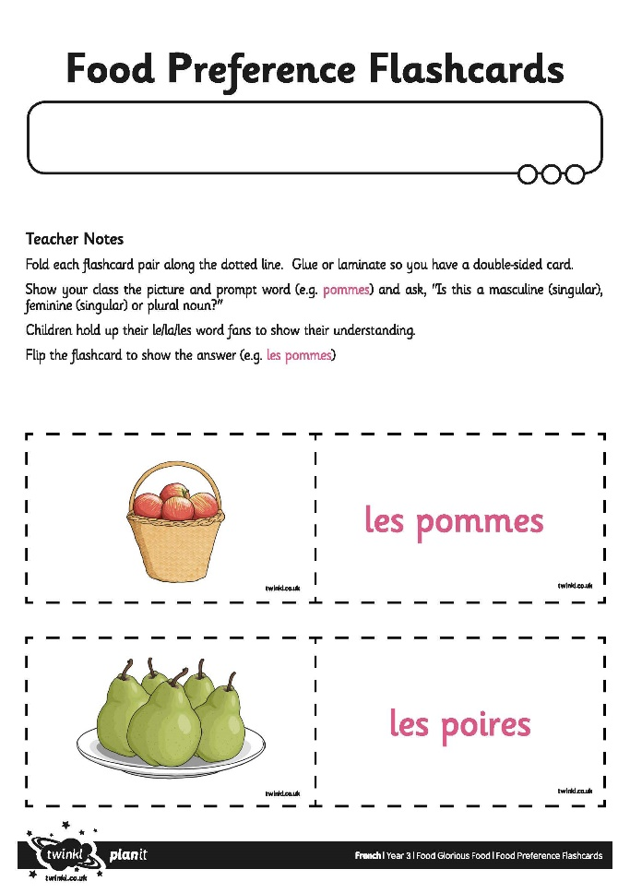
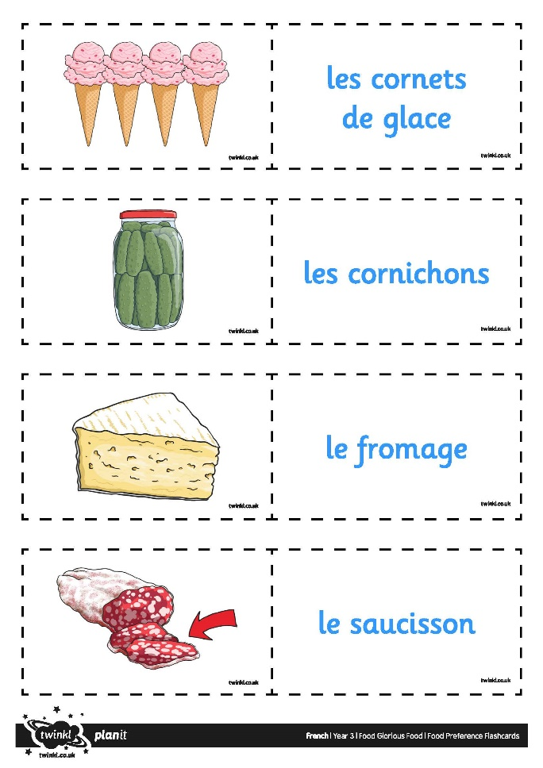
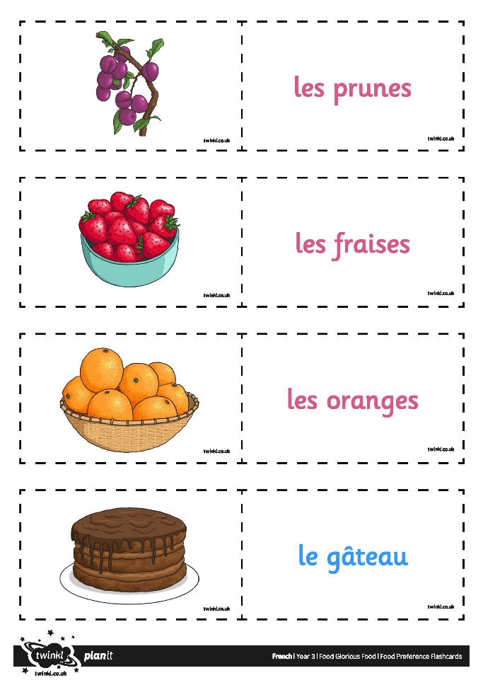
Le, la or les?

Slide 7



Qu’est-ce que tu préfères?
Je n’aime pas la pastèque.
J’aime le gâteau.
Je déteste les cornichons!
J’adore les sucettes!

Slide 8

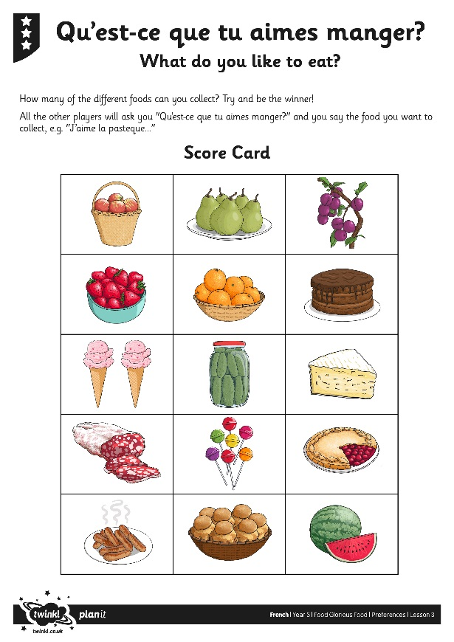
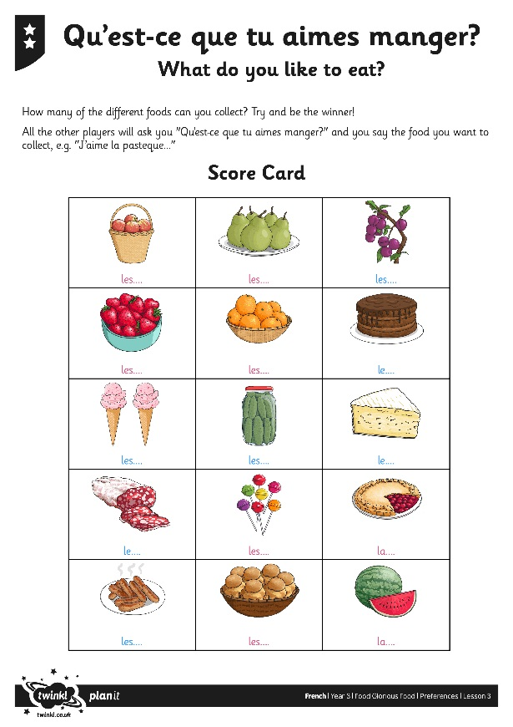

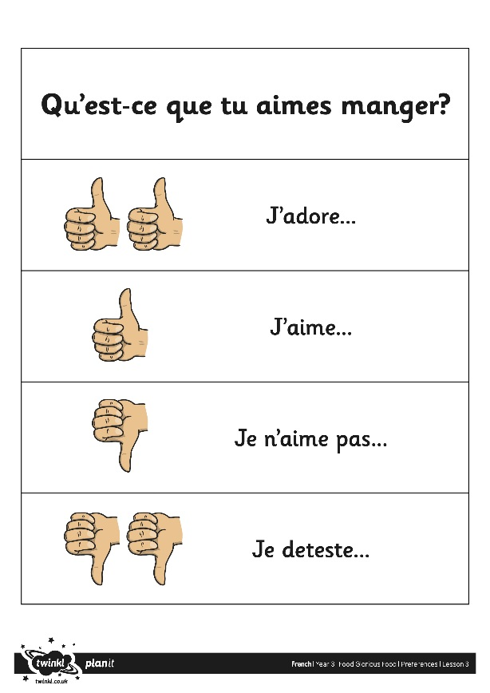
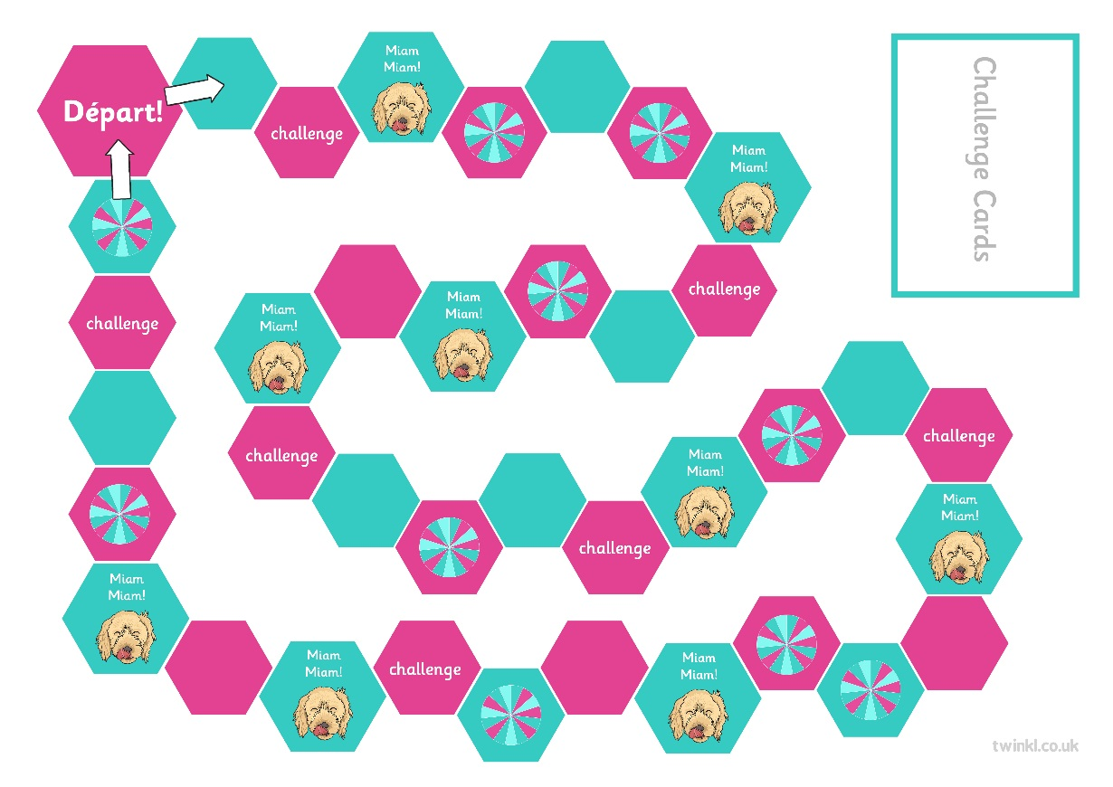
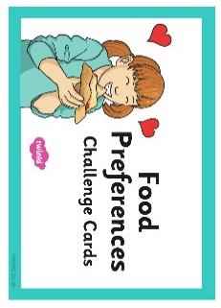
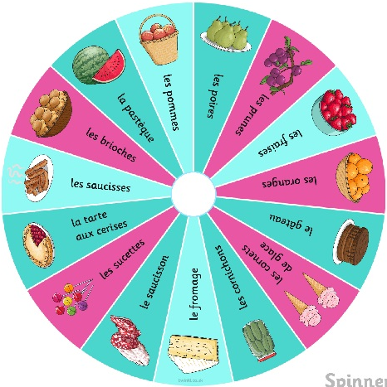


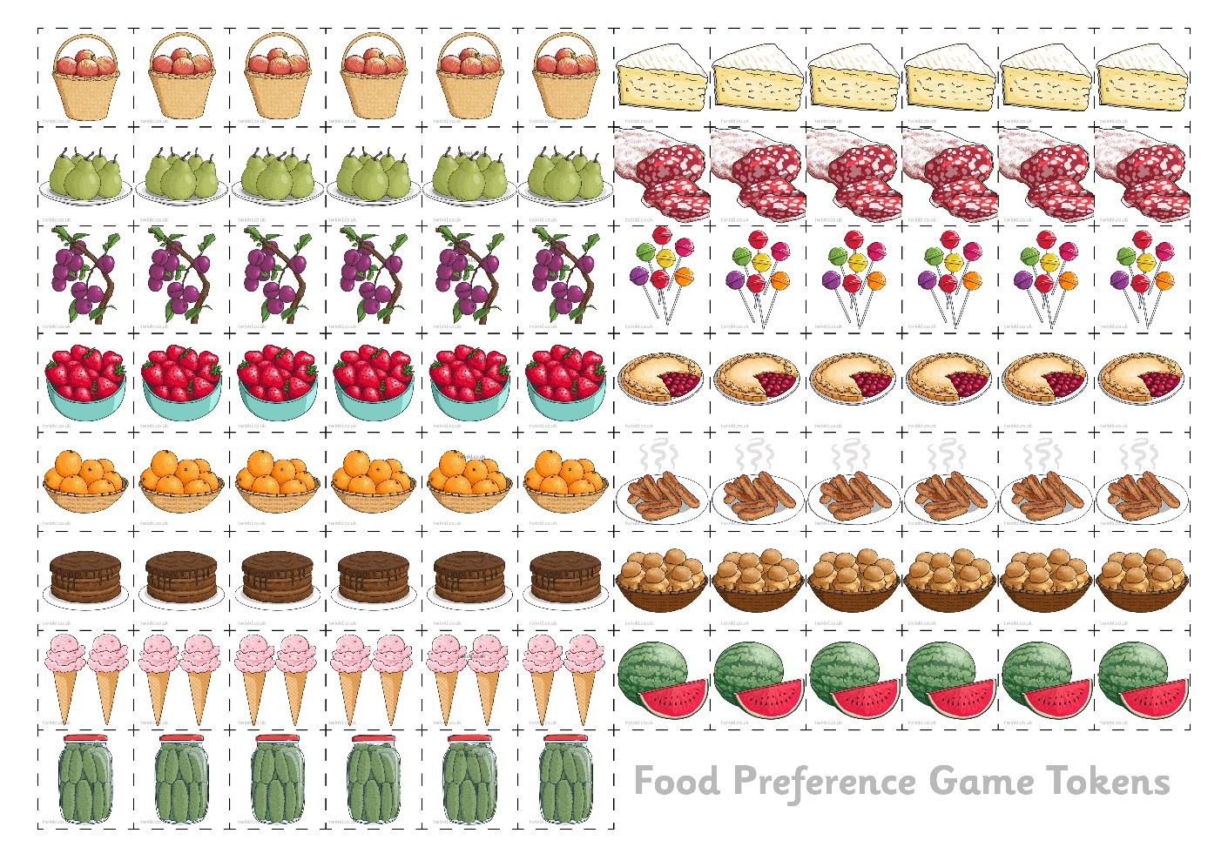
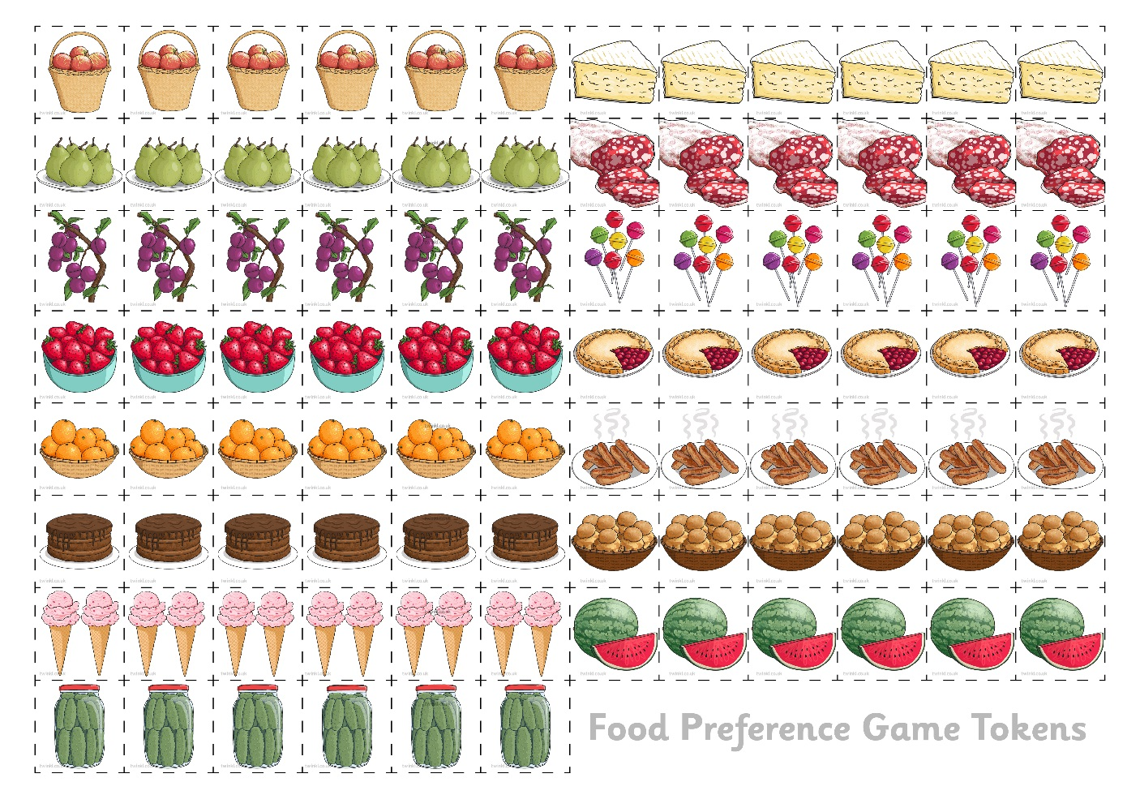
Allons jouer!
(Let’s Play!)

Slide 9
Aim
To use the definite article when generalising.
To give a preference for or against things.
Success Criteria
To use definite articles le/la/les to mean ‘the’.
To choose the correct article when talking about food.
To say if I like or dislike a food.
To make my preferences stronger.

