Slide 1
This terms’ concept is ‘Incarnation’
The Big Question is; What is the Trinity?
Lesson 1; What does the text about the Baptism of Jesus mean to Christians?
THE BAPTISM OF JESUS BY JOHN THE BAPTIST: MATTHEW 3:11–17
Read the text from a Bible, online or watch a video

Slide 2
Matthew 3:11-17 New International Version (NIV)
¹¹ “I baptize you with^{[a]} water for repentance. But after me comes one who is more powerful than I, whose sandals I am not worthy to carry. He will baptize you with^{[b]} the Holy Spirit and fire. ¹² His winnowing fork is in his hand, and he will clear his threshing floor, gathering his wheat into the barn and burning up the chaff with unquenchable fire.”
The Baptism of Jesus
¹³ Then Jesus came from Galilee to the Jordan to be baptized by John. ¹⁴ But John tried to deter him, saying, “I need to be baptized by you, and do you come to me?”
¹⁵ Jesus replied, “Let it be so now; it is proper for us to do this to fulfill all righteousness.” Then John consented.
¹⁶ As soon as Jesus was baptized, he went up out of the water. At that moment heaven was opened, and he saw the Spirit of God descending like a dove and alighting on him. ¹⁷ And a voice from heaven said, “This is my Son, whom I love; with him I am well pleased.”
You tube video link – The Miracle Maker https://www.youtube.com/watch?reload=9&v=JZ5jm5Ix5bY

Slide 3
Activity 1
Ask for suggestions about the meaning of details: the water, the voice, the dove. At the very start of Jesus’ public life, it pictures the Trinity: the voice of God announces Jesus as the Son of God and the Holy Spirit is present in the form of a dove.
Christians believe that one important thing the story teaches is that Jesus is not just a good man, but God, come to Earth to rescue humanity.
Ask pupils to list clues they can find in the story for this message.

Slide 4
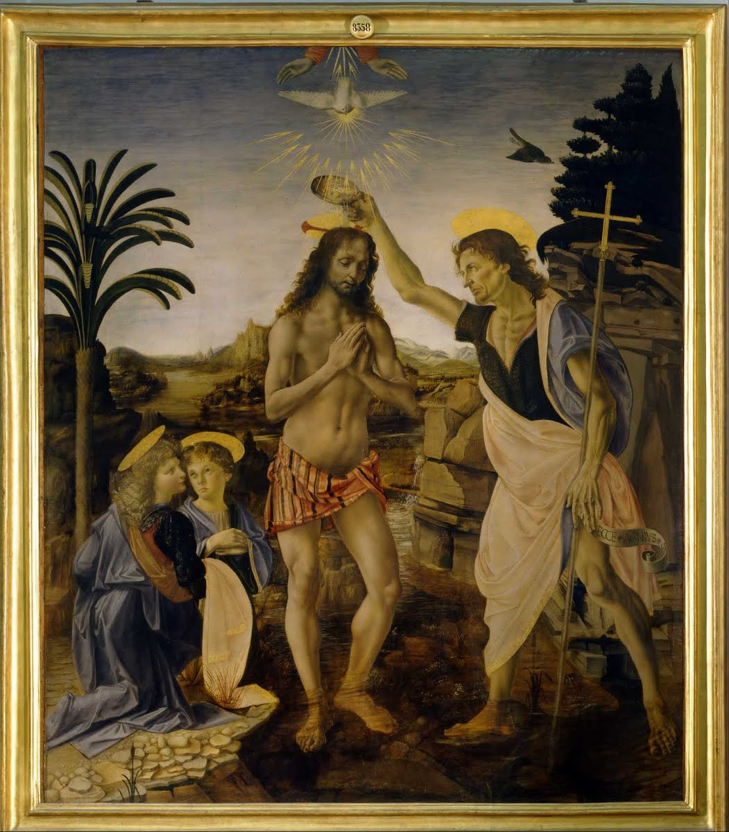
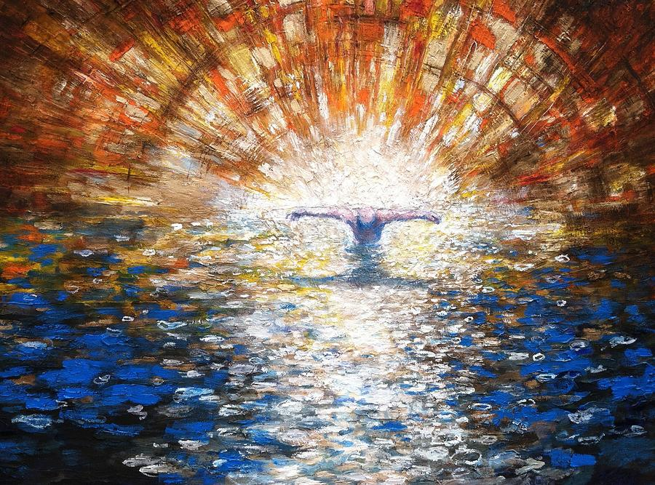
By Verrocchio
By Daniel Bonnell

Slide 5
Activity 2
Study the 2 paintings that represent the Baptism of Jesus.
Discuss similarities and differences between how the different painters show God.
Christians believe God is three in one, Father, Son and Holy Spirit.
List the evidence for this belief in the pictures.
Create your own pictures of the baptism of Jesus which include symbols for the voice of God and the Holy Spirit
Use any media you’d like; Painting, pastels, computer generated etc.

