Slide 1
Photo courtesy of ChrisK4u @flickr.com) - granted under creative commons licence - attribution

Slide 2
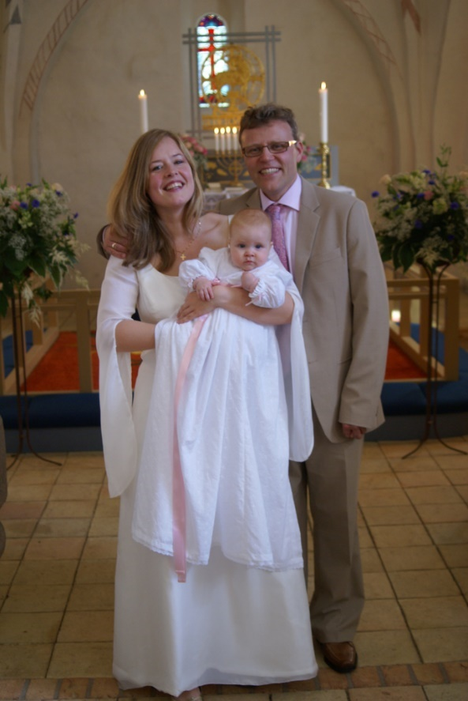
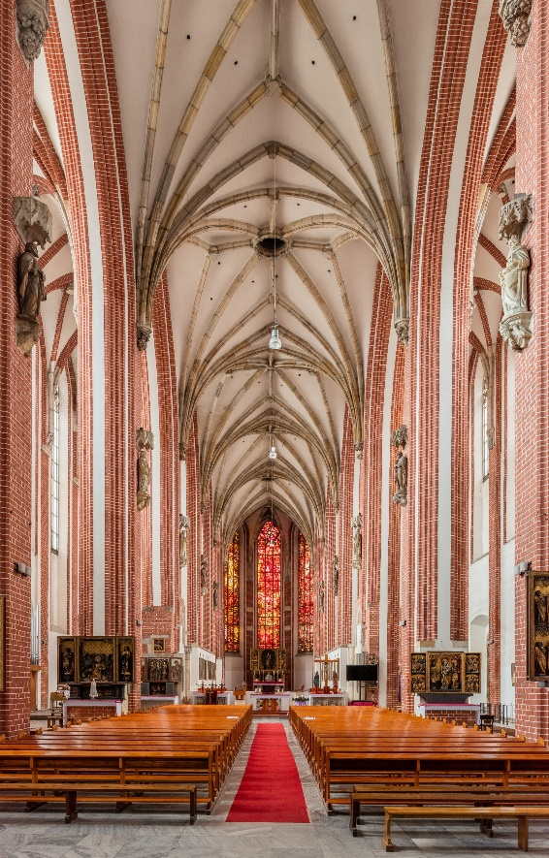
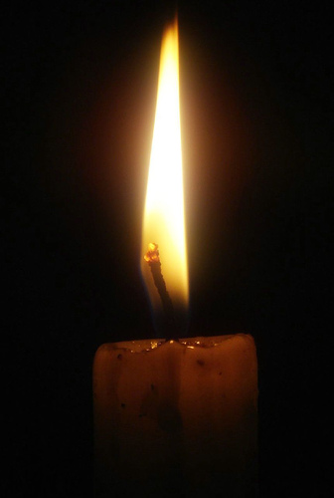
Starter Activity
What special Christian ceremony are we going to be learning about?
Look at the photographs for clues.
Photos courtesy of NCBrian, jenfagon and PhylB (@flickr.com) - granted under creative commons licence – attribution
Photos courtesy of archer10 (Dennis), kkalyan and NCBrian @flickr.com) - granted under creative commons licence - attribution

Slide 3
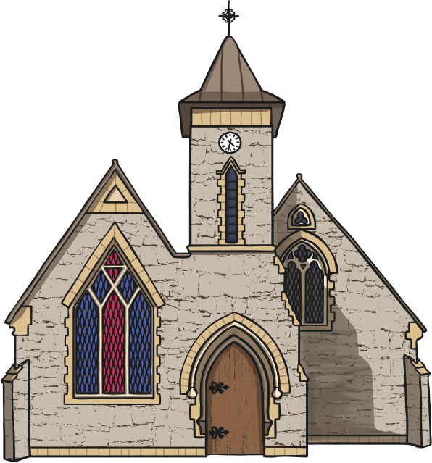
Learning Objective
To learn about what a Baptism is.
What happens during this special ceremony.
Why it is important to Christians.

Slide 4

Success Criteria
I can explain who can be baptised.
I can describe what happens during
a baptism service in church.
I can name special objects
needed for a baptism.
I can explain why it is an important
ceremony for Christians.

Slide 5


What is a Baptism?
A baptism is a way to receive an infant or an adult into the Church and is a sign of becoming a Christian.
A person of any age can be baptised. Some churches specialise in adult baptisms or Believer’s Baptisms.
What happens when a baby is baptised?

Slide 6
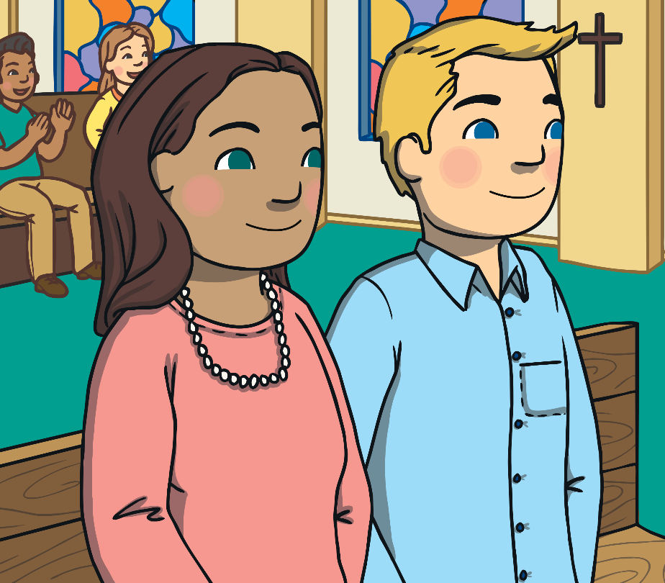
Special People
Godparents are an important part of the baptism service.
Before the baptism, the parents of the baby choose godparents to help them to look after their child.
Along with the parents of the baby at the baptism, the godparents say they believe in God then make special promises to look after the child and help him or her to grow up to be a good Christian person.

Slide 7
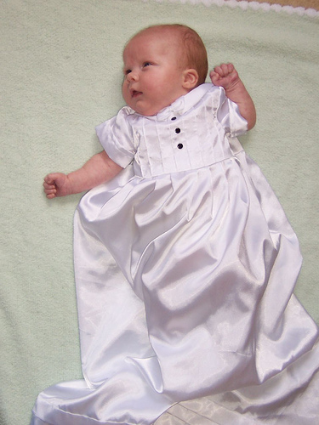
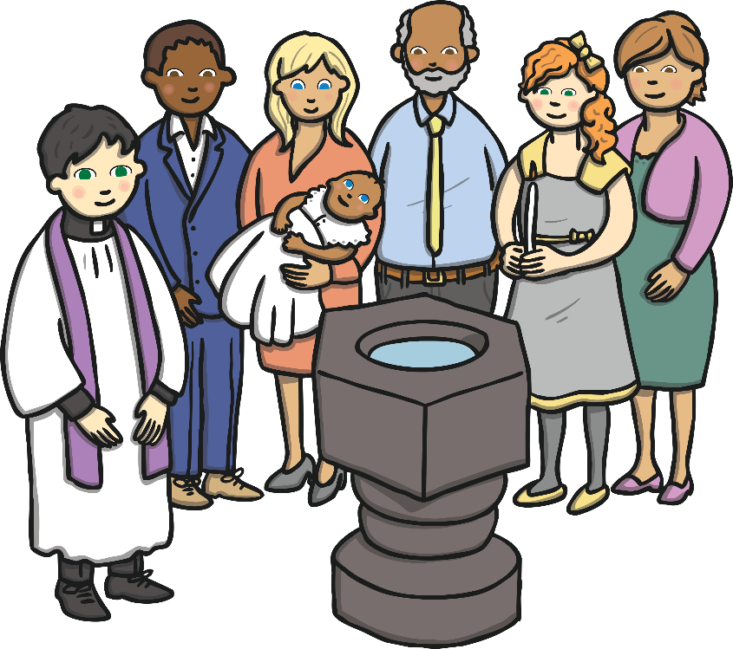
Special Objects
The baby will wear a special outfit because a baptism is a very special occasion in their life.
Photos courtesy of NCBrian, jenfagon and PhylB (@flickr.com) - granted under creative commons licence - attribution

Slide 8
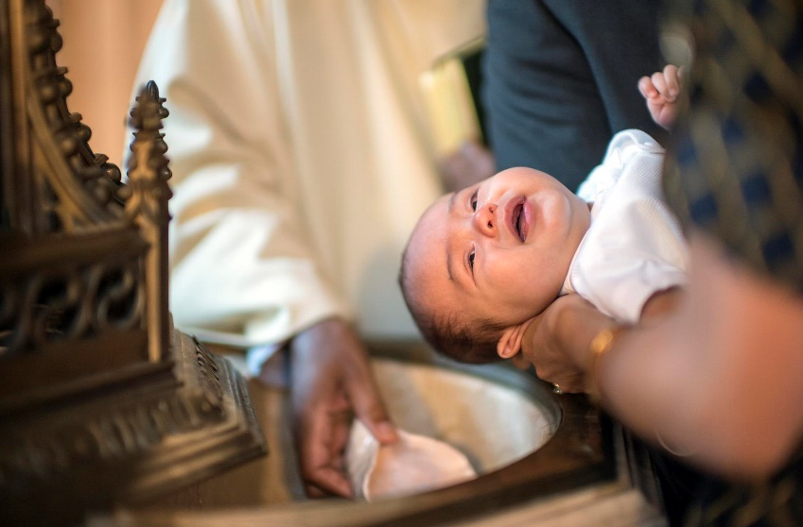
Special Objects
The vicar pours water into the font then blesses it. The baby has some of this special water poured over their head to show that the baby is clean, pure and a new member of God’s family. The vicar may use special oil to sign a cross on the baby’s forehead. A candle may also be given to represent the baby being a light in God’s world.
The vicar says important words as
the water is poured over the baby’s
head.
'I baptise you in the name of the
Father, and of the Son, and of the
Holy Spirit, Amen’.

Slide 9

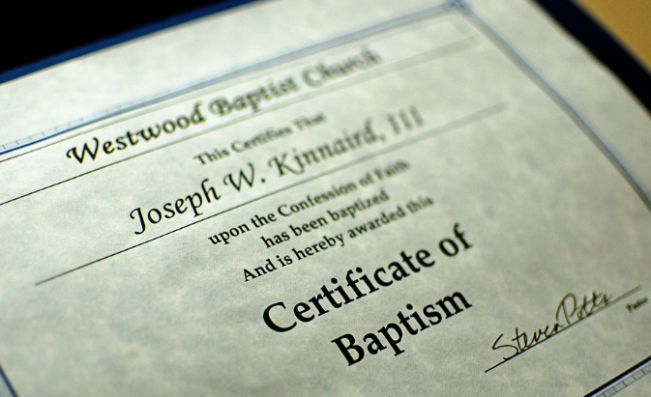
Special Objects
Once the baby has been baptised, the parents will be given a certificate to show this has happened and a candle which the baby can keep to always remind them that they are a part of God’s family.
Photos courtesy of archer10 (Dennis), kkalyan and NCBrian @flickr.com) - granted under creative commons licence - attribution

Slide 10
A Baptism Service
Watch a real baptism ceremony.
Can you spot the baby, parents, godparents and font?
Who else is there?
What else happens?
http://www.bbc.co.uk/learningzone/clips/a-christian-baptism/5963.html

Slide 11


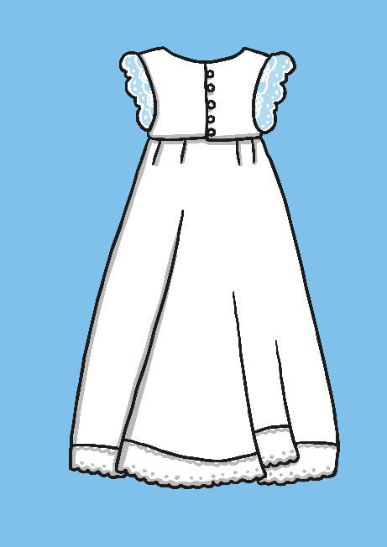
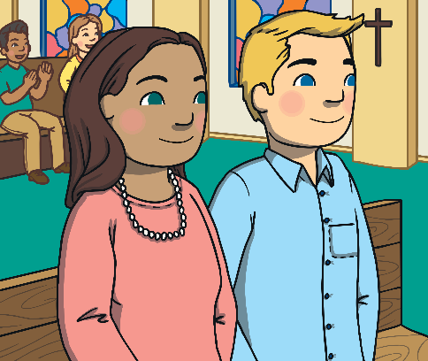


Match Up Activity
church
font
gown
godparents
candle
vicar

Slide 12

What Happens During an Adult Baptism (Believer’s Baptism)?
Many adults wish to be baptised,
too, as an outward sign of faith.
Jesus was baptised in the River Jordan by John the Baptist and wished his friends to baptise others.
Baptisms often used to take place
In a river. New Christians were dipped under the water’s surface
and brought up again as a sign
of a new birth.

Slide 13
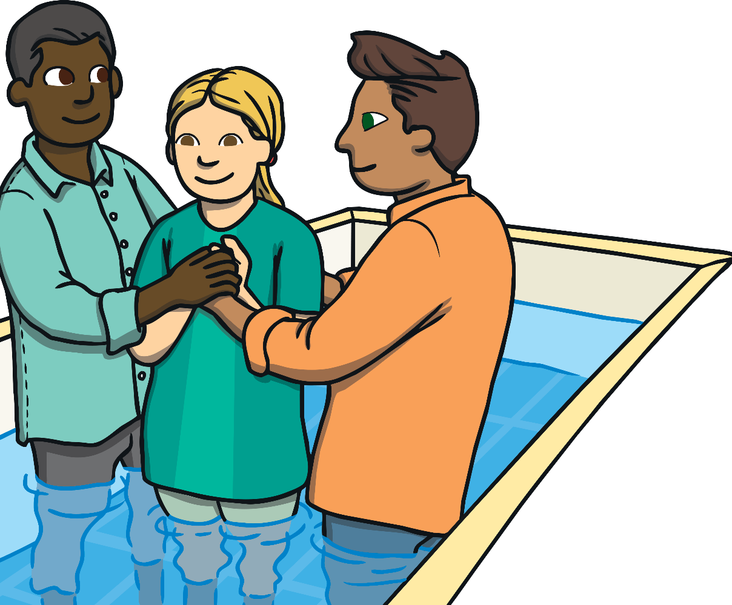
The first part of the service will contain hymns, bible readings and a
sermon (talk) by the minister.
Then the candidate and the minister enter a baptismal pool. The former is submerged for a few seconds while the minister says, “I baptise you in the name of the Father and of the Son and of the Holy Spirit’.
Click here to watch a video with more information.
Notes:
This PowerPoint Presentation contains links to external websites. Please check that the content of external links is appropriate for the intended audience. Twinkl Ltd is not responsible for the content of external links.

Slide 14

Plenary
Baptism is an important ceremony for Christians.
Look at the words below, what do they mean and
what do you notice?
Christianity
Christening
Christian

