Slide 1
Writing

Slide 2
Development Matters – the document which gives expected outcome for Foundation Stage

Slide 3
Literacy
Comprehension
•Demonstrate understanding of what has been read to them by retelling stories and narratives using their own words and recently introduced vocabulary.
• Anticipate (where appropriate) key events in stories.
• Use and understand recently introduced vocabulary during discussions about stories, non-fiction, rhymes and poems and during role play.
Word Reading
• Say a sound for each letter in the alphabet and at least 10 digraphs.
• Read words consistent with their phonic knowledge by sound-blending.
• Read aloud simple sentences and books that are consistent with their phonic knowledge, including some common exception words
Writing
• Write recognisable letters, most of which are correctly formed.
• Spell words by identifying sounds in them and representing the sounds with a letter or letters.
• Write simple phrases and sentences that can be read by others

Slide 4
Writing is really hard.
Lots of skills have to come together at once to make writing happen.
We need to hear the sounds we need, what they look like, where they should go on the paper, and how to coordinate the correct muscles to hold a pen to form that shape.
At the same time as thinking what we want to write and reading it back to see that it makes sense.

Slide 5
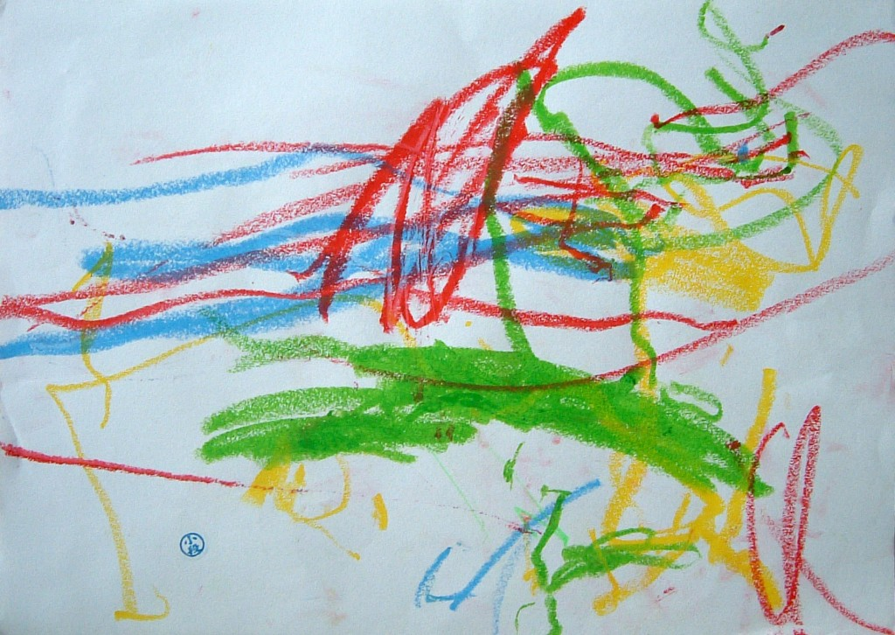
Early Mark Making
Many children begin to make marks –
How do we get from ……….

Slide 6
Mark Making for Meaning
When children have started to mark make they begin to put some meaning to this. It may be a shopping list that they have seen you write, or cards and invitations while playing.
If children see you write they are more likely to see its relevance and have a go themselves.

Slide 7
Gross Motor Control
This comes before fine motor control and is to do with body strength, coordination and large muscle development.
Fine Motor Control
This really means how well developed and how much control they have over smaller muscles such as fingers.
How we can help
Write dance
PE/FS
Handwriting patterns
Threading
Play dough

Slide 8
Emergent Writing
About now, after learning a few sounds we will start to write.
Firstly initial sounds, then final sounds, and then medial sounds if children can hear and say them.
Examples of our writing this week and how we would go about achieving this.
Hearing and saying the sound, finding it on a sound mat, writing it down.

Slide 9
I try to link what we are learning in the week to the sounds we know.
s – strawberry
a – apple
t – tomato
So that we are always consolidating our learning.

Slide 10
When we have learnt a few more sounds we can then begin to write words.
c a t CVC words are easier
apl – is fine as a phonetically plausible word.

Slide 11
When we have been writing initial sounds and CVC or phonetically plausible words we begin to write sentences.
Capital letters, finger spaces and full stops are now taught.

Slide 12
Things to remember.
Copy writing, dots and yellow writing do not really teach children the skills they need to write independently.
We write using lower case with capitals at the beginning of a sentence and in the usual places.
Children do need to try to hold pens/pencils correctly.

Slide 13
We try to make writing meaningful, fun and relevant.

Slide 14
Finally……. help but not too much
Remember if you…….
Cut it for me
Stick it for me
Read it for me
Say it for me
Write it for me
All that I learn is that you can do it better than me.

Slide 15


