Slide 1
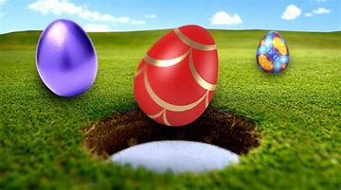
EASTER FACTS!
Easter is a celebration of the resurrection of Jesus Christ

Slide 2
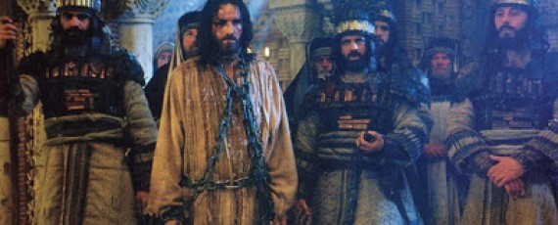
Jesus was arrested because he was taking over and the Romans didn’t like that.

Slide 3
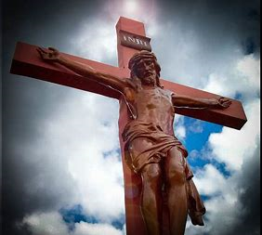
After Jesus was arrested he was nailed to the cross which his friends and his own mum had to watch. This is good Friday.

Slide 4
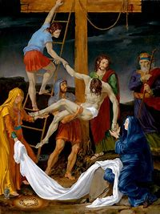
Jesus was then taken down from the cross and was put in a tomb

Slide 5
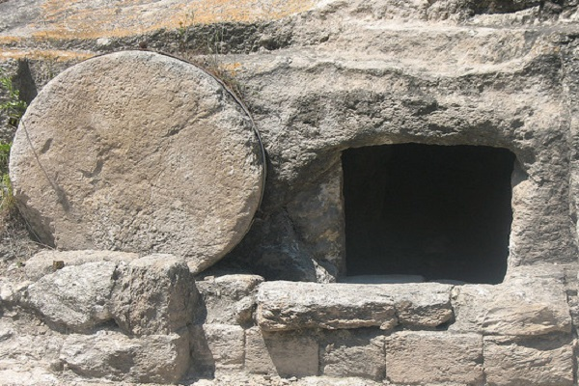
Jesus Christ rose from the dead in this tomb!
He rose on Easter Sunday.
This tomb is located in Gethsemane

Slide 6
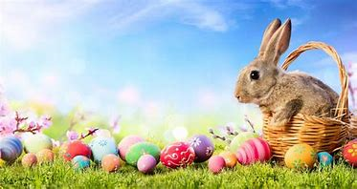
Easter is always celebrated between 22nd March – 25th April.

