Slide 1
ELECTRICITY
By eli duke
Project 2

Slide 2
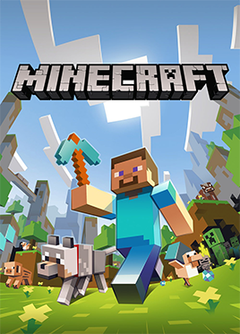
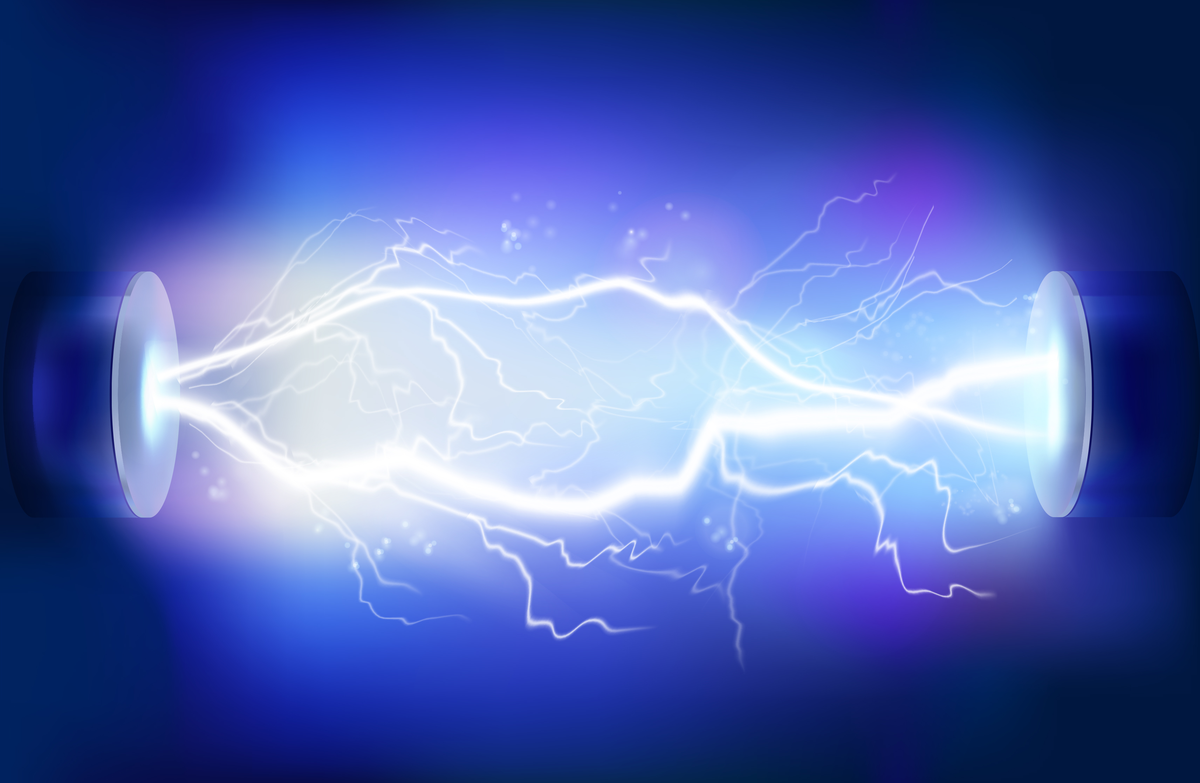
In this project I am going to show how electricity works the same as minecraft

Slide 3
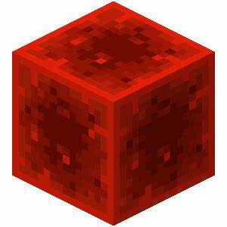
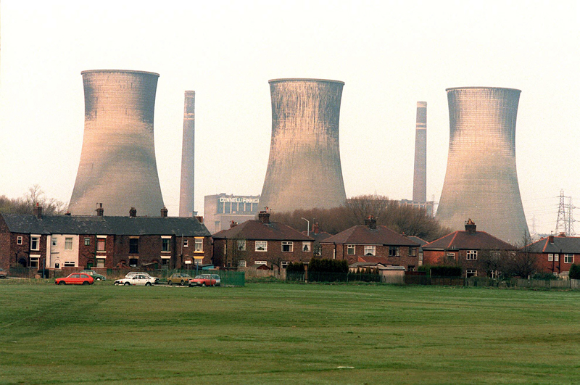
ELECtricity starts where the power source is.
In Minecraft the source is a red stone block however in life it is a power station.
Red stone block
Power station

Slide 4

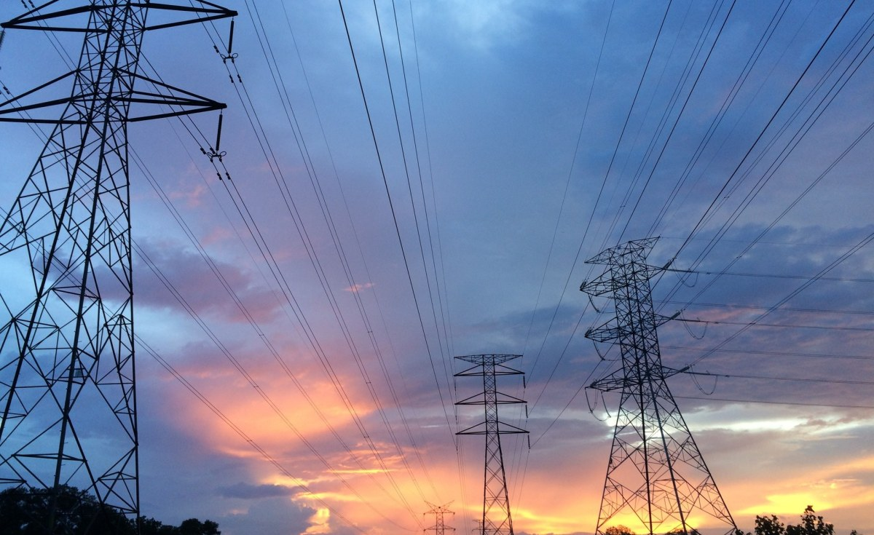
To move the power from the source in Minecraft I use red stone dust, in real life we use power cables
Red stone dust
Power cables

Slide 6
From the red stone dust it leads into the red stone comparator which splits the signal. In real life the power from the cables goes into your house fuse box, which splits the signal.

Slide 7
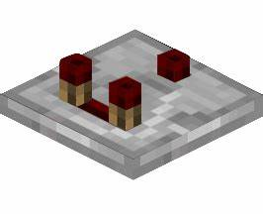
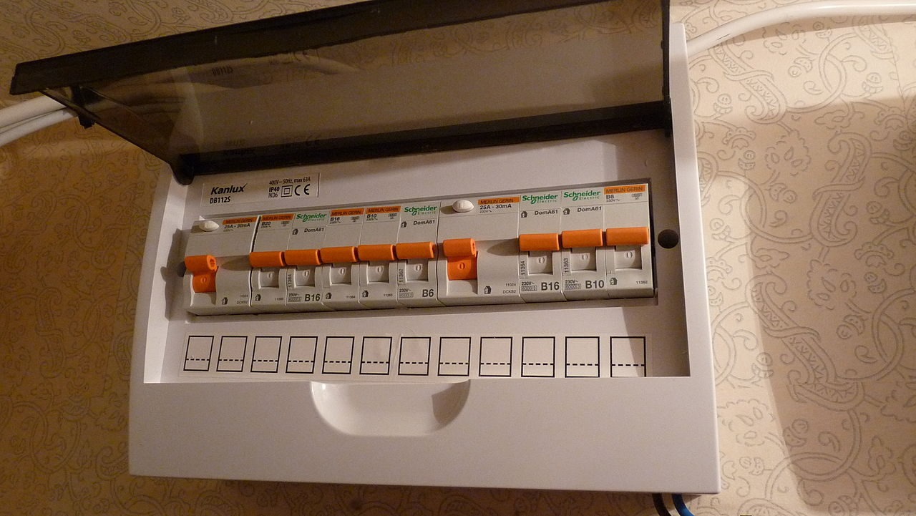

Slide 8
In Minecraft one end of the power goes to the lever, the other goes to what you’re powering (eg a red stone lamp). in real life one end of the power goes to the light switch the other goes to what you’re powering (eg a lamp)

Slide 9
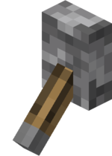
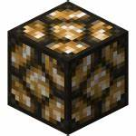
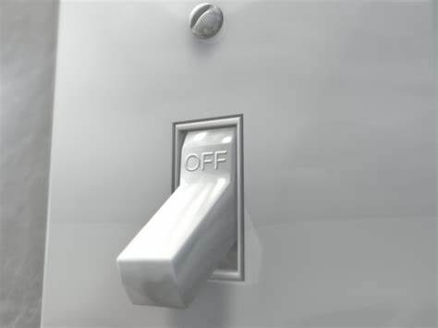
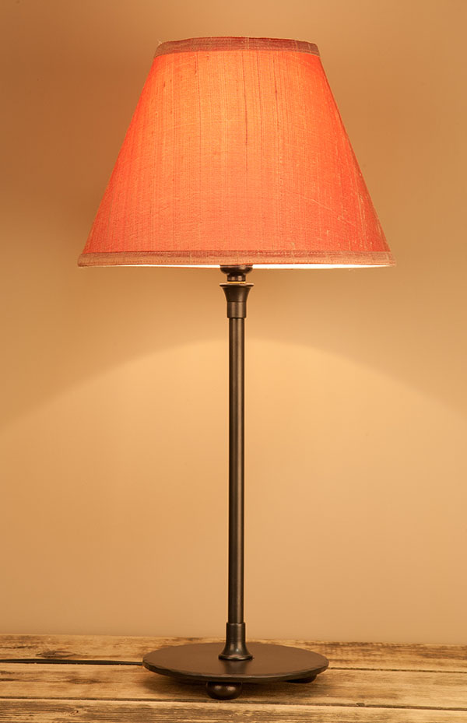

Slide 10
I hope you have learnt how Minecraft relates to real life electricity.
The end.

