Slide 1
Capacity

Slide 2
L.I: To be able to measure the capacity millilitres and litres.

Slide 3
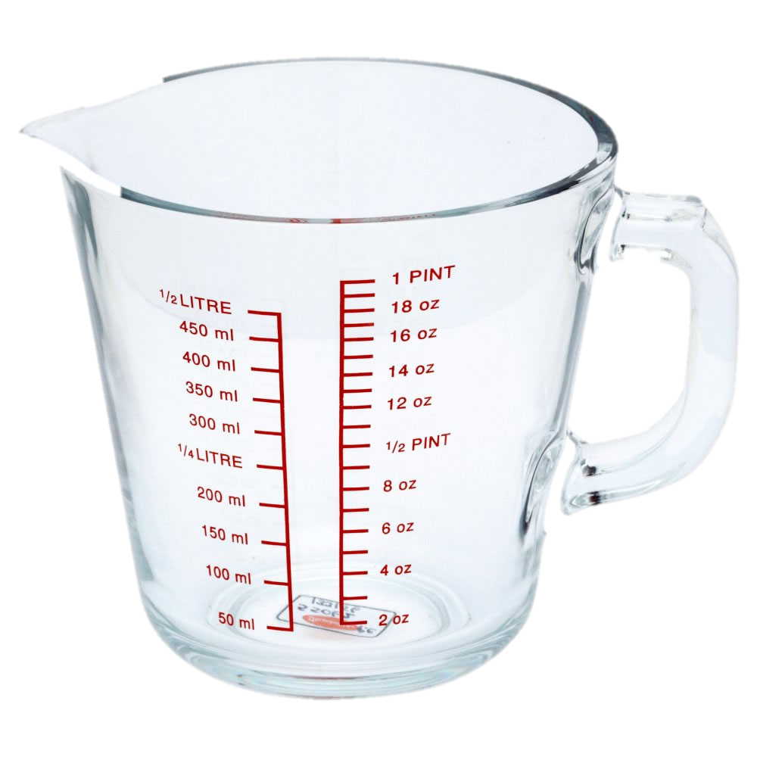
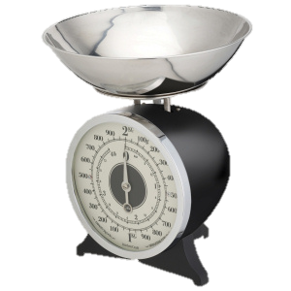
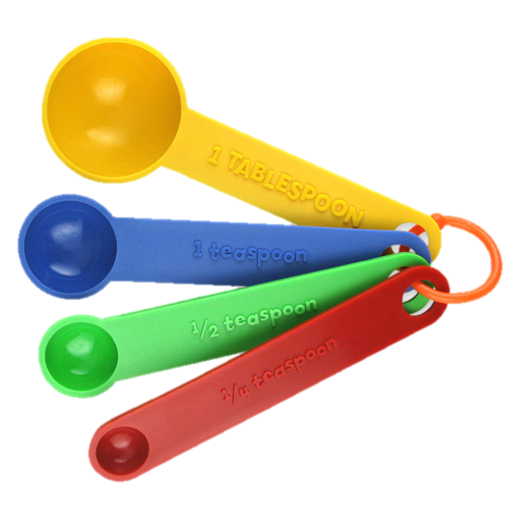
What is capacity?

Slide 4
How many millilitres (ml) are in a litre (l)?
1000 millilitres!

Slide 5
( use ITP Measuring here)
http://www.iboard.co.uk/iwb/Measure-Capacity-Simple-114

Slide 6

If a can of cola holds 200 ml how much will 4 cans hold?
How many cans would I need to make 1 litre?

Slide 7
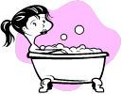
1. A bath holds 50 litres. A shower uses 34 litres. How many litres are used if Mrs Hitchin's has a bath and Mr Wright has a shower?
How much water will we save if Mrs Hitchin's decides to have a shower too?

Slide 8
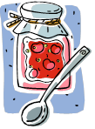
A jar has 350ml of jam. Mrs Tyrrell uses 240ml to make some jam tarts. How much is left?

