Slide 1
Fractions on a
Number Line

Slide 2
Example
What fraction is the arrow indicating on the number line?
How many sections is the line divided into?
How many sections along are we?
0
1

Slide 3
Fractions on a Number Line
What fraction is the arrow indicating on the number line?
0
1

Slide 4
Fractions on a Number Line
What fraction is the arrow indicating on the number line?
0
1

Slide 5
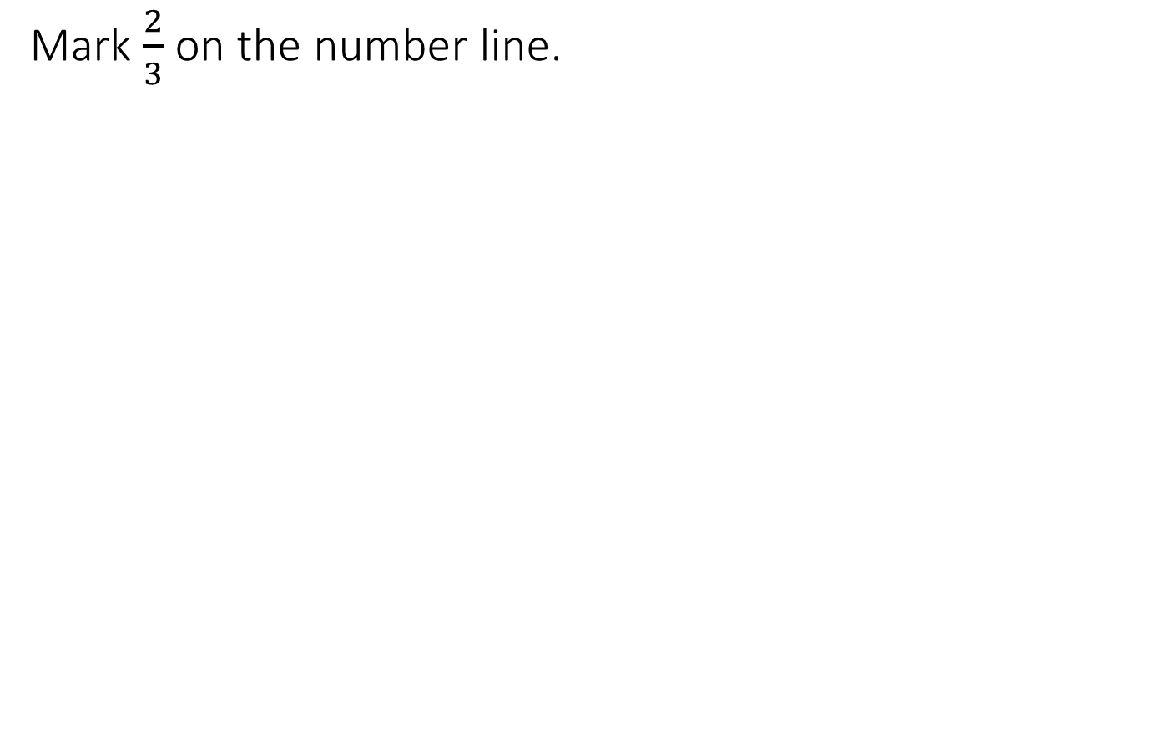
Fractions on a Number Line
Mark $\frac{2}{3}$ on the number line.
0
1

Slide 6
Fractions on a Number Line
What fraction is the arrow indicating on the number line?
0
1

Slide 7
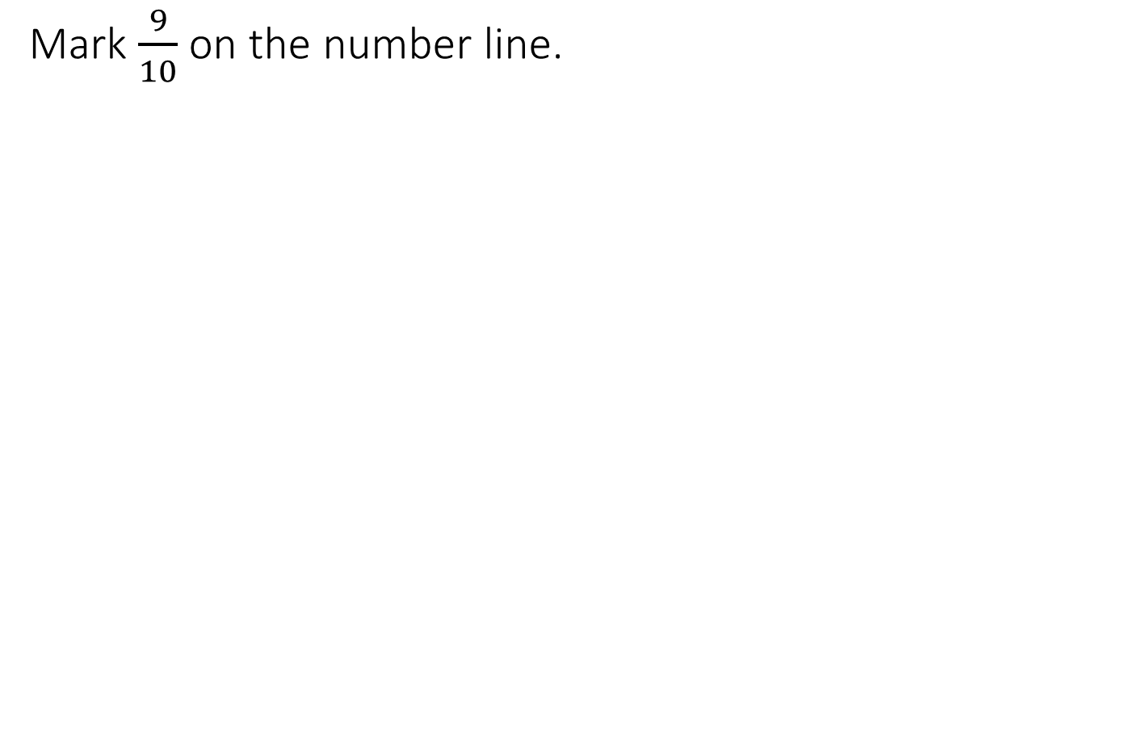
Fractions on a Number Line
Mark $\frac{9}{10}$ on the number line.
0
1

Slide 8
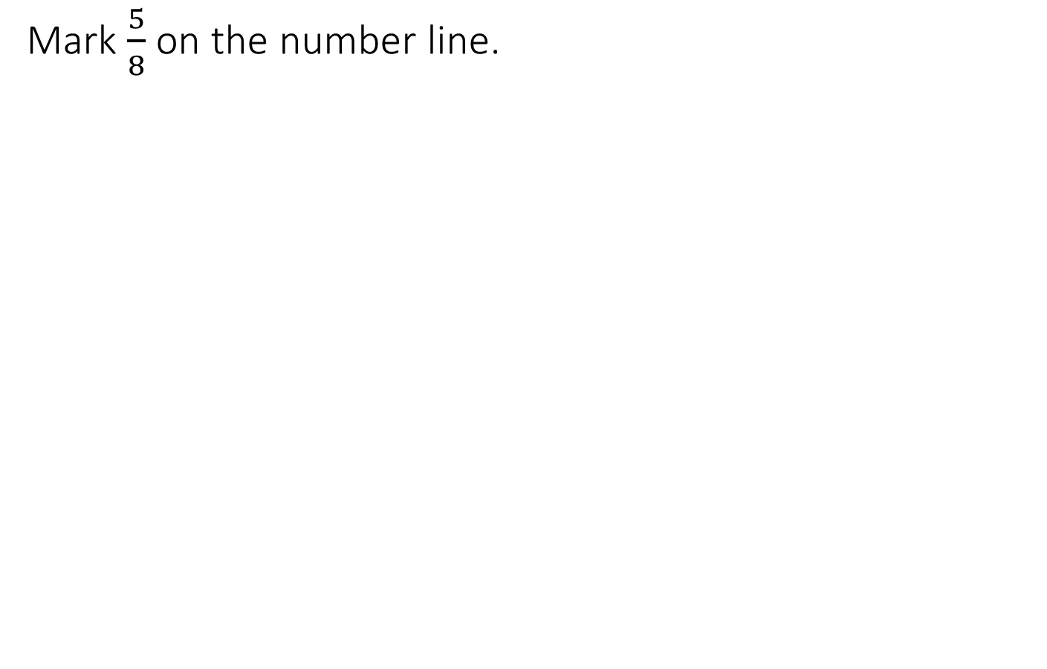
Fractions on a Number Line
Mark $\frac{5}{8}$ on the number line.
0
1

Slide 9
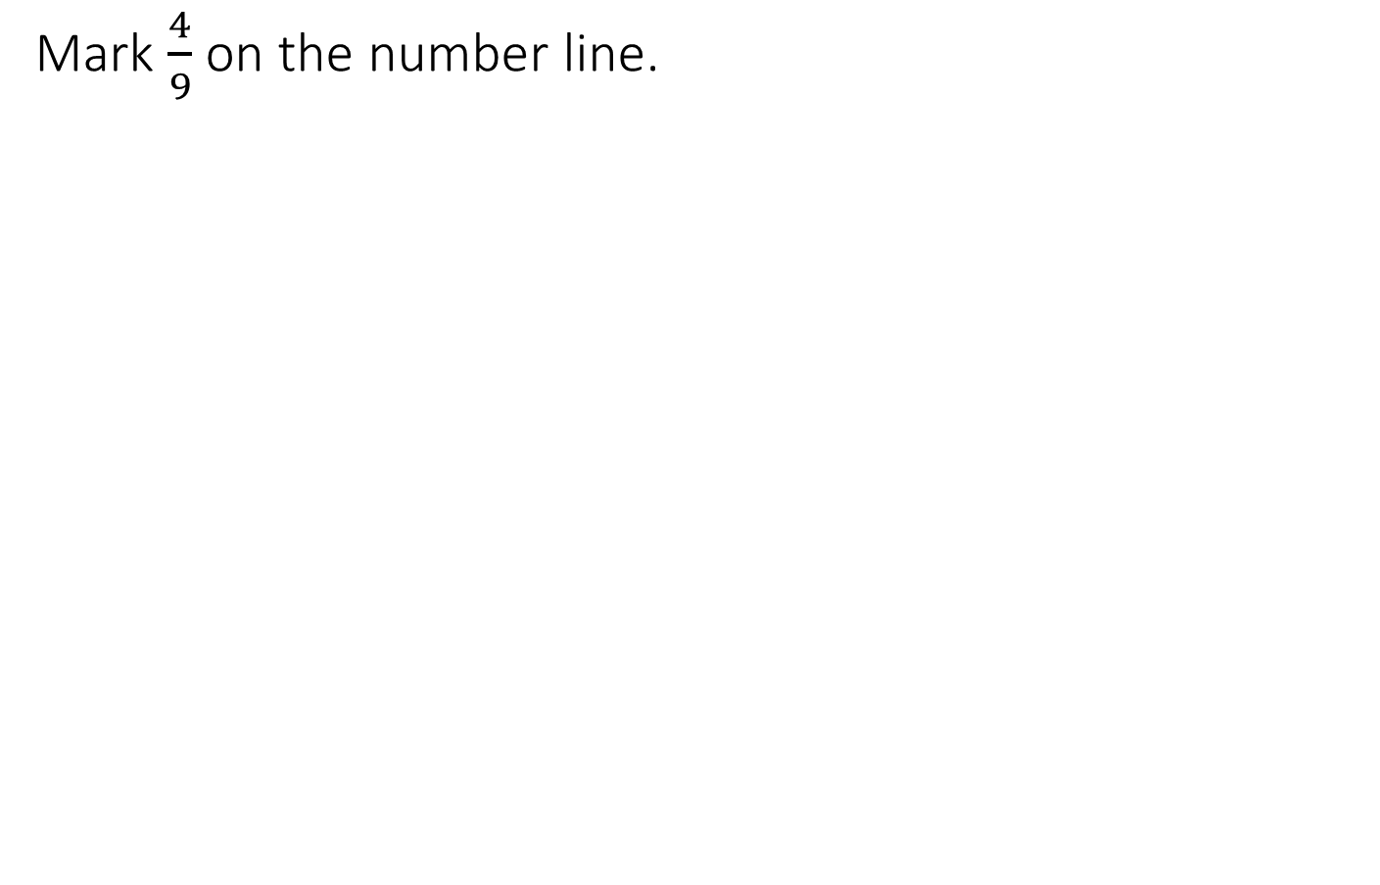
Fractions on a Number Line
Mark $\frac{4}{9}$ on the number line.
0
1

Slide 10
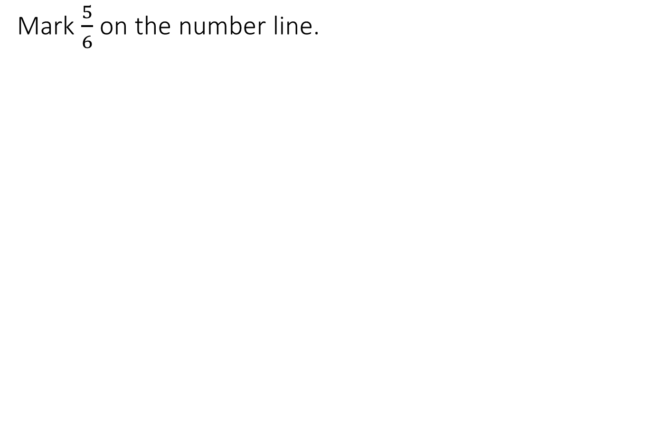
Fractions on a Number Line
Mark $\frac{5}{6}$ on the number line.
0
1

Slide 11
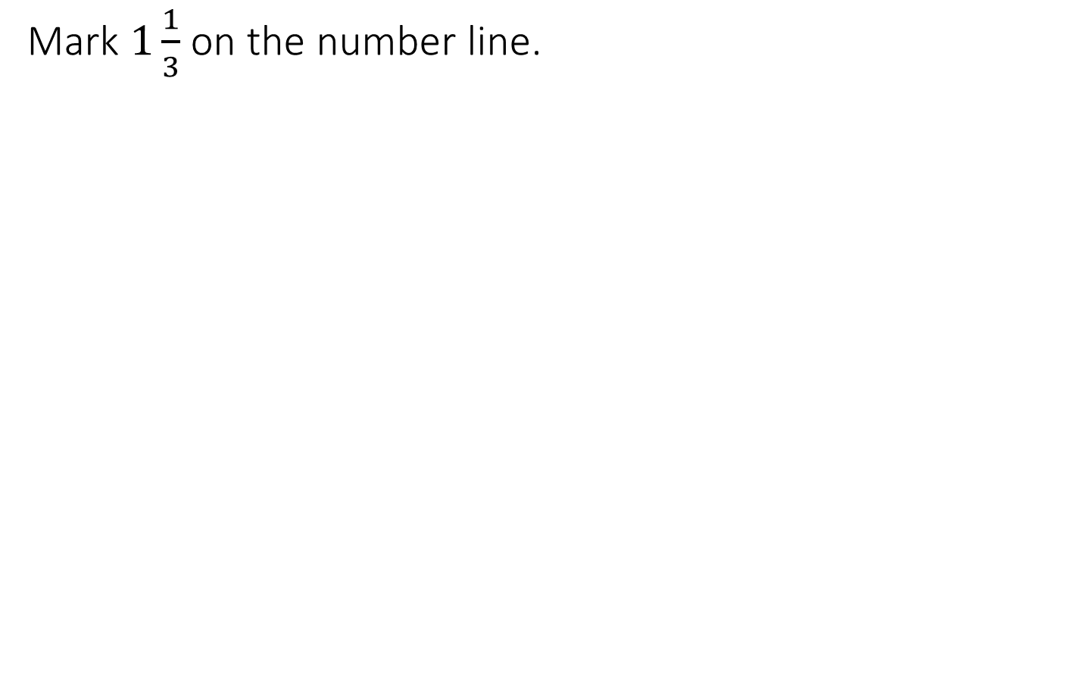
Fractions on a Number Line
Mark $1\frac{1}{3}$ on the number line.
0
2

Slide 12
Fractions on a Number Line
What fraction is the arrow indicating on the number line?
0
2

Slide 13
Fractions on a Number Line
What fraction is the arrow indicating on the number line?
0
2

Slide 14
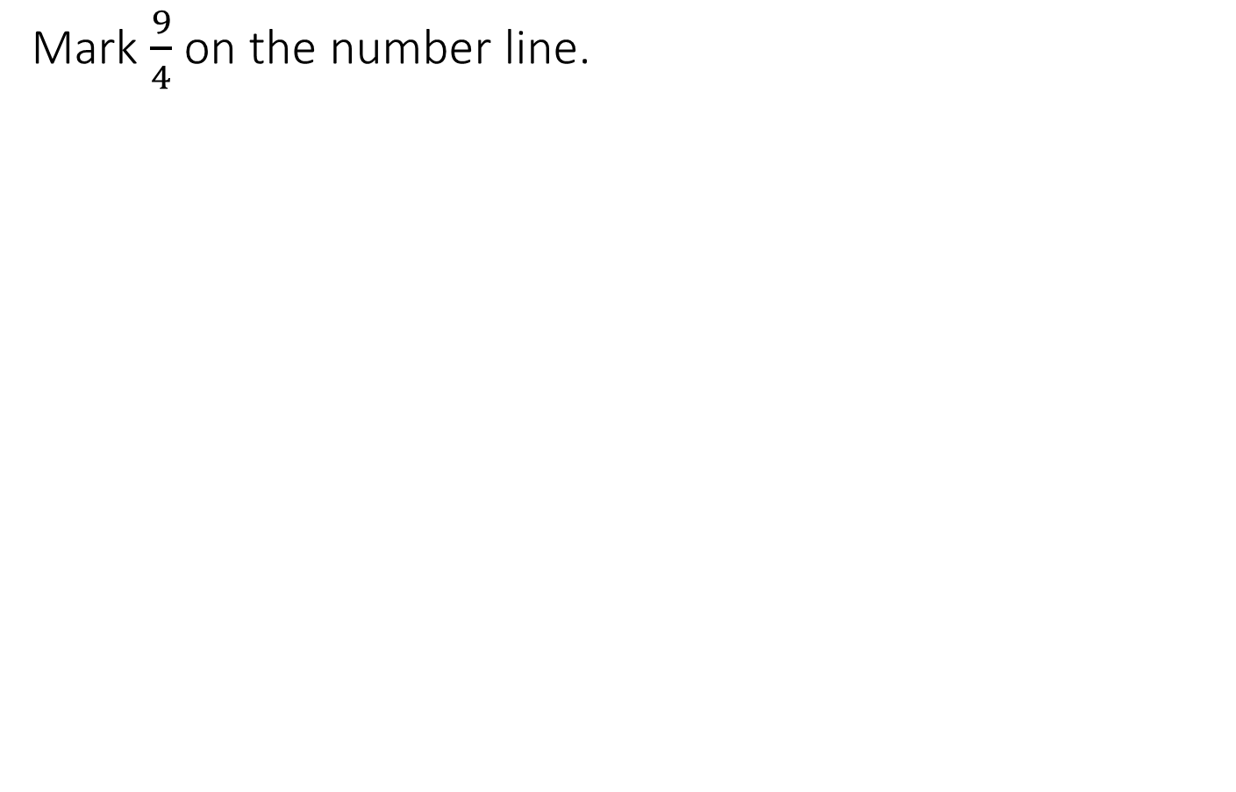
Fractions on a Number Line
Mark $\frac{9}{4}$ on the number line.
0
3

Slide 15
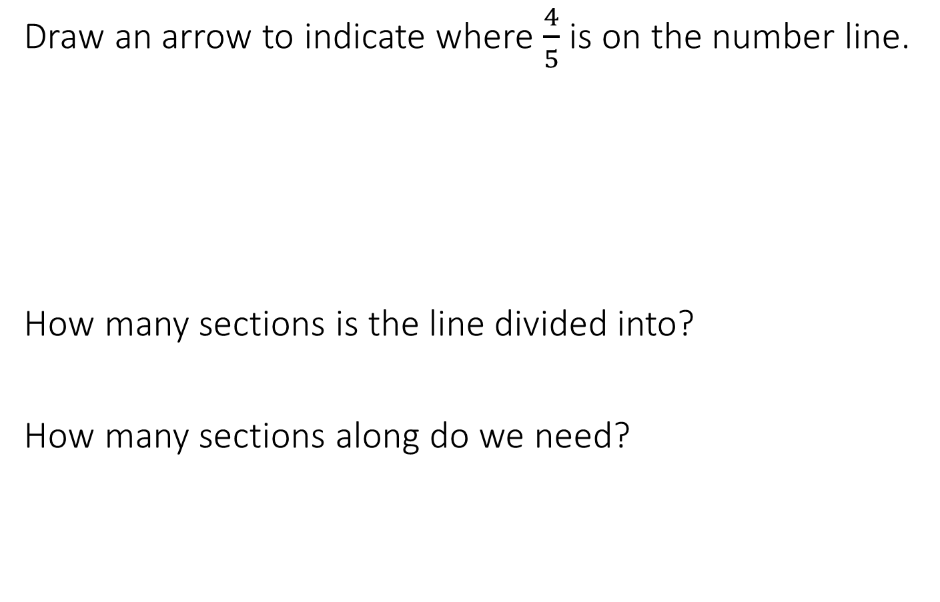
Example
Draw an arrow to indicate where $\frac{4}{5}$ is on the number line.
How many sections is the line divided into?
How many sections along do we need?
0
1

