Slide 1
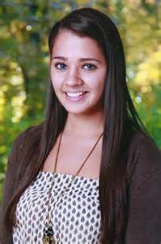
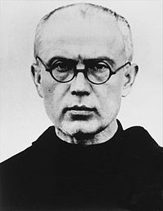
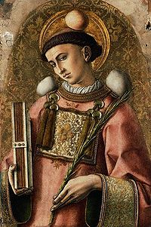
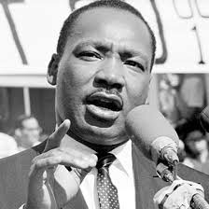
Martyrdom is:
Someone who dies for their beliefs (dictionary)
Someone who is ready to suffer violence or even die for Christ
Secular martyr – not connected with religion

Slide 2
Secular Martyrs
Martin Luther King was assassinated for his role in the American Civil Rights movement on April 4th, 1968

Slide 3
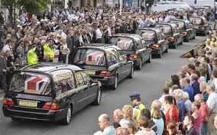
Secular Martyrs
Many people have died fighting wars for what they believe is right and/or to protect their country: WW2, Iraq, Afghanistan

Slide 4
Secular Martyrs
Vicky Soto died saving her pupils from a gunman at Sandy Hook Elementary School, Connecticut on December 14th, 2012

Slide 5
Christian Martyrs
St Stephen was the first Christian martyr and was stoned to death for teaching about Jesus

Slide 6
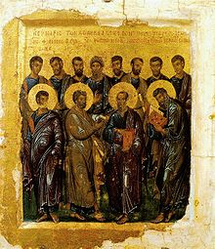
Christian Martyrs
Tradition tells us that John was the only Apostle not to be martyred

Slide 7
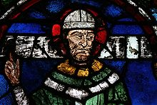
Christian Martyrs
St Thomas a Becket was murdered for his opposition to Henry VIII’s new Church of England on 29th December 1170

Slide 8
Christian Martyrs
St. Maximillian Kolbe volunteered to take the place of a family man in a Nazi death camp – died 14th August 1941
Could we also call him a secular martyr?

Slide 9
1 – What is a Martyr?
2 – What is the difference between a Christian and Secular Martyr?
3 – Which of the Martyrs that we talked about today do you think was the bravest? Why?
4 – Which one do you think made the biggest difference to the world? Why?
5 – What do you think happens to Martyrs after they die?
6 – Would you like to become a Martyr? Why?
7 – Why do you think there has been less Christian Martyrs recently than there used to be?

