Slide 1


French
Family and Friends
Year One
French | Year 3 | Family and Friends | Alphabet | Lesson 3

Slide 2
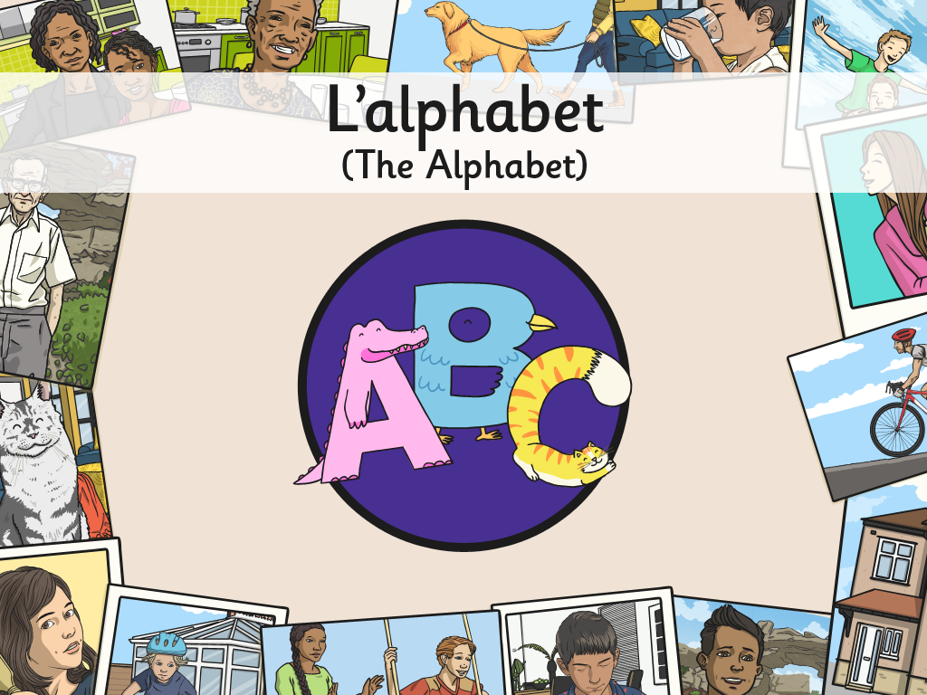


Slide 3
Aim
To recognise and repeat sounds and words with increasing accuracy.
To use songs or rhymes to help me remember new language.
Success Criteria
I can listen carefully to modelled pronunciation.
I can copy what I hear.
I can use a familiar tune to recall new sounds.
I can join in with a song to practise new language

Slide 4

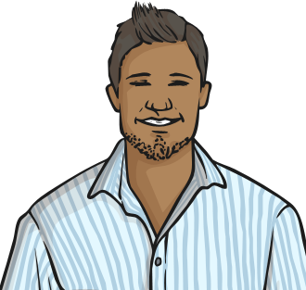


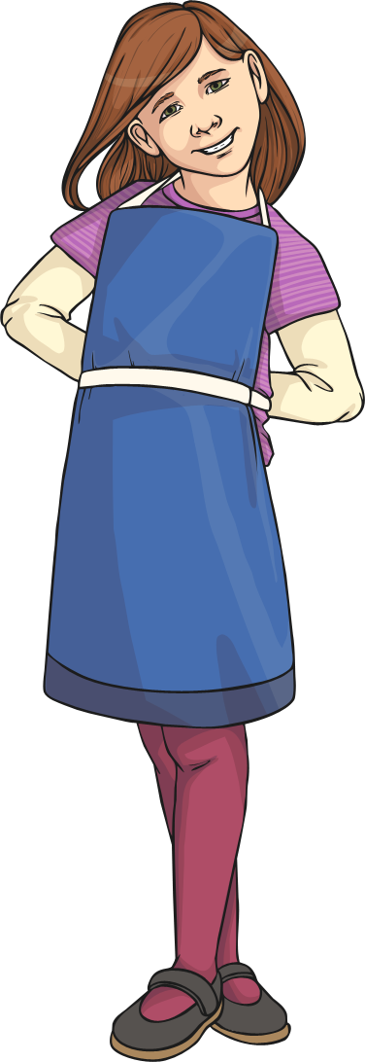

Je m’appelle…

Slide 5

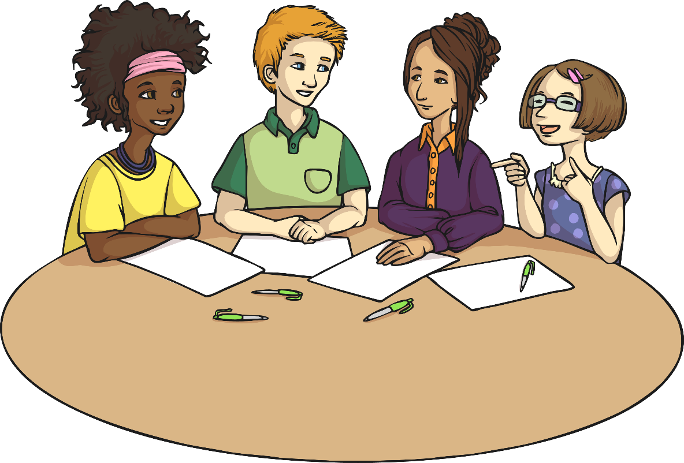
Our Names
Etienne
Brigitte
Nicole
Aimée

Slide 6
Je m’appelle…

Slide 7


























Les lettres

Slide 8


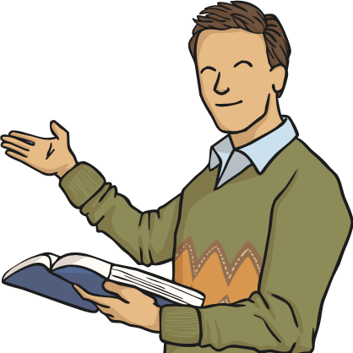






Les lettres
Did any letters sound familiar to you?
Which ones?

Slide 9

Set One

Slide 10

Set One

Slide 11

Set One

Slide 12

Set One

Slide 13

Set One

Slide 14

Set One

Slide 15

Set One

Slide 16

Set One

Slide 17
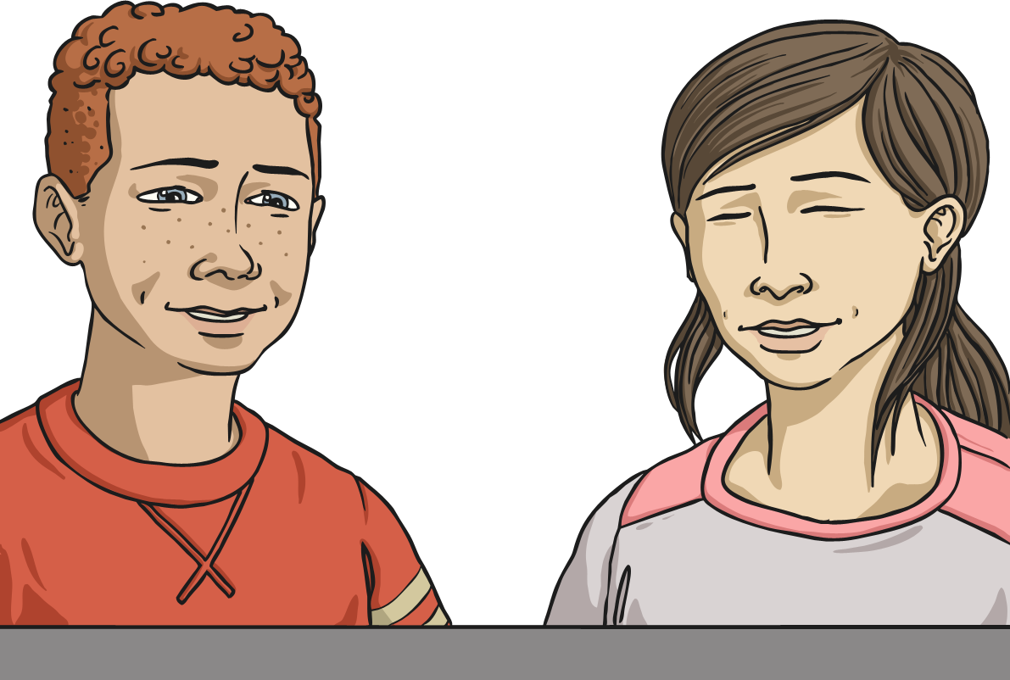
Set One
What sound did you hear in each of those letters?
ey

Slide 18







Allons-y!

Slide 19
Allons-y!
Let’s practise ey letters:

Slide 20

Set Two

Slide 21

Set Two

Slide 22

Set Two

Slide 23

Set Two

Slide 24

Set Two

Slide 25

Set Two

Slide 26

Set Two

Slide 27
Set One
What sound did you hear in each of those letters?
eh

Slide 28







Allons-y!
Let’s practice ey letters:

Slide 29
Allons-y!
Let’s practice ey letters:
Let’s practise eh letters:

Slide 30

Set Three

Slide 31

Set Three

Slide 32

Set Three

Slide 33
Set One
What sound did you hear in each of those letters?
ah

Slide 34



Allons-y!

Slide 35
Allons-y!
Let’s practise ah letters:

Slide 36

Set Four

Slide 37

Set Four

Slide 38

Set Four

Slide 39

Set Four

Slide 40
Set One
What sound did you hear in each of those letters?
ee

Slide 41




Allons-y!

Slide 42
Allons-y!
Let’s practise ee letters:

Slide 43

Set Five

Slide 44

Set Five

Slide 45
Set One
OO Sound file missing
What sound did you hear in each of those letters?
oo

Slide 46


Allons-y!

Slide 47
Allons-y!
Let’s practise oo letters:

Slide 48
Qu’est-ce qui manque ?
(What’s Missing?)
Put the letters you have in order, saying their names in French.
Which letters of the alphabet are left?
e
o

Slide 49
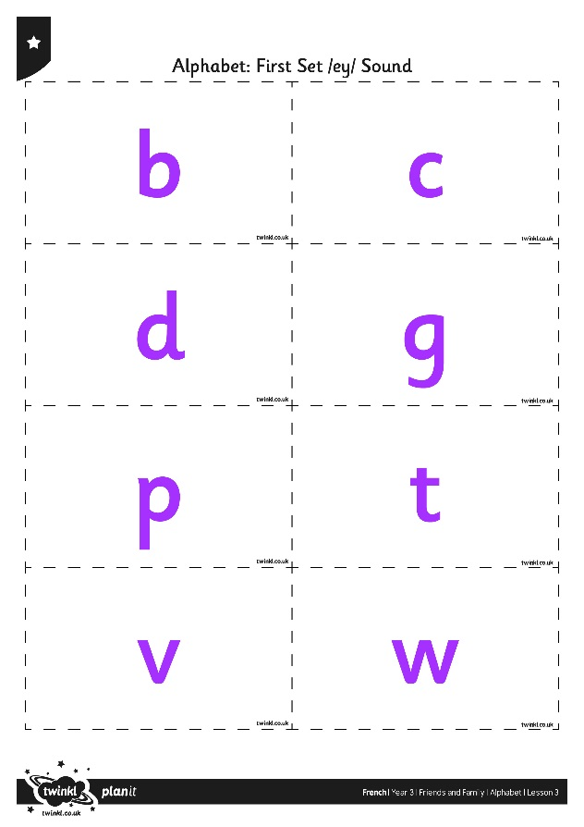
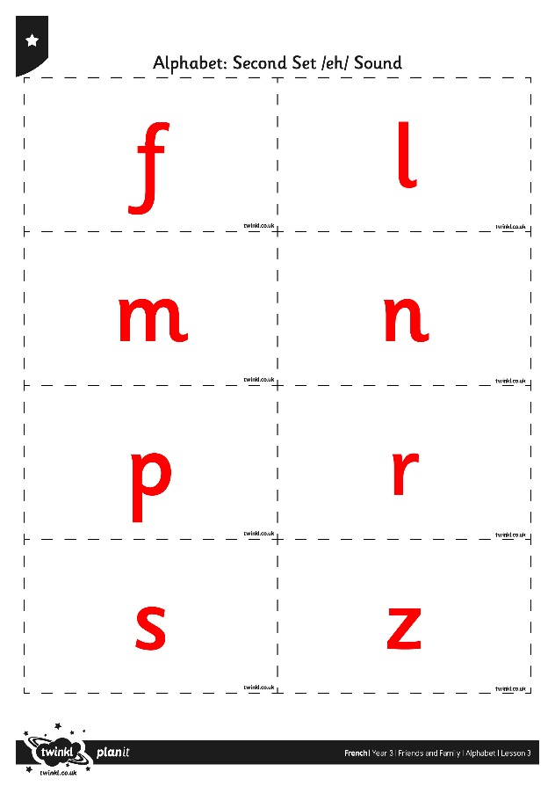
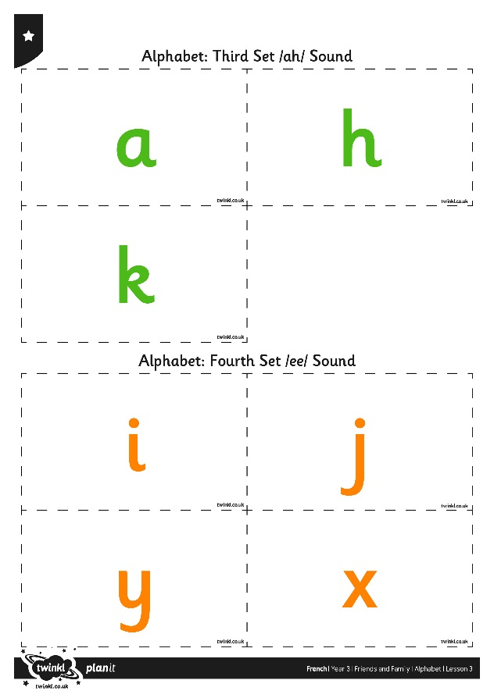
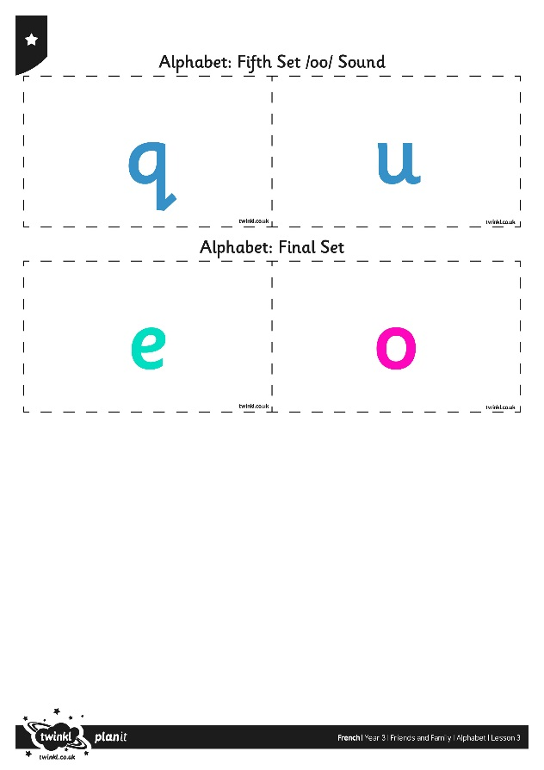
Allons jouer !
(Let’s Play a Game!)

Slide 50
Aim
To recognise and repeat sounds and words with increasing accuracy.
To use songs or rhymes to help me remember new language.
Success Criteria
I can listen carefully to modelled pronunciation.
I can copy what I hear.
I can use a familiar tune to recall new sounds.
I can join in with a song to practise new language

