Slide 1
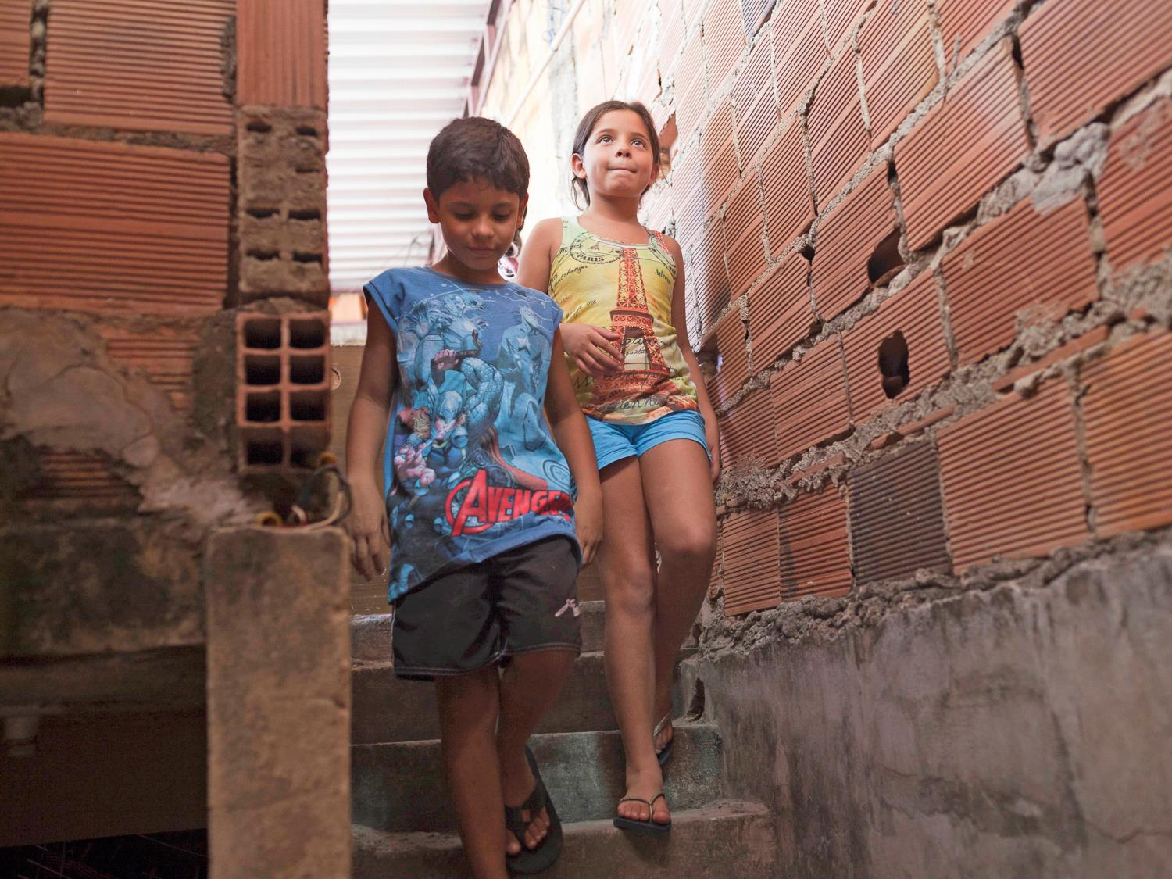


Photo investigation
www.actionaid.org.uk/schools - May 2016
Notes:
Time to investigate
Have a look at these image and use the shapes on the activity sheet to imagine what might be outside the photo. Using the second un-cropped photos and information cards, write about what you’ve found out.
Photo Credit: Lianne Milton/Panos/ActionAid

Slide 2
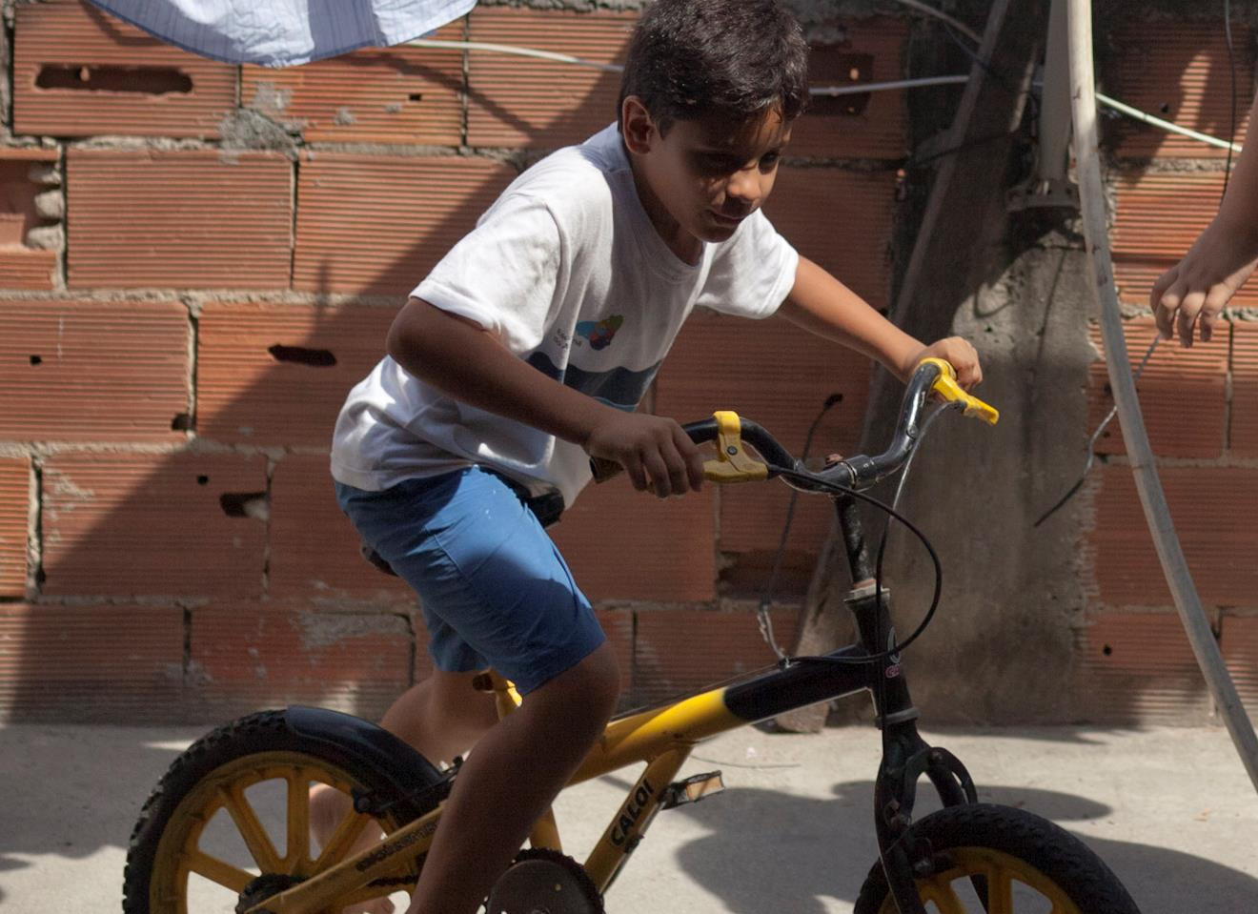

Notes:
Samir rides his bike
Photo Credit: Lianne Milton/Panos/ActionAid

Slide 3
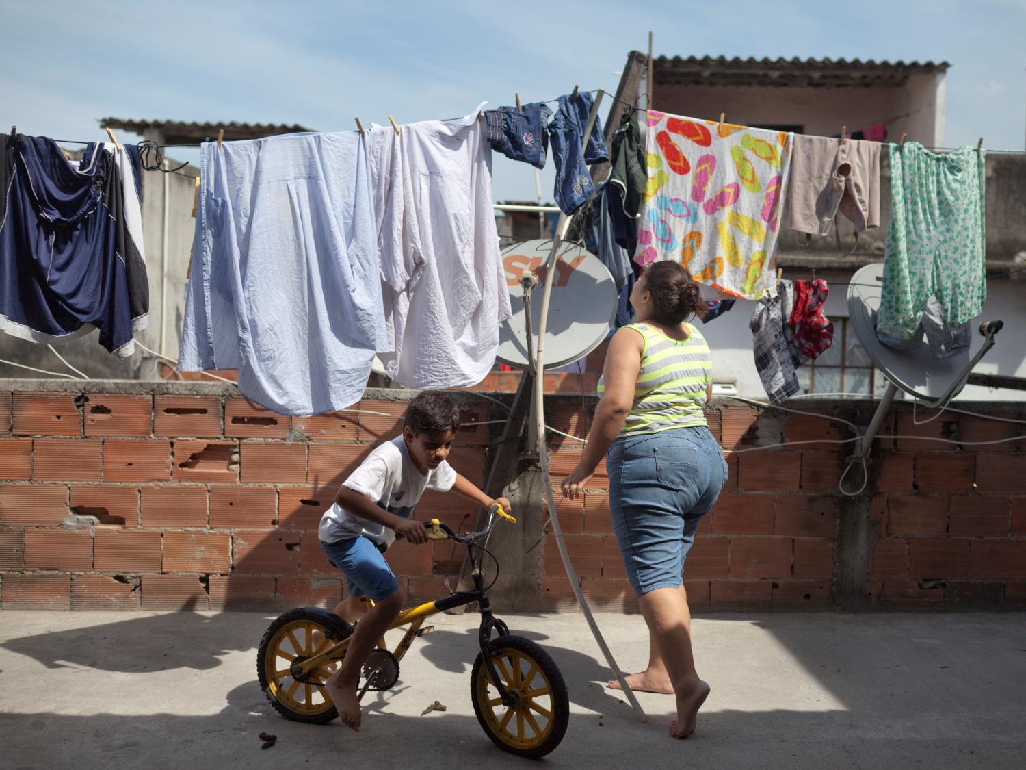
Notes:
Samir rides his bike on the roof
Maré favela is bigger than 74 football pitches, but Samir, eight, has no choice but to ride his bike in circles on his roof, which measures just 3.5 metres by 2.5 metres. This is where he keeps his dog, plays with his siblings and where his mum hangs out their washing.
Samir “I have to cycle my bike in circles on the roof. Mum won’t let us ride our bikes in the street because its not safe for us. My sister Samira got hit by a motorbike once.”
Photo Credit: Lianne Milton/Panos/ActionAid

Slide 4
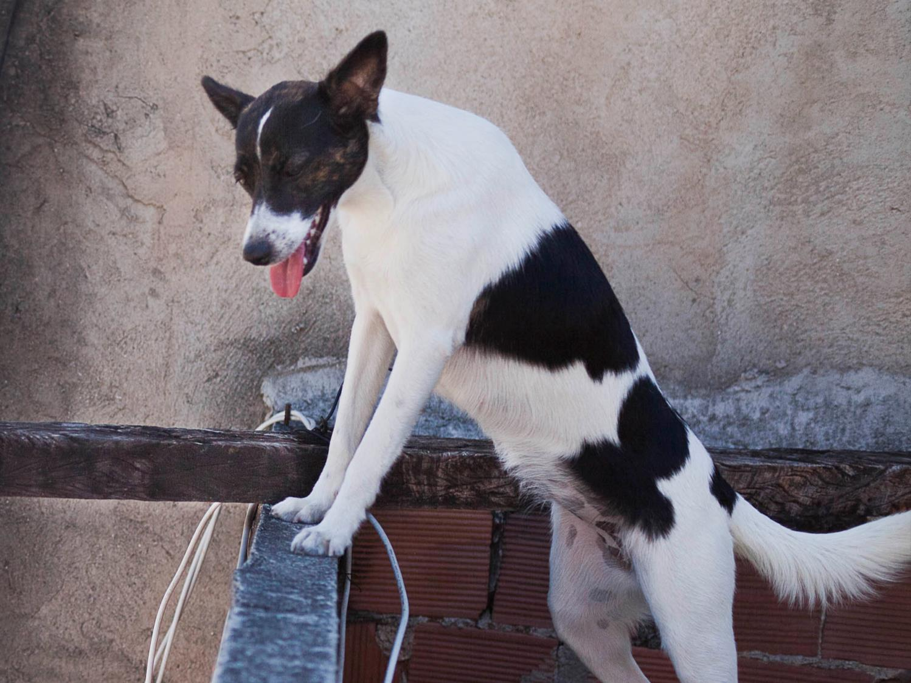
Notes:
Princess
Photo Credit: Lianne Milton/Panos/ActionAid

Slide 5
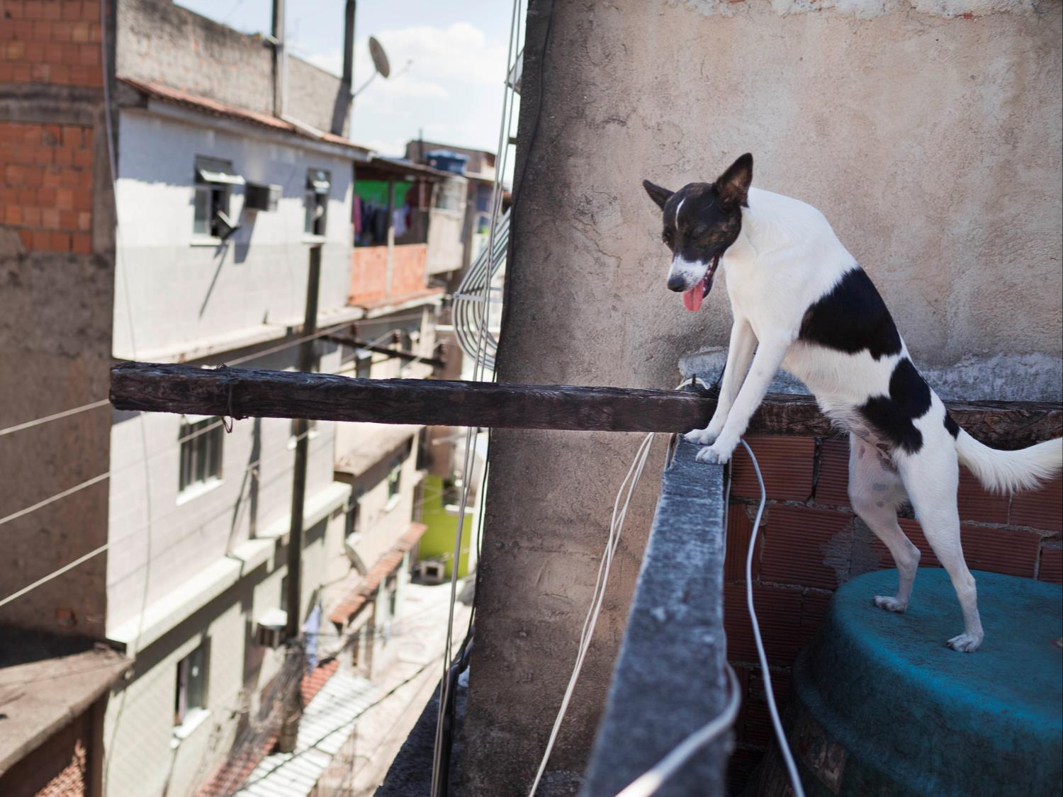
Notes:
Princess on the roof
Samir’ and Samira’s dog, Princess, looks down from her home on the roof to the slum below.
Samir “My favourite thing to do in my spare time is play with Princess, my dog. We play catch and fetch with her ball. She’s really good at retrieving it. We run together and the other day she tore my shorts! But it’s ok because I love her.”
Photo Credit: Lianne Milton/Panos/ActionAid

Slide 6
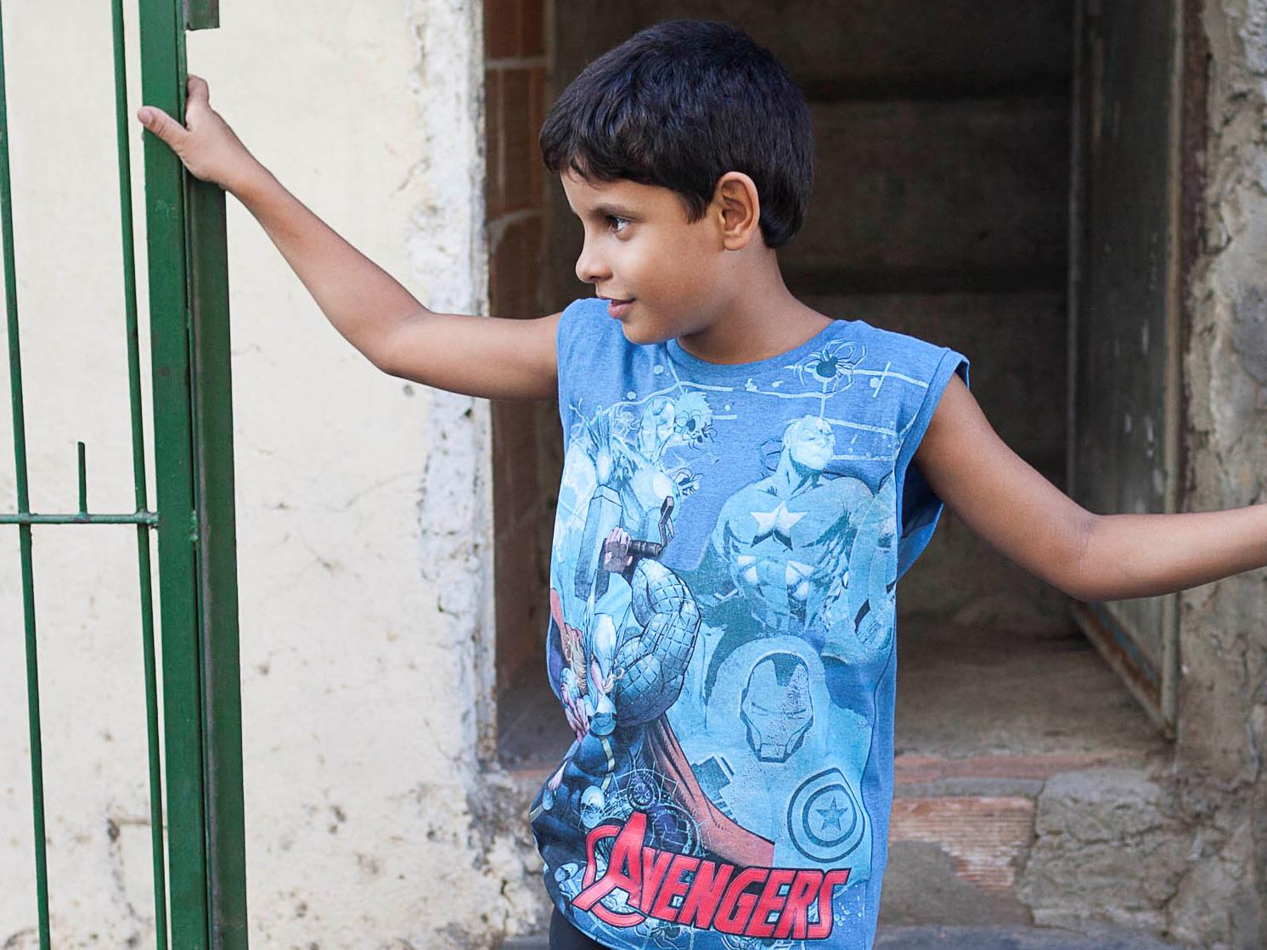
Notes:
Doorway
Photo Credit: Lianne Milton/Panos/ActionAid

Slide 7
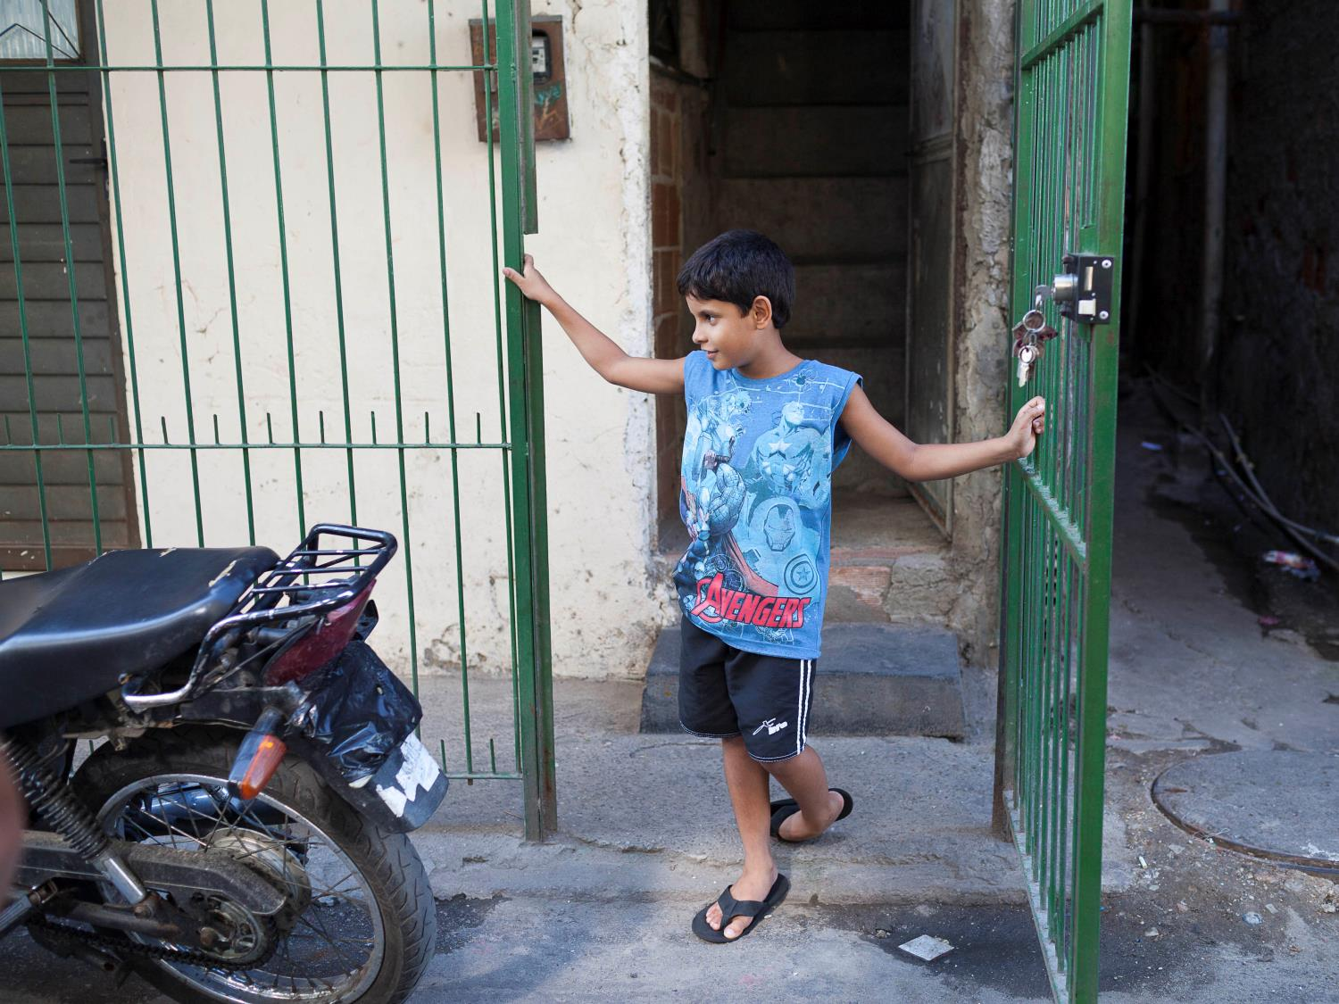
Notes:
Iron gates
Samir locks the iron gate at the entrance of his home when he gets home from school. Every home on Samir’s street is locked behind fortified iron gates.
Samir “Mum is very strict about us going outside, but we understand why. It’s serious. A lot of men here carry weapons and drive really fast.”
Photo Credit: Lianne Milton/Panos/ActionAid

Slide 8
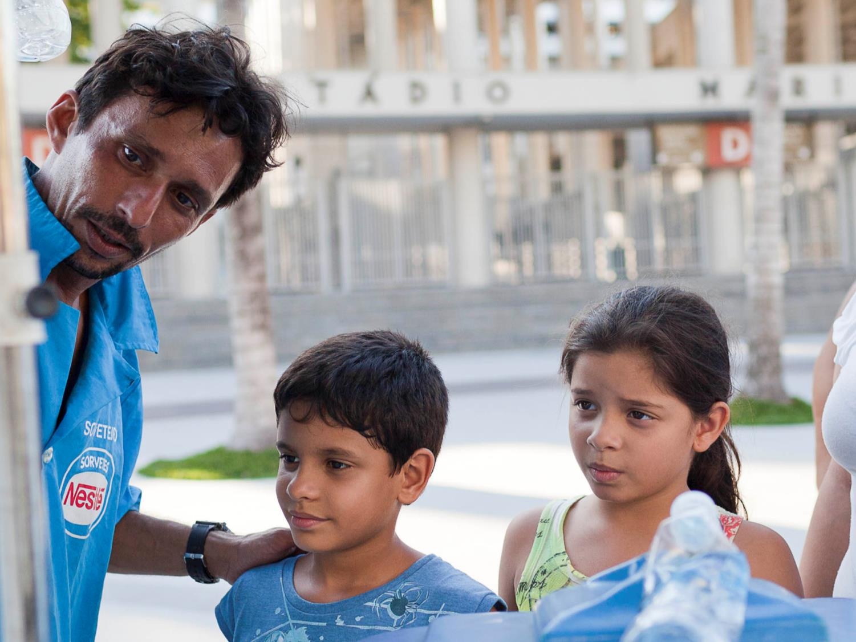
Notes:
Choices choices
Some of Rio’s richer residents live in high-rise apartments like these. They are usually located by the sea and have stunning views from the windows and balconies.
The city of Rio has grown over the years as more people move to the cities for work. It has a population of 12 million.
Photo Credit: Lianne Milton/Panos/ActionAid

Slide 9
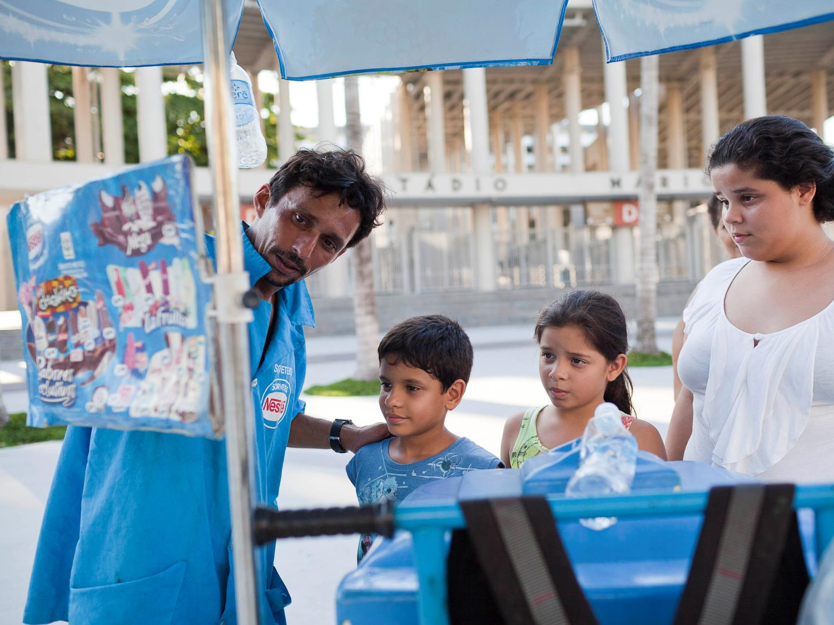
Notes:
Choosing an ice-cream
Samir and Samira buying ice-cream with their older sister, Sarah, outside a football stadium in Rio de Janeiro. Brazil was the host of the 2014 football World Cup and some of the games were played in Rio.
Photo Credit: Lianne Milton/Panos/ActionAid

Slide 10
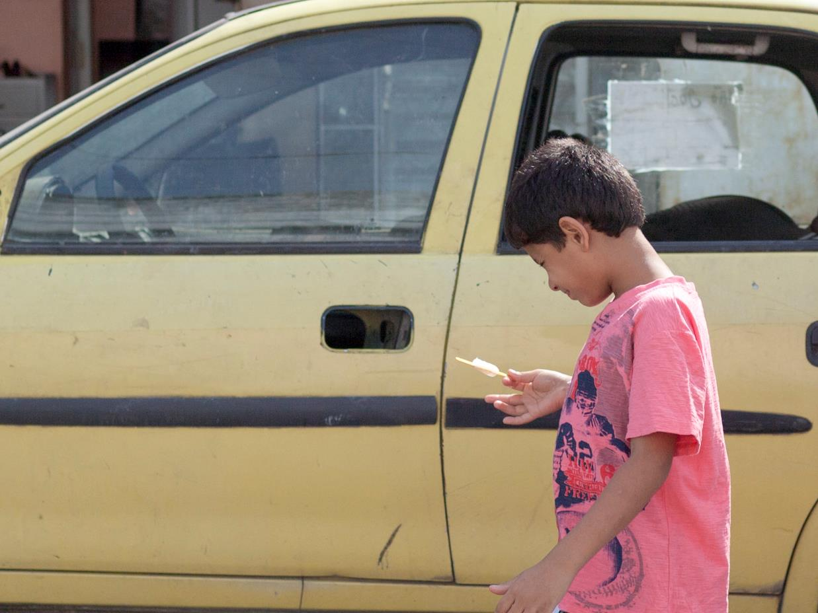
Notes:
Cars
Photo Credit: Lianne Milton/Panos/ActionAid

Slide 11
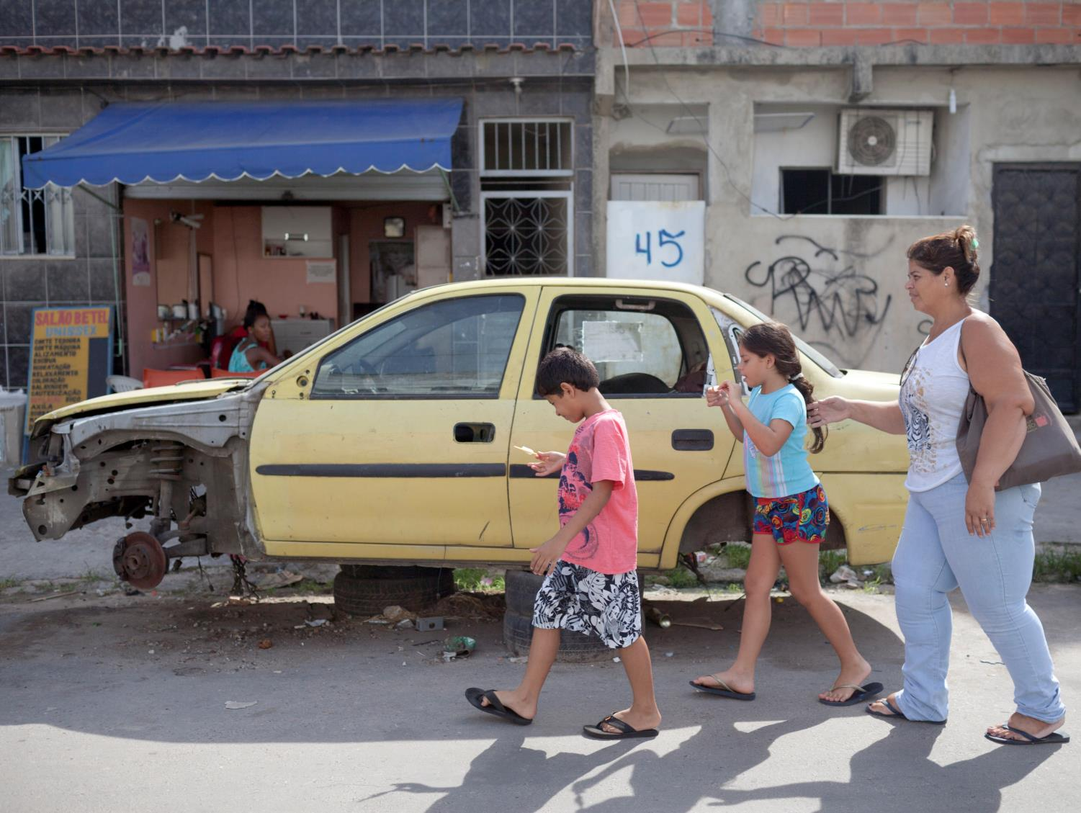
Notes:
Car-wreck
Samir and Samira walk past one of the many car wrecks inside the favela with their Mum. The car has no wheels and is balanced on two piles of tires. In the background is a hairdressers and a house number marked with spray paint.
Photo Credit: Lianne Milton/Panos/ActionAid

