Slide 1

Shoebox Habitats
https://www.youtube.com/watch?v=auSo1MyWf8g

Slide 2
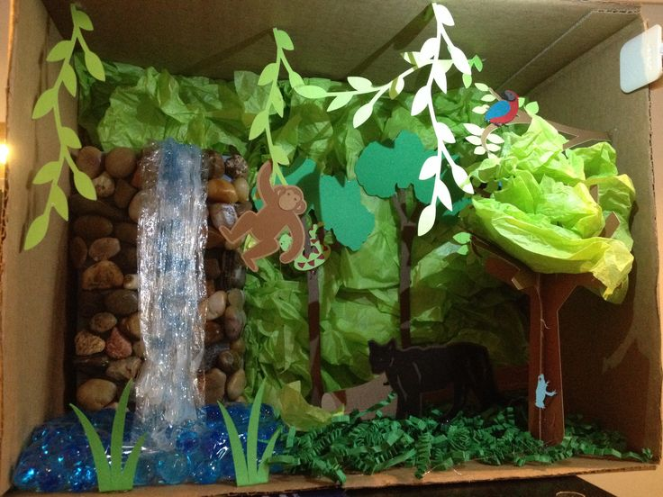

Slide 3
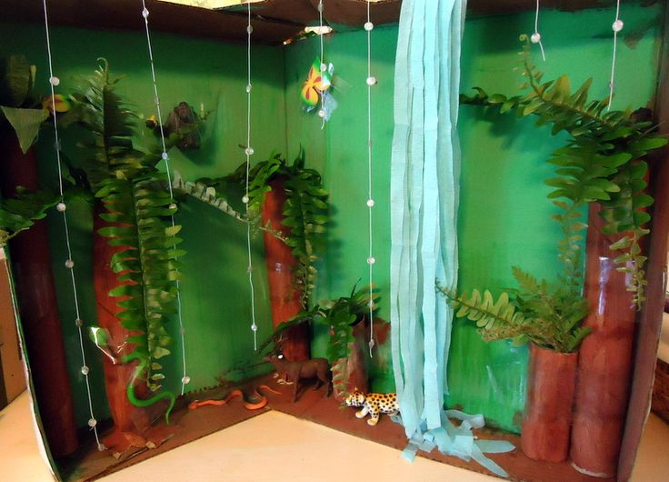

Slide 4
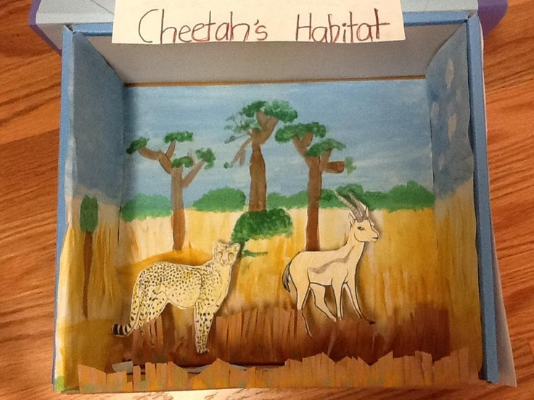

Slide 5
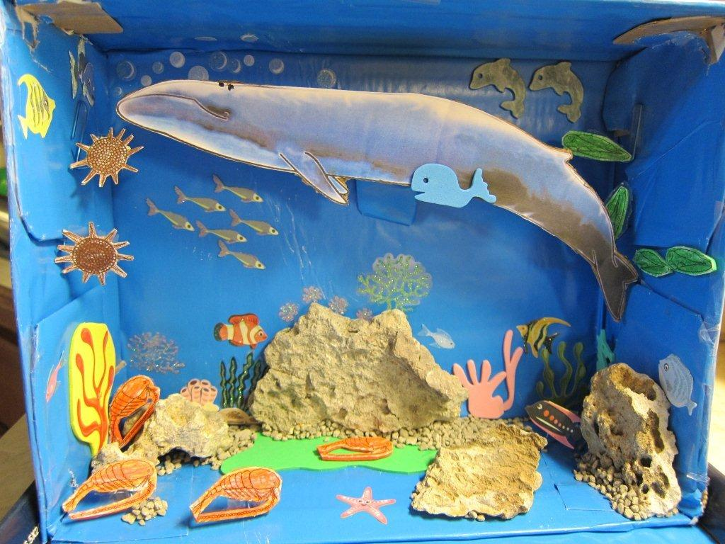

Slide 6
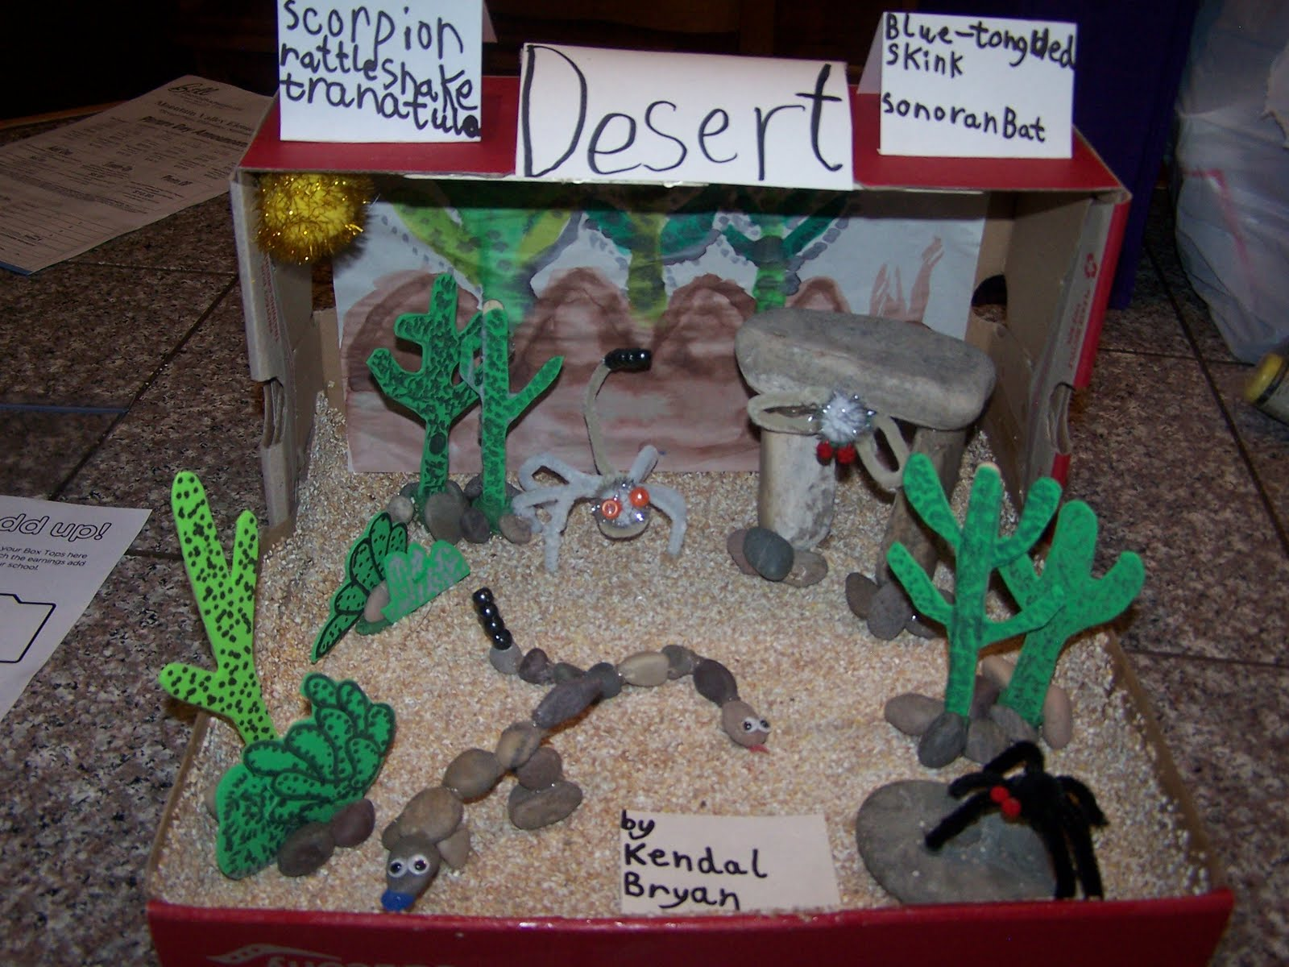

Slide 7
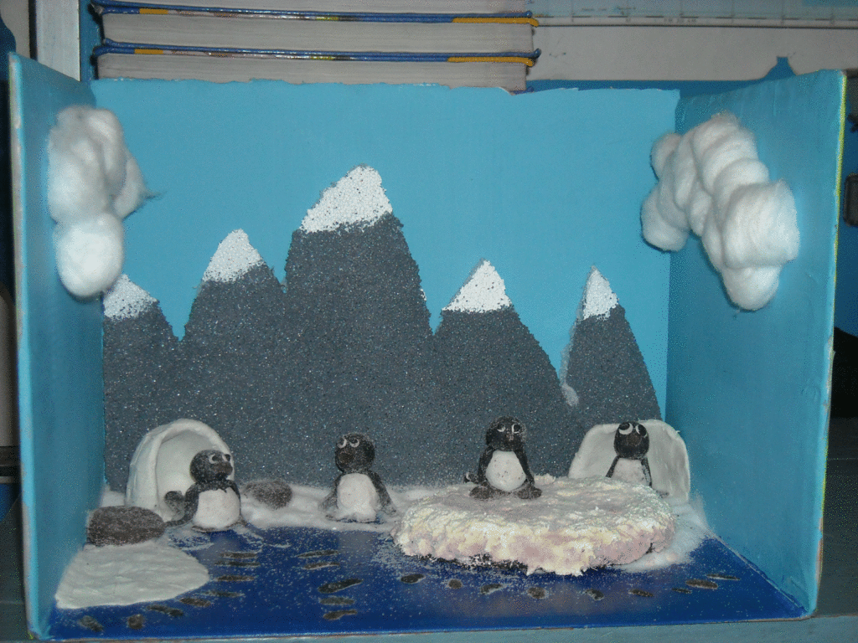

Slide 8

Now it’s your turn!

