Slide 1


French
Family and Friends
Year One
French | Year 3 | Family and Friends | What’s His Name? | Lesson 4

Slide 2
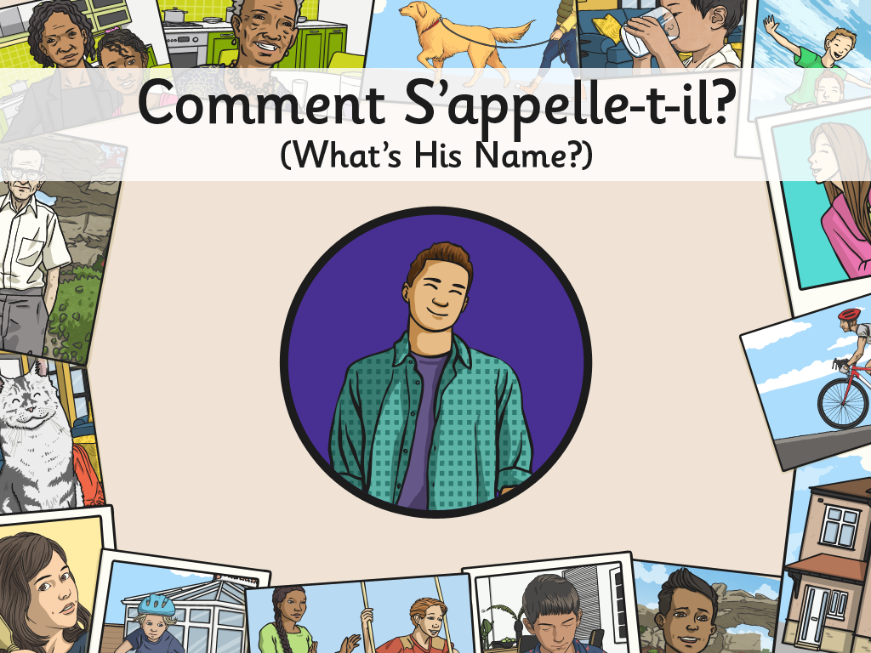


Slide 3
Aim
I can make links between known and new structures.
I can use a range of vocabulary to create different sentences.
Success Criteria
I can recognise how sentences can change to fit the subject.
I can use il and elle for ‘he’ and ‘she’.
I can use a vocabulary bank.
I can make new sentences by swapping key vocabulary.

Slide 4

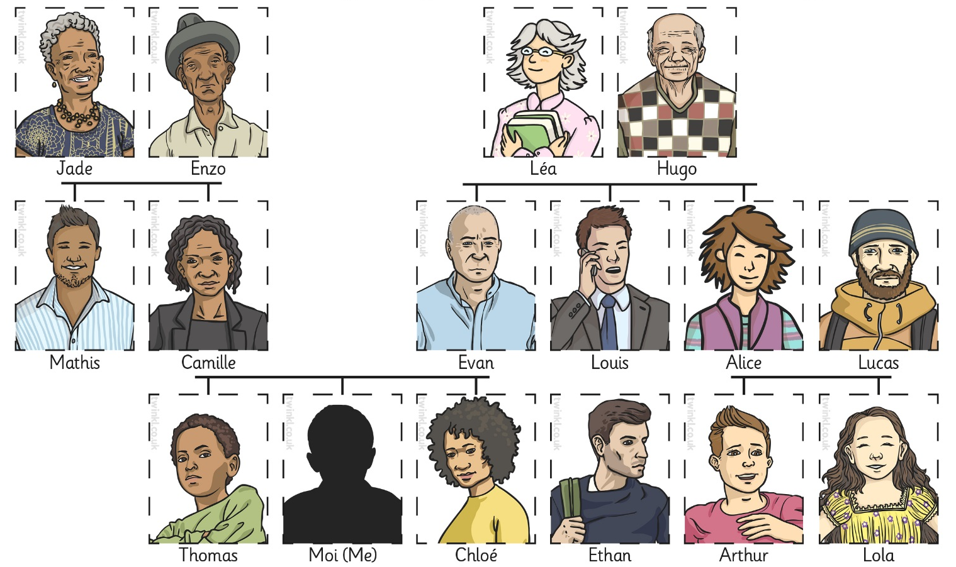
What Can You Remember?
Tell your partner as many of the family relationship words as you can remember from the last lesson.

Slide 5

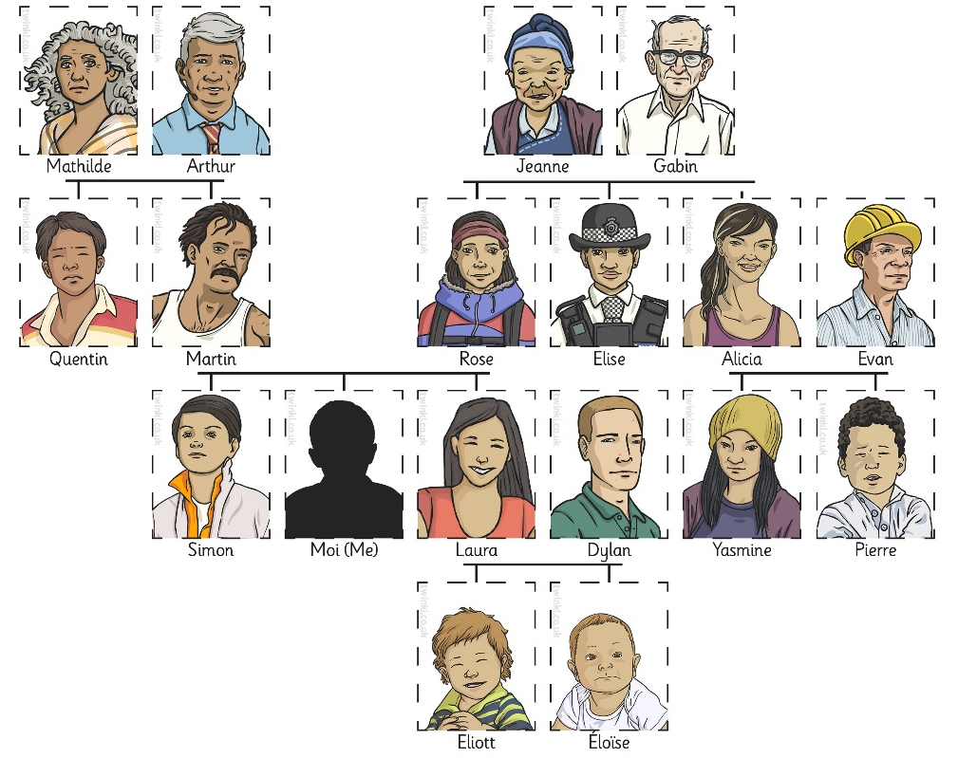
Qui Est-Ce?
(Who’s This?)
Voici . . .

Slide 6



What Else Do We Want to Know?
Click play buttons throughout to hear phrases and words.
?
?

Slide 7

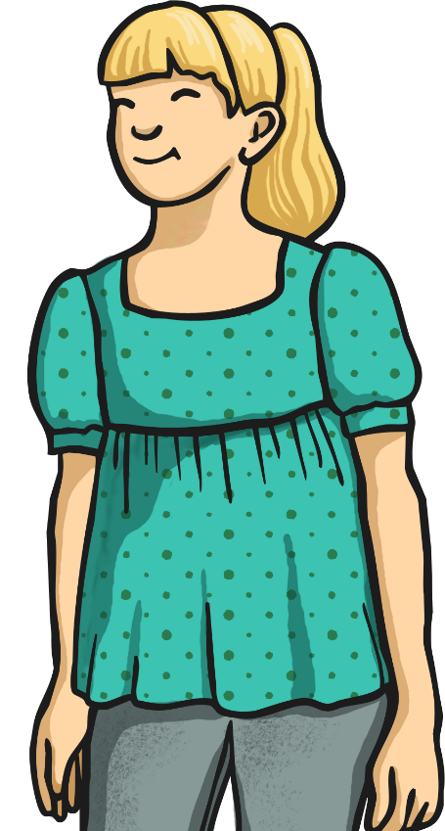
Comment Dit-On “What’s She Called?” en Français?
Comment
s’appelle-
t-elle?

Slide 8
Comment Dit-On “She’s Called…” en Français?
s’appelle…
Elle

Slide 9

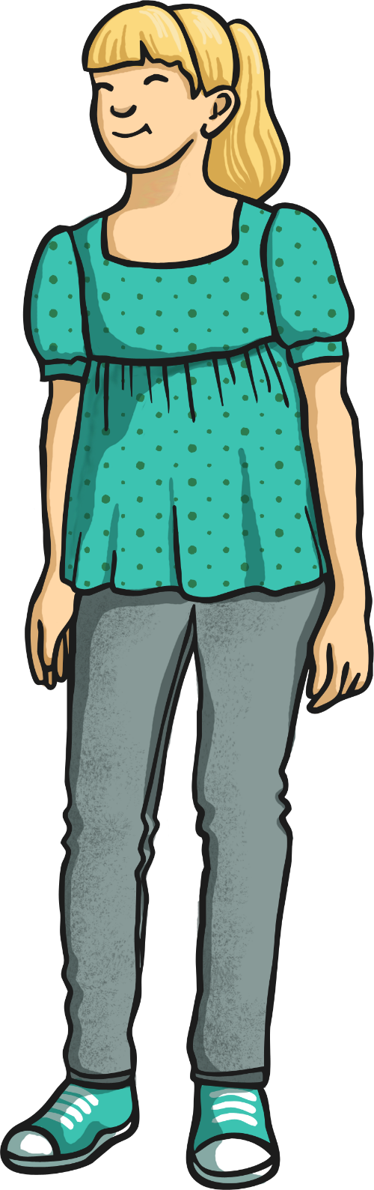
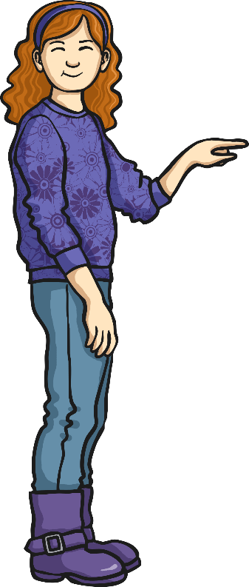

Allez-y!
Elle s’appelle ...
Comment s’appelle-t-elle?

Slide 10
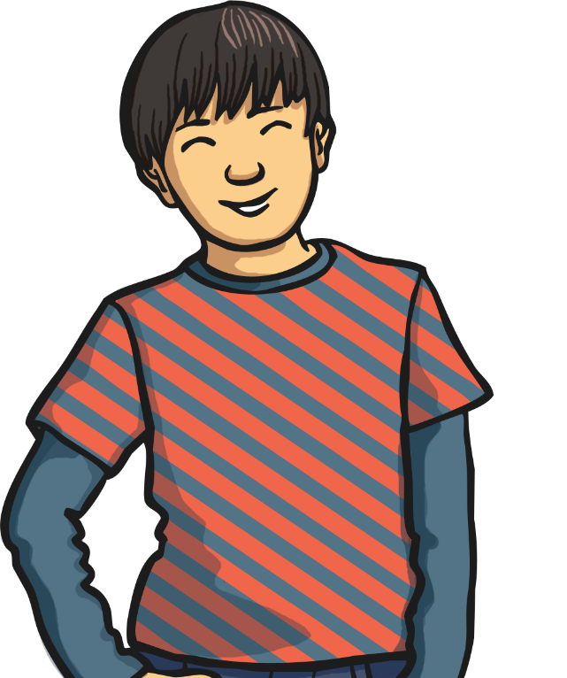
Comment Dit-On “What’s He Called?” en Français?
Comment
s’appelle-
t-il?

Slide 11
Comment Dit-On “He’s Called…” en Français?
s’appelle…
Il

Slide 12

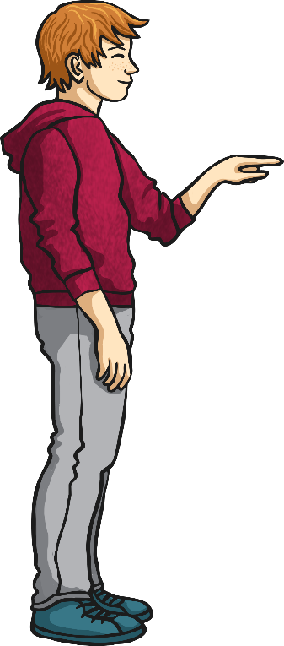
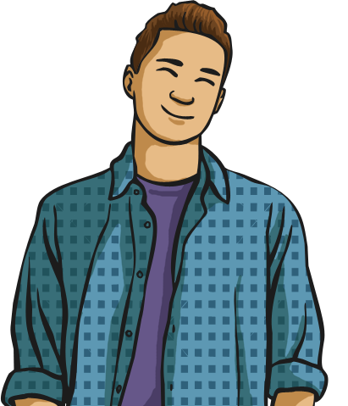
Allez-y!
Il s’appelle ...
Comment s’appelle-t-il?

Slide 13
La Grammaire
(Grammar Point)
Where have we seen/heard the word ...appelle... before?
Comment tu t’appelles?
Je m’appelle…
What’s similar about each of the four sentences? What’s different?
Comment s’appelle-t-elle?
Elle s’appelle…
Comment s’appelle-t-il?
Il s’appelle…

Slide 14

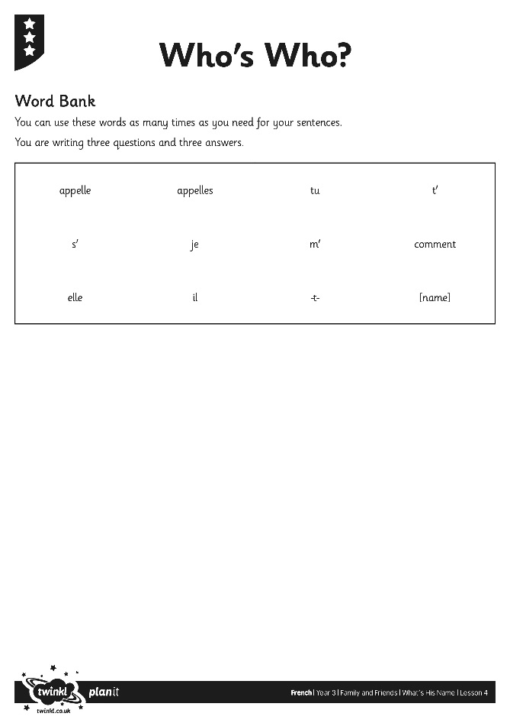
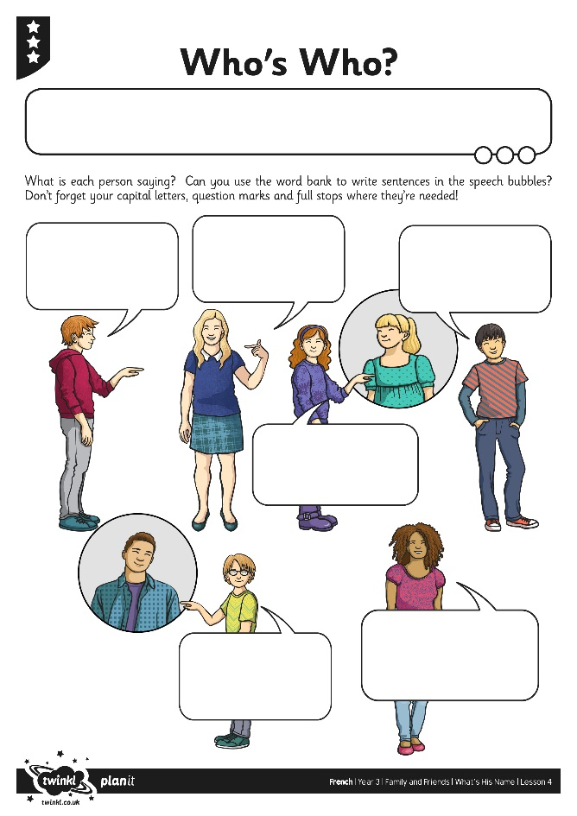
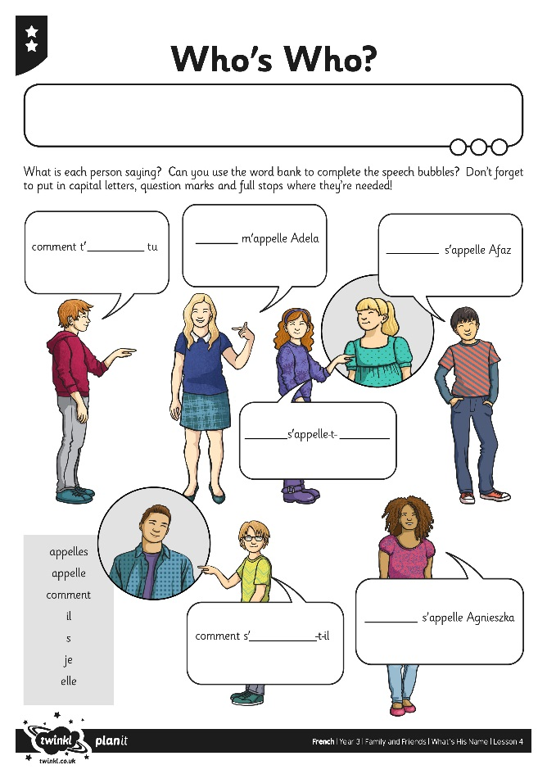
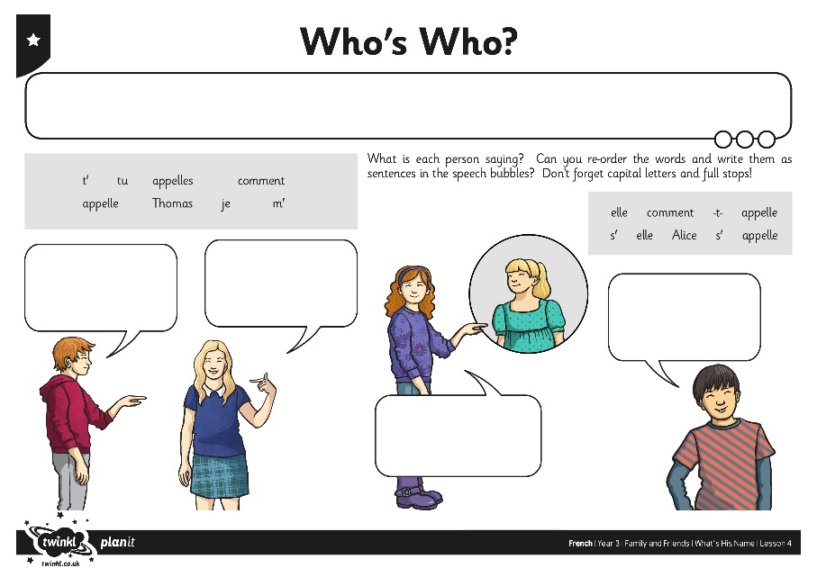
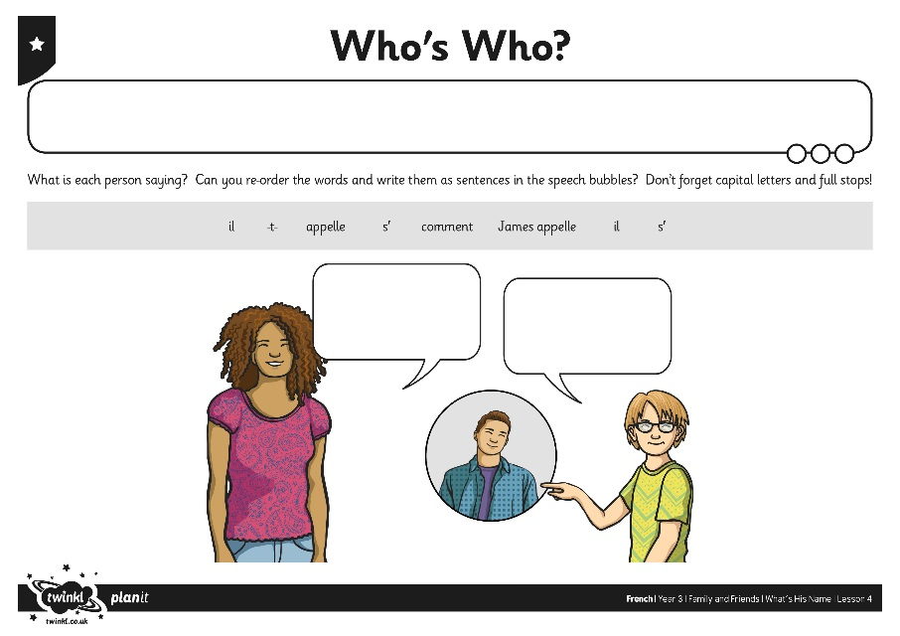
Who’s Who?

Slide 15

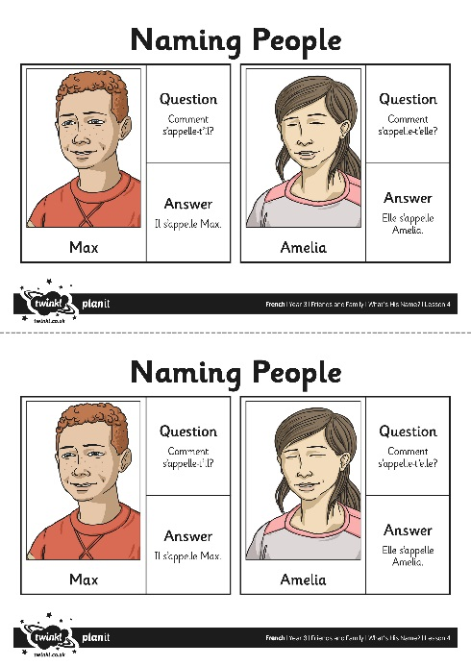
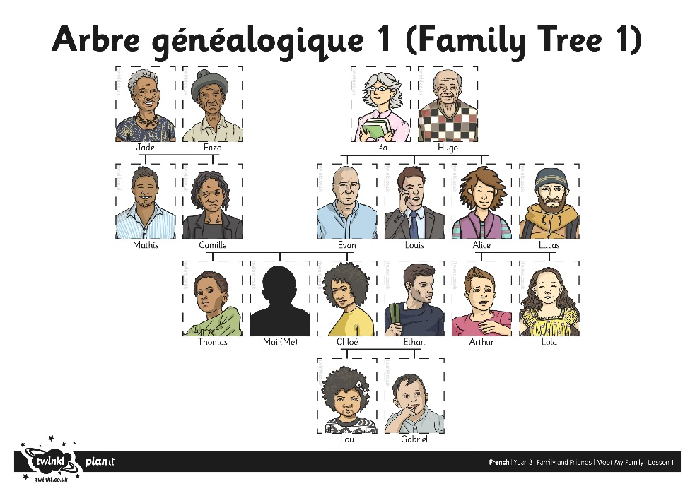
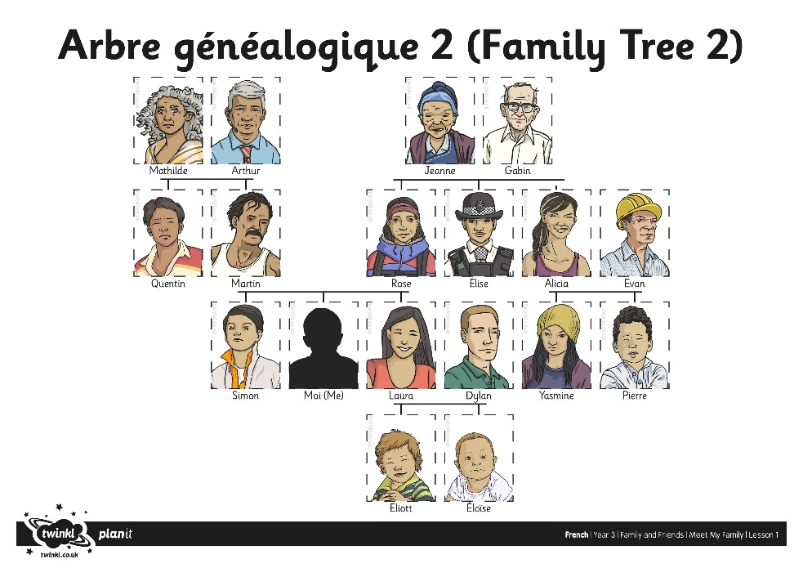
Qui Est-Ce?
(Who’s this?)
Comment s’appelle-t-il/elle?
Il/elle s’appelle…

Slide 16
Allons-Y!
(Let’s Go!)
Salut Alex! Ça va merci. Elle s’appelle ...
Bonjour Emma. Ça va? Comment s’appelle-t-elle?

Slide 17
Aim
I can make links between known and new structures.
I can use a range of vocabulary to create different sentences.
Success Criteria
I can recognise how sentences can change to fit the subject.
I can use il and elle for ‘he’ and ‘she’.
I can use a vocabulary bank.
I can make new sentences by swapping key vocabulary.

