Slide 1
Rainforests

Slide 2
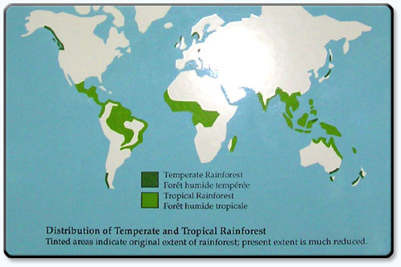
Rainforests of the World.
Rainforests cover less than 6% of the land’s surface.

Slide 3
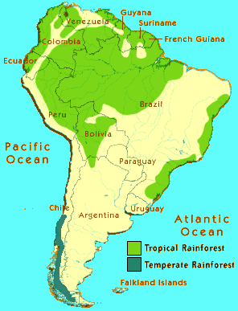
South America

Slide 4
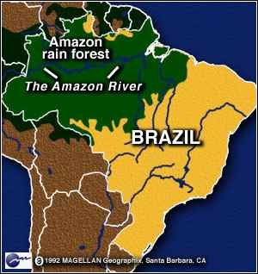
The Amazon Basin
A tropical Rainforest is one of the wettest parts of the world.
It is almost always raining.
The air feels sticky because of all the water.
The temperature is around 33’ C. It doesn’t change from day to night, or throughout the year.

Slide 5
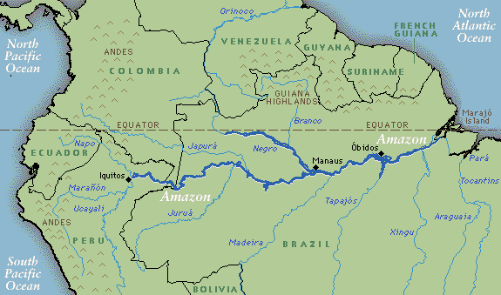
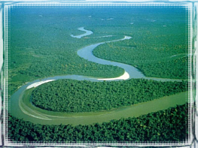
The Amazon River, is the largest river system in the world

Slide 6
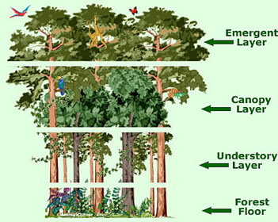
Layers / Strata of the Tropical Rainforest

Slide 7
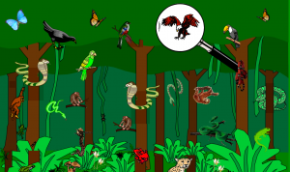

Slide 8
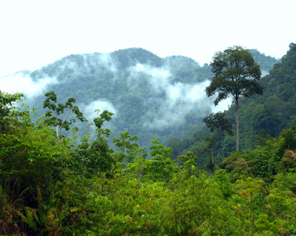
Rainforest Animals ->

Slide 9
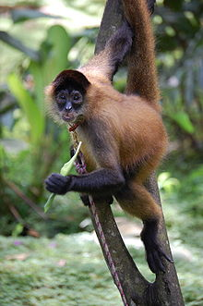
Spider Monkey

Slide 10
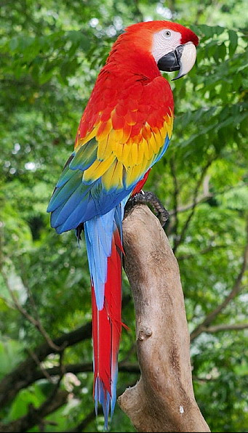
Macaw

Slide 11
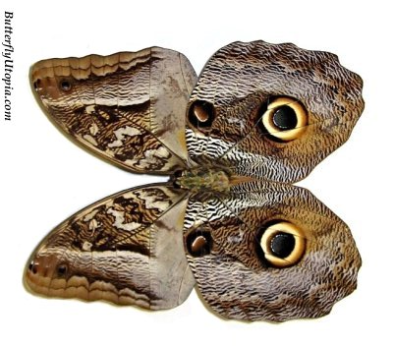
Owl Butterfly

Slide 12
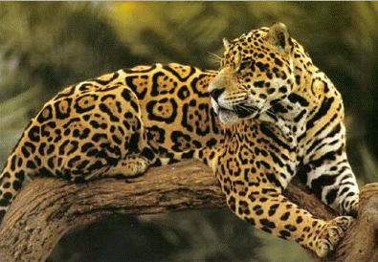
Jaguar

Slide 13
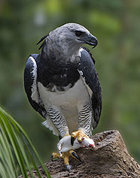
Harpy Eagle

Slide 14
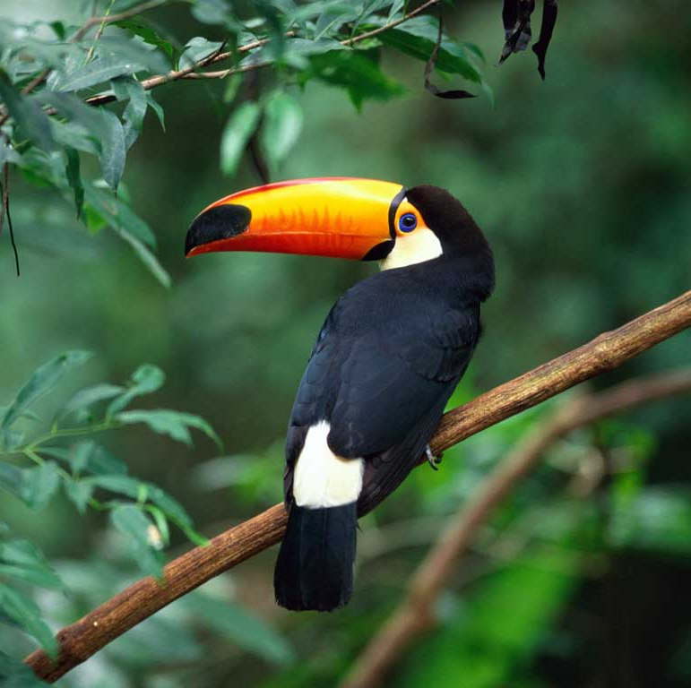
Toucan

Slide 15
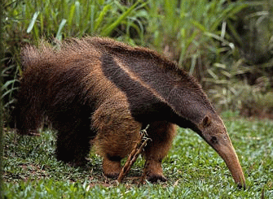
Giant Anteater

Slide 16
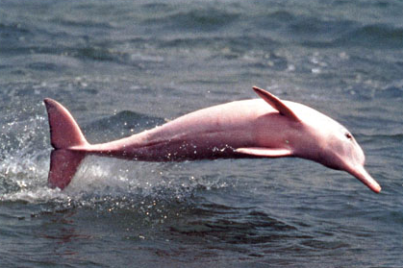
Amazon Pink River Dolphin

Slide 17
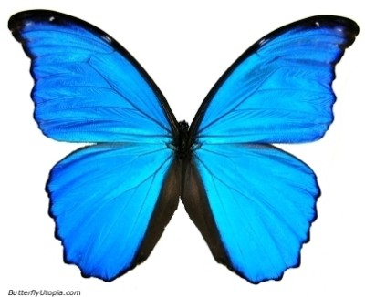
Blue Morpho Butterfly

Slide 18
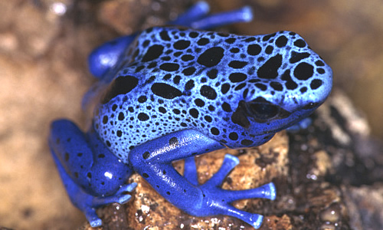
Poison Arrow Dart Frog

Slide 19
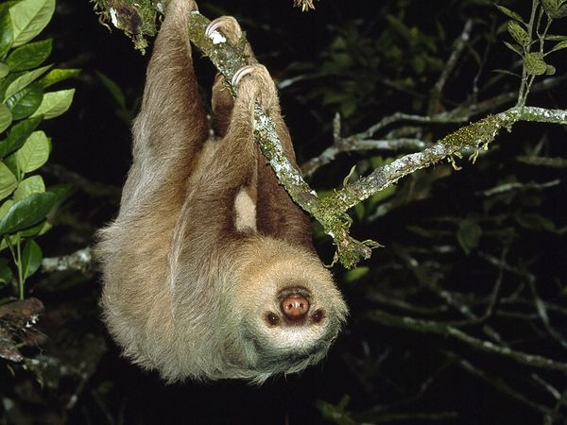
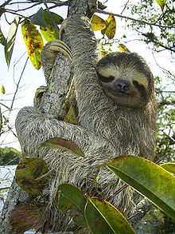
Sloth

Slide 20
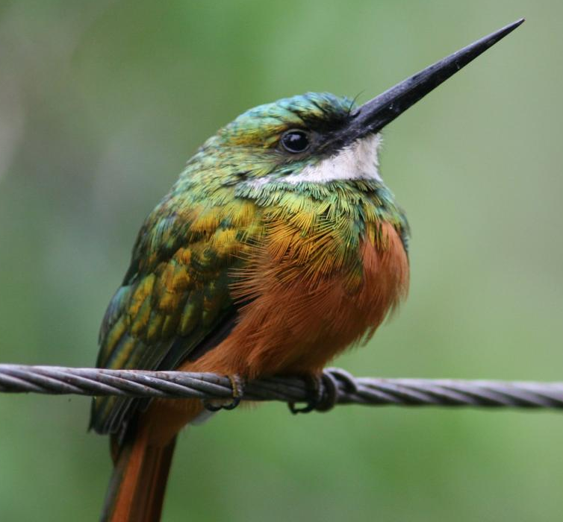
Rufous-tailed Jacamar

Slide 21
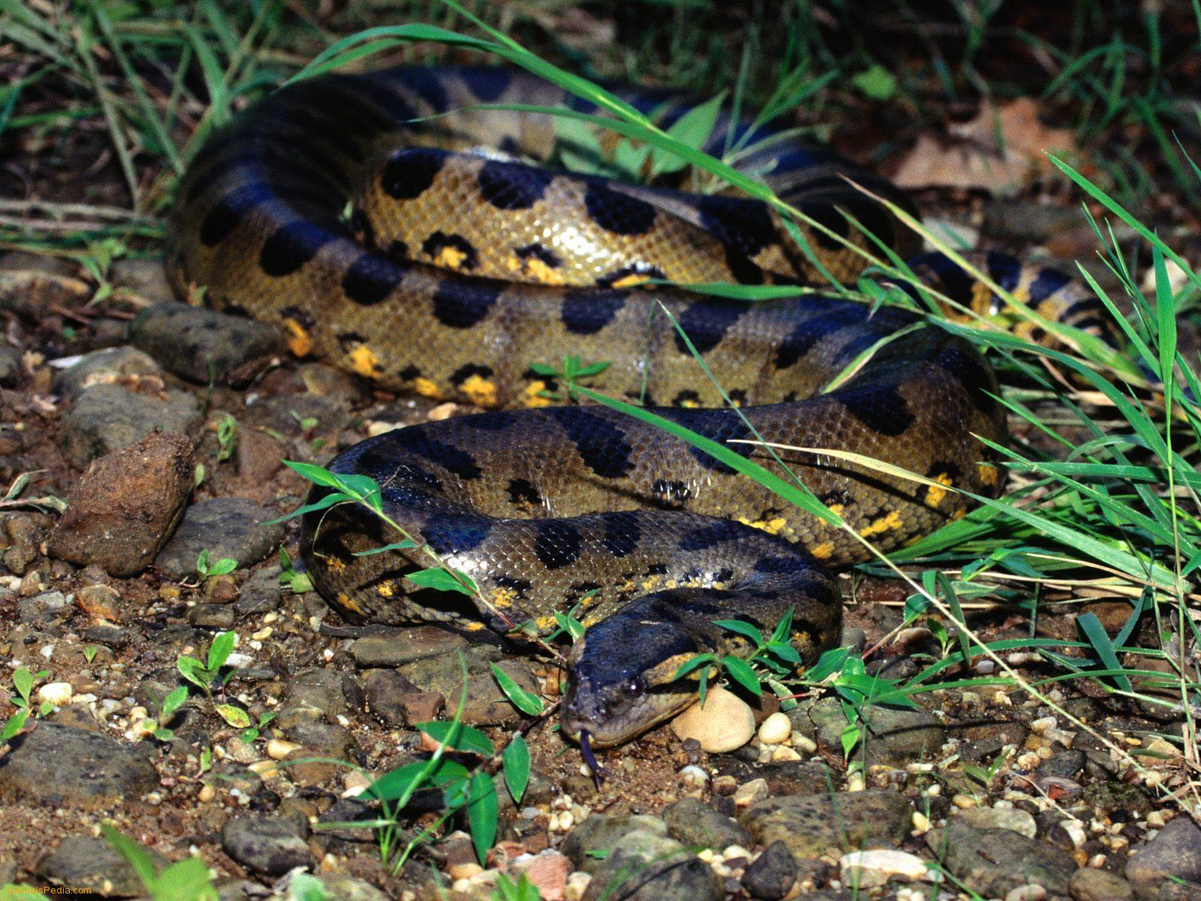
Anaconda

Slide 22
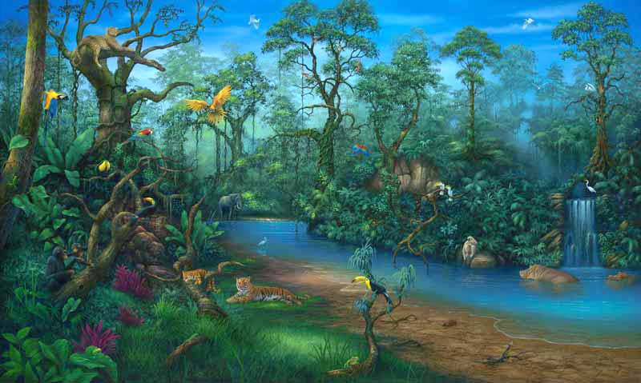

Slide 23


