Slide 1


French
Family and Friends
Year One
French | Year 3 | Family and Friends | Meet My Family! | Lesson 1

Slide 2



Slide 3
Aim
I can present a picture of family members using possessive adjectives.
Success Criteria
I can identify family members.
I can say ‘My…’
I can use voici to explain who’s who in a picture.

Slide 4



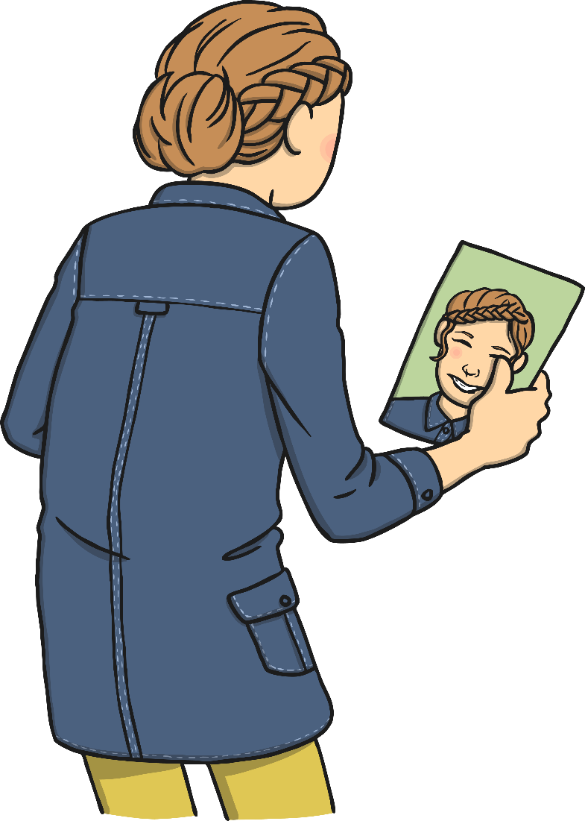

Qui Est-Ce?
(Who’s This?)
Click play buttons throughout to hear phrases and words.
C’est moi!

Slide 5
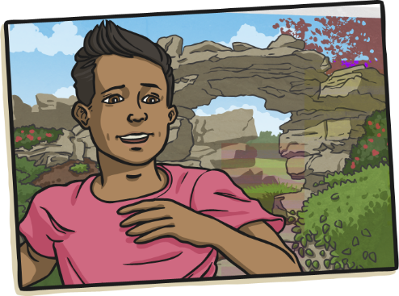
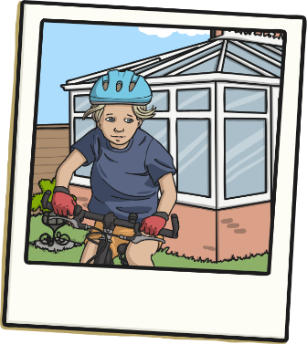
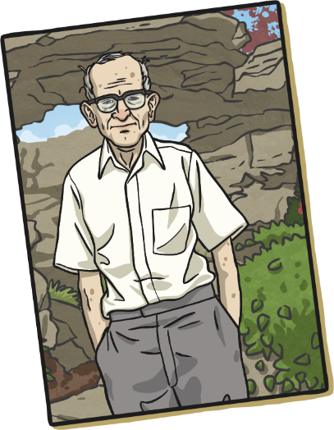
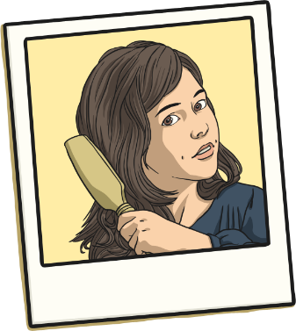
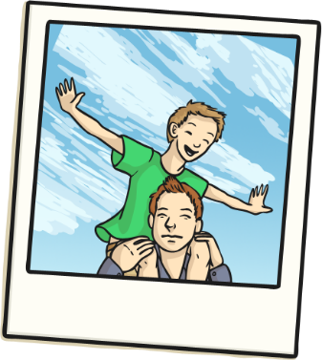
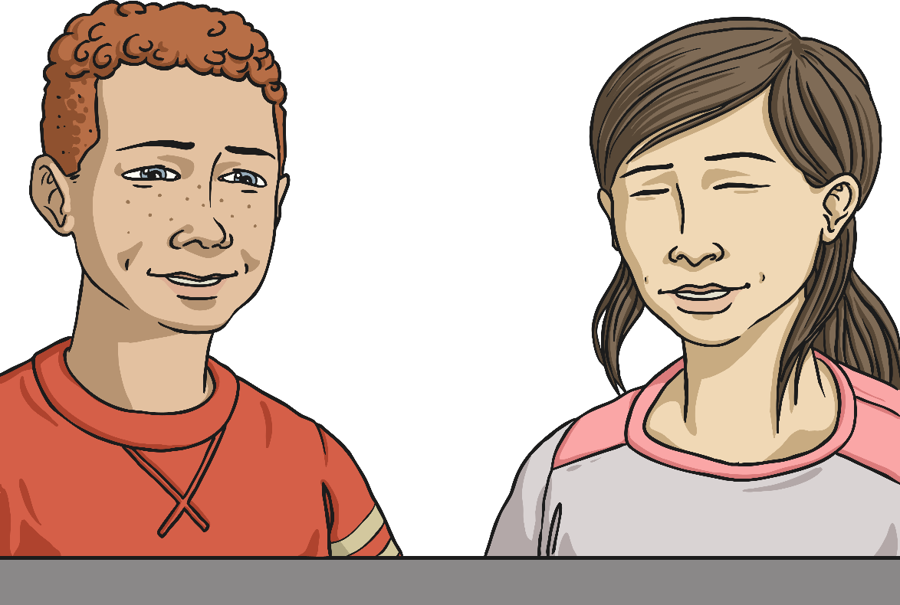
Who’s In Your Family?
Think about who is in your family.
Do you have an aunt?
How about a brother or sister?

Slide 6

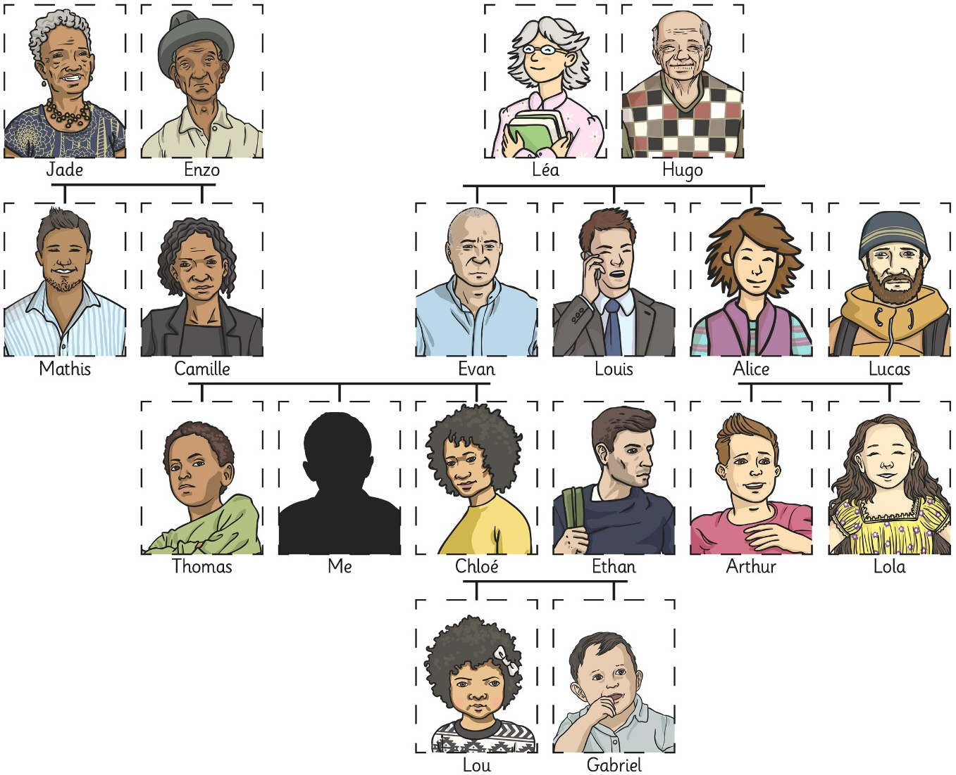

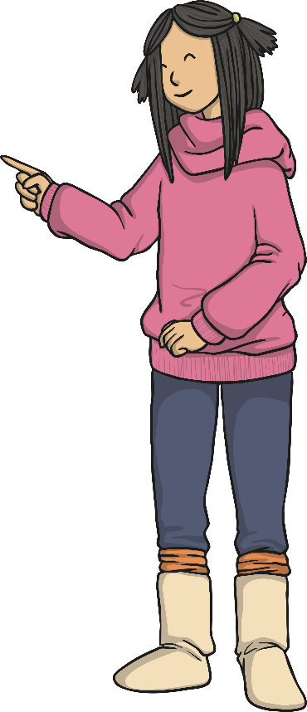
Qui Est-Ce?
Voici Jade.

Slide 7
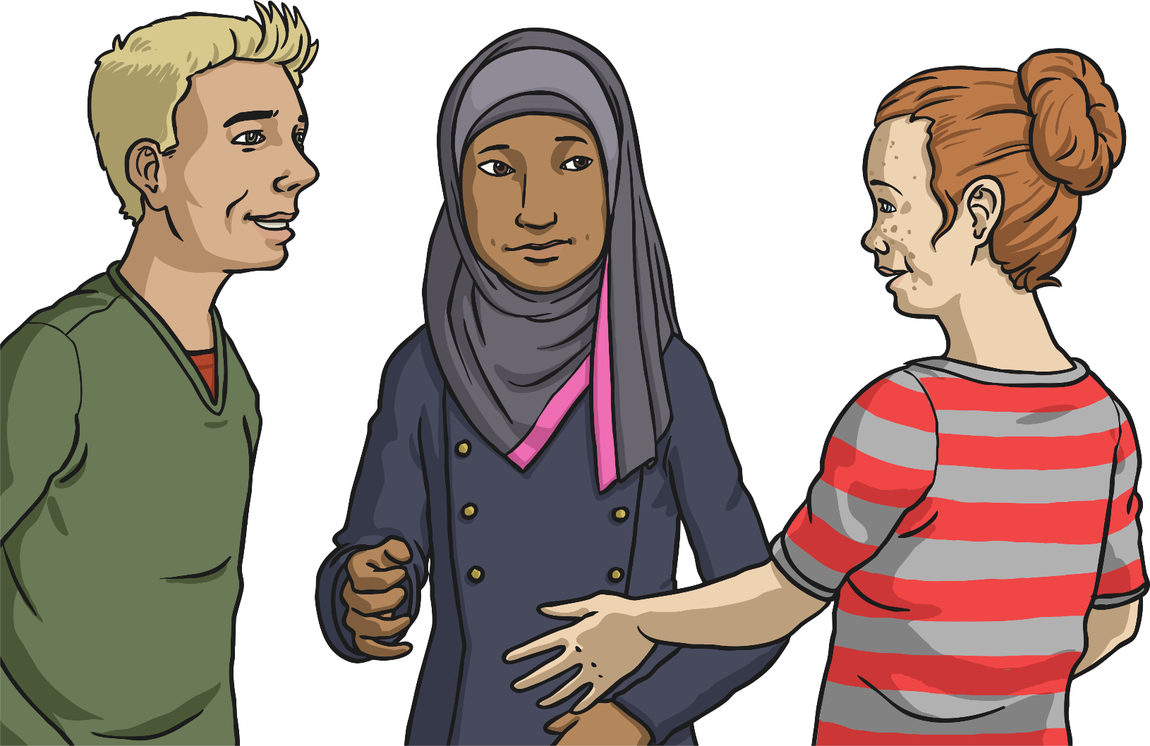
Qui Est-Ce?
Voici Sam.

Slide 8
Qui Est-Ce?
Voici
...ma famille.

Slide 9
Qui Est-Ce?
Voici
...mon frère.

Slide 10
Qui Est-Ce?
Voici
...ma soeur.

Slide 11
Qui Est-Ce?
Voici
...ma mère.

Slide 12
Qui Est-Ce?
Voici
...mon père.

Slide 13
Qui Est-Ce?
Voici
...mes parents.

Slide 14

Qui Est-Ce?
Voici
...mon grand-père.

Slide 15
Qui Est-Ce?
Voici
...ma grand-mère.

Slide 16
Qui Est-Ce?
Voici
...mes grands-parents.

Slide 17
La Grammaire
(Grammar Point)
mon...
un...
ma...
une...
mes... / mes…
des... / des…
What do you think?

Slide 18
Qui Est-Ce?
Voici
...ma tante.

Slide 19
Qui Est-Ce?
Voici
...mon oncle.

Slide 20
Qui Est-Ce?
Voici
...ma cousine.

Slide 21
Qui Est-Ce?
Voici
...mon cousin.

Slide 22
Qui Est-Ce?
Voici
...mes cousins.

Slide 23
Qui Est-Ce?
Voici
...mon neveu.

Slide 24
Qui Est-Ce?
Voici
...ma nièce.

Slide 25
Qui Est-Ce?
Voici
...ma famille!

Slide 26

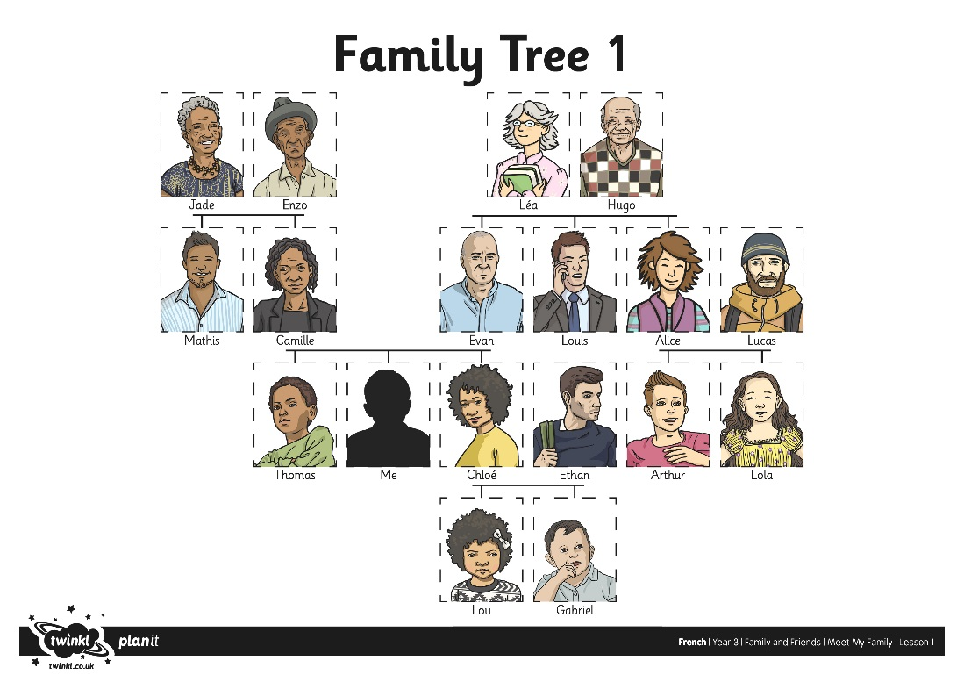
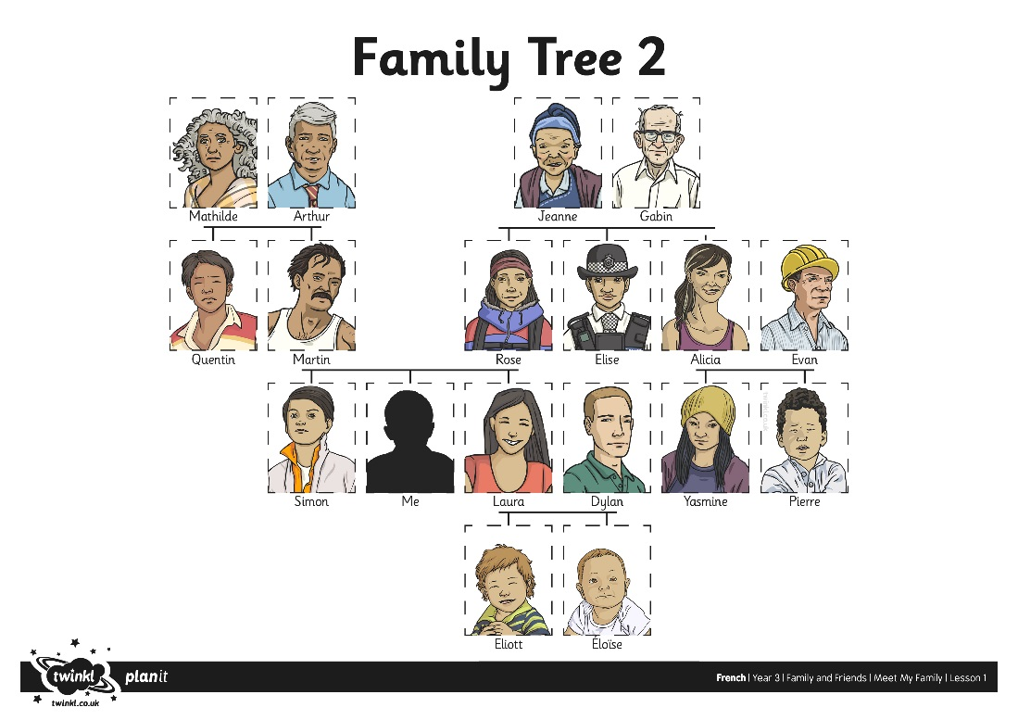
Family Trees

Slide 27
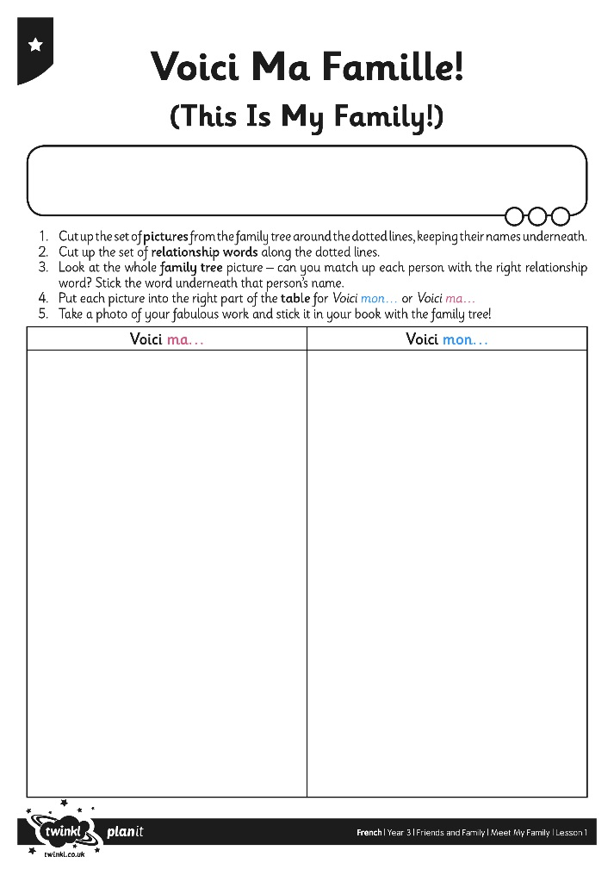
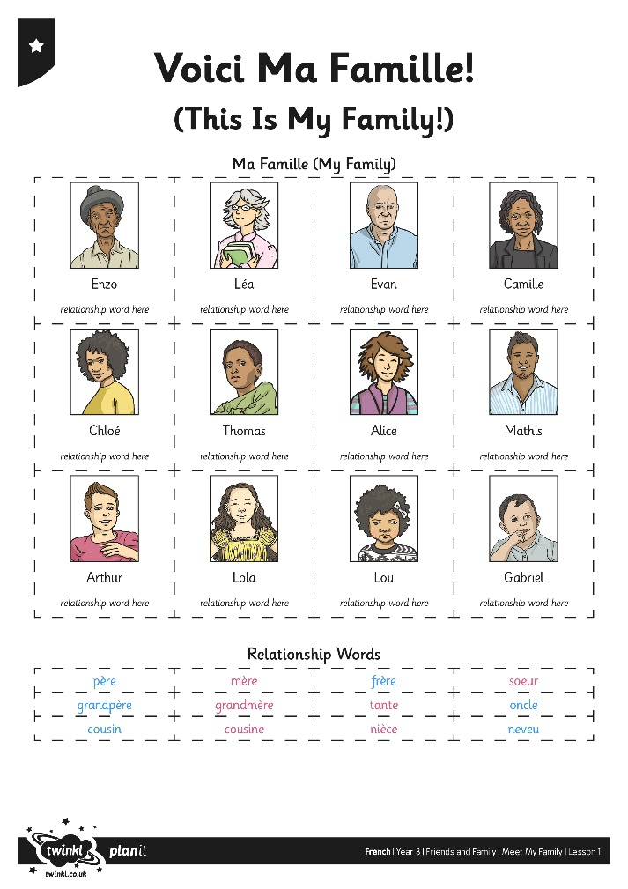
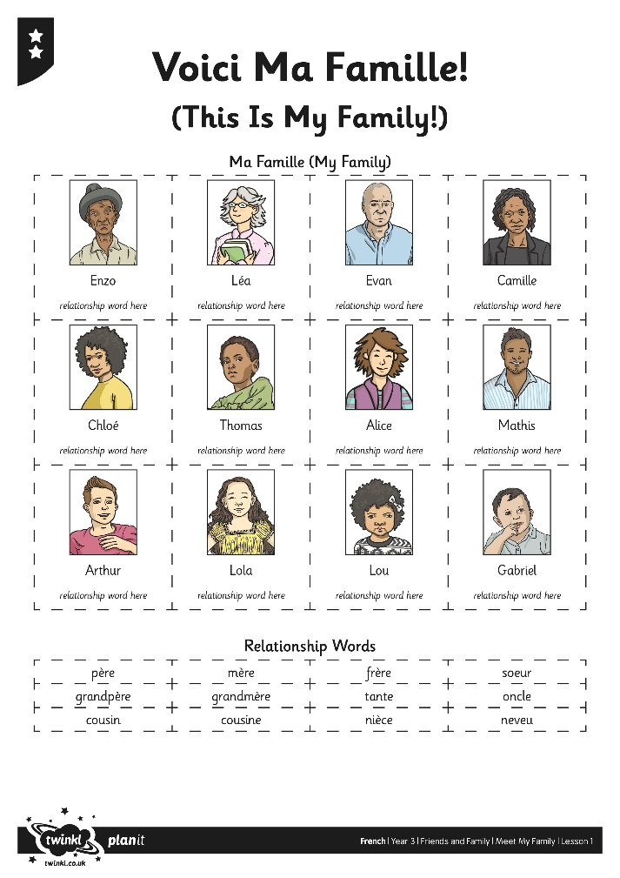

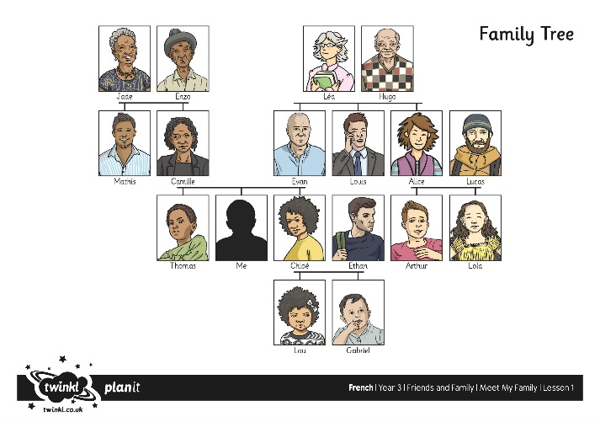
Who’s Who?

Slide 28


Recap
Look at the word bank of English family words.
How do you say these words ‘en Français’?
Comment dit-on
‘my mother’
en Français?
Ma mère.

Slide 29

Aim
I can present a picture of family members using possessive adjectives.
Success Criteria
I can identify family members.
I can say ‘My…’
I can use voici to explain who’s who in a picture.

