Slide 1


Does ‘standing up’ mean physically fighting or are there other ways?
By Reka, Hannah.S and Timothy

Slide 2

Our Conclusion:
We all agree on yes, there are different ways! These are the different ways…

Slide 3
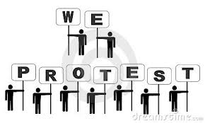
Way 1:
Peaceful Protesting- Shouting out about what you disagree with, peacefully so no fighting.

Slide 4
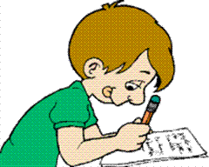
Way 2:
Making a complaint- sending a message or letter to someone important, or in charge, who can make a change.

Slide 5


Way 3:
Spreading the word- telling more people so you have more of a chance of your protest being successful and succeeding in what you are doing as you will be a bigger force.

