Slide 1
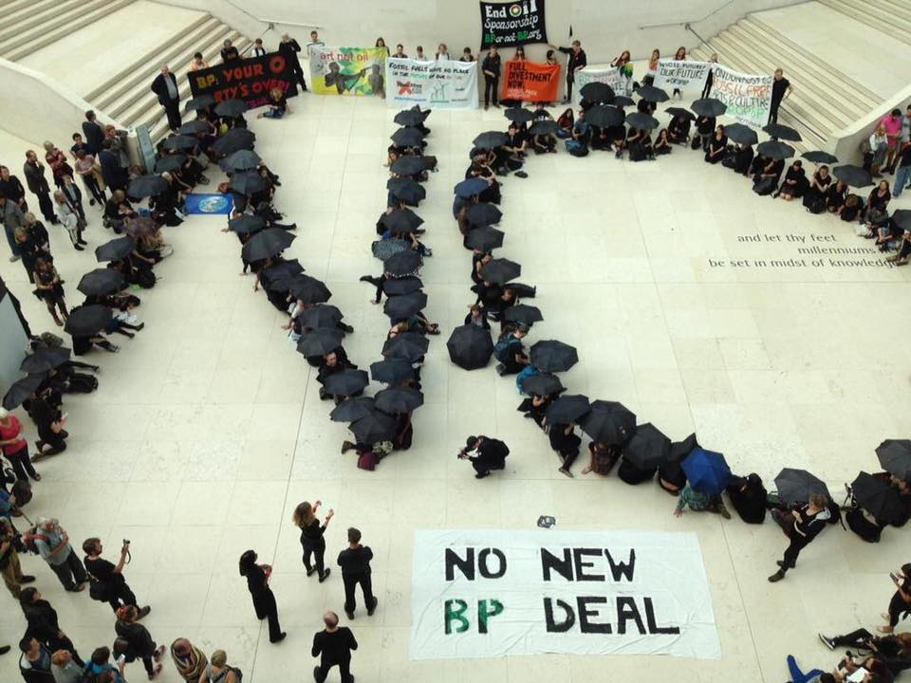
Should People Always Have The Right To Protest?
By:
Fiona
Herbie
Poppy
Jacob

Slide 2
Conclusion!
We think that everyone should be able to have their opinions but not always share them because the world is messed up enough without anything else to do with arguments!

Slide 3
Reason 1
People are always allowed to have their own opinions because everyone is equal and shouldn’t have to be left out or made to think that they’re opinion is wrong.

Slide 4
Reason 2
Protesting is right if you’re protesting against something bad but if it’s about something good then there’s no point in protesting at all!

Slide 5
Reason 3
If the police are needed to get involved then you must calm down and you should stop protesting whenever they get involved because then it might get out of hand!

Slide 6
Answer:
So in one word-
SOMETIMES!

