Slide 1
SHOULD PEOPLE HAVE THE RIGHT TO CARRY WEPONS?
Question 3
By Oscar

Slide 2
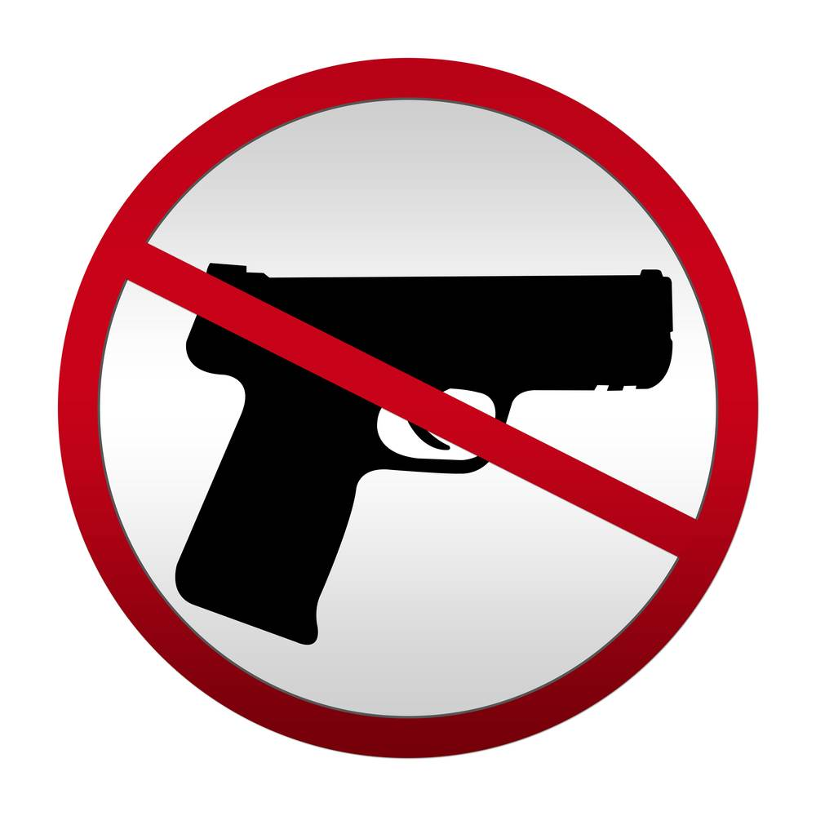
ITS WRONG!
It's wrong, people have guns to protect themselves or for shooting birds and animals. But there are people out there who just shoot innocent people for fun . And guns are so easily bought for people now, so it would just make matters worst. You don't need guns to protect yourself, that's why we have police; guns just make matters worst because if you shoot someone who looks like a burglar and is acting suspiciously and you shoot them and if they weren't a burglar you will probably go to prison and feel very guilty.

Slide 3
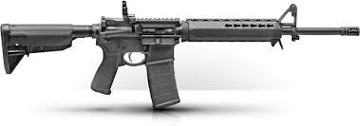
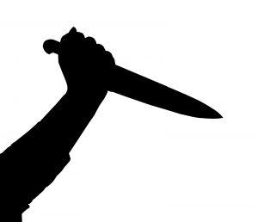
THEY’RE GOOD!
Guns kill people, everyone knows that! Guns provide protection for a household. If someone grabbed a person on the street or broke into a house, people would want the opportunity to be able to defend themselves so that they could prevent the possibility of that person killing or wounding them.

