Slide 1
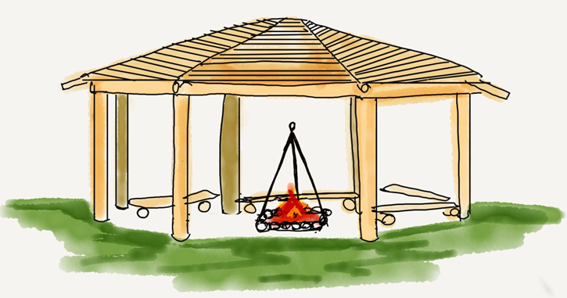



Forest School Handbook
‘Look deep into nature, and then you will understand everything better.’
Albert Einstein
The next review date for this handbook is September 2023.

Slide 2


School details
Elham Church of England Primary School
Vicarage Lane, Elham, Kent. CT4 6TT
Telephone number- 01303 840325
School Grid Reference- TR176437
Forest School Grid Reference- TR175436
What 3 words for school entrance- equal.revival.structure
What 3 words for Forest School- apart.pocketed.thuds
Age range- 4-11 PAN- 20 School capacity- 140
School type- Voluntary Aided
URN: 118741 DfE number: 886/3347
Local authority- Kent

Slide 3
Purpose of the handbook
The Forest School (FS) Handbook for Elham Church of England Primary School has been compiled to outline the policies and procedures that are in place to keep everyone involved in our FS safe.
This handbook has been written alongside other school policies and procedures and these should be read in conjunction with this document.
The handbook will be read by all adults who have a regular role in FS learning.
It will be read prior to any involvement in FS learning.
The Handbook is a working document and will be reviewed regularly and at least annually.
The next review date is September 2023.

Slide 4
Ethos & Principle Statement
At Elham Church of England Primary School we value all stakeholders and believe that everyone should have the opportunities to be involved in lifelong learning.
We aim to give everyone the opportunity to thrive and we recognise that every individual is unique and will have interests and learning styles that differ from those around them.
We strive to provide a broad and balanced curriculum that enables children to become well rounded individuals that are well prepared with the skills and attributes that will enable them to become successful, global citizens.
We actively promote a YES I CAN attitude and encourage children to learn from their ‘marvellous mistakes’.
We place well-being and mental health alongside physical education and recognise the importance of developing emotional intelligence, self-esteem, positive behaviour and motivated learning for each person at our school.

Slide 5

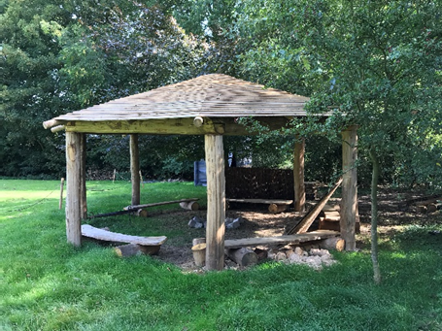
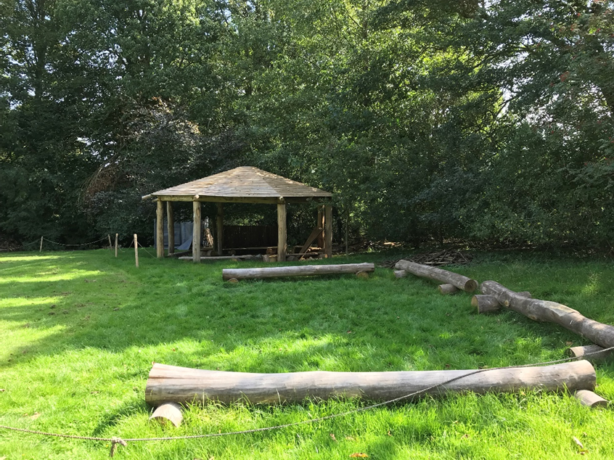
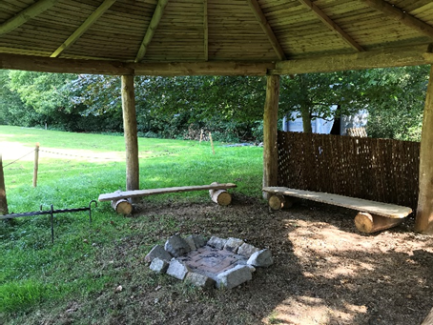
Forest School Ethos/Definition
“Forest School is an inspirational process that offers ALL learners regular opportunities to achieve, develop confidence and self-esteem, through hands on learning experiences in a local woodland or natural environment with trees.”
Forest School is a specialised approach that sits within and compliments the wider context of outdoor and woodland learning.

Slide 6
Forest School Ethos/Definition
Principles with criteria for good practice (bulleted – FS = Forest School)
1. Forest School is a long term process with frequent and regular sessions in a local natural space, not a one-off visit. Planning, adaption, observations and reviewing are integral elements.
• FS takes place regularly, ideally at least every other week, over an extended period of time, if practicable encompassing the seasons
• A FS programme has a structure which is based on the observations and joint work between learners and practitioners. This structure should clearly demonstrate progression of learning.
• The initial sessions of any programme establish physical and behavioural boundaries as well as making initial observations on which to base future programme development.

Slide 7
Forest School Ethos/Definition
2. Forest School takes place in a woodland or natural wooded environment to support the development of a relationship between the learner and the natural world
• Whilst woodland is the ideal environment for FS, many other sites, some with only a few trees, are able to support good FS practice.
• The woodland is ideally suited to match the needs of the programme and learners, providing them with the space and environment in which to explore and discover
• A FS programme constantly monitors its ecological impact and works within a sustainable site management plan agreed between the landowner/ manager and the Practitioner and the learners.
• FS aims to foster a relationship with nature through regular personal experiences in a local woodland/wooded site to help develop long term environmentally sustainable attitudes and practices in staff, learners and the wider community.
• FS uses the natural resources for inspiration, to enable ideas and encourage intrinsic motivation.

Slide 8
Forest School Ethos/Definition
3. Forest School aims to promote the holistic development of all those involved, fostering resilient, confident, independent and creative learners
• Where appropriate the FS leader will aim to link experiences at FS to home, work and/or school/education.
• FS programmes aim to develop, where appropriate, the physical, social, cognitive, linguistic, emotional, social and spiritual aspects of the learner.
4. Forest School offers learners the opportunity to take supported risks appropriate to the environment and themselves.
• FS opportunities are designed to build on an individual's innate motivation, positive attitudes and/or interests
• FS uses tools and fires only where deemed appropriate to the learners, and is dependent on completion of a baseline risk assessment.
• Any FS experience follows a Risk/Benefit process managed jointly by the practitioner and learner that is tailored to the developmental stage of the learner

Slide 9
Forest School Ethos/Definition
5. Forest School is run by qualified Forest School Practitioners who continuously develop their professional practice.
• FS is led by qualified Forest School Practitioners, who are required to hold a minimum of an equivalent Forest School Level 3 qualification
• There is a high practitioner/adults to learner ratio
• Practitioners and adults regularly helping at Forest School are subject to relevant checks into their suitability to have prolonged contact with children, young people and vulnerable people.
• Practitioners need to hold an up to date first aid qualification which includes paediatric and outdoor elements.
• FS is backed by relevant working documents which contain all the relevant policies and procedures required for running FS and establish the roles and responsibilities of staff and volunteers.
• The FS leader is a reflective practitioner sees themselves as a learner too

Slide 10
Forest School Ethos/Definition
6. Forest School uses a range of learner centred processes to create a community for development and learning.
• A learner-centred pedagogical approach is employed that is responsive to the needs and interests of the learners.
• Play and choice are an integral part of the FS learning process and play is recognised as vital to learning and development at FS
• FS provides a stimulus for all learning preferences and dispositions
• Reflective practice is a feature of each session to ensure learners and practitioners can understand their achievements, develop emotional intelligence and plan for the future.
• Practitioner observation is an important element of FS pedagogy. Observations are used to 'scaffold' and tailor learning and development at FS
• The Practitioner models the pedagogy which they promote during their programmes through careful planning, appropriate dialogue and relationship building.
(The Forest School Association www.forestschoolassociation.org enquiries@forestschoolassociation.org)

