Slide 2
Aim
I can choose what happens to my body and I can get help with any concerns.
Success Criteria
I know what sort of touch I am happy with and what sort I am
not happy with.
I know the difference between a little deal and a serious problem.
I know how to get help for myself or others.
This resource is fully in line with the Learning Outcomes and Core Themes outlined in the PSHE Association’s Programme of Study.

Slide 3

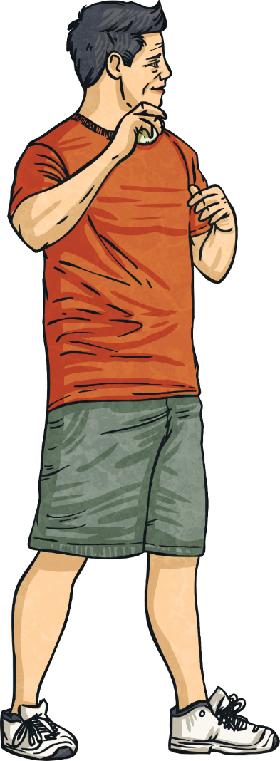
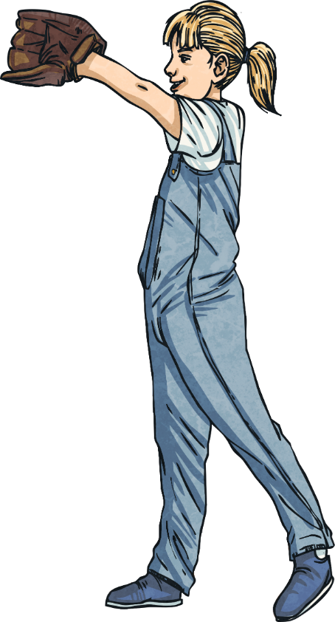
Who does your body belong to?
What type of physical contact is OK?
What can you do if you feel uncomfortable about something?

Slide 4



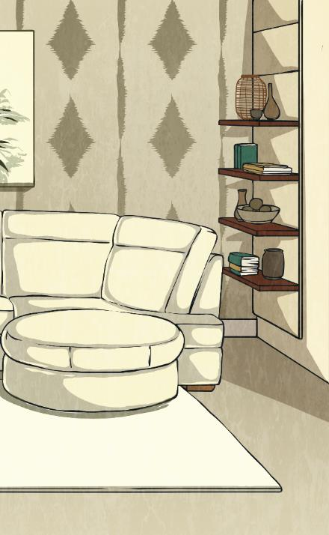
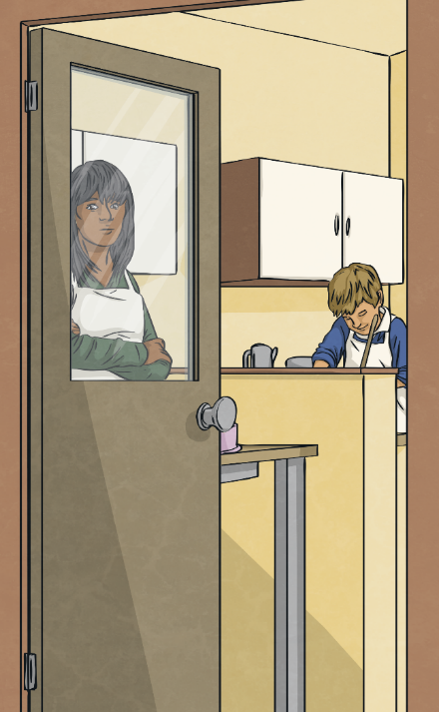
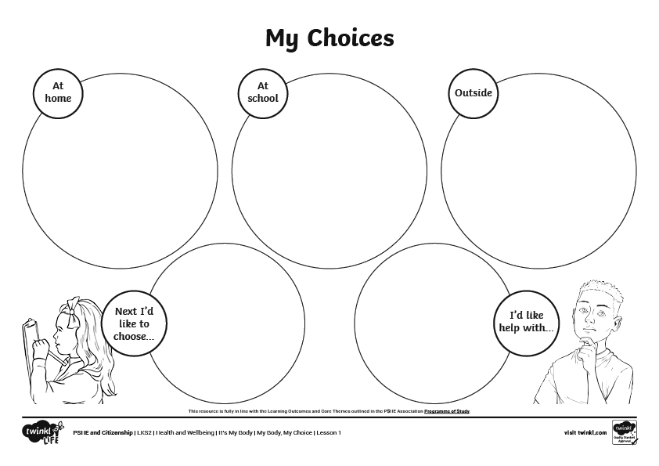
My Choices
We get to make lots of choices at home, at school and outside.
Now, think about something you’d like help with.
Now think about what you’d like
to choose.
  At home, we make choices like which bedtime story we’d like to read or which programmes we’d
  like to watch.
Use the top three boxes to show what you can do in these three different areas.
Maybe you’re
not allowed to make your own breakfast and
you’d like to?
Maybe someone
has told you something is
right but you’re
not sure.
Are there times where you find it difficult to make choices?
Note down all of
the things you look forward to being in charge of when you are older.
Use the My Choices Worksheet to make some notes of all of the things you get to decide in these different areas.
Maybe someone
has told you to keep something
a secret.
Make a note of anything you’re not comfortable with.
Maybe you’d
like to choose
your own clothes
more often?
  Outside, we might choose which swing to go on, what to get from the shops or which friends
  to play with.
  At school, we make choices like who we play with or what we have for our lunch.

Slide 5
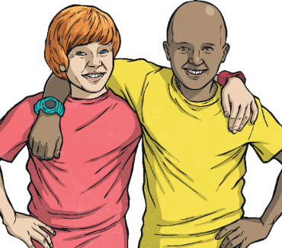
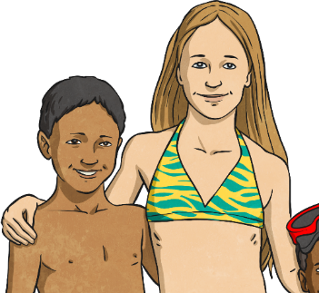
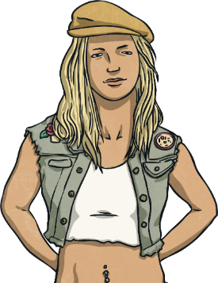
You Can Touch Me Here
There are areas
of your body that are quite public,
like your hands.
There are areas of your body that are private, like under your underwear.
There are areas
that are in the middle, that we sometimes show,
like your stomach.

Slide 6

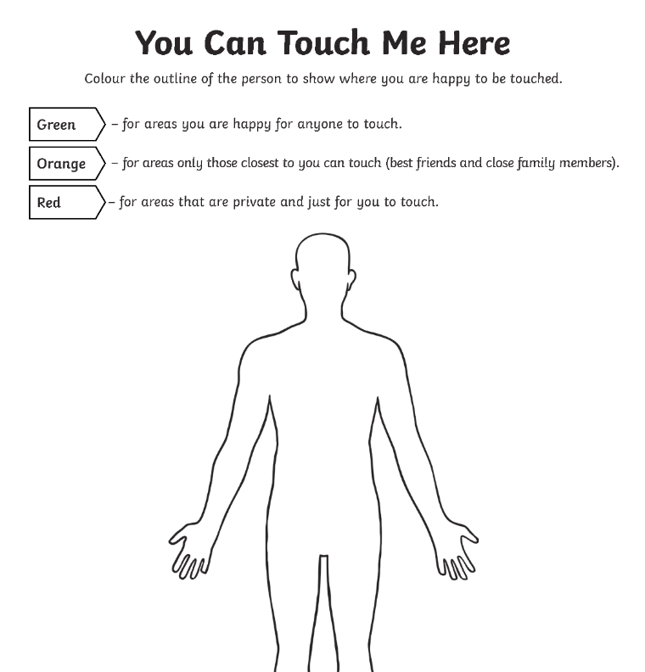

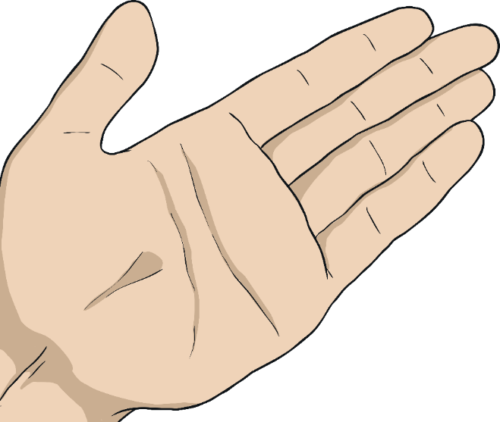
You Can Touch Me Here
How do you feel about the space around your body?
Orange – for areas only those closest to you can touch (best friends and close family members).
Green – for areas you are happy for anyone to touch.
Red – for areas that are private and just for you to touch.
Is there any area of your body that is furious or sad
if anyone ever touches it? If necessary, colour this area in black.
You are going to show the areas where you are happy to be touched by colouring the outline of the person.

Slide 7


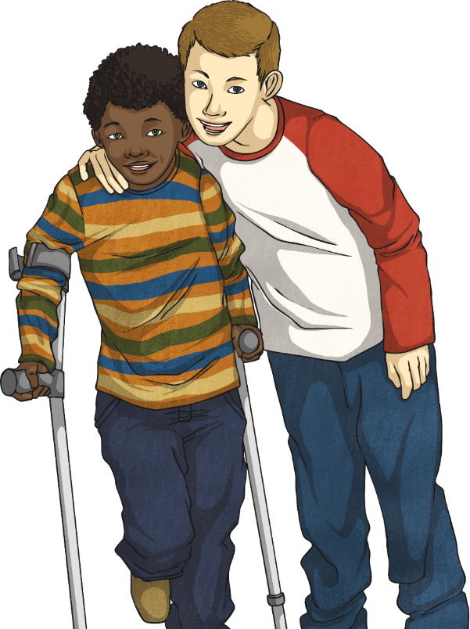

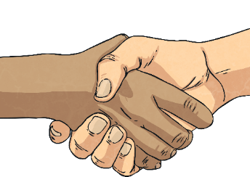
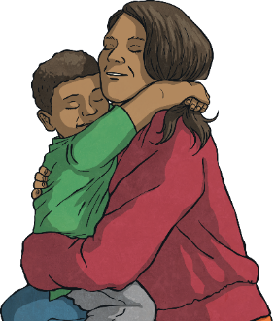
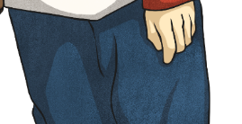
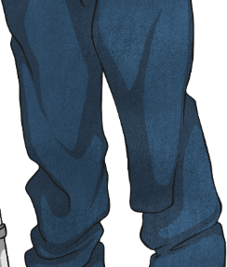
You Can Touch Me Here
Friends and family can touch us on the hands, arms and head. It might be OK if they touch us on the legs.
Strangers are usually allowed to touch us on our hands. It might be OK if they touch our arms, shoulders or back.
We are all different. Some people dislike touch more than others.
If you’re not sure whether touch is OK, trust your instincts. If someone touches you on your chest, head, back, legs or bottom in a way you don’t like, it’s probably not alright. Tell an adult you trust.

Slide 8
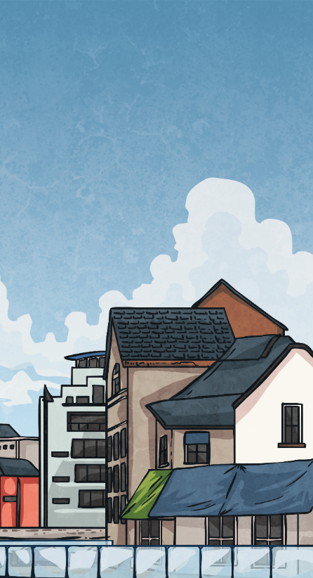
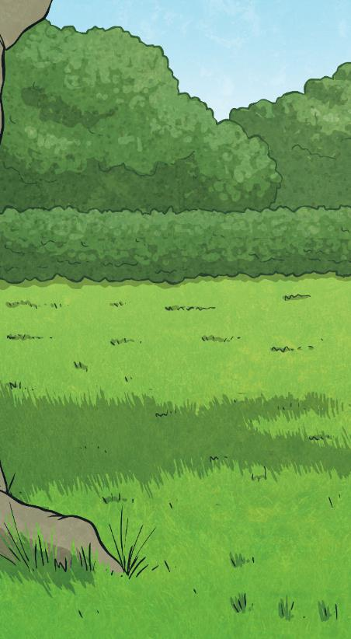
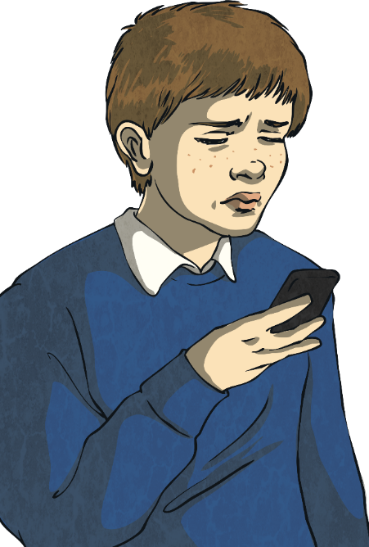
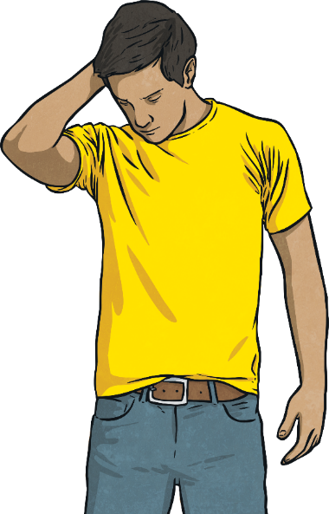
Little Deal, Tricky, Big Deal
There are lots of different problems that we might need to deal with in life.
Let’s look at some examples to see if they are a little deal, tricky or a big deal.
Sometimes there are little problems, sometimes there are big ones.
We need to find good ways of dealing with different problems.

Slide 9
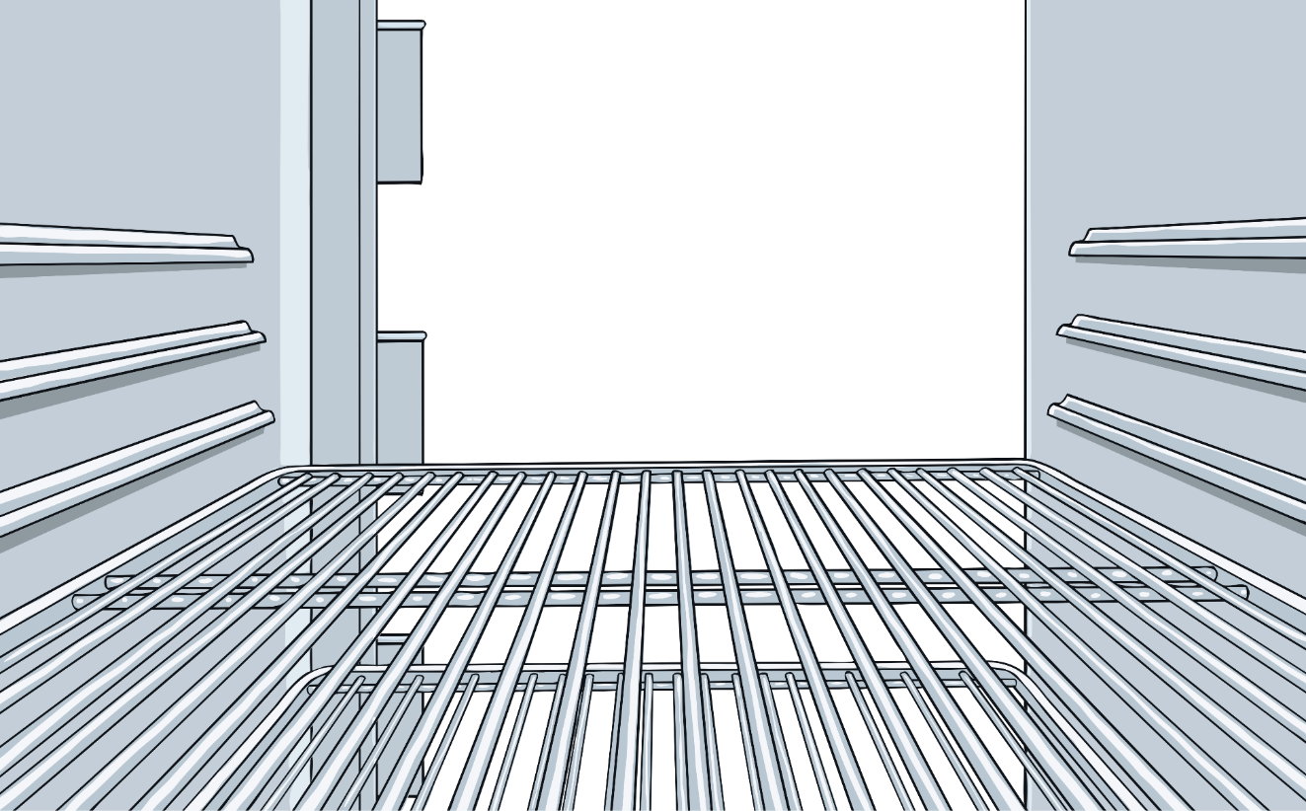

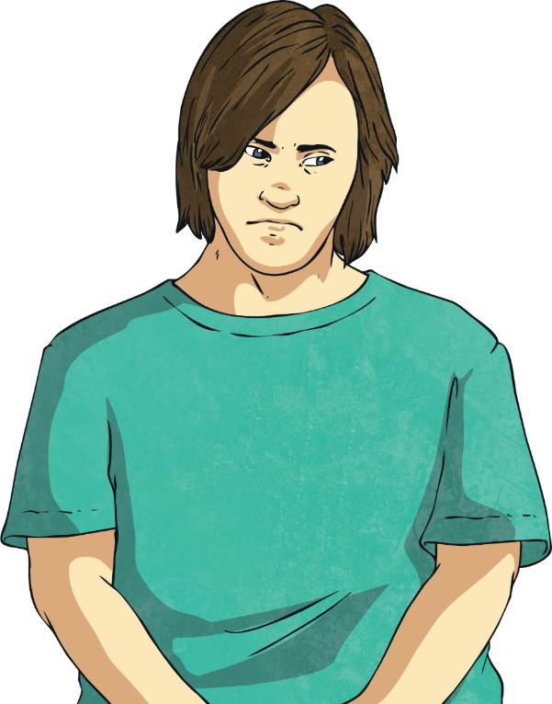
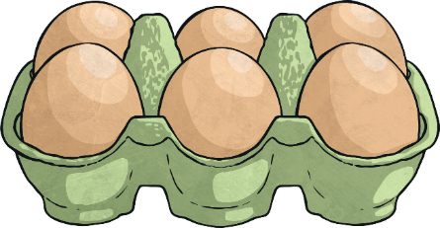



Little Deal, Tricky, Big Deal
Someone bumps into you in the line.
You’re finding it hard to keep your mum’s surprise birthday party a secret.
You are given food you don’t like.
You don’t like your jacket but your dad wants you to wear it.
Remember:
Be kind, we all
make mistakes.
Think of options to resolve the difference.
These
situations
are a little
deal.
You can deal with these calmly and say what you don’t like. You can help the other person see your point of view and be friendly as you do it.

Slide 10
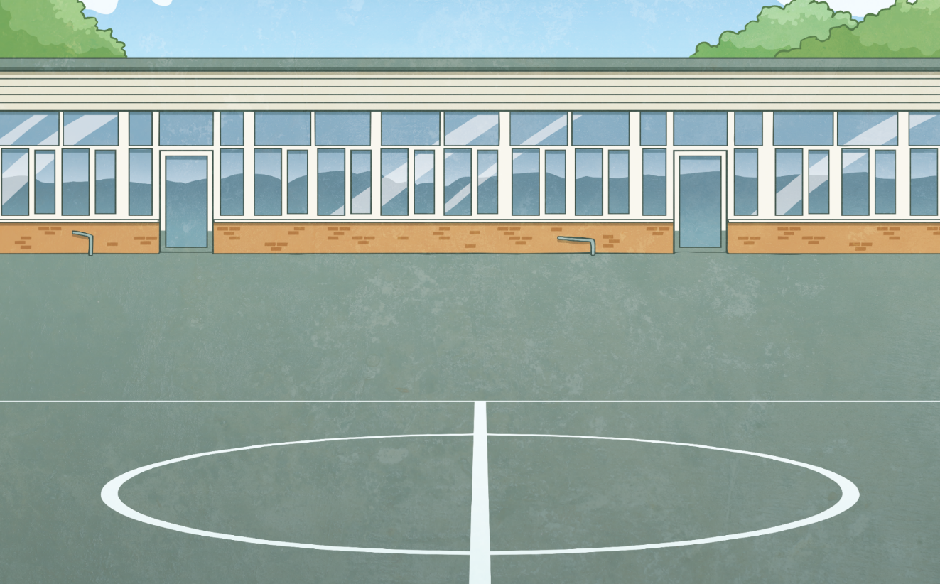
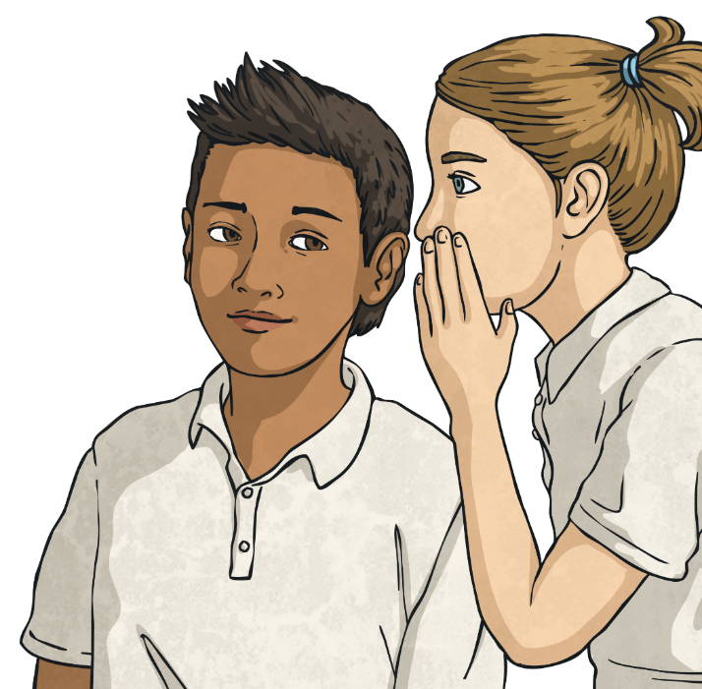
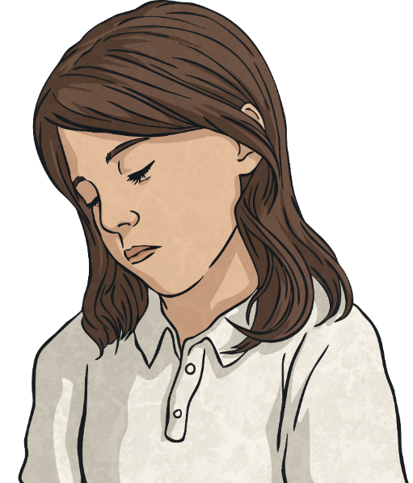
Little Deal, Tricky, Big Deal
Remember:
Be kind and firm with your body language and tone of voice.
Get help if it gets
too tricky.
Your mum wants a kiss but you don’t want to.
Older children are making fun of you.
Someone is picking on you in the playground.
Your best friend keeps calling you mean names.
You could try to avoid these situations, although sometimes, you will need to be clear about what you don’t like and why. You may need to get help.
These
are tricky situations.

Slide 11
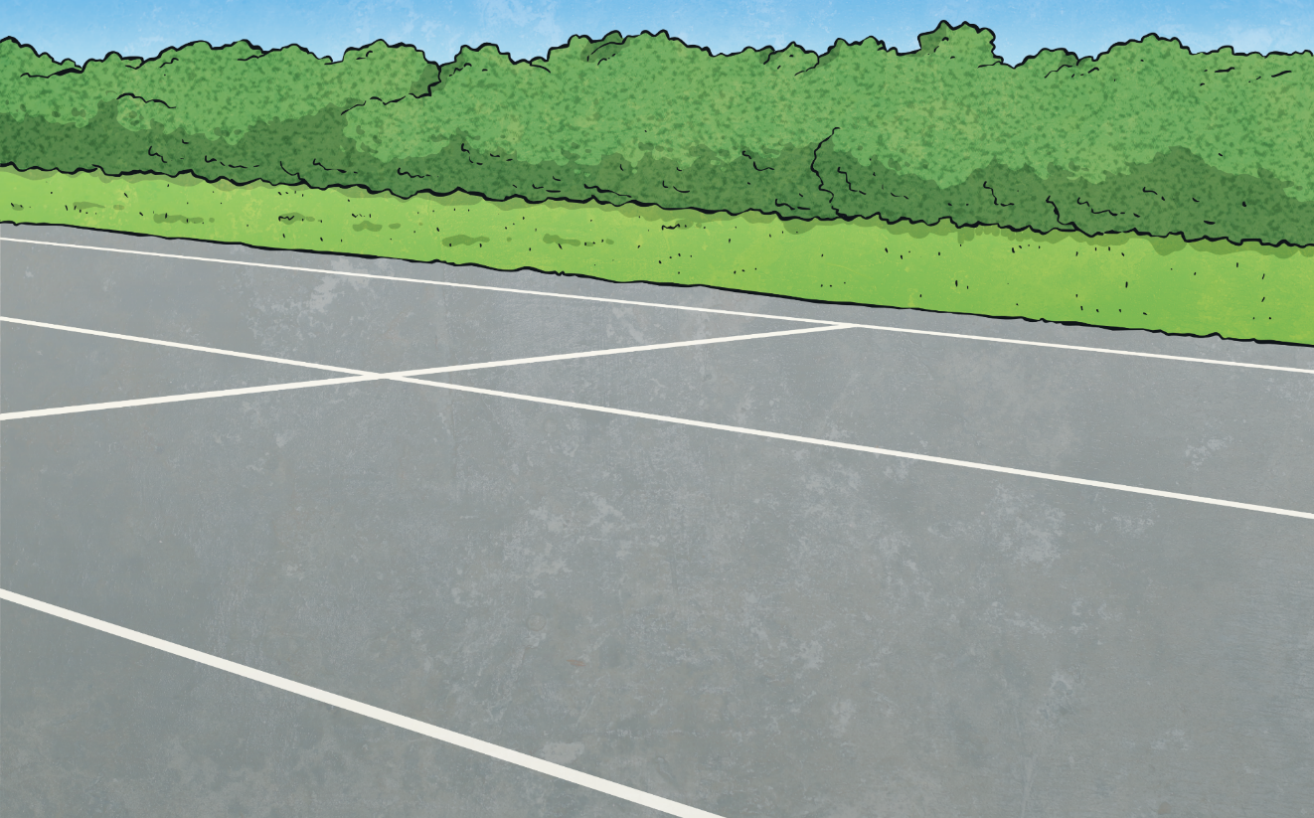
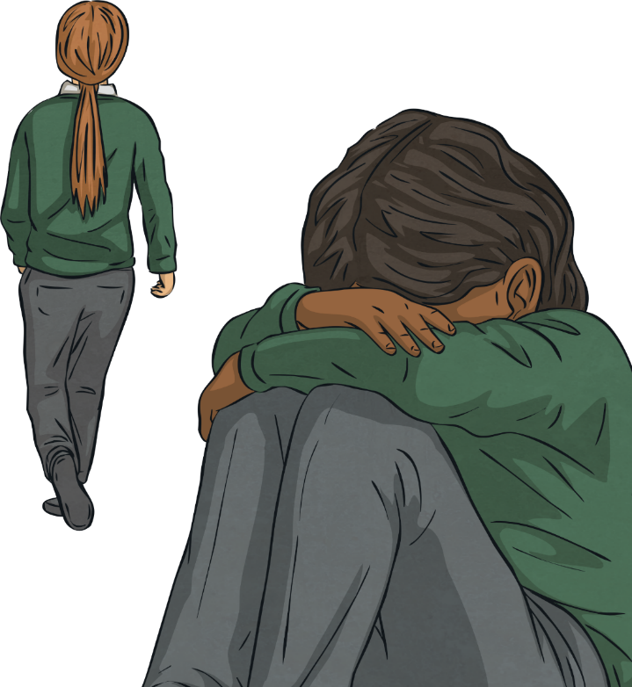
Little Deal, Tricky, Big Deal
  An adult wants to do something to your body that you don’t like.
  Someone is hitting you.
  An adult or older child is repeatedly telling you that you are bad or being mean to you.
  You are under pressure to do something that you know is not safe.
  A family friend keeps patting your bottom and has told you to keep it
  a secret.
These
situations
are a big
deal.
Remember:
Get away from the situation.
Get help.
These situations are very difficult to deal with and you will need some help to resolve the situation. Speak to an
adult that you trust or call Childline on 0800 1111.

Slide 12
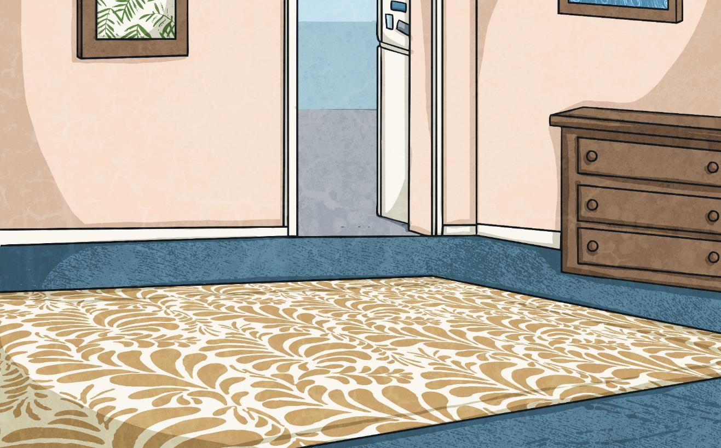
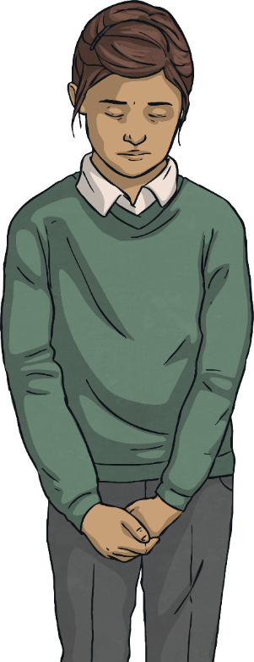
Little Deal, Tricky, Big Deal
It’s a big deal if anyone is saying or doing something that:
makes you feel uncomfortable;
that you know or think is wrong;
that upsets you a lot;
that hurts you; or
that frightens you.

Slide 13
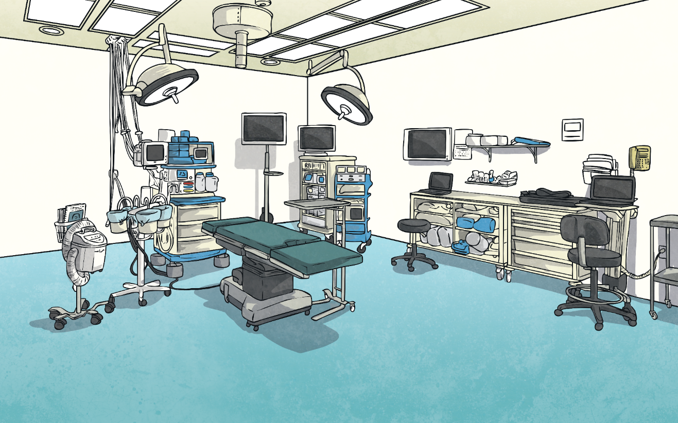
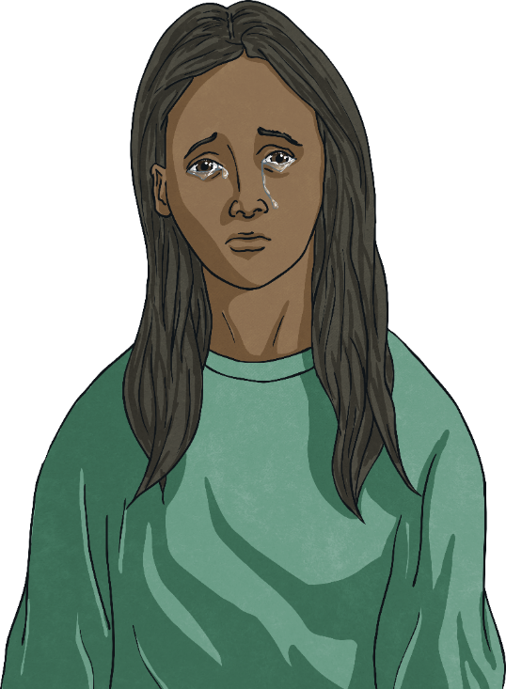
Little Deal, Tricky, Big Deal
One example of this is something called Female Genital Mutilation (or FGM). There are some families in this country and other countries who believe that girls’ private parts should be changed or removed through surgery.
FGM doesn’t happen in many families and it is actually illegal in the UK because it is considered violence towards girls. The girls can end up in pain and may suffer health problems following the surgery.
Reflecting
Consolidating
This is a big deal and any child whose family believes in this should get help from a trusted adult - perhaps someone at school, outside of the family.

Slide 14



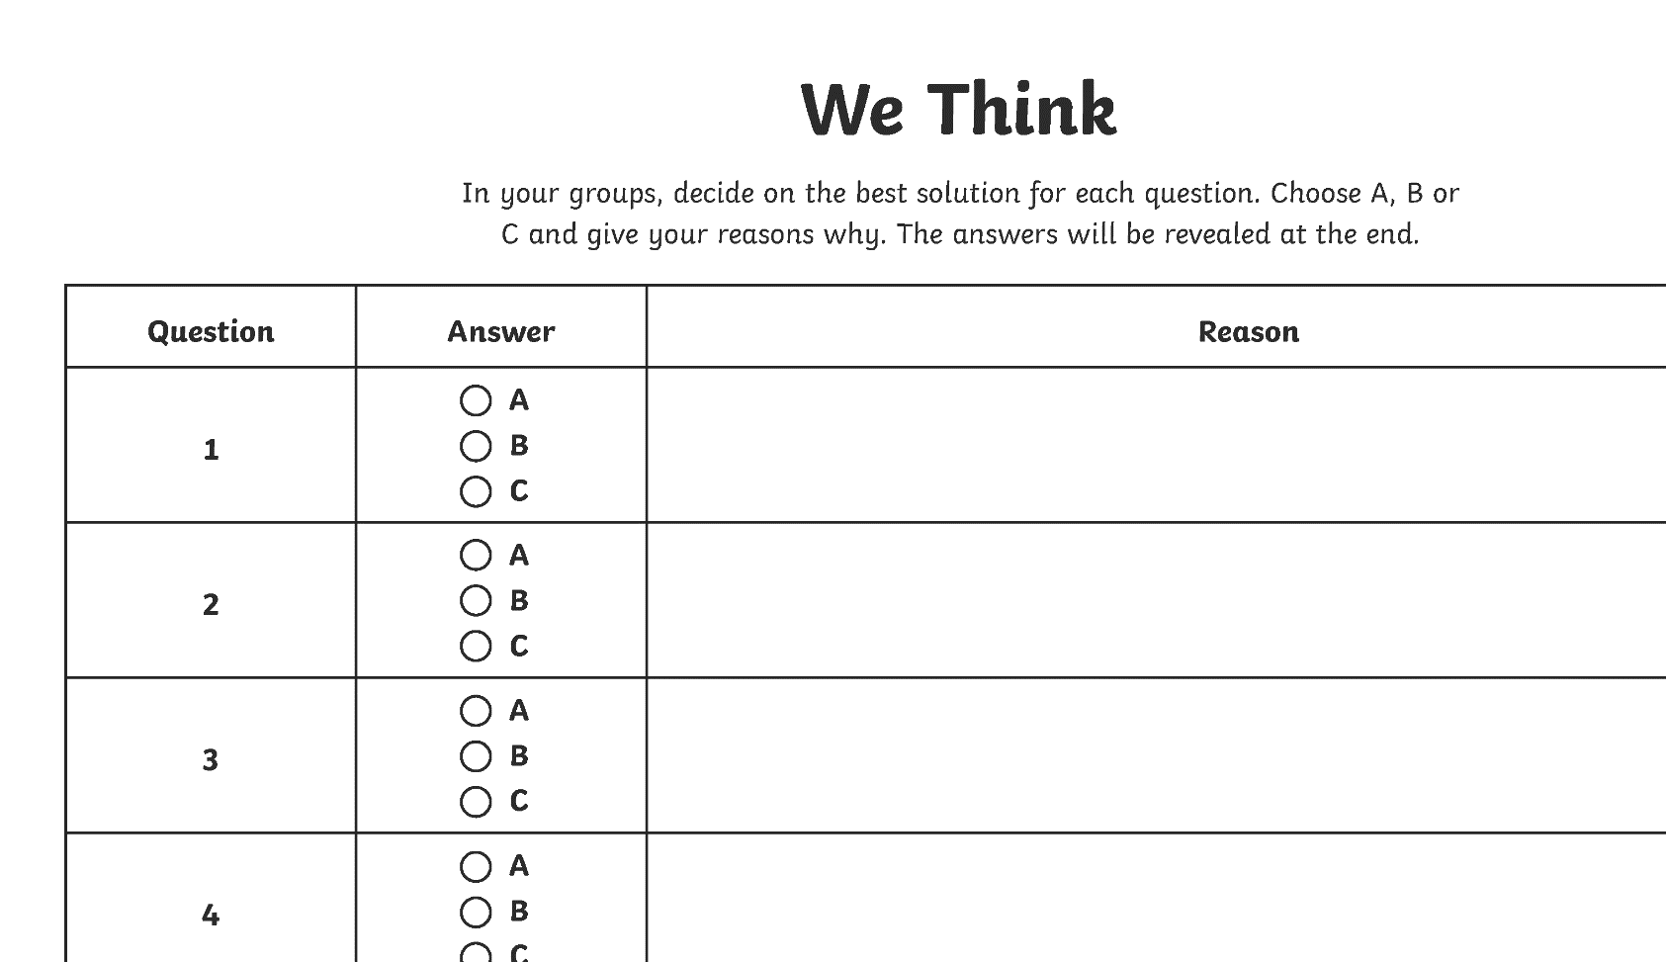

We Think
You will hear a set of questions with multiple choice answers. In your groups, listen to the question and possible answers.
Take it in turns giving one reason why you think this answer is best.
If you
can’t decide, take a vote.
I think A is best because he will be able to get help faster.
Remember,
you reasons are really important.
Decide on the best way to react in each situation and fill in the We Think answer sheet.

Slide 15
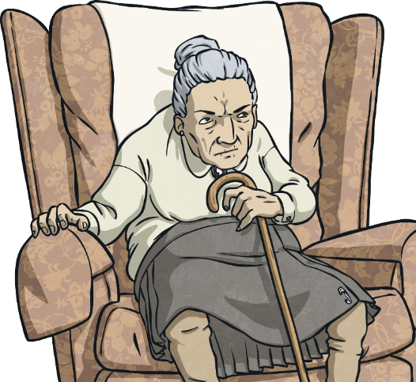
We Think
Question 1
Your granny wants a kiss goodbye but you don’t want to kiss her. What do you do?
A
Give her a kiss even though it makes you feel unhappy.
Discuss the answers
with your group. Choose the one most of you agree on and give a good reason why you are choosing
this option.
B
Give her a cuddle and a smile but don’t kiss her.
C
Tell her you don’t want to kiss her and walk away.

Slide 16

We Think
Question 2
A friend is at your house and asks you to let them borrow your iPod. They say if you were a good friend, you’d let them. What do you do?
A
Say they can use it at your house but they can’t take it home.
Discuss the answers
with your group. Choose the one most of you agree on and give a good reason why you are choosing
this option.
B
Let them have it – you don’t want them to think you’re a bad friend.
C
Tell them to ‘get lost’ and that it’s their bad luck they don’t have one.

Slide 17
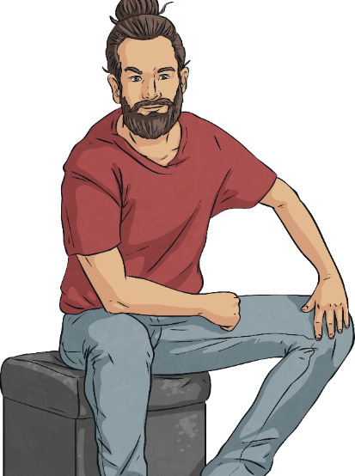
We Think
Question 3
Your uncle wants you to sit on his knee, stroke your hair and tell you you’re lovely. You like your uncle but you don’t like it when he does this.
A
Go along with it as he is really nice to you and you don’t want to upset him.
Discuss the answers
with your group. Choose the one most of you agree on and give a good reason why you are choosing
this option.
B
Say ‘No, thanks’ and move away.
C
Rudely tell him that you don't want to sit on his knee and you never will.

Slide 18
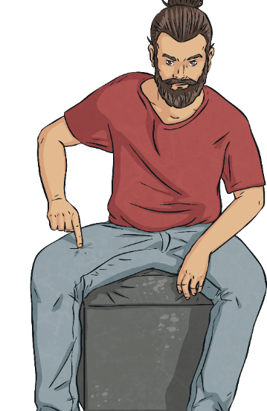
We Think
Question 4
Even after you say no, your uncle tells you that you have to sit on his knee or he’ll be cross.
A
Sit on his knee to make the situation better again.
Discuss the answers
with your group. Choose the one most of you agree on and give a good reason why you are choosing
this option.
B
Shout that you don’t like it, get out quickly and tell a trusted adult.
C
Hit him and run away.

Slide 19
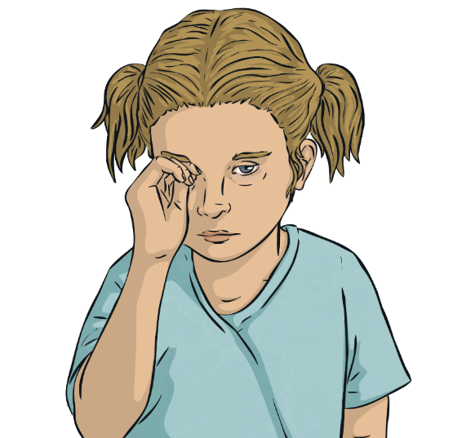
We Think
Question 5
At school, your friend tells you their mum hit them last night and that this often happens when their mum gets angry. They ask you to keep the secret.
A
Listen, give them support and keep the secret as they asked.
Discuss the answers
with your group. Choose the one most of you agree on and give a good reason why you are choosing
this option.
B
Listen, give them support and
tell the teacher or another adult you trust.
C
Listen and tell them they should hit her back.

Slide 20





We Think
Let's see which answers would be the best option.
Question 1
Question 2
Question 3
Question 4
Question 5
B
If someone asks you to keep an uncomfortable secret, listen and give them support. Also make sure you tell a trusted adult.
If someone you love wants a kiss and you don’t want to kiss them, try giving them a cuddle and a smile instead. This is still kind but means you do not have to feel uncomfortable.
If you have already said no and someone is still telling you to do something you don’t like, shout that you don’t like it and get out quickly to go and find help from a trusted adult.
Letting your friend use your iPod at your house is being a good friend. Your friend needs to understand that it is expensive and that they shouldn't try to make you feel bad for not letting them borrow it.
If someone wants to do something that makes you feel uncomfortable, say ‘No, thanks’ and move away.

Slide 21
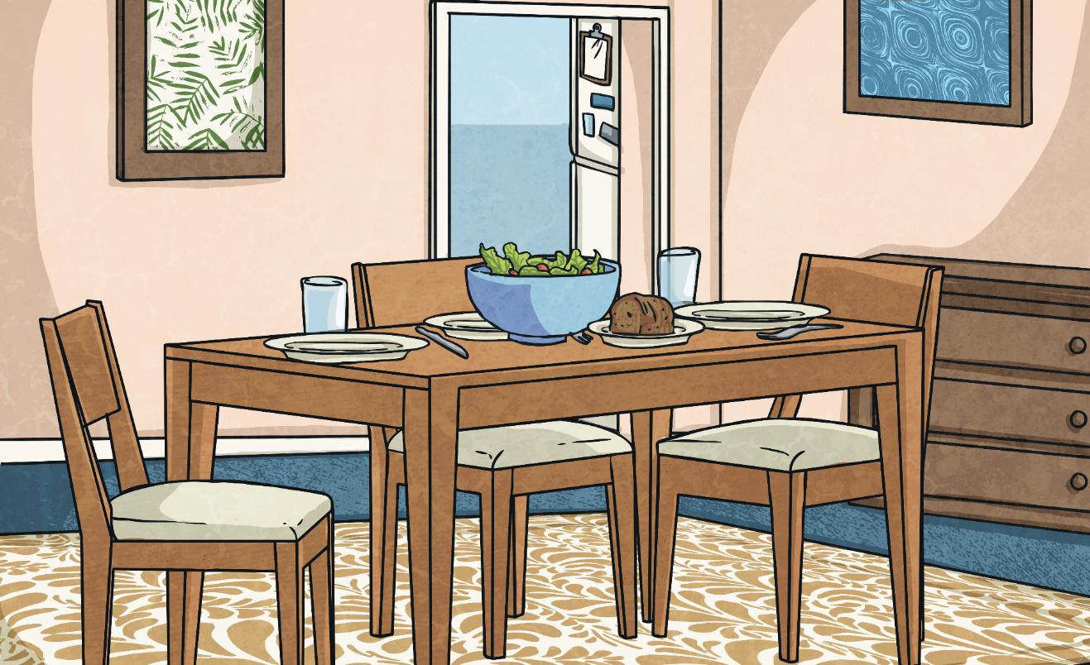
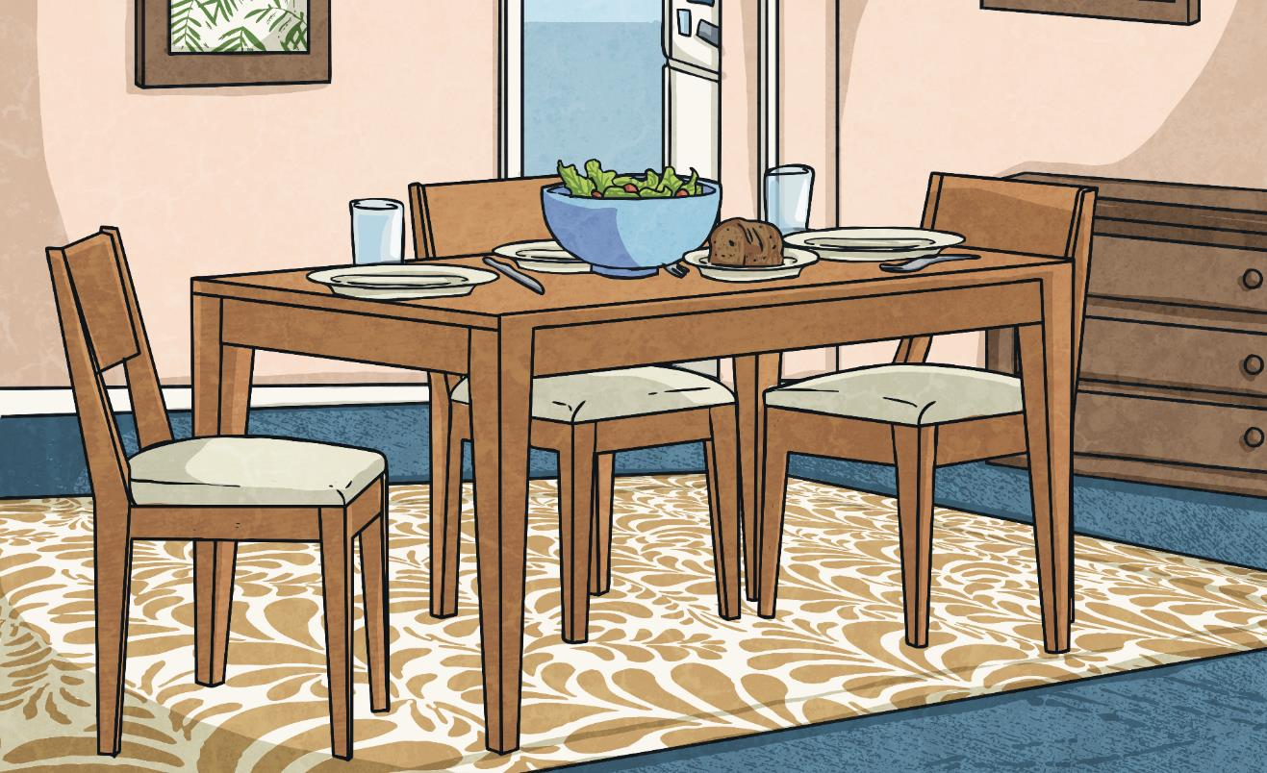
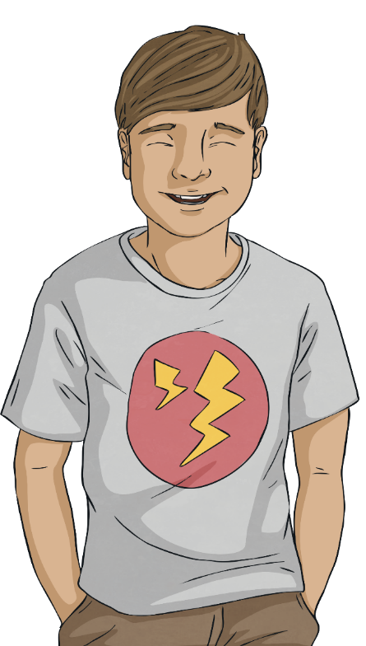
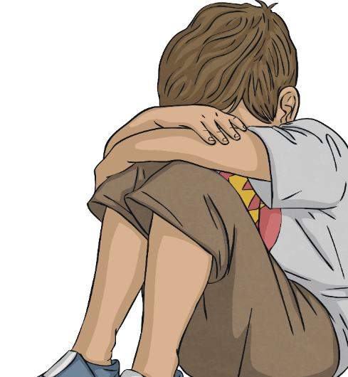
We Think
It’s my body, my choice.
What’s under your underwear is private, always.
Decide if a problem is a little deal, tricky or a big deal.
I’ve got a problem.
It’s a big deal.
I’ve got a problem.
It’s a big deal.
Your body is precious and you deserve to be safe.
Remember!
If it’s a big deal – tell.
Tell a grown-up you trust.
Tell your teacher or another adult at school.
Call Childline on 0800 1111.

