Slide 1


Maths
Measurement
Year One
Maths | Year 3 | Measurement | Add and Subtract Money | Lesson 2 of 5: The Sweet Shop

Slide 2


The Sweet Shop

Slide 3
Aim
I can add amounts of money.
Success Criteria
I can add amounts of money up to £1.
I can calculate the total cost of several items.

Slide 4






Combinations
Find all the different amounts you can make
choosing any three of these coins:
Show
Answers
Hide
Answers
30p
45p
£1.10
£1.25
£1.40
£2.05
£2.10
£2.20
£2.25
£2.40
£3.05
£3.20
£4.00
£4.05
£4.20
£5.00

Slide 5

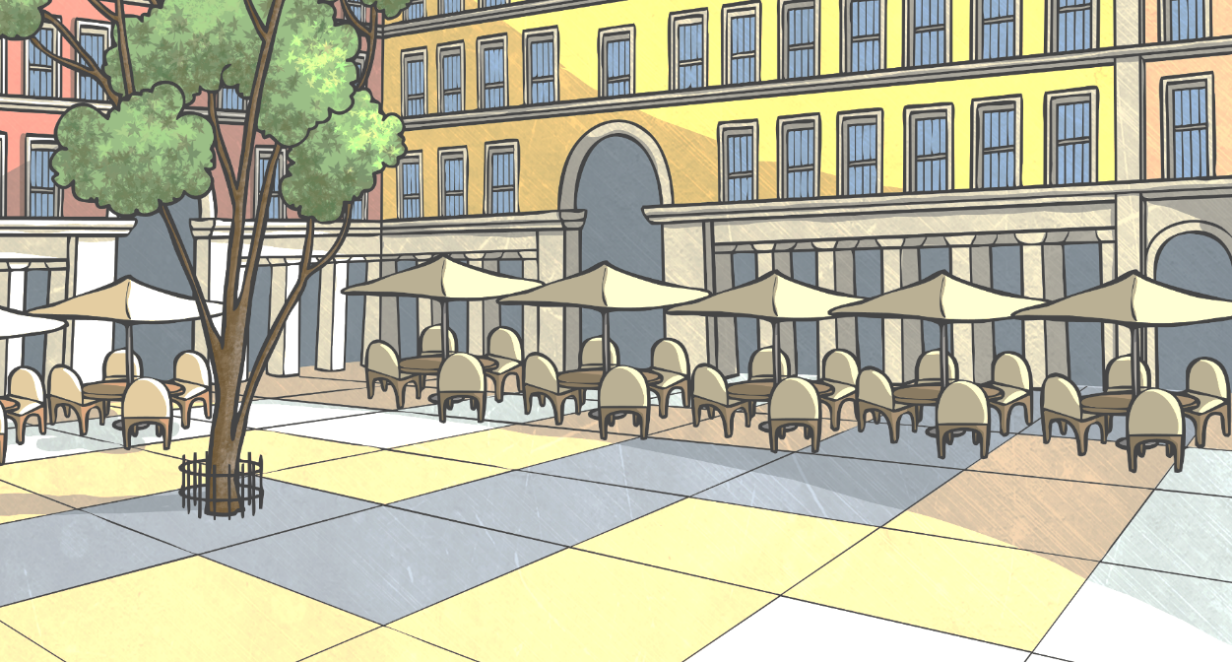
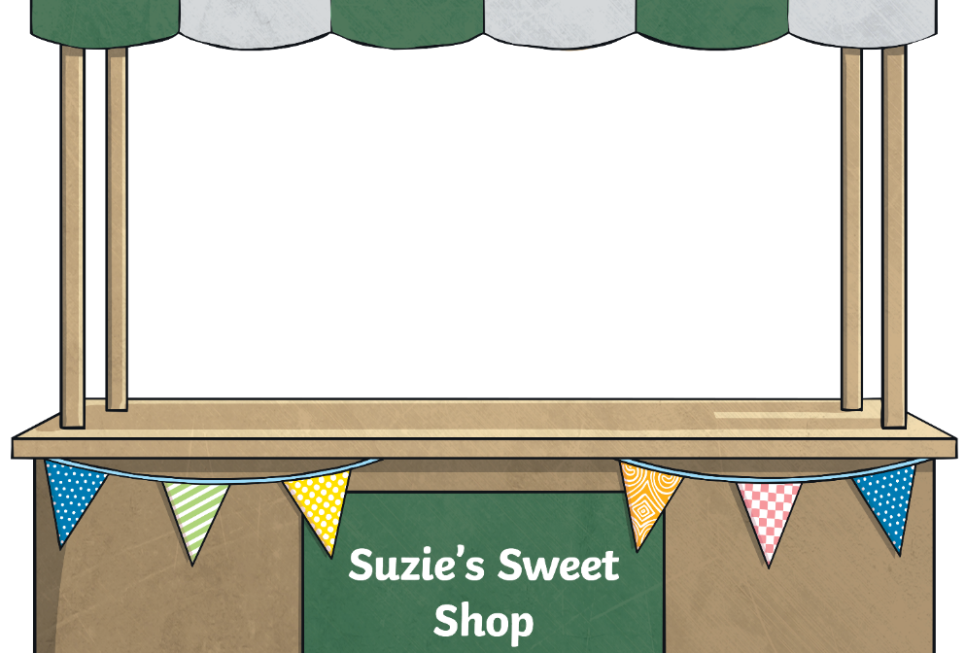

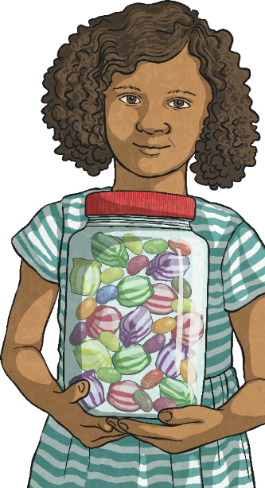



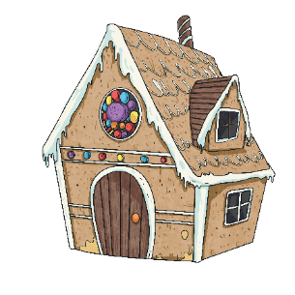
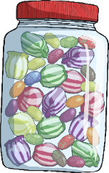
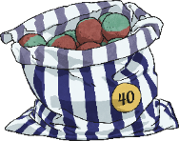




Suzie’s Sweet Shop
Here are some of the items for sale at the Suzie’s Sweet Shop:
lollipop
25p
bag of toffees
45p
toffee apple
38p
fizzy sweets
12p
small chocolate bar
42p
large chocolate bar
63p
jelly beans
49p
popcorn
64p

Slide 6
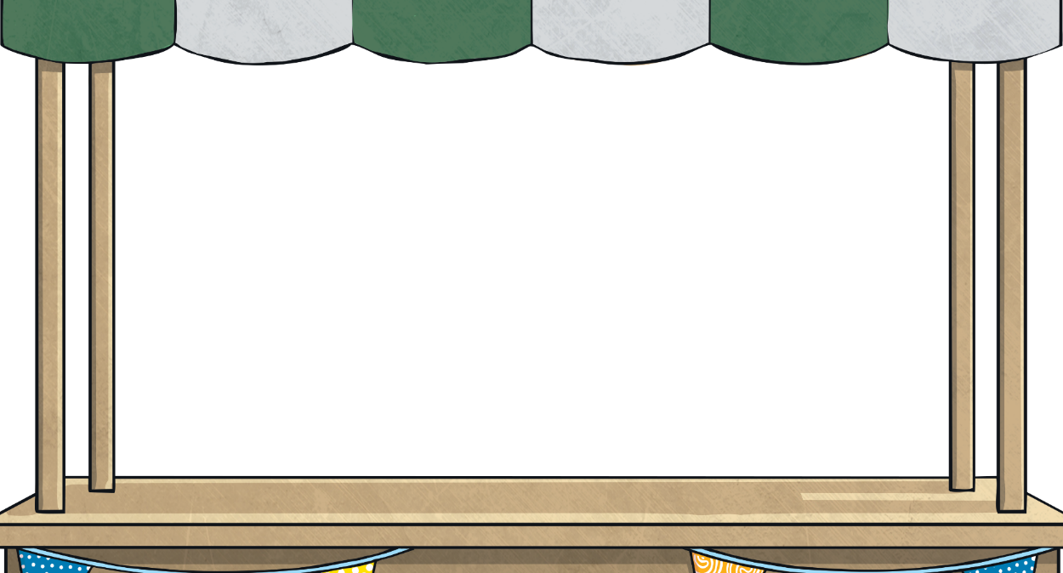

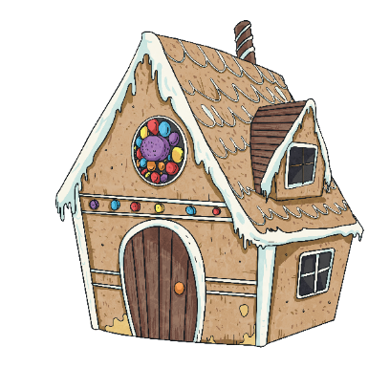
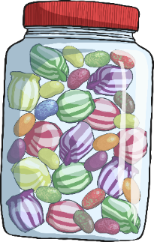

Suzie’s Sweet Shop
Jas goes to Suzie’s Sweet Shop and buys a bag of toffees and a pack of fizzy sweets. How much does it cost?
lollipop
25p
bag of toffees
45p
toffee apple
38p
fizzy sweets
12p
57p
small chocolate bar
42p
large chocolate bar
63p
jelly beans
49p
popcorn
64p

Slide 7
Suzie’s Sweet Shop
Lisa goes to Suzie’s Sweet Shop and buys a small chocolate bar and a lollipop. How much does it cost?
lollipop
25p
bag of toffees
45p
toffee apple
38p
fizzy sweets
12p
67p
small chocolate bar
42p
large chocolate bar
63p
jelly beans
49p
popcorn
64p

Slide 8
Suzie’s Sweet Shop
Carly goes to Suzie’s Sweet Shop and buys a toffee apple and a bag of toffees. How much does it cost?
lollipop
25p
bag of toffees
45p
toffee apple
38p
fizzy sweets
12p
83p
small chocolate bar
42p
large chocolate bar
63p
jelly beans
49p
popcorn
64p

Slide 9
Suzie’s Sweet Shop
Tasneem goes to Suzie’s Sweet Shop and buys some popcorn and a lollipop.
How much does it cost?
lollipop
25p
bag of toffees
45p
toffee apple
38p
fizzy sweets
12p
89p
small chocolate bar
42p
large chocolate bar
63p
jelly beans
49p
popcorn
64p

Slide 10
Suzie’s Sweet Shop
Tyreec goes to Suzie’s Sweet Shop and buys a lollipop, a some fizzy sweets and a bag of jelly beans. How much does it cost?
lollipop
25p
bag of toffees
45p
toffee apple
38p
fizzy sweets
12p
86p
small chocolate bar
42p
large chocolate bar
63p
jelly beans
49p
popcorn
64p

Slide 11
Suzie’s Sweet Shop
Jade goes to Suzie’s Sweet Shop and buys a large chocolate bar and
2 packs of fizzy sweets. How much does it cost?
fizzy sweets
12p
lollipop
25p
bag of toffees
45p
toffee apple
38p
fizzy sweets
12p
87p
small chocolate bar
42p
large chocolate bar
63p
jelly beans
49p
popcorn
64p

Slide 12

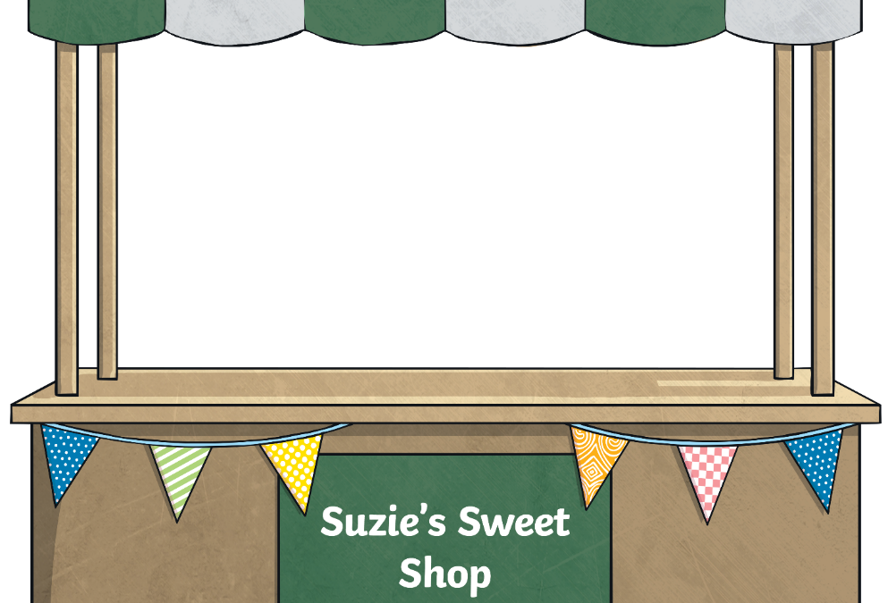

Do You Have Enough Money?
You go to Suzie’s Sweet Shop. You have £1 to spend.
You would like to buy a large chocolate bar and a lollipop.
Do you have enough money?
lollipop
25p
bag of toffees
45p
toffee apple
38p
fizzy sweets
12p
Yes
small chocolate bar
42p
large chocolate bar
63p
jelly beans
49p
popcorn
64p
they cost
88p

Slide 13
Do You Have Enough Money?
You go to Suzie’s Sweet Shop. You have £1 to spend.
You would like to buy some popcorn and a bag of jelly beans.
Do you have enough money?
lollipop
25p
bag of toffees
45p
toffee apple
38p
fizzy sweets
12p
No
small chocolate bar
42p
large chocolate bar
63p
jelly beans
49p
popcorn
64p
they cost
£1.13

Slide 14
Do You Have Enough Money?
You go to Suzie’s Sweet Shop. You have £1 to spend.
You would like to buy a bag of toffees and a small chocolate bar.
Do you have enough money?
lollipop
25p
bag of toffees
45p
toffee apple
38p
fizzy sweets
12p
Yes
small chocolate bar
42p
large chocolate bar
63p
jelly beans
49p
popcorn
64p
they cost
87p

Slide 15
Do You Have Enough Money?
You go to Suzie’s Sweet Shop. You have £1 to spend.
a toffee apple, a bag of jelly beans and a bag of toffees.
Do you have enough money?
lollipop
25p
bag of toffees
45p
toffee apple
38p
fizzy sweets
12p
No
small chocolate bar
42p
large chocolate bar
63p
jelly beans
49p
popcorn
64p
they cost
£1.32

Slide 16

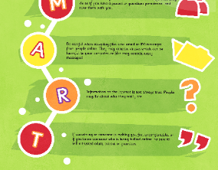



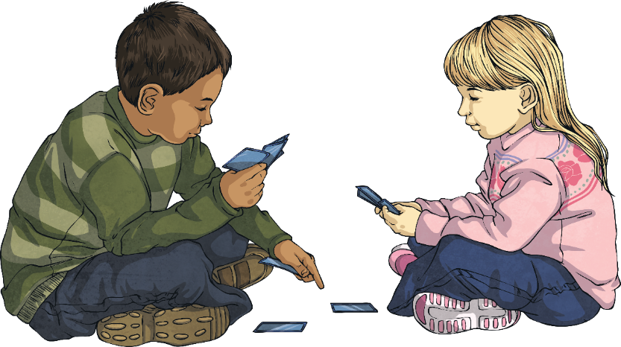
Do You Have Enough Money?
With your partner, take it in turns to be the shopkeeper and customer.
Shuffle the Sweet Cards and place them face down in front of you.
Add the cost of the two sweets together to find the total cost.
If not, the shopkeeper must tell the customer that they don’t have enough money.
The customer holds the £1 card, and takes two sweet cards.
If the customer has enough money, the shopkeeper can sell them the sweets!
If your teacher tells you, you can take three sweet cards.

Slide 17


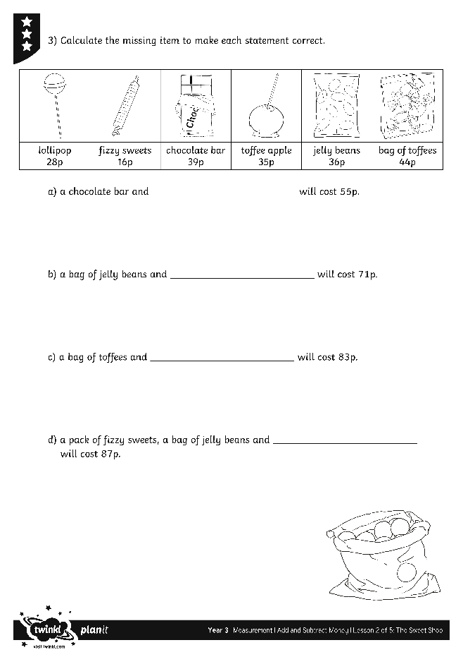
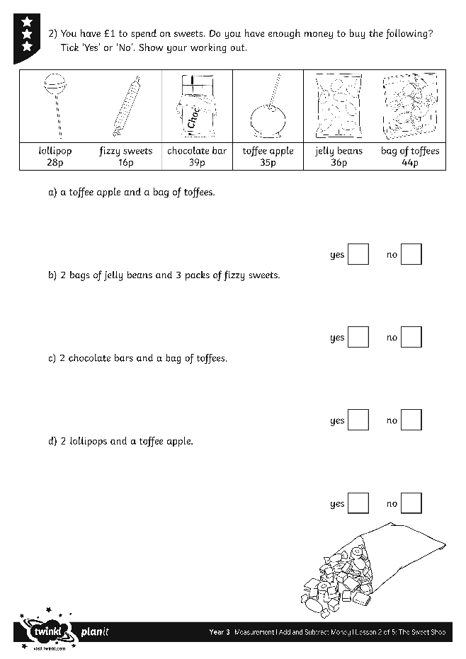
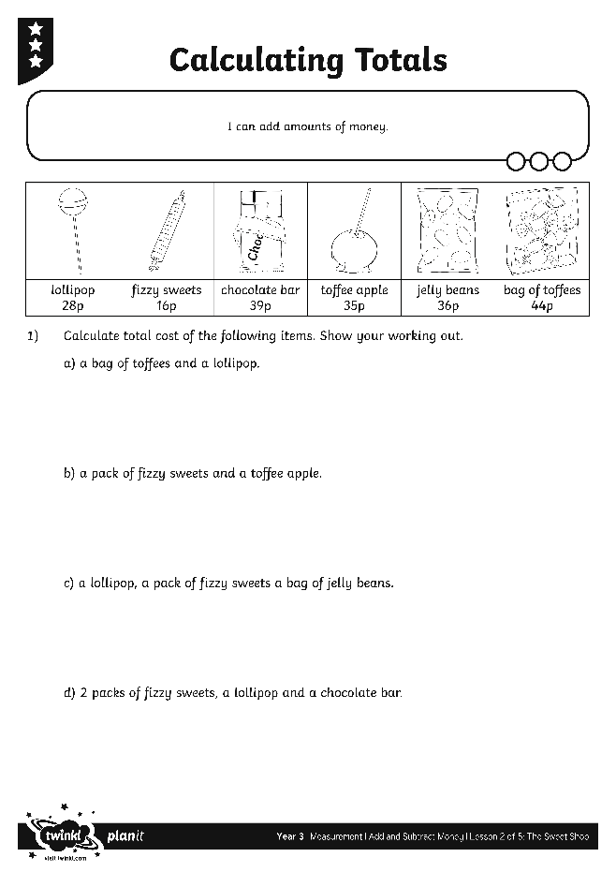

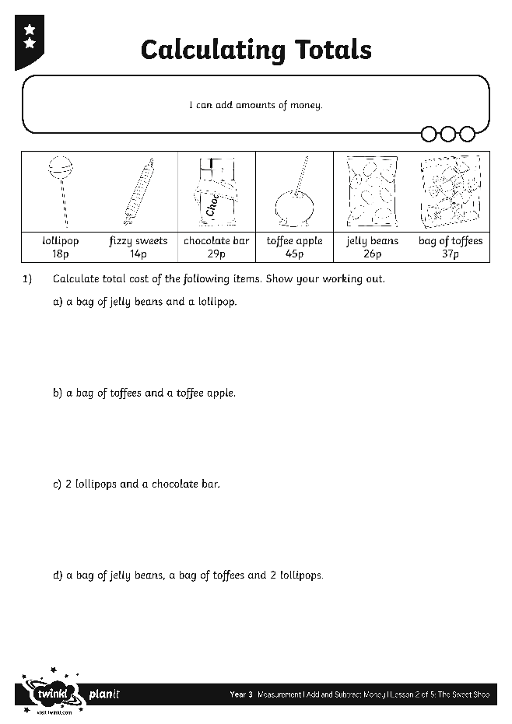
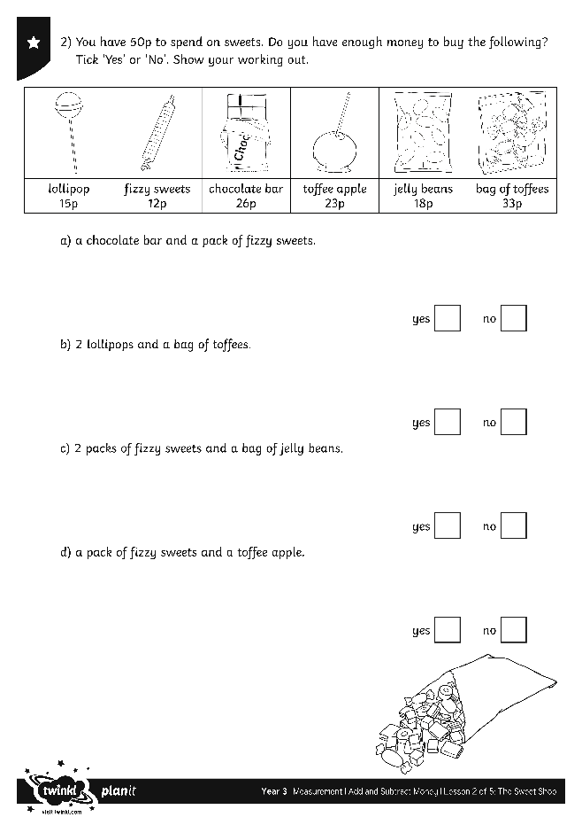
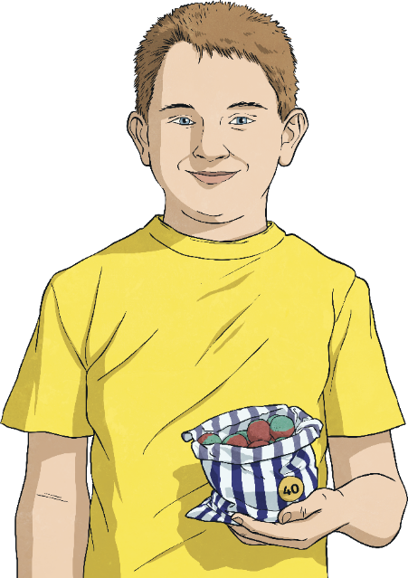

Calculating Totals
Use your marvellous money skills to complete these activity sheets:

Slide 18
Greater Than, Less Than, Equal To
Choose <, > or = to make this number sentence correct.
lollipop
25p
bag of toffees
45p
<
toffee apple
38p
fizzy sweets
12p
click to reveal the answer
small chocolate bar
42p
large chocolate bar
63p
jelly beans
49p
popcorn
64p

Slide 19
Greater Than, Less Than, Equal To
Choose <, > or = to make this number sentence correct.
lollipop
25p
bag of toffees
45p
<
toffee apple
38p
fizzy sweets
12p
fizzy sweets
12p
fizzy sweets
12p
fizzy sweets
12p
click to reveal the answer
small chocolate bar
42p
large chocolate bar
63p
jelly beans
49p
popcorn
64p

Slide 20
Greater Than, Less Than, Equal To
Choose <, > or = to make this number sentence correct.
lollipop
25p
bag of toffees
45p
<
toffee apple
38p
fizzy sweets
12p
fizzy sweets
12p
click to reveal the answer
small chocolate bar
42p
large chocolate bar
63p
jelly beans
49p
popcorn
64p

Slide 21
Greater Than, Less Than, Equal To
Choose <, > or = to make this number sentence correct.
lollipop
25p
bag of toffees
45p
=
toffee apple
38p
fizzy sweets
12p
click to reveal the answer
small chocolate bar
42p
large chocolate bar
63p
jelly beans
49p
popcorn
64p

Slide 22
Greater Than, Less Than, Equal To
Choose <, > or = to make this number sentence correct.
lollipop
25p
bag of toffees
45p
<
toffee apple
38p
fizzy sweets
12p
fizzy sweets
12p
fizzy sweets
12p
click to reveal the answer
small chocolate bar
42p
large chocolate bar
63p
jelly beans
49p
popcorn
64p

Slide 23

Aim
I can add amounts of money.
Success Criteria
I can add amounts of money up to £1.
I can calculate the total cost of several items.

Slide 24


