Slide 1


Science
Animals Including Humans
Year One
Science | Year 3 | Animals Including Humans | Types of Nutrition | Lesson 1

Slide 2
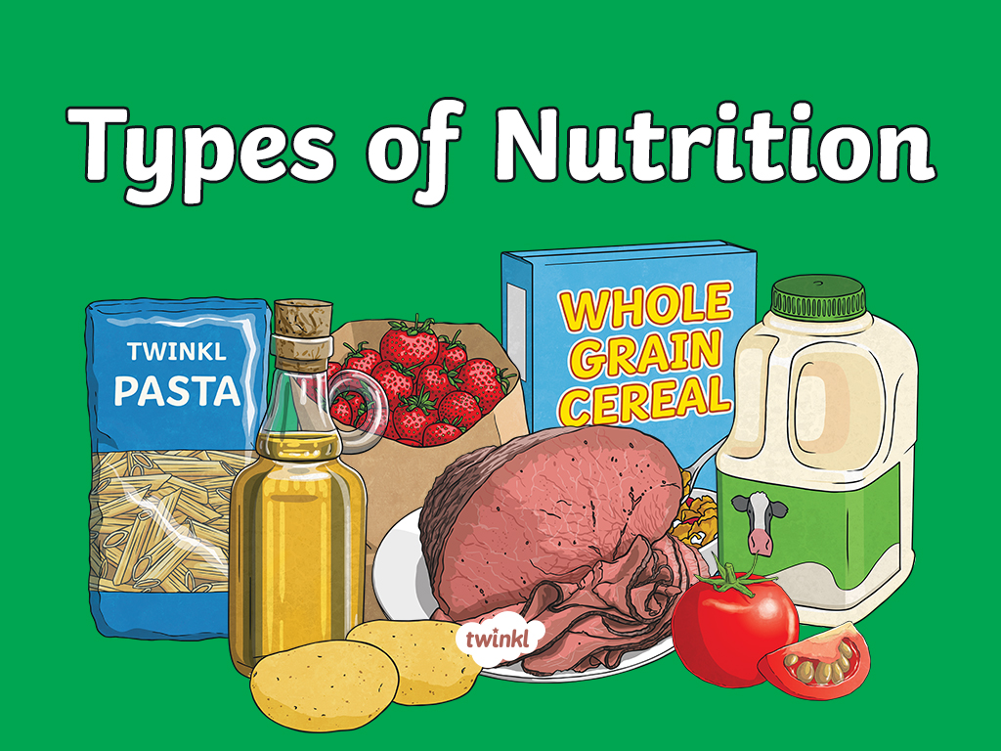

Slide 3
Aim
I can explain how living things obtain food.
I can state why animals, including humans, need the right type
of nutrients.
Success Criteria
I can explain how plants obtain food.
I can explain how animals, including humans, obtain food.
I can demonstrate I understand the difference between how plants and animals obtain food.
I can explain the difference between food groups and types
of nutrients.
I can explain what types of nutrients humans need.

Slide 4

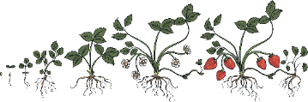
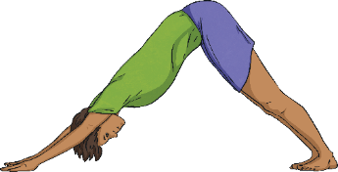
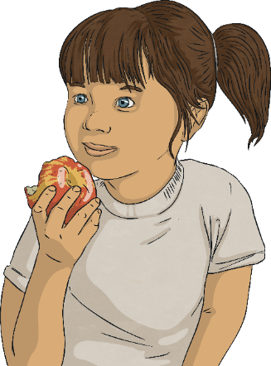
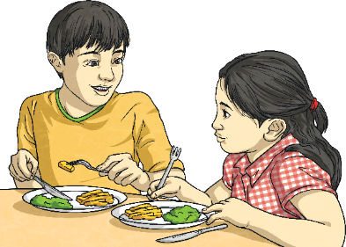
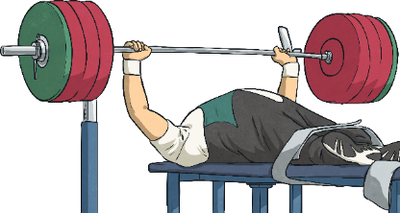
Living Things and Food
Why do living things need food?
To grow
To be strong
To be healthy

Slide 5
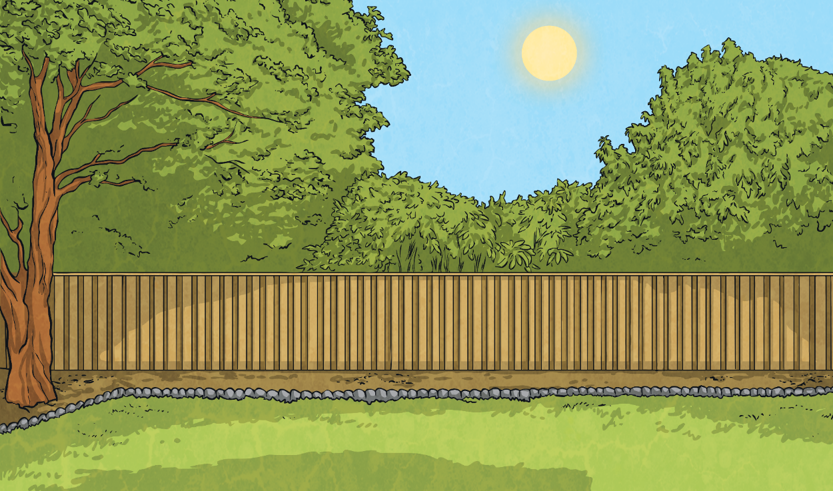
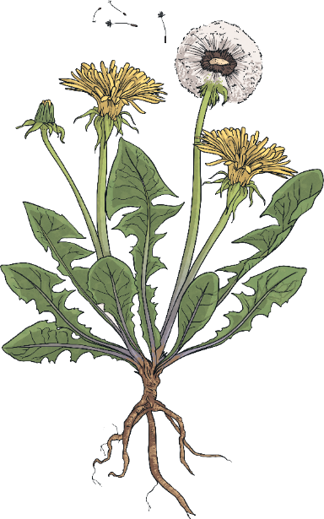


Photosynthesis
sunlight
How do plants obtain food?
Plants make their own food! This process is called photosynthesis.
They use water, sunlight and carbon dioxide (a gas in the air) to produce food in their leaves.
carbon
dioxide
water

Slide 6
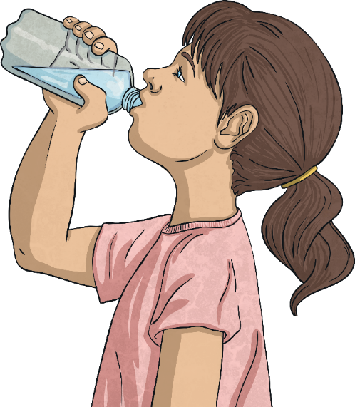
Animals and Photosynthesis
water
sunlight
What would happen to animals if they tried to obtain food in the same way as plants?
carbon
dioxide

Slide 7

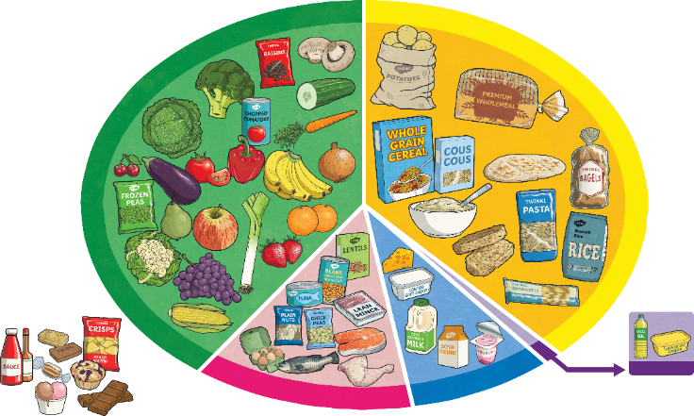
Human Food
What kind of foods do humans need?
Food is commonly divided into five food groups.
How many of the food groups can you remember?
As a group label the food groups.

Slide 8
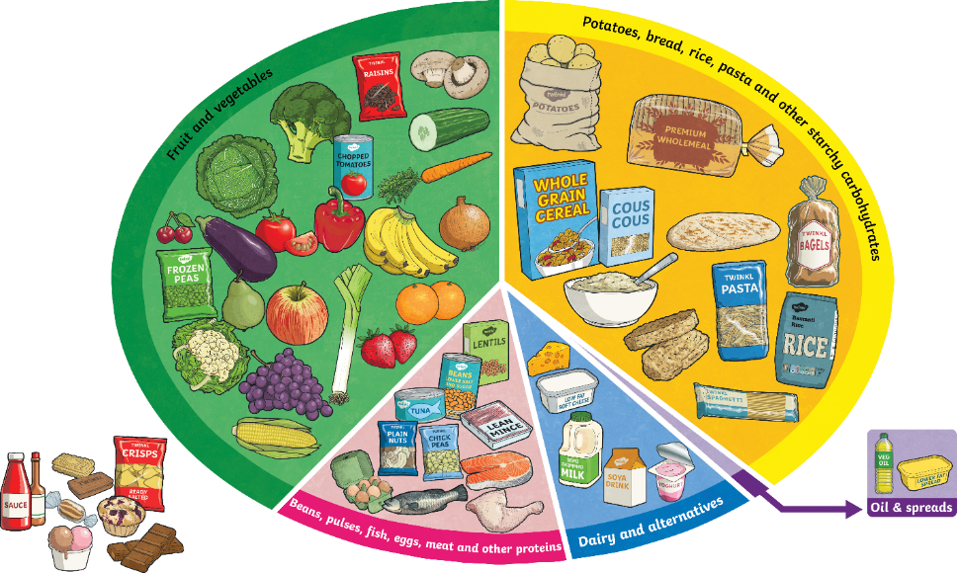
Human Food
What kind of foods do humans need?
Fruit and vegetables
Aim to eat 5 a day! Dried, frozen and tinned fruits and vegetables count as well as fruit juices. Important as sources of vitamins and minerals which reduce your risk of disease and keep you healthy. Limit fruit juice and/or smoothies to 150ml a day.
Potatoes, bread, rice, pasta and other starchy carbohydrates
These are important for giving us energy.
Oil and spreads
Choose unsaturated oils and use in small amounts.
Dairy and alternatives
These are important for strong teeth and bones.
Beans, pulses, fish, eggs, meat and other proteins
These are very important for helping us grow and build muscles. Try to eat 2 portions of fish a week and try to reduce intake of red and processed meat.
Why do you think foods that are high in sugar and/or fat are not a food group?
Check another group’s work using the picture, then give it back to them.
How many did you get correct?
Are there any groups you were confused by? Which ones? Why?

Slide 9
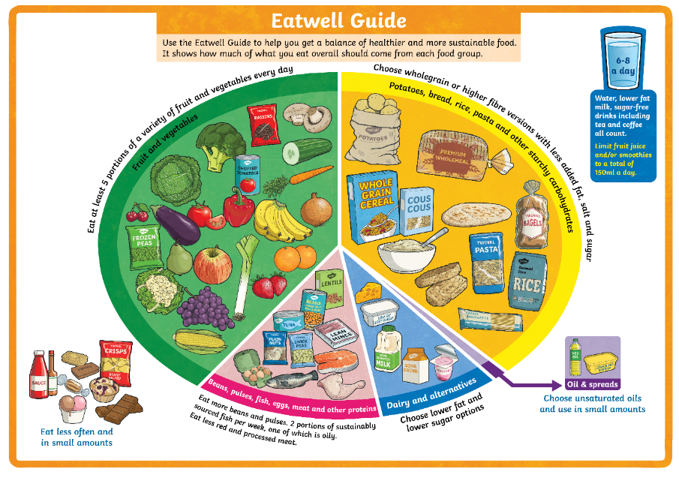
Food Groups
The Eatwell Guide helps us to make decisions about how to make sure we eat the right balance of nutrients in our diets.
The food groups are shown on the Eatwell Guide.
Notice that drinking plenty of water is also very important to keep us healthy.

Slide 10
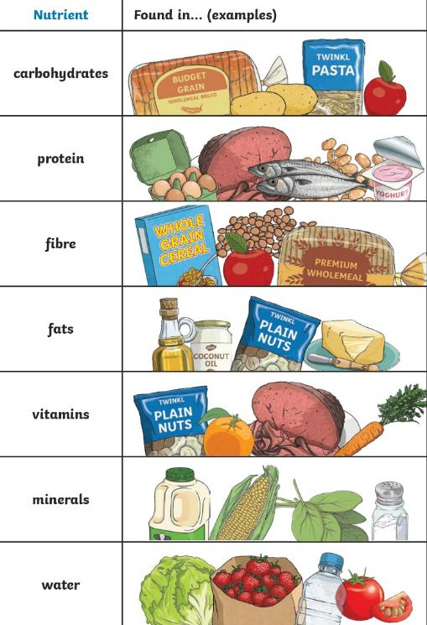
Types of Nutrients
Nutrients are substances that animals need to stay alive and stay healthy. These nutrients are found in the foods we eat.
There are seven nutrients.

Slide 11
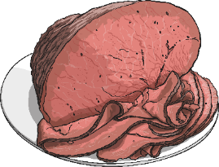

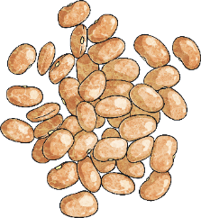
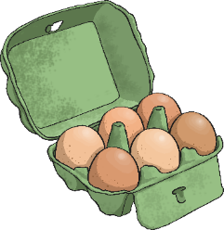
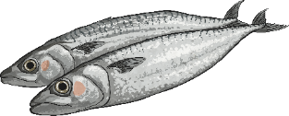
Types of Nutrients - Proteins
Proteins help your body to grow and repair itself.
Foods high in protein include:
Red Meat
Fish
Beans
Yoghurt

Slide 12

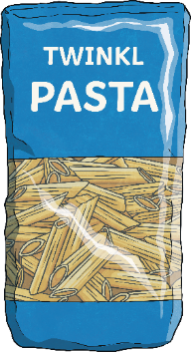


Types of Nutrients - Carbohydrates
Carbohydrates give
you energy.
Foods high in carbohydrates include:
Bread
Pasta
Fruit
Potatoes

Slide 13



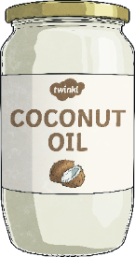
Types of Nutrients - Fats
Fats give you energy.
Foods high in fats include:
Nuts
Oils
Avocados
Butter

Slide 14

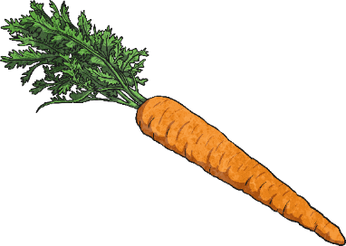

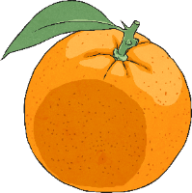
Types of Nutrients - Vitamins
Vitamins keep your
body healthy.
Foods high in vitamins include:
Oranges
Carrots
Beef
Nuts

Slide 15

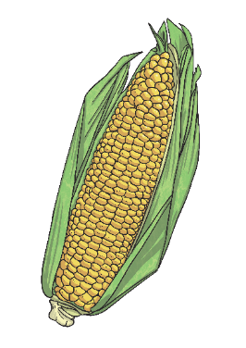


Types of Nutrients - Minerals
Minerals keep your
body healthy.
Foods high in minerals include:
Milk
Spinach
Salt
Sweetcorn

Slide 16




Types of Nutrients - Water
Water helps to move nutrients in your body and get rid of waste that you don’t need. It is an essential nutrient for our survival. While it is really important to drink plenty of water, it is also important to remember that many foods contain water also.
Foods high in water include:
Tomatoes
Cucumbers
Lettuce
Strawberries

Slide 17
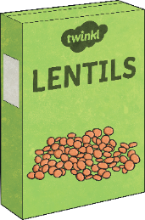
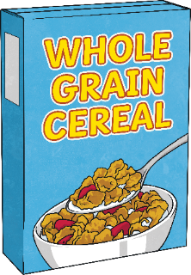

Types of Nutrients - Fibre
Fibre helps you to digest the food that you
have eaten.
Foods high in fibre include:
Cereal
Apples
Wholegrain bread
Lentils

Slide 18


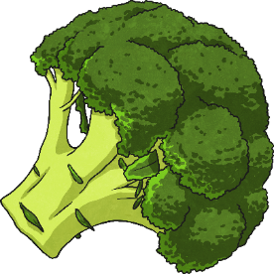
Food Groups and Nutrients
Within each food group, there are many foods which contain more than
one type of nutrient.
For example, eating broccoli from the fruit and vegetables section would provide with various different nutrients. This food is a great source of minerals (especially a mineral called potassium), a really good source of vitamins and it provides the body with fibre.

Slide 19

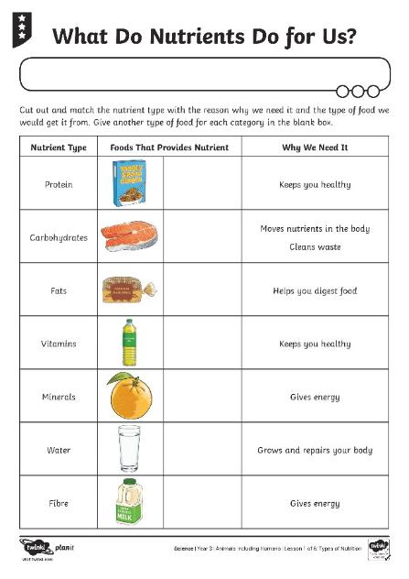
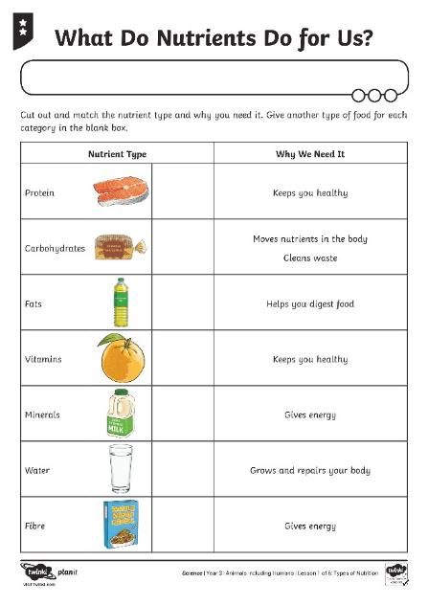
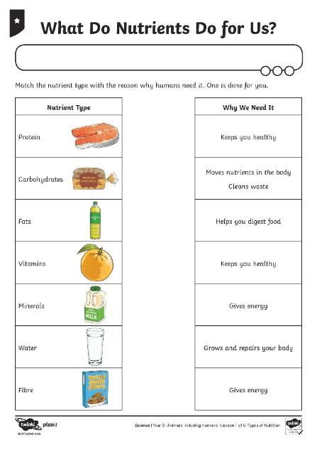
What do Nutrients do For us?

Slide 20
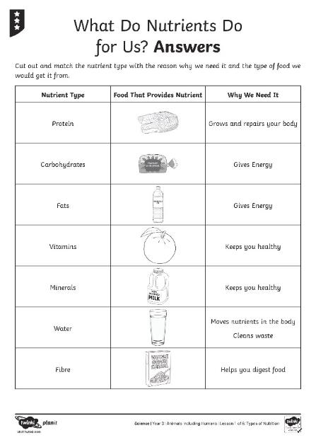
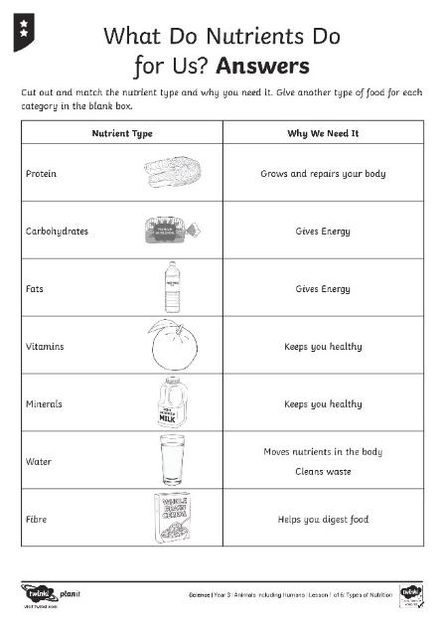
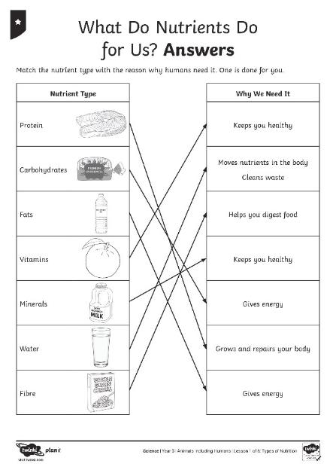
What do Nutrients do For us?

Slide 21










Nutrients for Animals
Although the Eatwell Guide provides human beings with guidance to know
how much of different kinds of foods to eat, the guide does not apply to
other animals.
Some animals need to eat more of certain nutrients than others. There are special terms for animals that eat particular types of foods.
Carnivores: These animals feed on other animals.
Herbivores: These animals only eat plants.
Omnivores: These animals eat both meat and plants.
Carnivores | Herbivores | Omnivores

Slide 22
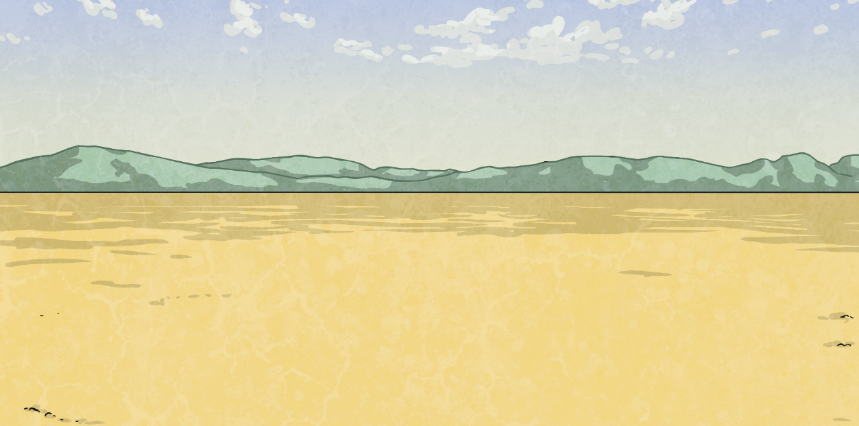
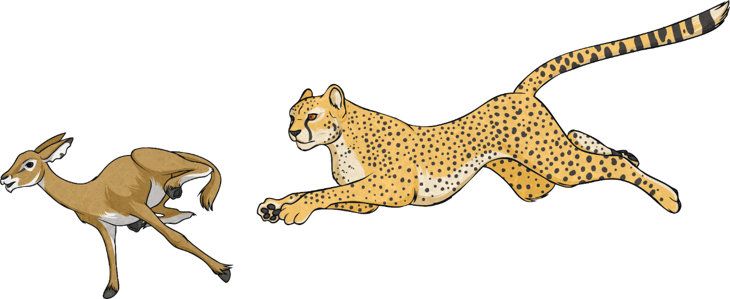
Nutrients for Animals
Carnivores eat lots of meat so they get lots of their energy from protein rather than from carbohydrates. Their bodies are designed for this.
A carnivore’s diet is mostly made up of protein but meat also provides vitamins, minerals and fats.
Although carnivores have a diet which is high in protein, not all carnivores require the same balance of nutrients.

Slide 23

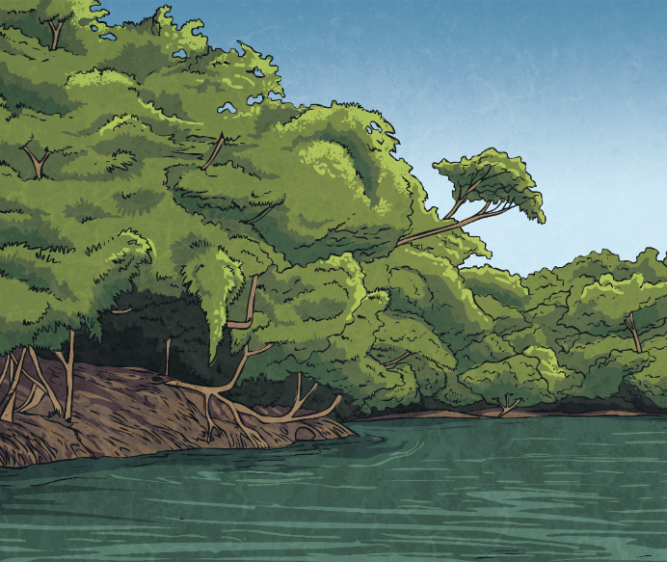
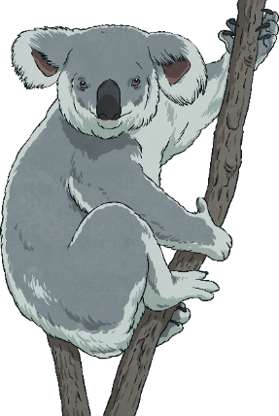
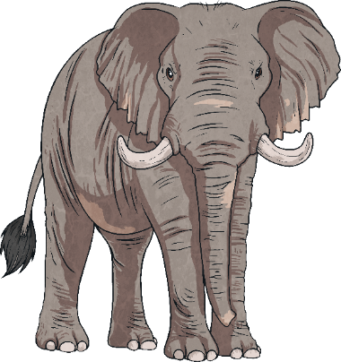
Nutrients for Animals
Herbivores get their energy from eating plants. As plants are often not high
in carbohydrates, protein and fats, herbivores have to eat large amounts of
plant-based foods to get the energy they need. Some herbivores spend a lot of their day eating.
While some herbivores eat a wide variety of plants, others will only eat a limited number of types, meaning that they consume a smaller range of vitamins and minerals.
Koalas, on the other hand, only eat eucalyptus tree leaves. These leaves do not provide high levels of
energy for these animals
but as koalas sleep for twenty hours a day, they need less energy than
other animals.
Elephants eat a wide variety of plant foods such as branches, fruit, grasses and leaves.

Slide 24
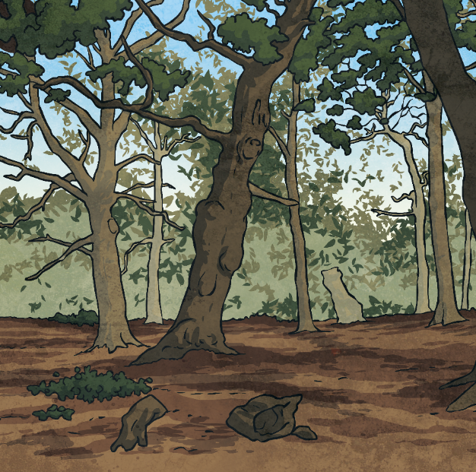


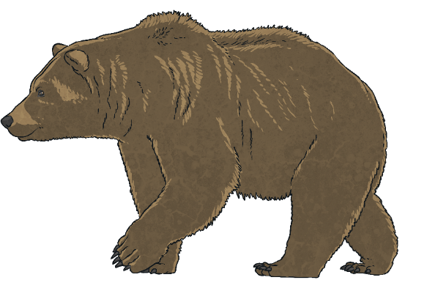
Nutrients for Animals
Omnivores get their nutrients from both meat and plants. Omnivores can therefore be more flexible in what they eat, often only eating what is available
to them.
For example, a brown bear will eat fish when it can catch them in a river, but it will also pick berries to eat if they are available.
Different omnivores vary in the balance of nutrients they require.
Even pandas, who are famous for eating bamboo for most of their day, occasionally eat rats or birds they catch or find.

Slide 25


Share What You Know
Can you talk for one minute about the things you have
learnt about nutrition for humans and animals?
Your teacher will start the timer.
Tell your partner some of the things you now know about nutrition.
When the timer ends, swap roles with your partner.
Words to help you…
food groups
five
nutrients
seven
energy
healthy
carnivore
60

Slide 26

Aim
I can explain how living things obtain food.
I can state why animals, including humans, need the right type
of nutrients.
Success Criteria
I can explain how plants obtain food.
I can explain how animals, including humans, obtain food.
I can demonstrate I understand the difference between how plants and animals obtain food.
I can explain the difference between food groups and types
of nutrients.
I can explain what types of nutrients humans need.

Slide 27


