Slide 1
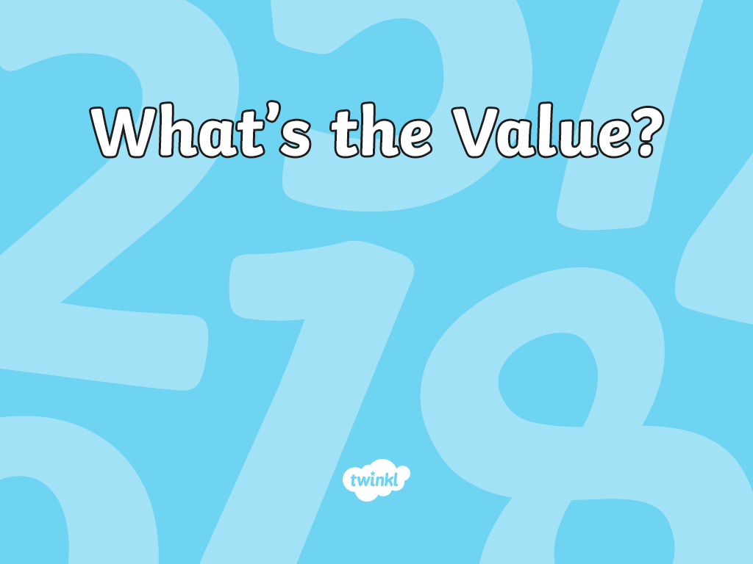

Slide 2
Remember It
Complete the table.
Number | Rounded to Nearest 10 | Rounded to Nearest 100 | Rounded to Nearest 1 000
399
12 948
99 999
30 008
16 294
400
400
0
12 950
12 900
13 000
100 000
100 000
100 000
30 010
30 000
30 000
16 290
16 300
16 000

Slide 3
Rounding with Number Lines
Previously, we used number lines to round
numbers to the nearest 10.
In this example, the number line that shows
5 623 is nearer to 5 620 than 5 630.
5620
5623
5630

Slide 4
Rounding with Number Lines
Number lines can also be used when rounding numbers
to the nearest 10 000 or 100 000.
What is 63 906 rounded to the nearest 10 000?
The number is closer to 60 000 than 70 000. In this case, 63 906 rounds down to 60 000 when rounding to the nearest 10 000.
The previous multiple of 10 000 is 60 000. The next multiple of 10 000 is 70 000. Finding the midpoint helps to position the number on the number line. Halfway between 60 000 and 70 000 is 65 000.
60 000
63 906
70 000
65 000

Slide 5
Rounding with Number Lines
What is 63 906 rounded to the nearest 100 000?
The number is closer to 100 000 than it is to zero. In this case, 63 906 rounds up to 100 000 when rounding to the nearest 100 000.
63 906
0
100 000
50 000
The previous multiple of 100 000 is 0. The next multiple of 100 000 is 100 000. Finding the midpoint helps to position the number on the number line. Halfway between 0 and 100 000 is 50 000.

Slide 6
Rounding with Number Lines
The same method works when rounding larger numbers.
What is 704 827 rounded to the nearest 100, 1 000, 10 000 and 100 000?
Rounded to the nearest 100
704 827
704 800
704 900
704 850
Rounded to the nearest 1 000
704 827
704 000
705 000
704 500

Slide 7
Rounding with Number Lines
The same method works when rounding larger numbers.
What is 704 827 rounded to the nearest 100, 1 000, 10 000 and 100 000?
Rounded to the nearest 10 000
704 827
700 000
710 000
705 000
Rounded to the nearest 100 000
704 827
700 000
800 000
750 000

Slide 8



Round Using Number Lines
Choose a section and try rounding these numbers. Blank number lines might be helpful.
Round to the nearest 100 and 1 000 | Round to the nearest 100, 1 000 and 10 000 | Round to the nearest 10, 100, 1 000, 10 000 and 100 000
205 6 738 | 15 603 593 039 | 999 901 801 999

Slide 9
Round Using Number Lines
Let’s check to see how you got on.
205
Round to
the nearest
100 and 1 000
205
6 738
200
250
300
205
0
500
1 000
6 738
6 700
6 750
6 800
6 738
6 000
6 500
7 000

Slide 10
Round Using Number Lines
Let’s check to see how you got on.
To the
Nearest 100
To the
Nearest 1 000
To the Nearest 10 000
15 603
593 039
15 600
593 000
16 000
593 000
20 000
590 000

Slide 11
Round Using Number Lines
Let’s check to see how you got on.
To the
Nearest 10
To the
Nearest 100
To the Nearest 1 000
999 900
802 000
999 900
802 000
1 000 000
802 000
999 901
801 999
To the
Nearest 10 000
To the
Nearest 100 000
1 000 000
800 000
1 000 000
800 000

