Slide 1
Converting measurements

Slide 2
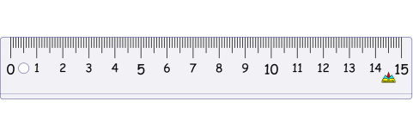
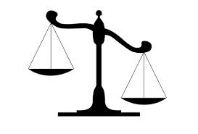

How could you group these measurements and pictures?
ml
km
g
l
m
kg
cm
mm
What do you know about these measurements?
Write down anything you know.

Slide 3

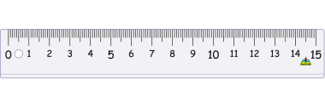
How could you group these measurements?
Length
Mass
Volume
mm
g
ml
cm
kg
l
m
km

Slide 4
Kilometers & Kilograms
What does the word kilo mean?
A thousand
Knowing this complete these sentences:
1 km = _____ m
1 kg = _____ g
1000
1000

Slide 5
Converting between km and m
1 km = 1000 m
1 kg = 1000 g
How do you convert from km to m?
Use what you already know … 1km = 1000m
x 1000
1 km = 1000m
÷ 1000
How do you convert from m to km?

Slide 6
Converting between kg and g
1 km = 1000 m
1 kg = 1000 g
Can you apply this to kg and g?
How do you convert from kg to g?
How do you convert from g to kg?
x 1000
km m
÷ 1000
x 1000
kg g
÷ 1000

Slide 7
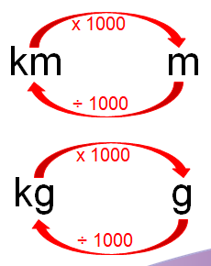
Converting kg and g
What is 5.3 kilograms in grams?
You could use a place value grid to help you.
5300g
Th | H | T | U | tenths | hundredths
9
0
3
1
3
5
To times by 1000 we need to move each digit 3 places to the left.
5
3
0
0
1
3
9
What is 9130 grams in kilograms?
9.13kg

Slide 8
Converting km and m
Can you fill in the missing values on the double number line?
1/10 km
3 4/5 km
½ km
0.5
1
4
?
2
2.5
3.2
?
?
km
m
500
1000
2000
?
3200
?
4000
2500
Challenge:
Where would ½ km go on the number line?
What about 1/10 km?
What about 3 4/5km?

Slide 9
Converting mm, cm, m and km
1 cm = _____ mm
1 m = _____ cm
1 km = _____ m
10
100
Using this, can you fill in the rules on the diagram?
1000
x 10
x 100
x 1000
mm cm m km
÷10
÷100
÷1000
How about the other way?
Notes:
Have rulers and meter sticks at hand

Slide 10
Converting ml and l
What do you think ‘milli’ in millilitre means?
It is a prefix which means 1/1000
So how many millilitres do you think are in a litre?
litre = _____ ml
1000
x 1000
l ml
÷ 1000
Notes:
Have measuring jugs/water bottles

Slide 11
Converting ml and l
x 1000
l ml
Try these:
2000 ml = ____ l
400 ml = ____ l
32401 ml = ____ l
÷ 1000
And these!
1 l = ____ ml
2.3 l = ____ ml
0.52 l = ____ ml
Challenge:
¾ l = ____ ml
Hint:
What is ¾ as a decimal?

Slide 12
Converting units of time
How many seconds are in a minute?
How about a day?
How many months are in a year?
How many weeks are in a year?
How many hours are in a day?
How many minutes in an hour?
How about a day?
Notes:
Could be done on whiteboards – quick reminder …

Slide 13
Converting units of time
1 year = 12 months
1 year = 52 weeks
1 month = 28-31 days
1 day = 24 hours
1 week = 7 days
1 hour = 60 minutes
1 minute = 60 seconds
3 years = ____ months
____ years = 60 months
4 weeks = ____ days
56 days = ____ weeks
Challenge:
2.5 years = ____ months
1.2 days = ____ hours

Slide 14
Imperial units – inches, pounds, pints & yards
litre | kilogram | cm | metre
inch
pounds (lb)
Can you match the imperial unit to the correct metric unit?
pint
yard

Slide 15
Imperial units – inches, pounds, pints & yards
1 inch ≈ 2.5 cm
This means that it is not equal to but nearly equal to (approximate).
What do you notice?
Is there anything different?

Slide 16
Imperial units – inches, pounds, pints & yards
A centimeter at a pinch
Is roughly 2 point 5 per inch
A kilo of goo,
Is 2 point 2
A litre of water’s
A pint and 3 quarters.
A yard at a run
Is 0.91
1 inch ≈ 2.5 cm
1 cm ≈ 0.4 inches
1 kg ≈ 2.2 pounds
1 lb ≈ 0.45kg
1 l ≈ 1.75 pints
1 pint ≈ 0.57 l
1 yard ≈ 0.91m
1 metre ≈ 1.09 yards

Slide 17
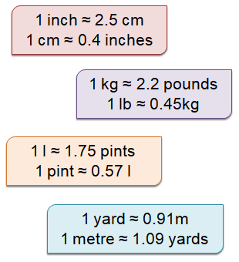
Converting imperial units
What is 3 pints in l?
3 pints = ____ l
1.71
Hint:
What would the number sentence be?
3 x 0.57
Challenge:
What is 2.4 pints in litres?
1.368 l

Slide 18
Converting imperial units
What is 4 inches in cm?
4 inches = ____ cm
10
Hint:
What would the number sentence be?
4 x 2.5
Challenge:
What is 19.6 inches in m?
0.49 m

