Slide 1
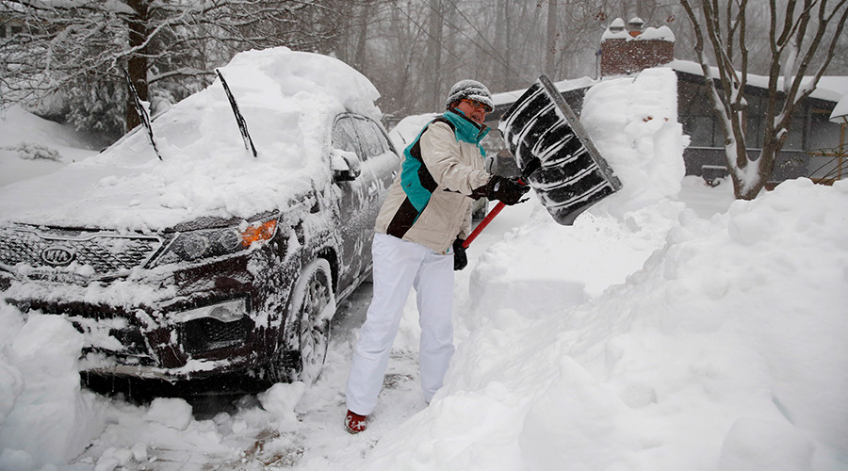
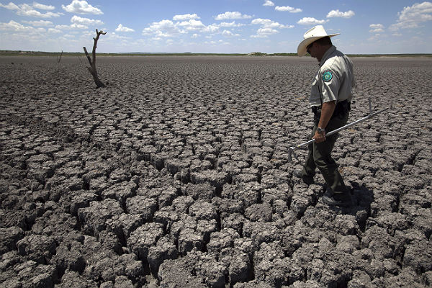
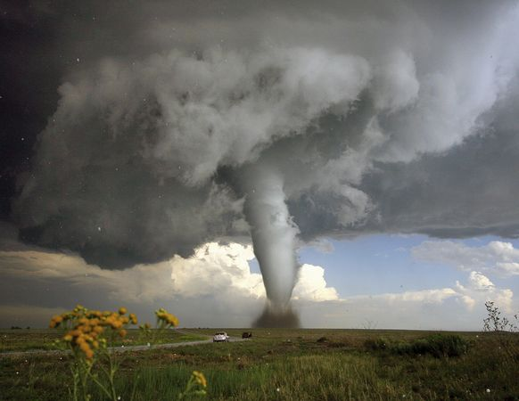
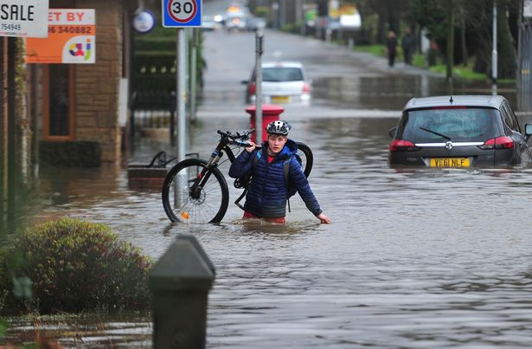
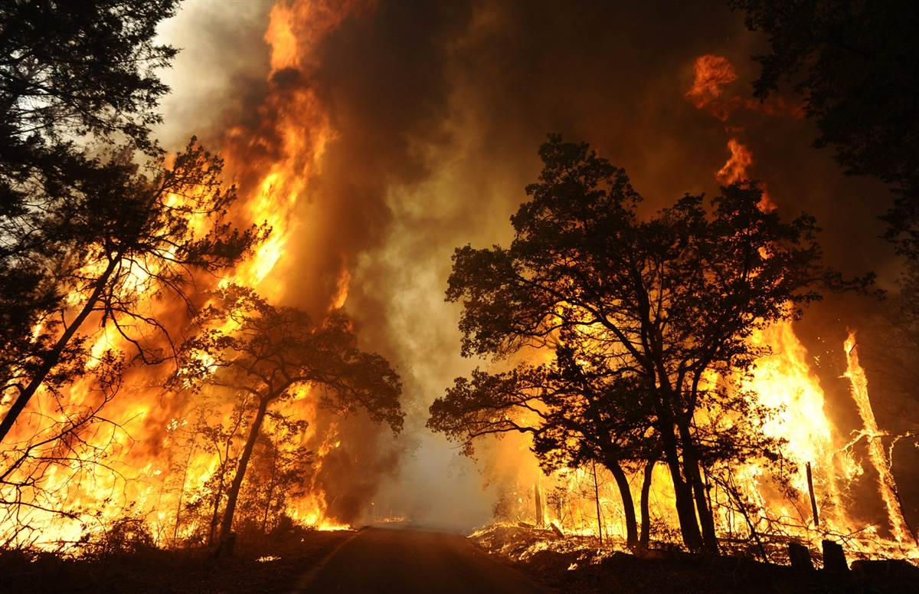
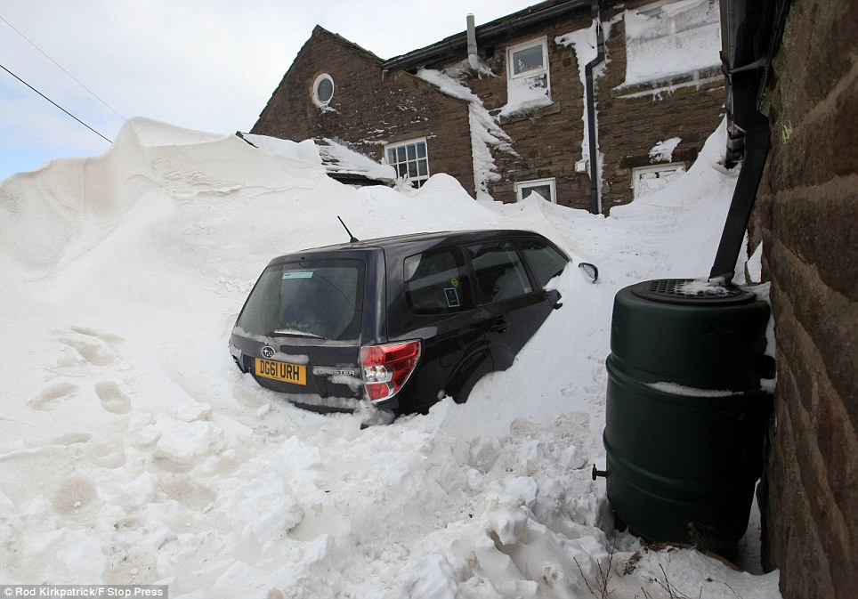
Extreme weather
Aims:
To know different types of extreme weather
To locate extreme weather around the world
Starter: how many types of extreme weather can you name?
Challenge: can you say where they happen?

Slide 2
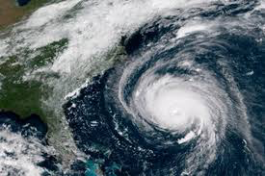
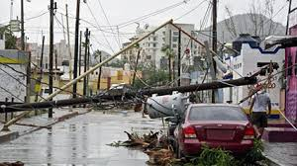
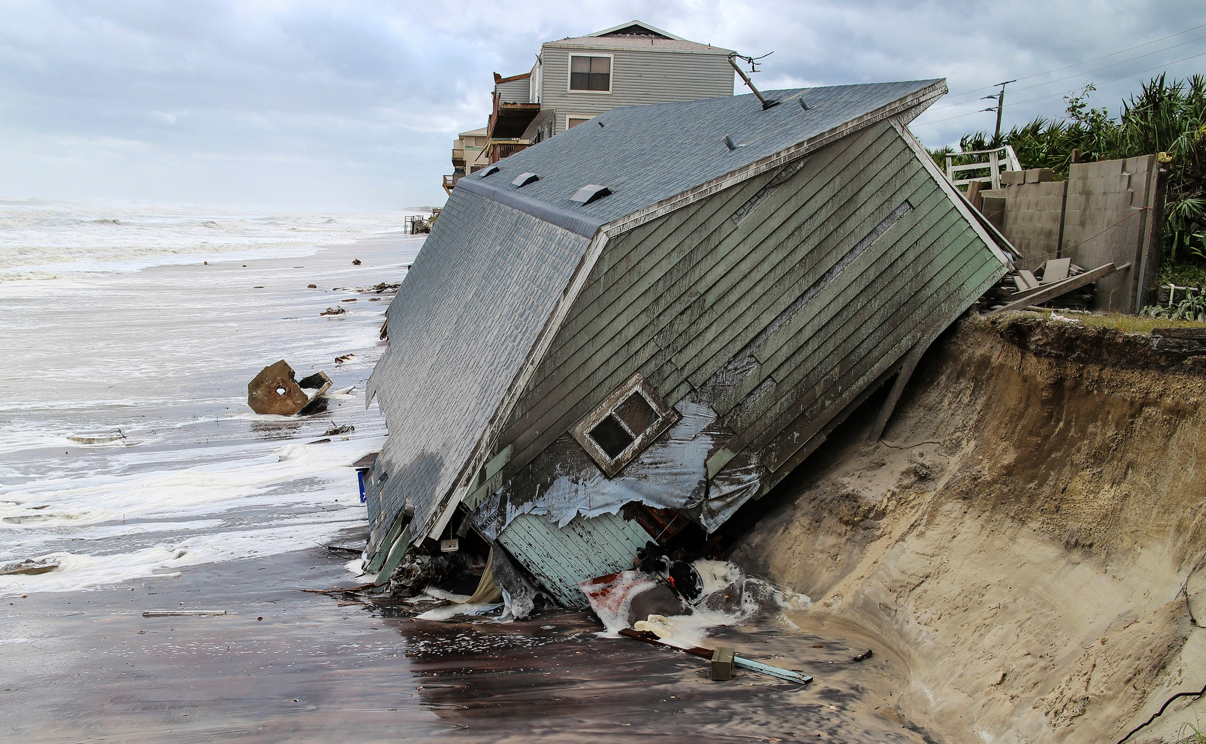
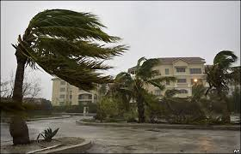
Hurricanes
Hurricane Florence
September 2018
Wind speeds 180mph
130 deaths

Slide 3
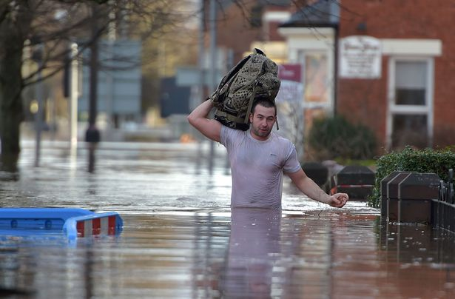
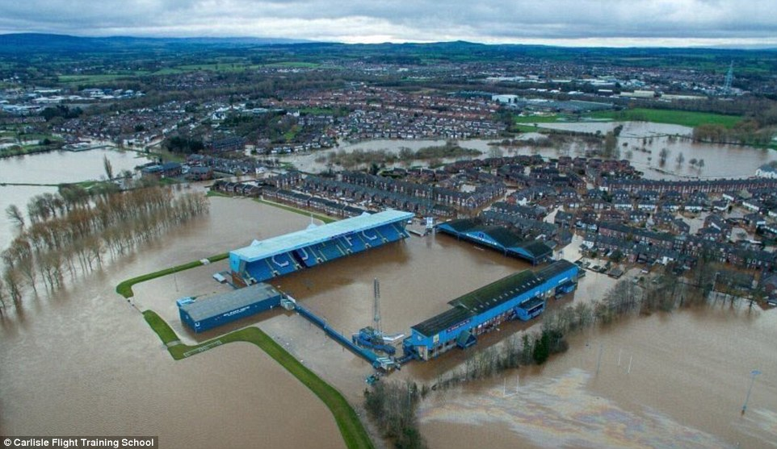
Flooding
- 6th December 2015 – Storm Desmond
Storm Desmond brought 13.5 inches of rain in 24 hours
60,000 homes across North West were left without power

Slide 4
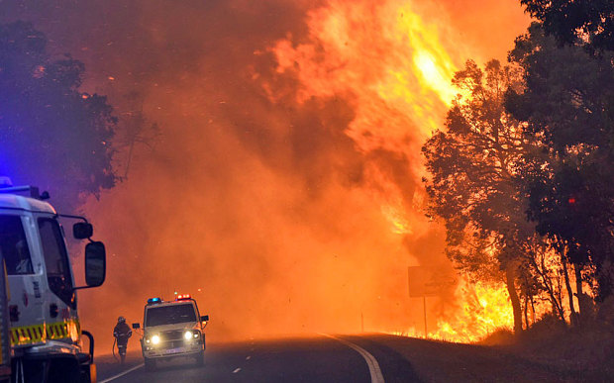
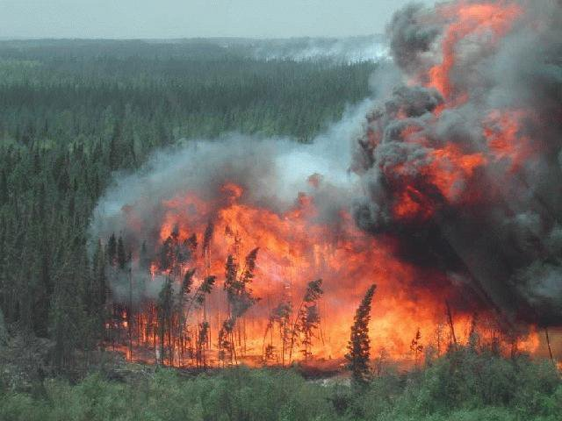
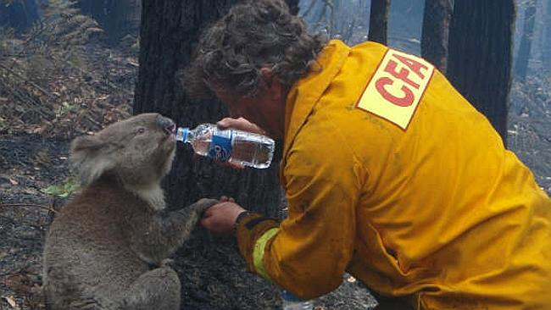
Wildfires – Australia
Uncontrolled fires in Tasmania, Australia
Destroyed 12000 hectares of land – about 20,000 football pitches!
Notes:
http://www.bbc.co.uk/news/world-australia-35157303

Slide 5
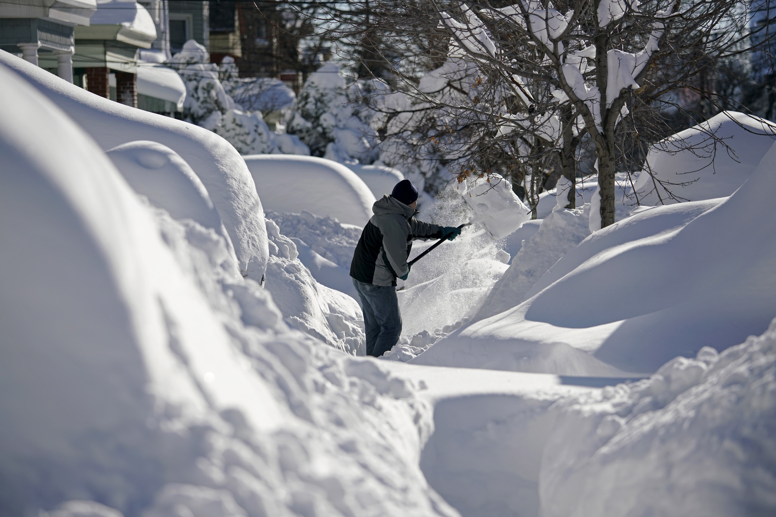
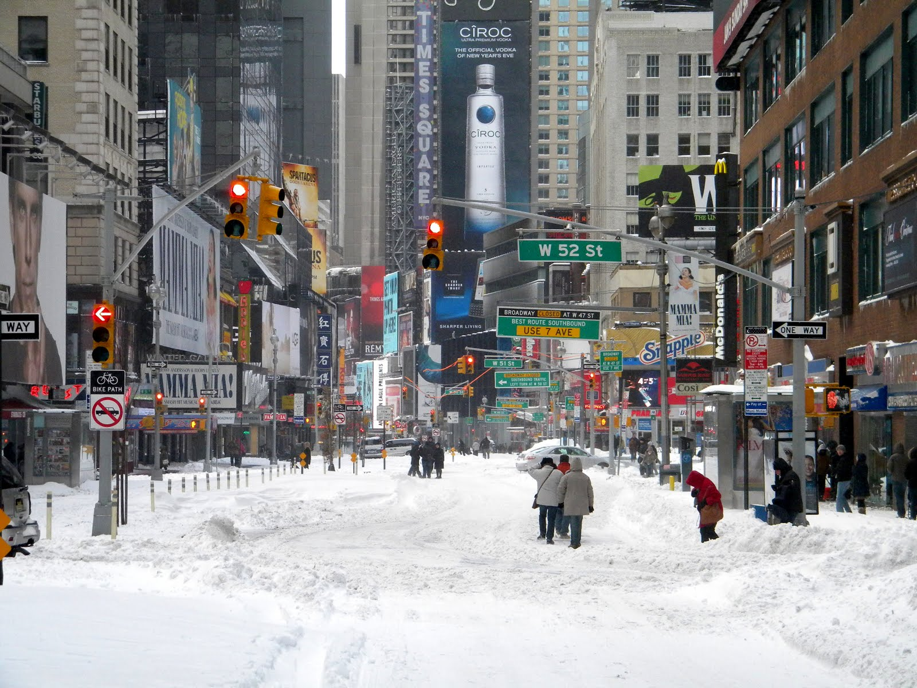
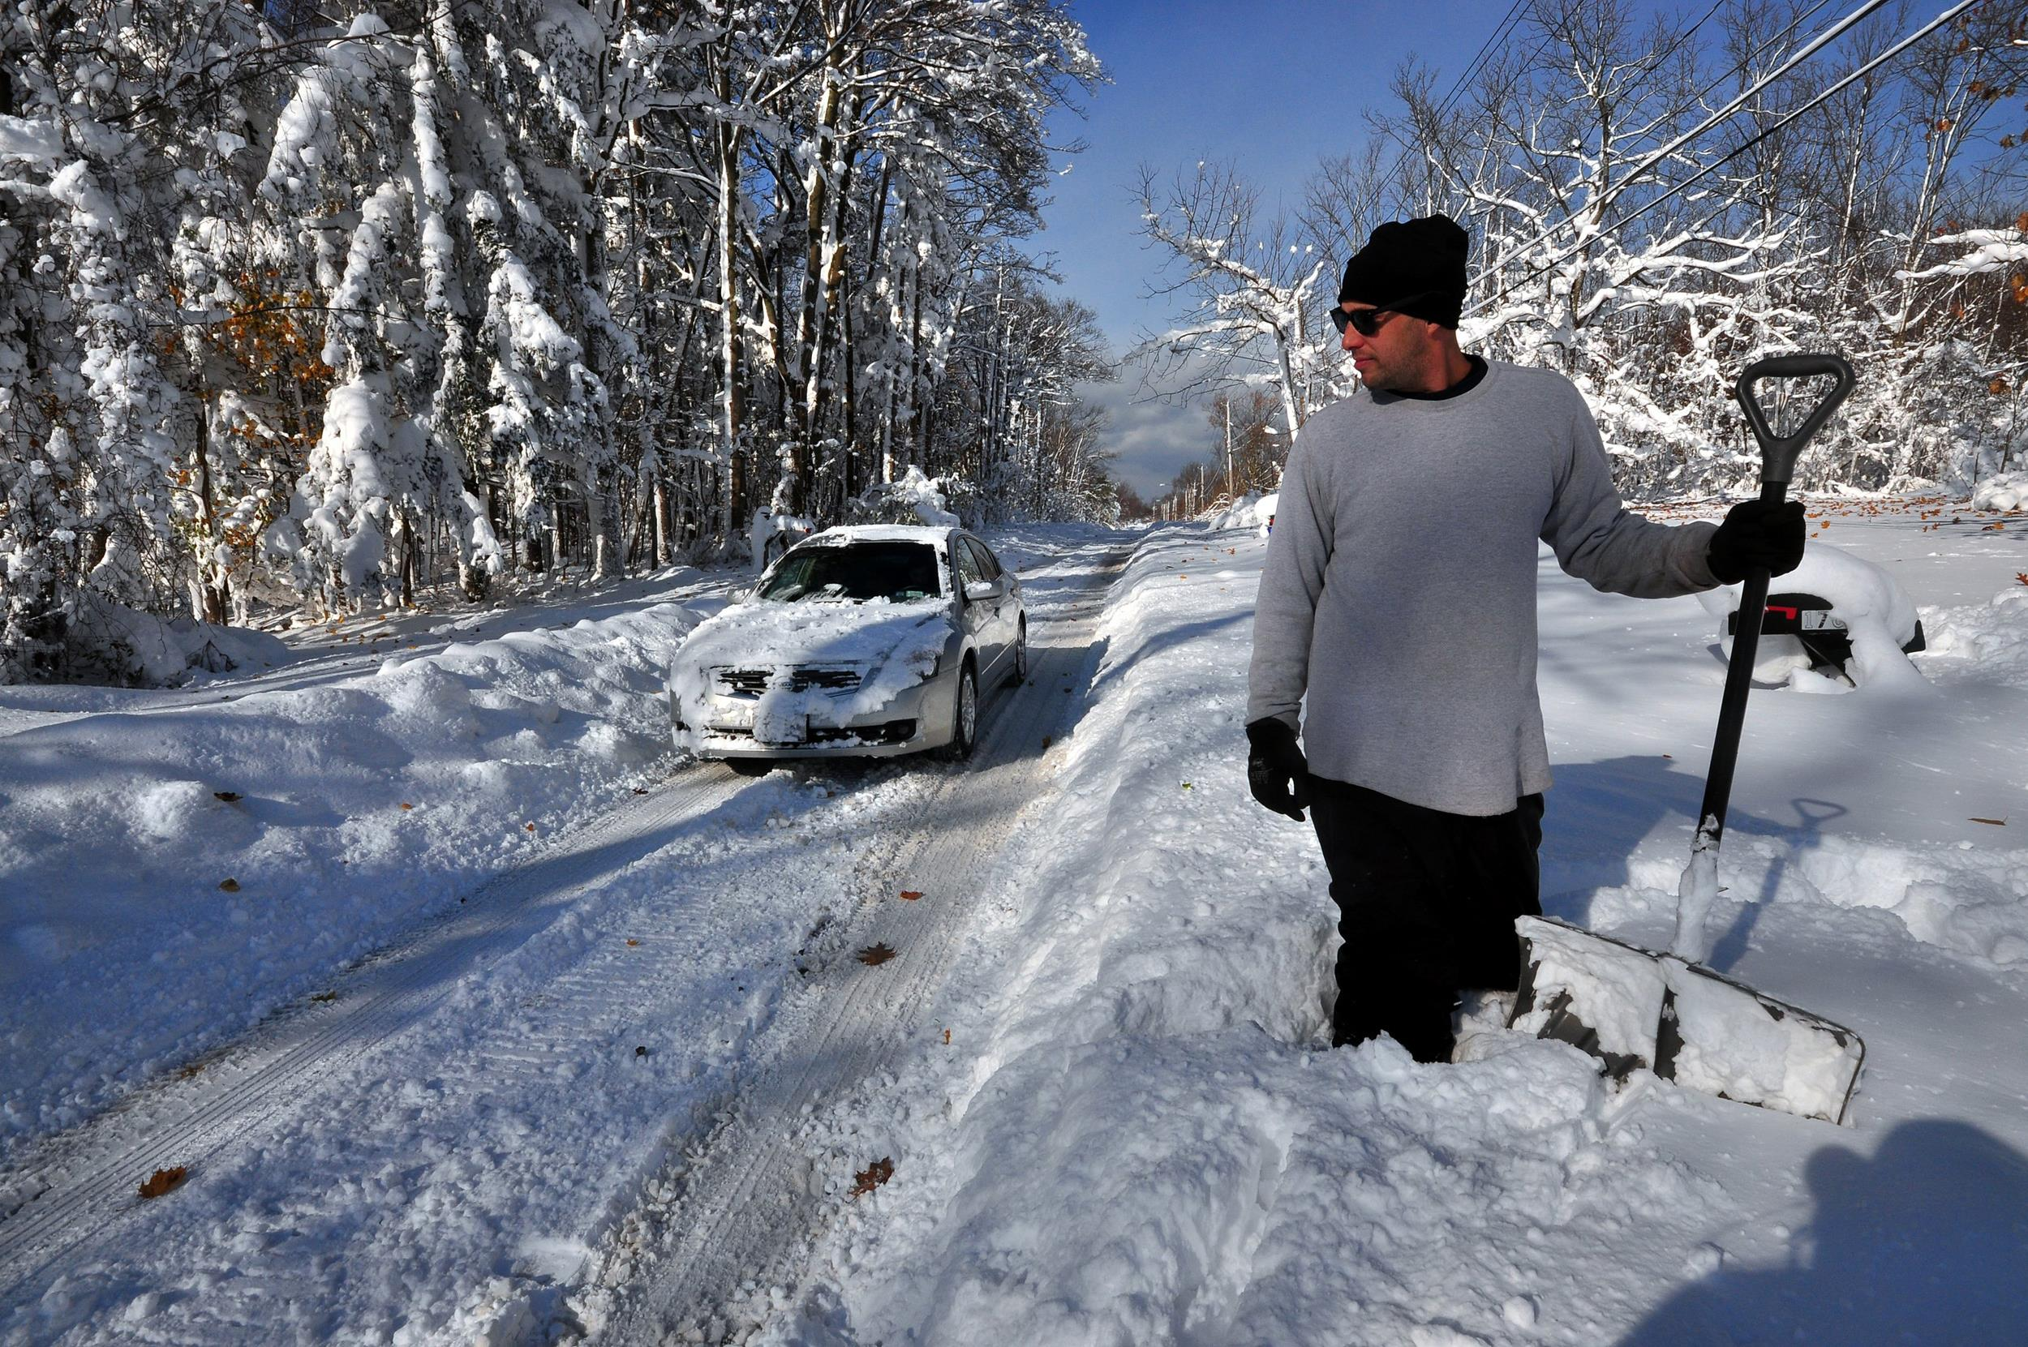
Snowstorms – USA
January 2016
On Friday January 22, winter storm Jonas hit almost a dozen East Coast states killing 48 people

Slide 6
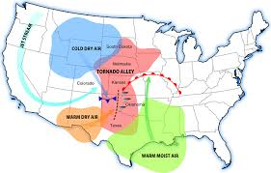
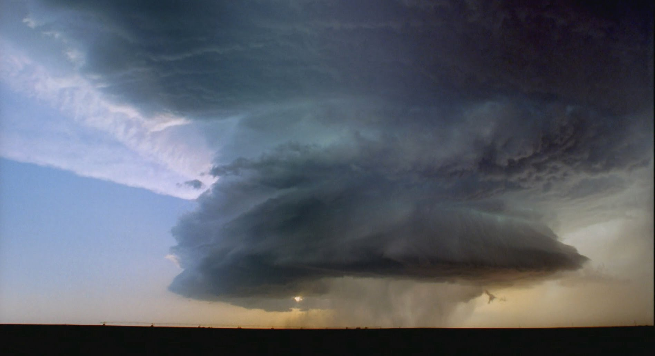
Tornado Alley – Oklahoma, USA
Tornadoes regularly happen in this part of the USA – think ‘The Wizard of Oz’!

Slide 7
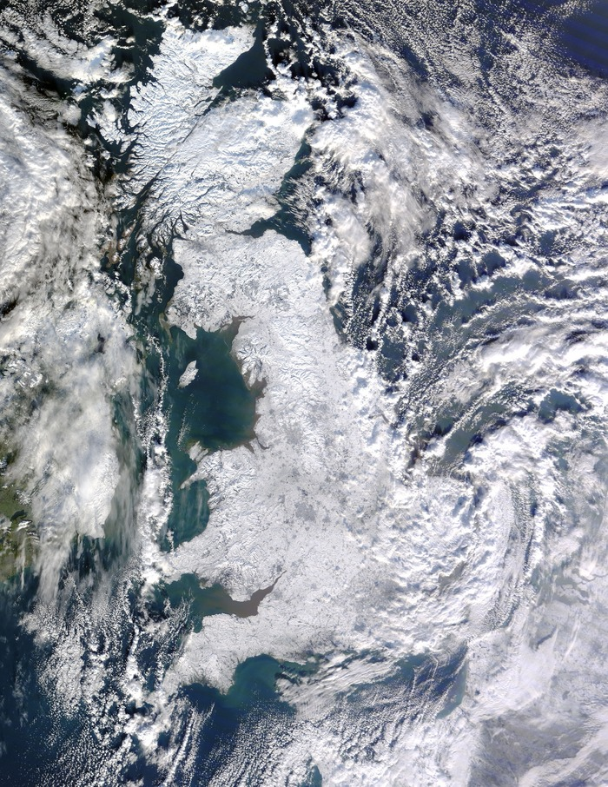
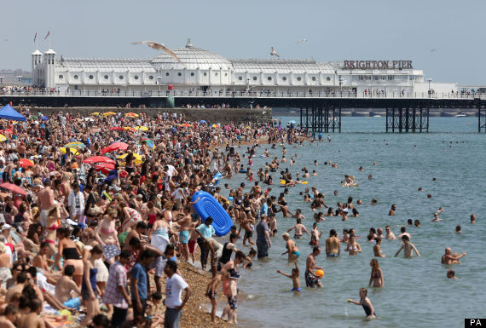
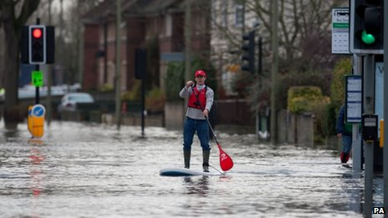
What is ‘extreme weather’?
COPY:
An unusual weather event that is unpredictable and can cause widespread damage

Slide 8
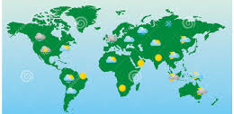

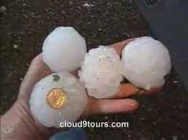
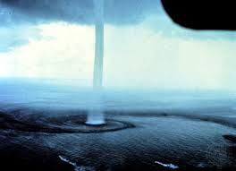
Extreme weather – mapping task
Cover your map with labels showing:
The name of the weather event
A symbol of the weather event
e.g. Tornado =
EXTRA: which types of extreme weather would you most like to experience, and why

Slide 9









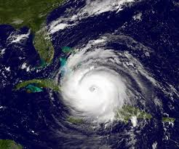

Slide 10
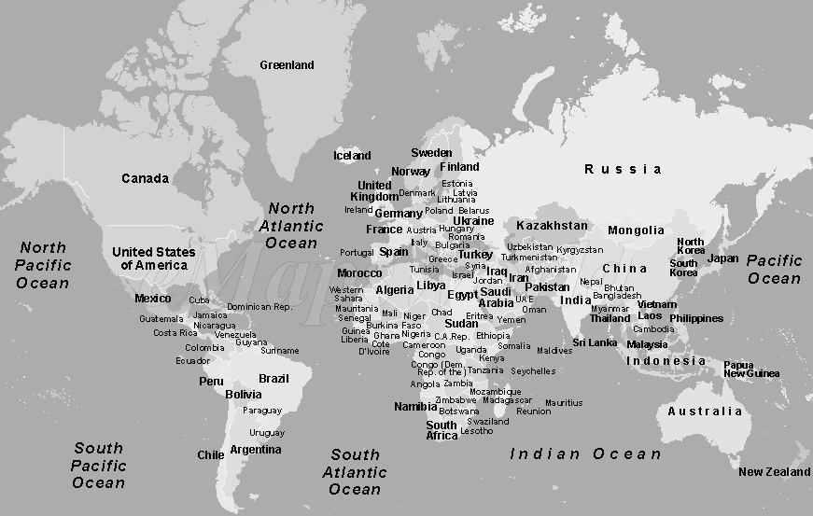
Extreme weather – mapping task
Tornadoes
Alaska
New York
Key:
Wildfires in Australia = Hurricanes in Cuba = Lightning storms in Mexico = Dust storms in Saudi Arabia =
Freezing rain in Canada = Drought in Egypt = Blizzards in New York = Fog in Sheffield =
Floods in India = Hail storms in Alaska = Heatwaves in Spain = Tornadoes in the USA =

Slide 11



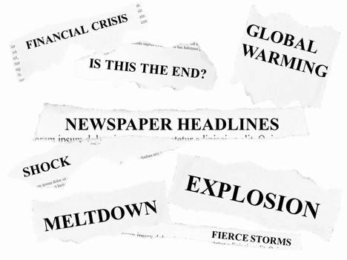
Think of a headline to go with each of the following pictures…...

Slide 12
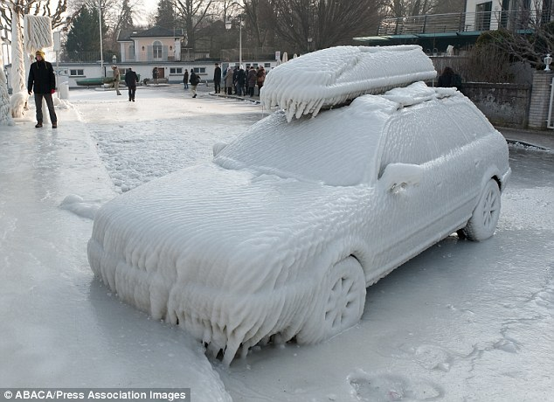
1

Slide 13
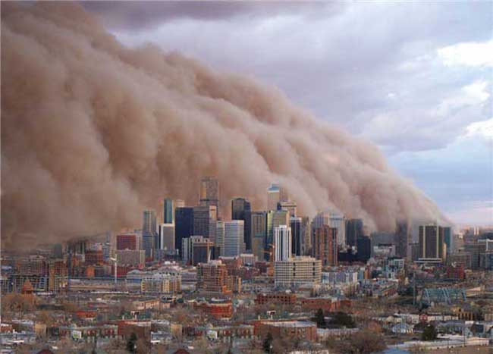
2

Slide 14
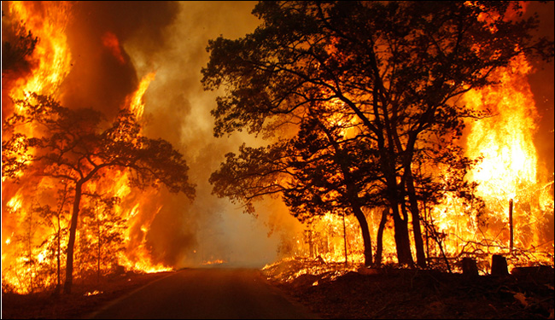
3

Slide 15
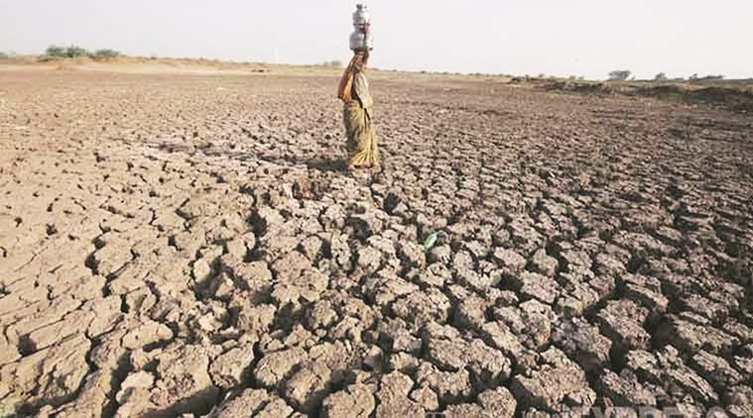
4

Slide 16
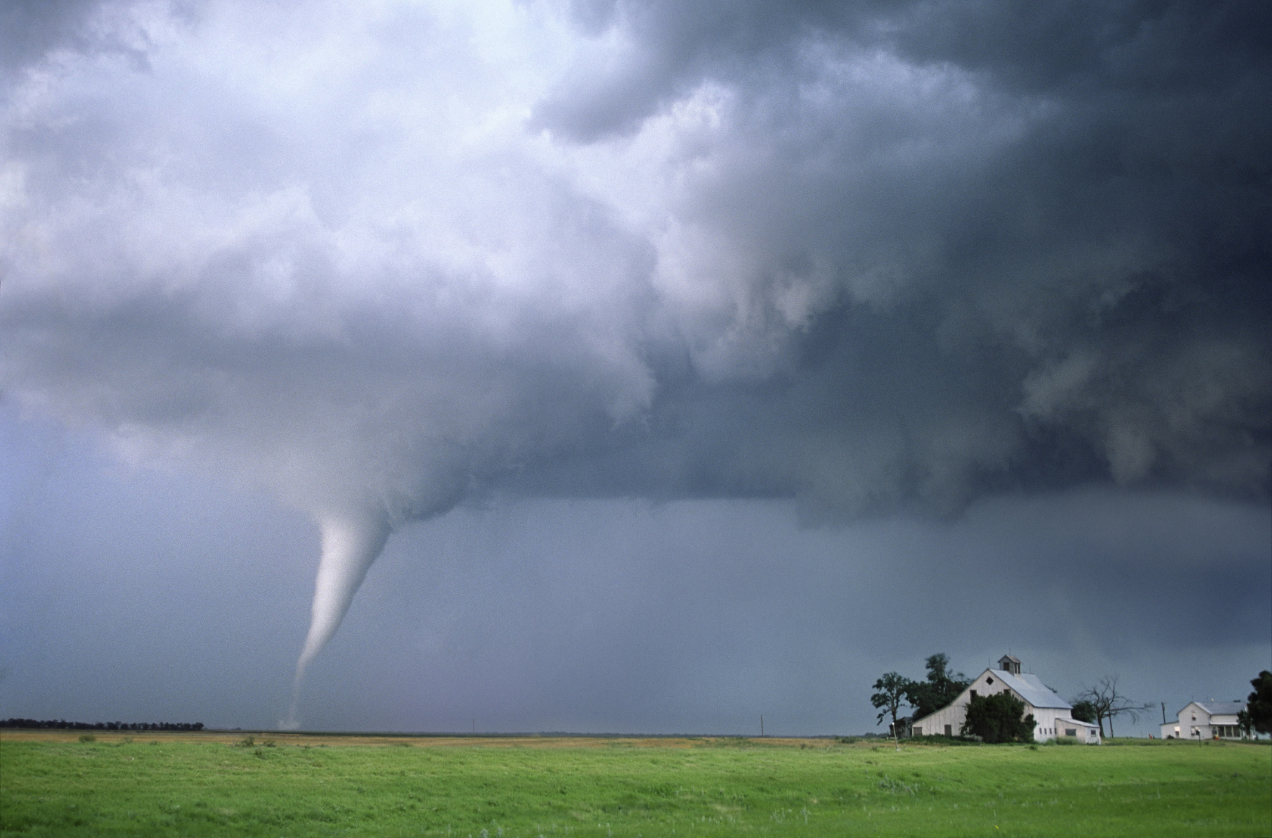
5

Slide 17
To print

Slide 18
Extreme weather – mapping task
Tornadoes
Alaska
New York
Key:
Wildfires in Australia = Hurricanes in Cuba = Lightning storms in Mexico = Dust storms in Saudi Arabia =
Freezing rain in Canada = Drought in Egypt = Blizzards in New York = Fog in Sheffield =
Floods in India = Hail storms in Alaska = Heatwaves in Spain = Tornadoes in the USA =

