Slide 1
Bidmas
You think you can just do your sums in any order you like? THINK AGAIN! Listen up!

Slide 2
Think about this sum-
=35?
3 + 4 x 5
Nope!
When lots of things happen in a sum we can’t got left to right. Try this sum on a calculator
You should have 23
Your calculator knows the correct order to work in

Slide 3
Bidmas
To help us remember the order we use the word BIDMAS
B
I
D
M
AS
Brackets first
Then Indices (another name for powers e.g. 3²)
Then Division
Then Multiplication
Do adding and subtracting together at the end, going left to right

Slide 4
Here are some examples of how to use BIDMAS
A good tip is to underline the bit you are going to do, then write the answer under your line, along with the rest of the sum.

Slide 5

B
I
D
M
A
S
(3
4)
x 2
+
x 2
=
7
=
14

Slide 6
B
I
D
M
A
S
3
3
4
x 2
+
+
=
8
=
11

Slide 7
B
I
D
M
A
S
4
4
x 3²
x
=
9
=
36

Slide 8
B
I
D
M
A
S
3
3
4
- 2
+
x 3
- 2
=
+
12
=
13

Slide 9
B
I
D
M
A
S
3
3
x
(5
2
x
2
- 2
- 3)
- 2
=
x
2
- 2
3
4
- 2
12
=
10

Slide 10
6 + 4 x 3 =
30
72
x
x
What do you think?

Slide 11
10 – 8 ÷ 2 =
6
1
x
What do you think?

Slide 12
1 + 4 x 3² =
145
37
x
What do you think?

Slide 13
20 - 4 + 10 =
26
6
x
What do you think?

Slide 14
3 + 4 x 3 + 1 = 19
( )
Tim’s sum is wrong
We can make it right be adding a pair of brackets. Where do they need to go?

Slide 15
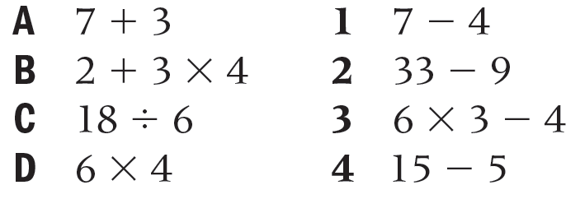
Match each of these calculations with one that gives the same answer.
Hint: work all of them out and then match them up

Slide 16
Answers
A = 10
B = 14
C = 3
D = 24
1 = 3
2 = 24
3 = 14
4 = 10

Slide 17
Bidmas
  24
  3
  2
  20
  10
  1
  26
  22
  1
  19
  0
  2
  9
  5
  1
  26
  25
  20
  17
  5
  1
  1
  2
  A)
  (3 + 3 ) x 4
  4 x 2 – 5
  (5 + 7) ÷ 6
  5 x 3 + 5
  (9 – 4 ) + 5
  1 + 1 – 1
  2 x (15 – 2)
  (5 x 4 ) + 2
  (8 + 2 ) ÷ 10
  (21 x 1 ) – 2
  B)
  (1 + 14) – (5 x 3 )
  (10 + 6 ) ÷ (4 x 2)
  (1 + 2 ) x (6 – 3)
  (2 x 6 ) – (14 ÷ 2)
  (7 x 2) ÷ ( 20 – 6)
  (3 x 10) – (2 x 2)
  (9 x 5) – ( 2 x 10)
C)
(3 x 3 – 4 ) x (2 + 2)
2 x (13 – 4) – (23 ÷ 23)
3 x (1 + 4) – (5 x 2)
4 x (3 + 2) – ( 24 – 5)
7 x ( 4 ÷ 2 ) ÷ ( 3 x 5 -1 )
((9 + 7 x 3 ) ÷ 10) – 1

Slide 18
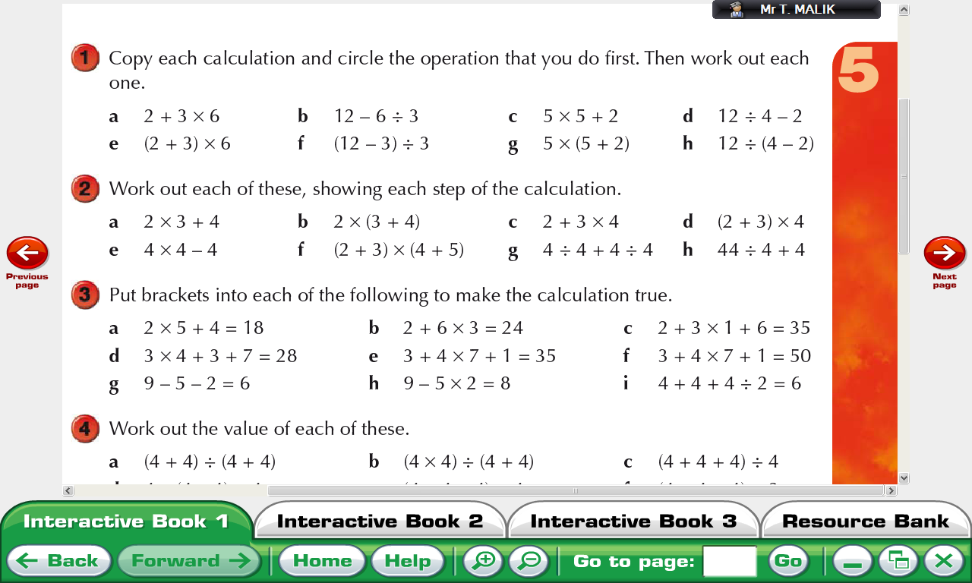

Slide 19
a 2 + 3 × 6 = 20
b 12 – 6 ÷ 3 = 10
c 5 × 5 + 2 = 27
d 12 ÷ 4 – 2 = 1
e (2 + 3) × 6 = 30
f (12 – 3) ÷ 3 = 3
g 5 × (5 + 2) = 35
h 12 ÷ (4 – 2) = 6

Slide 21
What is the secret message?
Start 27 2 + 2 x 4 | T 10 8 – 3 x 2 | T 8 5x7+6x9 | O 12 5 x 2 + 7
R 7 37 – 4 x 8 | D 26 (5 – 2) x 5 | E 18 6 x (9 – 7) | R 60 7 x 8 - 9
H 2 2 x (4 + 5) | T 6 64÷(5 + 3) | S 47 9 x (5 – 2) | M 5 (4 + 5) x 8
A 72 48 ÷ (6+2) | E 89 4x(3+2)x3 | R 17 3x4+2x7 | E 15 11x3-2x13
Notes:
Start with the box marked start. Find the answer to the problem, go to the box with this answer. Write down the letter in this box. Etc until you get back to start.
What is the secret message?
THE ORDER MATTERS

Slide 22
THEORDERMATTERS

Slide 23
a 10
b 14
c 14
d 20
e 12
f 45
g 2
h 15

Slide 24
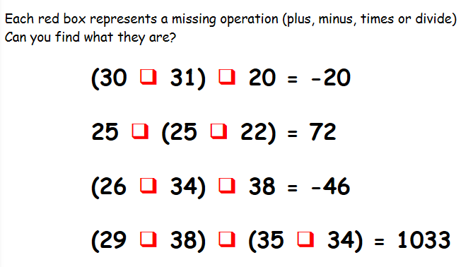
Missing Operations

Slide 25
(30 - 31) x 20 = -20
25 + (25 + 22) = 72
(26 - 34) - 38 = -46
(29 x 38) - (35 + 34) = 1033

Slide 26
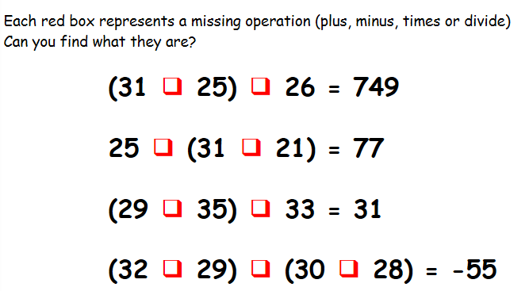
Again

Slide 27
(31 x 25) - 26 = 749
25 + (31 + 21) = 77
(29 + 35) - 33 = 31
(32 - 29) - (30 + 28) = -55

Slide 28
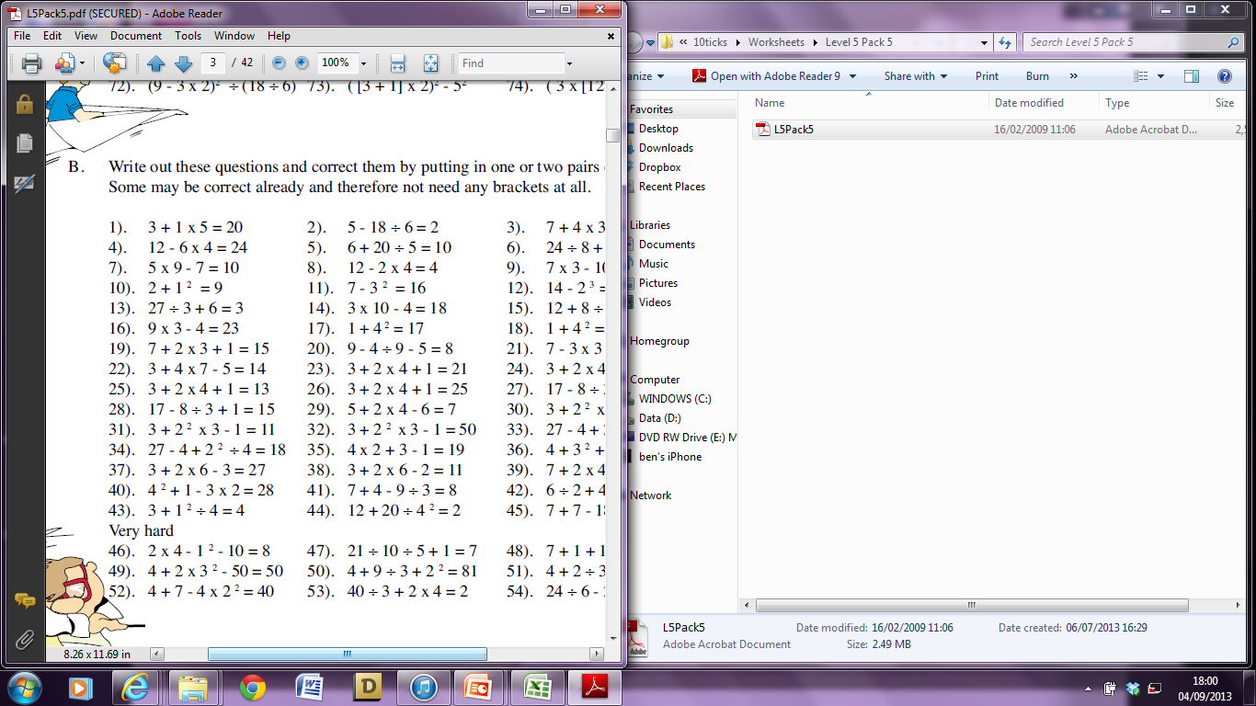
Where do we need to put the brackets?
Challenge Questions

Slide 29
Evaluate the following:
5 x 3 – 4
50 ÷ 5 x 3
Put the brackets in for the following to work:
36 ÷ 4 + 5 = 4
3 + 4 x 7 – 5 = 14
Evaluate the following:
7² + (4 – 9)
(9 ÷ 3) x 4²

Slide 30
Evaluate the following:
5 x 3 – 4 = 11
50 ÷ 5 x 3 = 30
Put the brackets in for the following to work:
36 ÷ (4 + 5) = 4
(3 + 4) x (7 – 5) = 14
Evaluate the following:
7² + (4 – 9) = 44
(9 ÷ 3) x 4² = 48

