Slide 1

PSHE and Citizenship
Living in the Wider World | One World
PSHE and Citizenship | UKS2 | Living in the Wider World | One World | Biodiversity | Lesson 5

Slide 3
Aim
I can understand what biodiversity is and explain the importance of doing all we can to encourage it.
Success Criteria
I can explain to a partner what biodiversity is.
I can identify the benefits of biodiversity.
I can show what biodiversity means to me through images and words.
I can reflect on what I can do to encourage biodiversity.
This resource is fully in line with the Learning Outcomes and Core Themes outlined in the PSHE Association’s Programme of Study.

Slide 4
The Big Questions

Slide 5

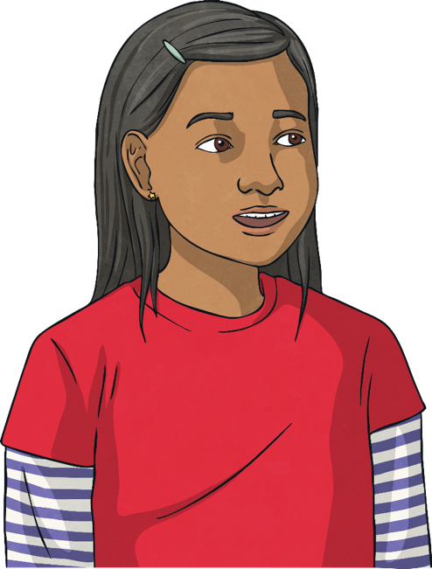
What is biodiversity and why is
it important?
What can we do
to encourage biodiversity?

Slide 6
Reconnecting

Slide 7

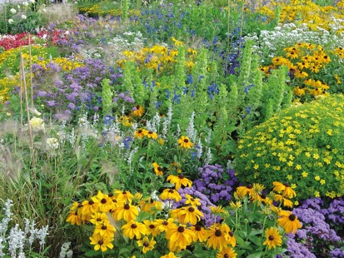
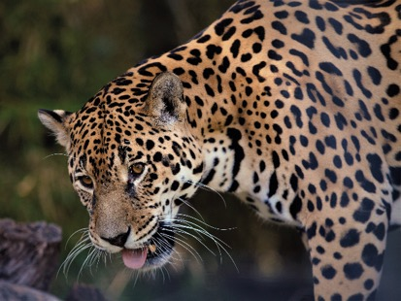
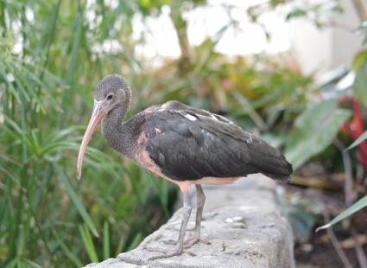
A – Z of Living Things
Our world is a truly amazing place! It is full of life, all of which has an important and very specific role to play.
With a partner, in the given time, think of a living thing (plant or animal) for each letter of the alphabet.
Wow! Our world is home to so many living things. All of these living things are vital to the future health of the planet.

Slide 8
Exploring

Slide 9

Biodiversity
What does biodiversity mean?
‘Bio’ means living thing and ‘diversity’ means the variety of something, so biodiversity is the variety of different plants and animals in the world or in a particular habitat or ecosystem.
What is an ecosystem?
An ecosystem is a community of living things (animals and plants) that interact with each other and the environment in which they live. These are in perfect natural balance, with the living things in each ecosystem all having a perfect role to play. If these systems become unstable as the biodiversity changes within them, there can be negative consequences.
Like what?
For example, farmers in America killed coyotes because they were attacking their cows. However, fewer coyotes meant the numbers of the animals they ate, such as deer mice, became too high. Deer mice carry an infectious disease. This disease was passed to humans as the deer mice spread into homes and buildings.

Slide 10
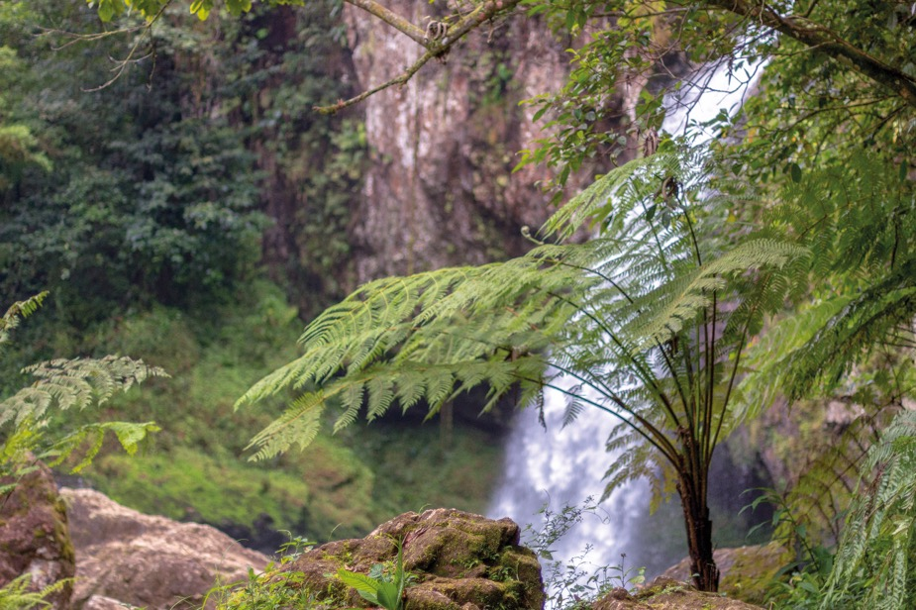
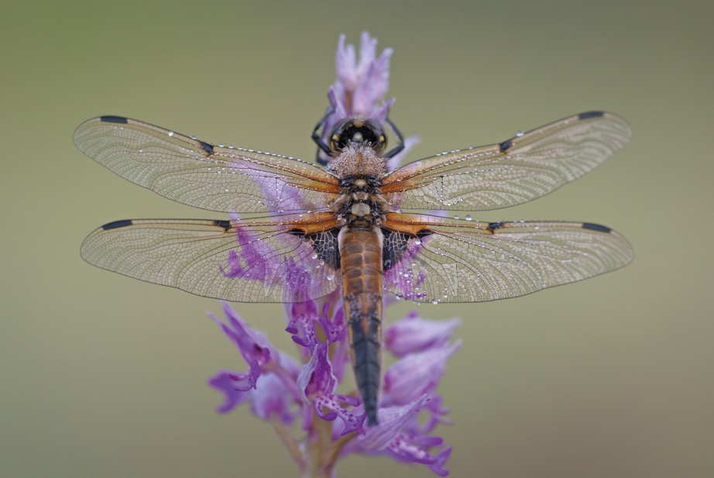
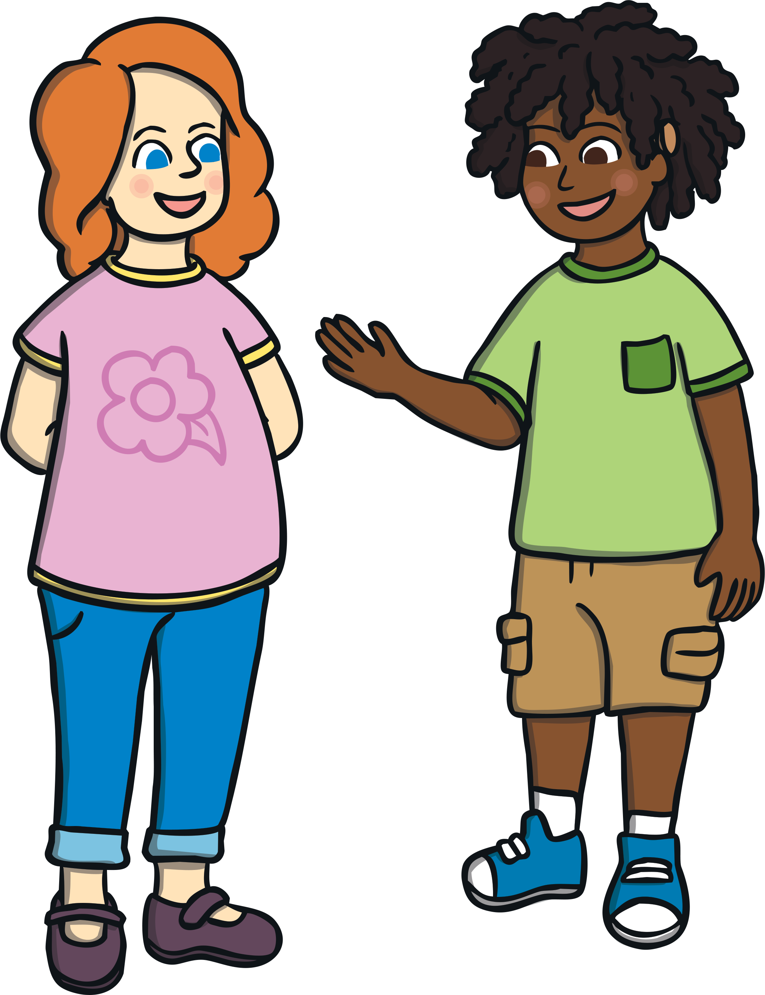
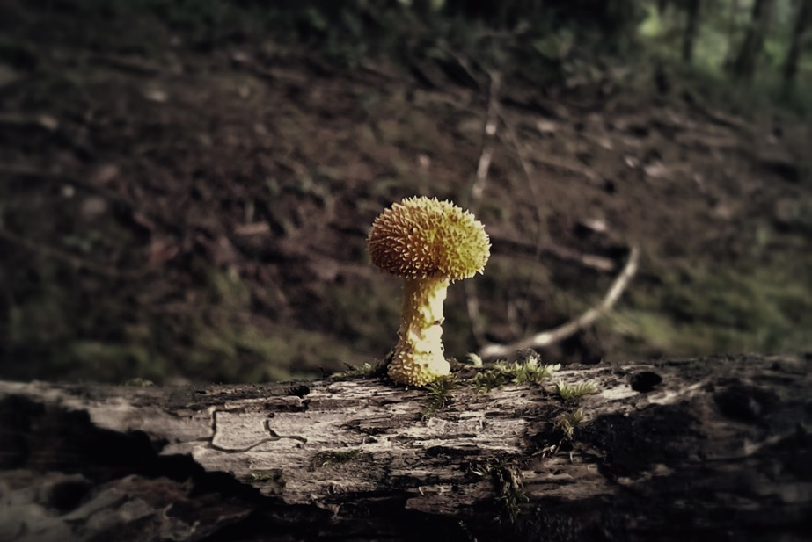
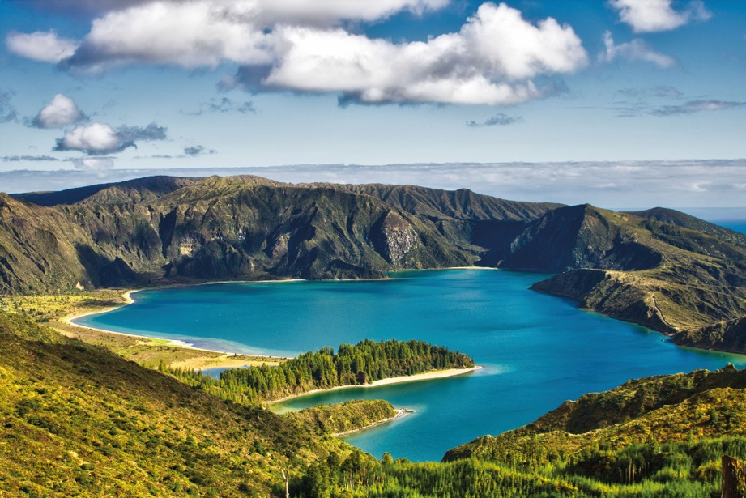
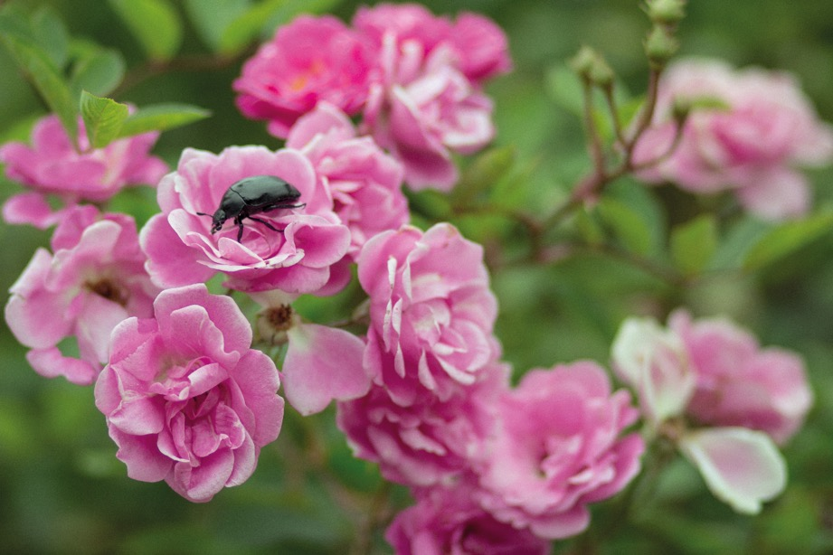
Biodiversity
Tell a partner all you now know about biodiversity.
Well done! The biodiversity of our world is something to be celebrated and treasured.
Next Image

Slide 11

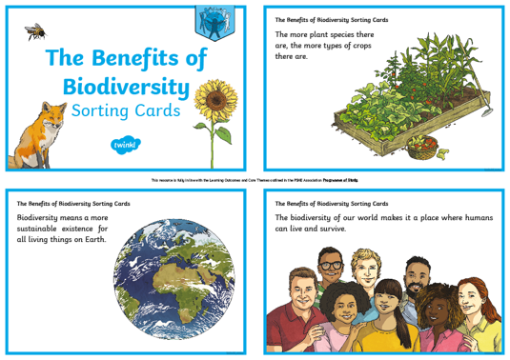
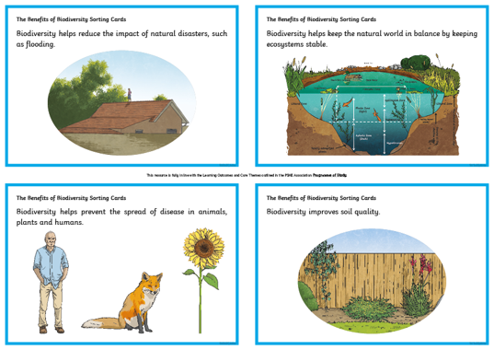
The Importance of Biodiversity
All living things have the right to live a healthy, happy and safe life.
So, why is biodiversity important to me?
In your group, read The Benefits of Biodiversity Sorting Cards. Discuss each one and then put them in order, from the one you consider the most important benefit of biodiversity, to the one you consider the least important.
Remember to explain your thoughts to your group members and to listen to and respect each other’s viewpoints.
Did you find it easy to decide? Or was it quite difficult?

Slide 12
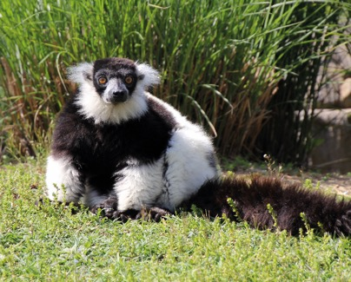
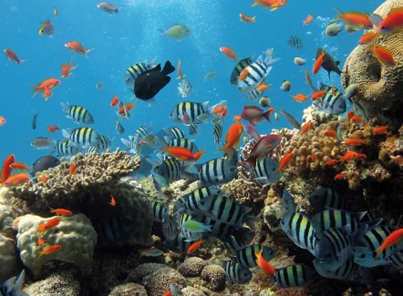
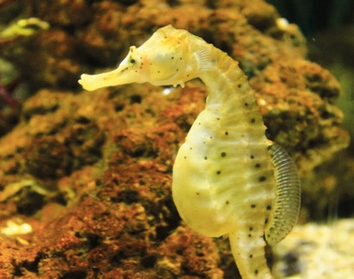
The Importance of Biodiversity
Biodiversity is incredibly important to the future of our world and the benefits are all equally important. We must do all we can to
encourage it.
Consolidating
Reflecting

Slide 13
Consolidating

Slide 14

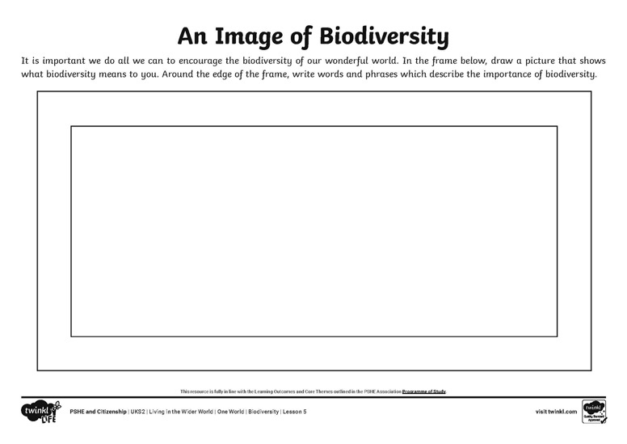
An Image of Biodiversity
What does biodiversity mean to you?
Draw a picture on your An Image of Biodiversity Activity Sheet.
Then, write words and phrases around the edge of your picture to describe the importance of biodiversity.

Slide 15
Reflecting

Slide 16
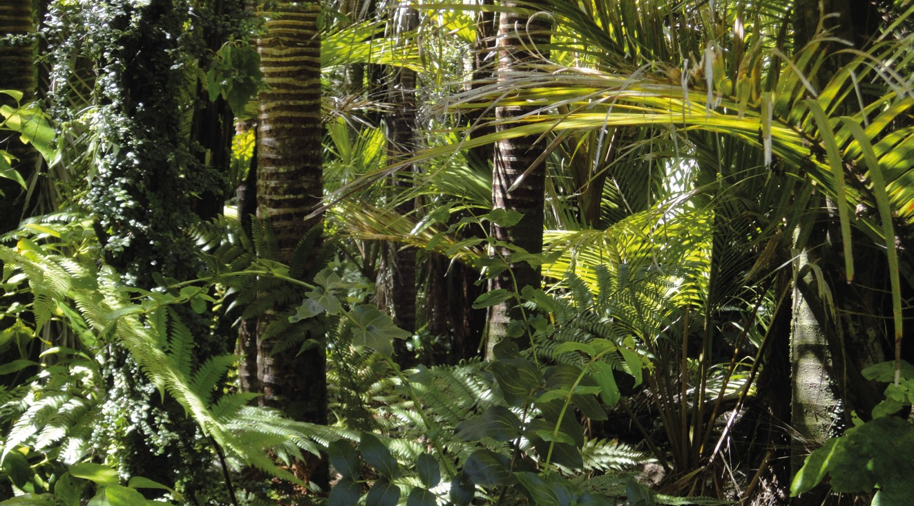
What Can I Do?
This is a thriving environment, with lots of biodiversity.

Slide 17
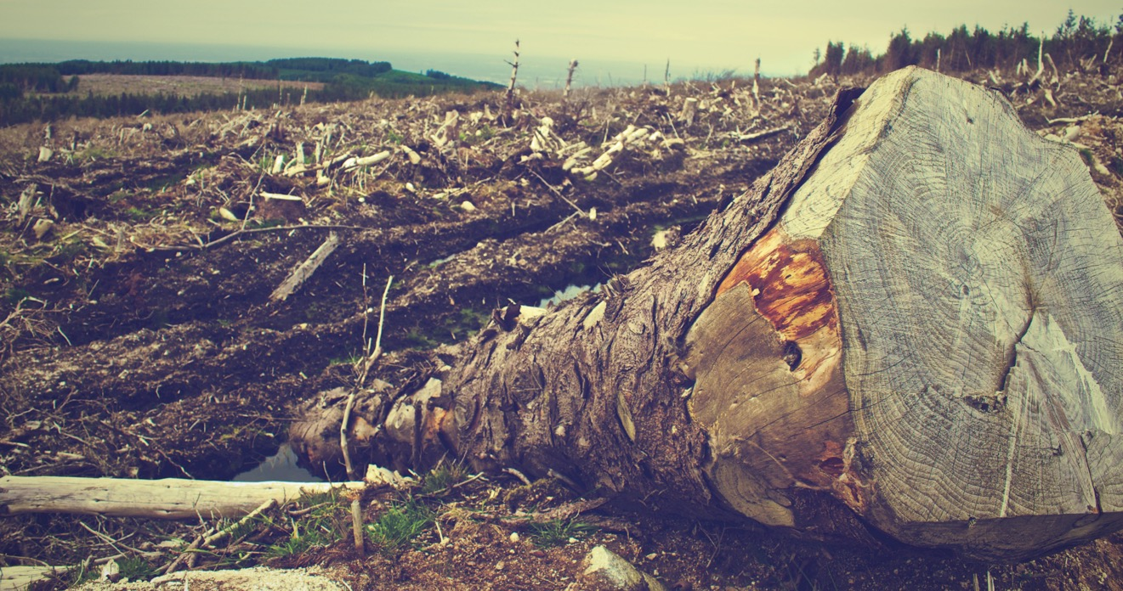
What Can I Do?
This is an environment which is not thriving; the biodiversity has
been lessened.
Biodiversity is under threat due to human activity. Although this is worrying, humans can also do things to encourage and improve biodiversity.

Slide 18
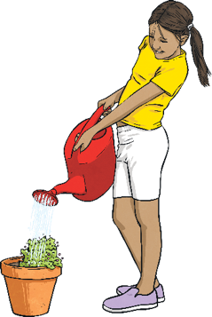
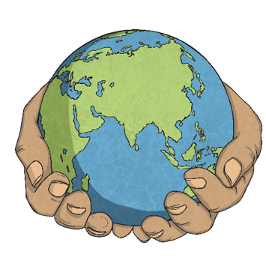
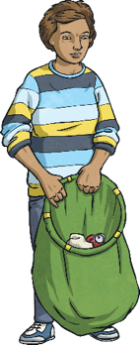
What Can I Do?
Take a moment of quiet to think about your answer to this question…
What can I do to encourage biodiversity where I live and throughout
the world?
If you feel happy to, please share your ideas with the class.
It is incredibly exciting that we can choose to make a difference and that by all doing a little, a lot can be achieved!

Slide 19
The Big Questions

Slide 20
What is biodiversity and why is
it important?
What can we do
to encourage biodiversity?
What is the most interesting thing you have learnt today?

Slide 21
Aim
I can understand what biodiversity is and explain the importance of doing all we can to encourage it.
Success Criteria
I can explain to a partner what biodiversity is.
I can identify the benefits of biodiversity.
I can show what biodiversity means to me through images and words.
I can reflect on what I can do to encourage biodiversity.

