Slide 1
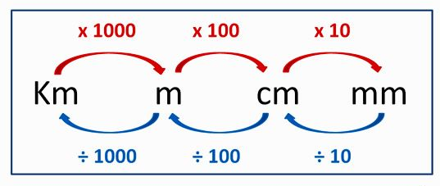
LI: to convert between millimetres, centimetres, metres and kilometres.
mm, cm, m and km

Slide 2
km
kilometres
cm
Metres
mm
Millimetres
m
Centimetres

Slide 3
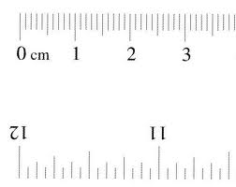
How many….?
mm in a cm?
10
cm in a m?
100
m in a km?
1000

Slide 4
Convert: mm to cm
X 10
How many mm in 1 cm?
10
in 2 cm?
20
in 5 cm?
50
in 30 cm?
300

Slide 5
Convert: cm to m
X 100
How many cm in 1 m?
100
in 2.5 m?
250
in 14 m?
1400
in 40 m?
4000

Slide 6
Convert: m to km
X 1000
How many m in 1 km?
1000
in 6 km?
6000
in 11 km?
11,000
in 35 km?
35,000

Slide 7
Converting
cm to mm – x 10
m to cm – x 100
km to m – x 1000

Slide 8
Convert: cm to mm
÷ 10
How many cm in 10 mm?
1
in 70 mm?
7
in 150 mm?
15
in 800 mm?
80

Slide 9
Convert: m to cm
÷ 100
How many m in 100 cm?
1
in 340 cm?
3.4
in 6000 cm?
60
in 8400 cm?
84

Slide 10
Convert: km to m
÷ 1000
How many km in 1000 m?
1
in 9000m?
9
in 20,000 m?
20
in 63,000 m?
63

Slide 11
Converting – reverse it!
mm to cm ÷ 10
cm to m ÷ 100
m to km ÷ 1000

Slide 12
I can measure length and convert lengths
Which is longer?
1m or 200 cm?
2.5 m or 300cm?
50mm or 4 cm?
1km or 1000m?
50,000m or 500 km?
200cm
300cm
50mm
the same!
500km

Slide 13
Now try these:
6.4cm in mm
2. 7.36m in cm
3. 2340m in km
4. 59mm in cm
5. 513km in m
6. 44.65m in cm
7. 12,340m in km
8. 3910km in m
9. 6m in mm
10. 3262mm in m
11.8.1m in mm
12. 450m in km

Slide 14
Now try these:
6.4cm in mm
2. 7.36m in cm
3. 2340m in km
4. 59mm in cm
5. 513km in m
6. 44.65m in cm
64mm
7. 12,340m in km
8. 3910km in m
9. 6m in mm
10. 3262mm in m
11.8.1m in mm
12. 450m in km
12.34km
736cm
3,910,000m
2.34km
6000mm
5.9cm
3.262m
513,000m
8100mm
4465cm
0.45km

Slide 15
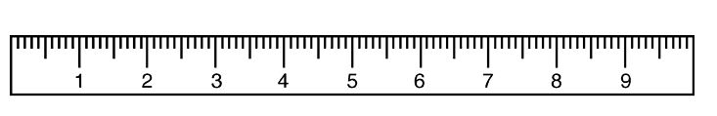
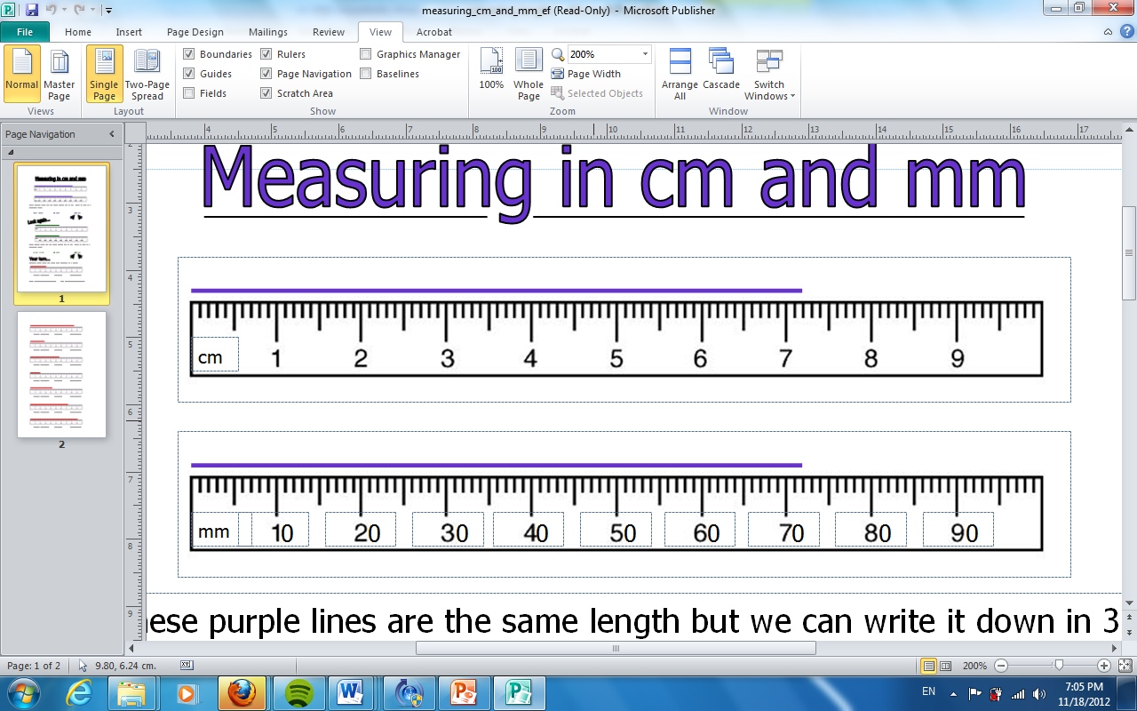
Measuring in centimetres (cm)
cm
Measuring in millimetres (mm)

Slide 16
cm
How long is the line?
___ cm ___mm

Slide 17
How many millimetres?
___ mm
Can you write that in centimetres?

Slide 18
7cm 2mm 72mm
7.2cm
7cm 2mm

Slide 19
cm
How many cm?
5.5cm

Slide 20
How many cm?
8.4cm

Slide 21
cm
How many cm?
3.3cm

Slide 22
Traffic Lights
Traffic light your work:
I did not understand my work
I understood some of my work
I understood everything

