Slide 1
By
Eli Duke
Evaporation Investigation

Slide 2
Project – To see if temperature Affects How Fast Towels Dry

Slide 3


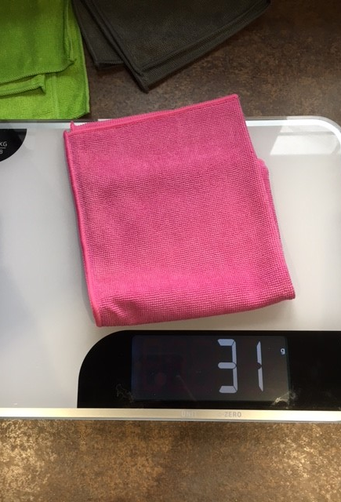

I used 3 towels, all the same size. Each towel weighed 31 grams.
z
I used a measuring jug and poured 125 ml of water on to each one.
Each towel then weighed 85 grams.

Slide 4
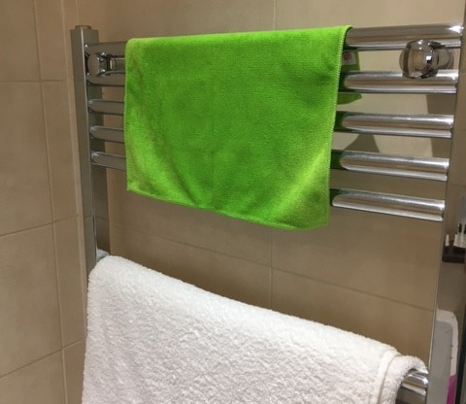
I laid the wet towels in the bathroom.
I laid one towel over the bath.
I laid the second towel on the radiator.
I laid the third towel on the windowsill.

Slide 5
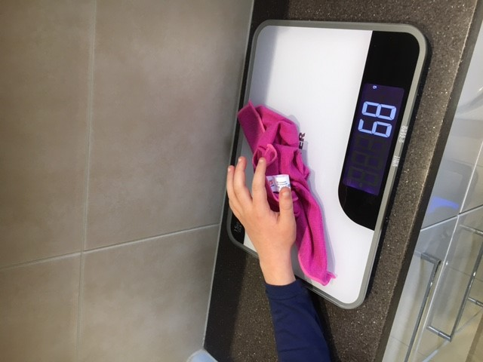
Every 30 minutes I weighed each towel.
I checked this weight against the start weight of the wet towels. I did this to measure how much water had evaporated. The lighter the towel the more water had evaporated.

Slide 6
THE RESULTS

Slide 7
 | Weight when placed | Weight after 30 minutes | Weight after 60 minutes | Weight after 90 minutes
Towel 1 (bath) | 85g | 77g | 72g | 68g
Towel 2 (Radiator) | 85g | 78g | 70g | 62g
Towel 3 (Window seal) | 85g | 71g | 67g | 64g

Slide 8
In my investigation I found out the radiator dried (evaporated) the most water, the only thing I had to change was to turn the radiator on from the start.
The results would be the same yet maybe the radiator towel would be drier.
Conclusion

