Slide 1
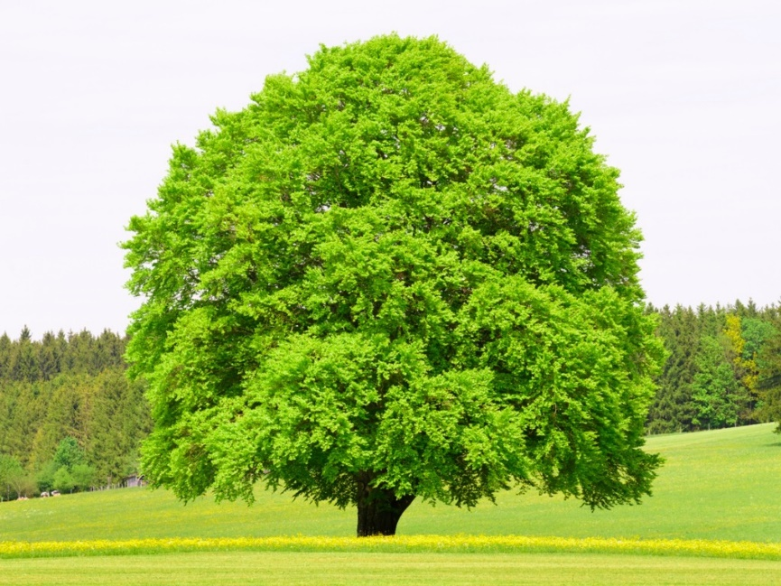
Welcome to Beech
Class
Mrs Hall and Miss Laslett
Mrs Glass
Mrs Kendall

Slide 2
Timings:
School starts at 8:35 am
Children come into class at 8:35am to complete their reading quiz, Early Morning Work or read.
….. It ends at 3:15pm.

Slide 3
PE:
Wednesday – Coach
Please come to school in PE kit
(Green T-shirt, dark shorts & trainers).
Earrings to be removed or taped on these days.
It is not an optional subject so please make sure they have the correct kit.
Trainers and tracksuits (plain green, black or navy) for the colder months.
A spare T-shirt to change into afterwards.

Slide 4
Homework:
Reading daily
At least 3 times a week – Reading Records collected in on a Wednesday to check – if no reading recorded (at least 3 times) children will stay in to read for 15 mins during lunchtime play.
Tables weekly
Test on a Tuesday.
All children start with 2, 5 and 10.
Topmarks website
Spellings weekly
Given out on a Thursday. Handed in the following Wednesday.
Taken from NC Statutory spelling lists for Year 4 & 5.
If no homework handed in children will stay in to complete it during their lunchtime play.
Their words are to be written 3 times and 4 sentences.
Test on a Thursday.

Slide 5

Website
*Each class have their own page on the website.
*Every week the spellings will be added to our Beech page.
*Every week we will share what we have been doing in our lessons, and pictures will sometimes be added too.
*Please take a look at what we have been doing.

Slide 6
Star Reader Chart
Every time a quiz is completed your child should show a teacher that they’ve passed (60% +)
The value of points that the book is worth is tallied.
Each child has an individual target to reach.
When that target is reached, they receive a small prize.

Slide 7
Expectations:
P Presentation of work is high.
PChildren are reading at home.
Children give their best at all times.
Children follow the rules.

Slide 8
Rewards and Sanctions
Children that are displaying good behaviour and learning;
Raffle Tickets
*In KS2 raffle tickets will be given during the lesson if a child is seen to be following the rules. They write their name on the ticket and it goes into a box.
*On a Friday 2 tickets will be pulled out of the box – individual prizes given.
*If the whole class reach the weekly target (60) tickets in the box, another ticket is pulled out and that child chooses a whole class reward.
Team points
* For good work in books.
* Counted up once a week, and in Celebration assembly the winning team have their ribbon around the cup.

Slide 9
Rewards and Sanctions cntd...
If children are not following our school rules:
Children will get a warning
If the behaviour continues, children will be given a yellow card.
5 minutes of playtime will be missed if the child still has the yellow card at playtime.
If the behaviour hasn’t improved, the child will receive a red card. This means lunchtime play will be missed and they will complete a 4 Ws form.
If this is a regular occurrence, we will tell the child to phone parents to inform them of their behaviour.
Children can redeem themselves during the session.
Violence or swearing will result in a red card straight away and a visit to Mr File.

Slide 10
Groups
Mixed ability seating (apart from Guided reading)
Each term seats are changed.
Focus groups according to the lesson objective and previous learning.
Maths – Children often choose the level they want to work at (Bronze, Silver, Gold, Platinum – challenge)

