Slide 2
Aim
Divide numbers up to 4 digits by a one-digit number using the formal written method of short division and interpret remainders appropriately for the context.

Slide 3

Divide 4 Digits by 1 Digit
Diving
Match each division question with its place value representation and short division calculation. Click each division to reveal the answer.
A
4209 ÷ 3 = 1403
B
1055 ÷ 5 = 211
C
6072 ÷ 6 = 1012
D
Th | H | T | O
1000
1000
1000
1000
1000
1000
10
10
10
10
10
10
1
1
1
1
1
1
10
1
1
1
1
1
1
E
Th | H | T | O
G
 | 1 | 0 | 1 | 2
6 | 6 | 0 | 7 | ¹2
100
100
100
100
100
10
10
10
10
10
1
1
1
1
1
100
100
100
100
100
H
 | 1 | 4 | 0 | 3
3 | 4 | ¹2 | 0 | 9
F
Th | H | T | O
1000
1000
1000
100
100
100
1
1
1
1000
100
100
100
1
1
1
I
 | 0 | 2 | 1 | 1
5 | 1 | ¹0 | 5 | 5
100
100
100
1
1
1
100
100
100

Slide 4

Divide 4 Digits by 1 Digit
Diving
Solve the division problems to find the missing numbers and save the day
3 | 6 | 5 | 1 | 6
2
1
7
2
a)
²
Chef’s Shopping List
kg flour
ml milk
kg sugar
ml cream
4 | 4 | 5 | 6 | 8
1
1
4
2
b)
2172
¹
1142
c) 8414 ÷ 7 =
1202
1202
1401
d) 8406 ÷ 6 =
1401

Slide 5

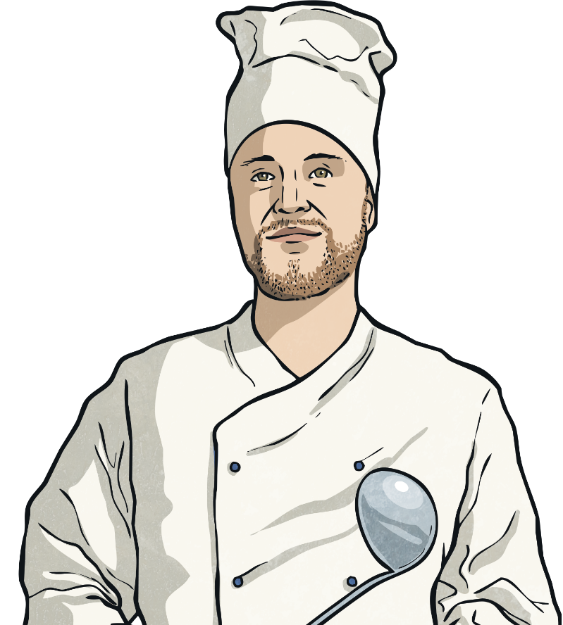
Divide 4 Digits by 1 Digit
Deeper
Fernando the chef is trying to complete a calculation for ingredients.
He has started but is stuck and doesn’t know what to do next.
Why is Fernando stuck? Explain your thinking and work out the calculation for him.
 |  | 2
7 | 2 | ²1 | ⁸8 | 4
Fernando has incorrectly calculated 21(hundreds) divided by 7 as 2(hundreds) when it should be 3. He’s stuck because 88 divided by 7 will give a 2 digit answer. The correct calculation is:
 |  | 3 | 1 | 2
7 | 2 | ²1 | 8 | ¹4

Slide 6



Divide 4 Digits by 1 Digit
Deepest
Can you identify the missing digits in these calculations?
 |  | 7 |  | 4
4 | 2 |  | 9
2
8
6
 | 2 | 4 | 2
3 |  |  | 8 | 4
8
7
2

Slide 7


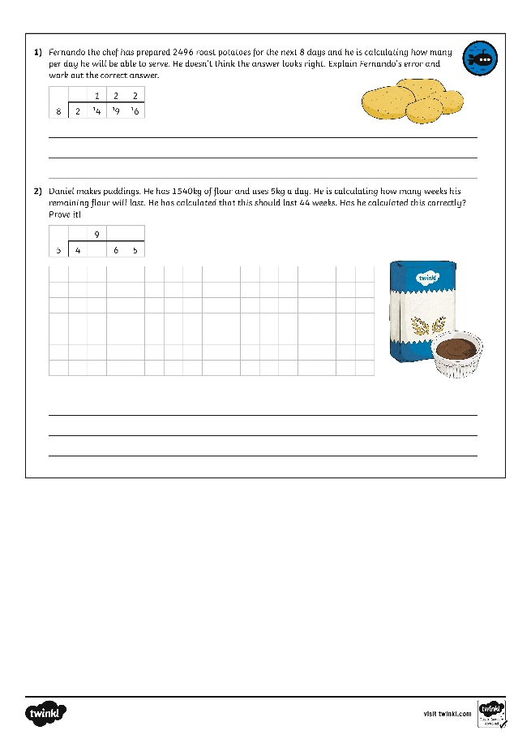
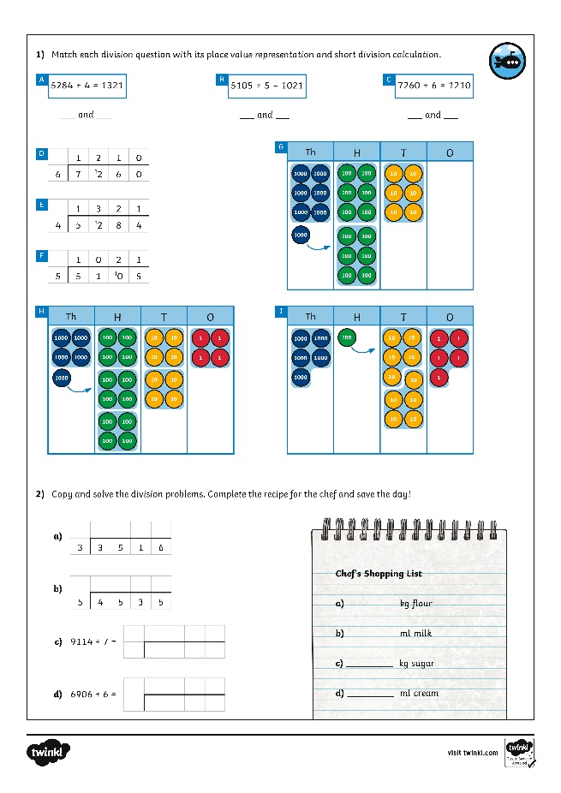
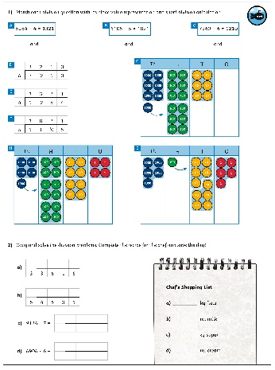
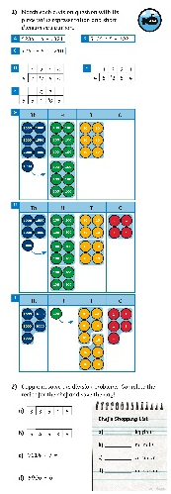
Divide 4 Digits by 1 Digit
Dive in by completing your own activity!
Right preview - Right click and replace existing images with horizontal and vertical version jpgs of the activity sheet to keep shadow settings.
Left preview - hide the image of the child, drag in your jpgs, crop to just around the black strokes. Width should be 4cm for the horizontal, 2cm for vertical. Drag and rotate into place. Doesn’t have to be too neat as meant to look like the child stuck it in ☺

