Slide 2
Aim
Multiply numbers up to 4 digits by a one- or two-digit number using a formal written method, including long multiplication for two-digit numbers.

Slide 3

Multiply 4 Digits by 1 Digit
Diving
Thousands | Hundreds | Tens | Ones
Write the multiplication calculation which is represented by the place value counters.
 | 1 | 2 | 3 | 1
× |  |  |  | 3
 | 3 | 6 | 9 | 3

Slide 4
Multiply 4 Digits by 1 Digit
Diving
Thousands | Hundreds | Tens | Ones
Write the multiplication calculation which is represented by the place value counters.
 | 2 | 3 | 2 | 2
× |  |  |  | 4
 | 9 | 2 | 8 | 8
 | ¹

Slide 5
Multiply 4 Digits by 1 Digit
Diving
Thousands | Hundreds | Tens | Ones
Write the multiplication calculation which is represented by the place value counters.
 | 5 | 0 | 4 | 2
× |  |  |  | 6
3 | 0 | 2 | 5 | 2
 |  | ² | ¹

Slide 6

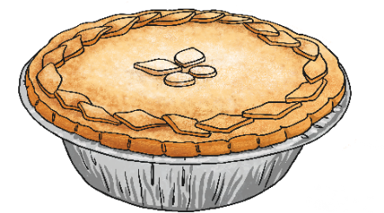
Multiply 4 Digits by 1 Digit
Diving
Thousands | Hundreds | Tens | Ones
Write a word problem which
could be solved by the calculation represented by the place value counters.
The place value counters show 3105 × 3.
Here is one possible word problem:
Jasmine packs 3105 pies a day.
How many pies does she pack after 3 days?

Slide 7


Multiply 4 Digits by 1 Digit
Deeper
Can you identify the errors that have been made in these short multiplication calculations?
Carry out the calculations correctly to find the correct products.
The correct answer is
14 586.
1 × 6 has been recorded as 1 whereas it is in fact 6.
 | 2 | 4 | 3 | 1
× |  |  |  | 6
1 | 4 | 5 | 8 | 1
 | ² | ¹
 | 3 | 4 | 1 | 5
× |  |  |  | 3
1 | 0 | 2 | 3 | 5
 | ¹
The correct answer is
10 245.
The regrouped ten has not been added to the 3 lots of tens to make 4 tens.

Slide 8

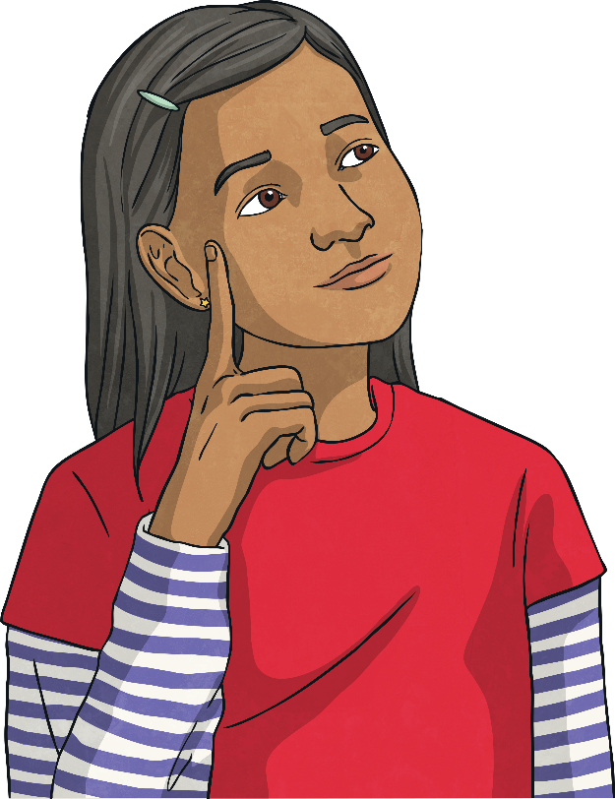
Multiply 4 Digits by 1 Digit
Deepest
Can you identify the missing digits in these calculations?
 |  | 3 |  | 1 | 4
 | × |  |  |  | 3
 |  |  | 6 |  | 2
 |  |  |  | 2 | 4
 | × |  |  |  | 5
 | 2 | 5 | 1 |  | 0
2
9
4
¹
5
0
2
¹
²

Slide 9


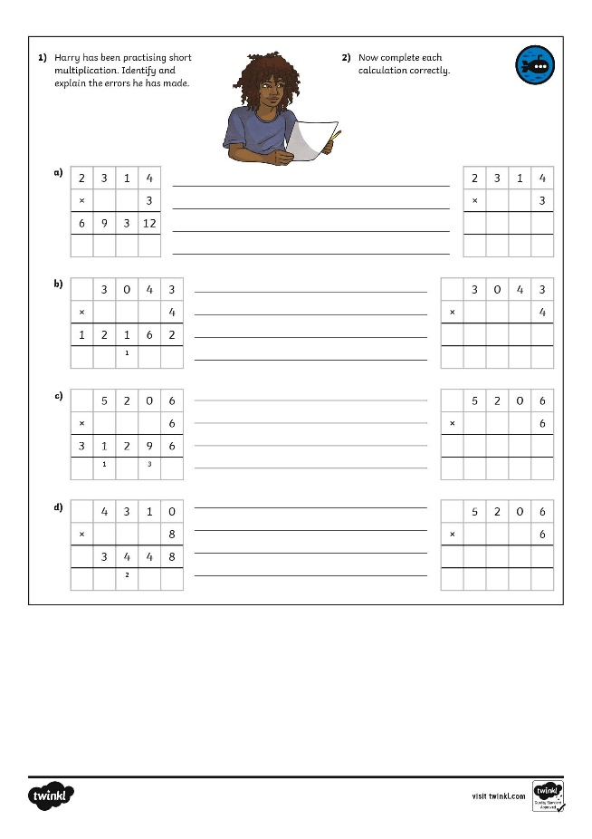
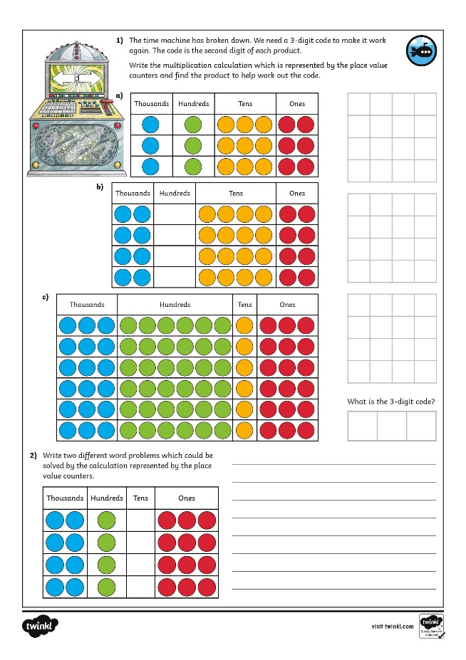
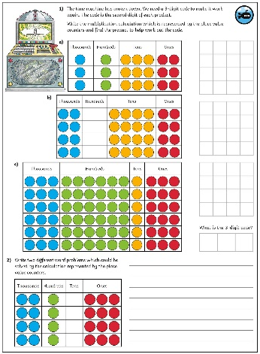
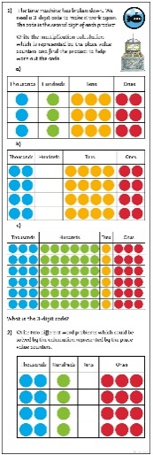
Multiply 4 Digits by 1 Digit
Dive in by completing your own activity!

